Slide 1
Images and Music
of Ireland
Text Talk Week 2, Day 5

Slide 2
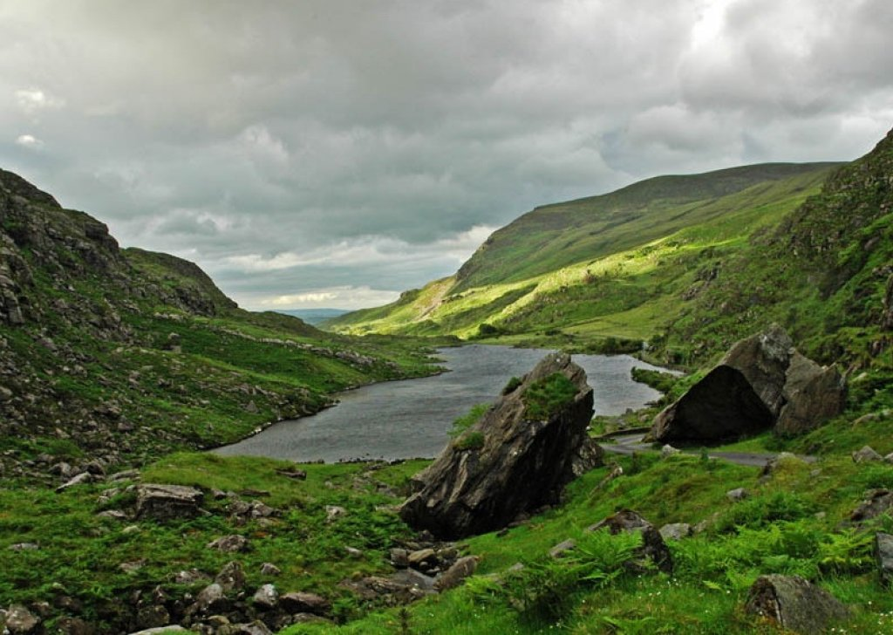
countryside

Slide 3
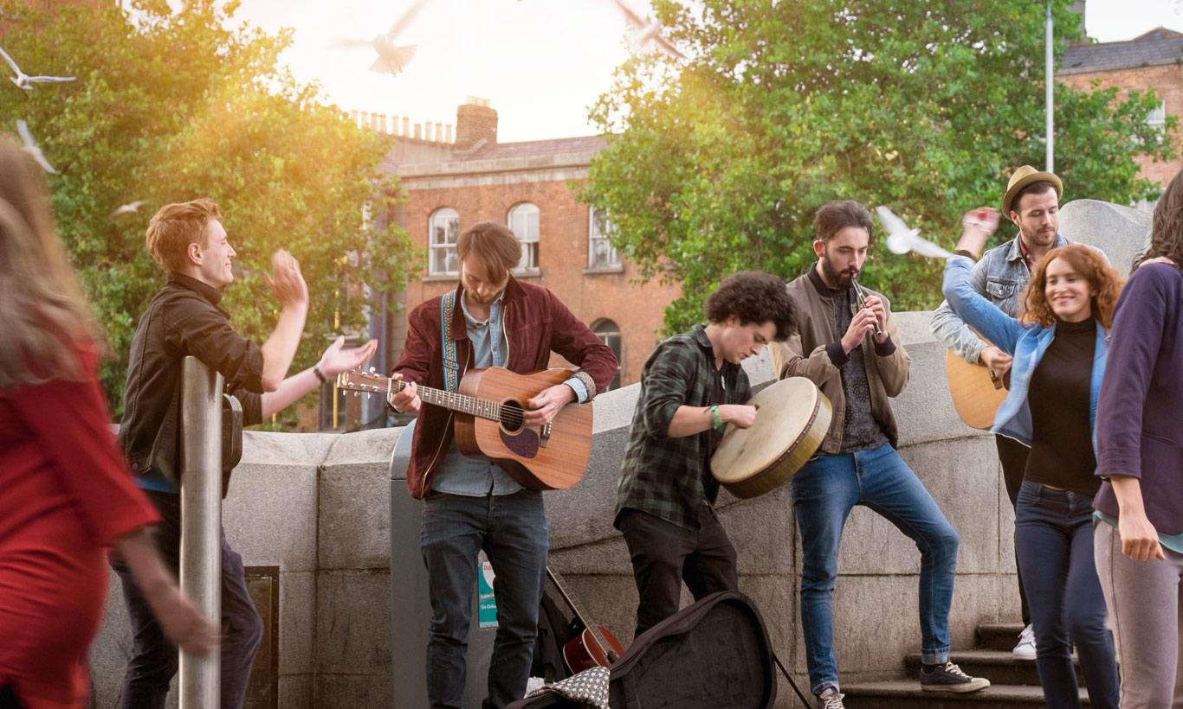
playing music

Slide 4
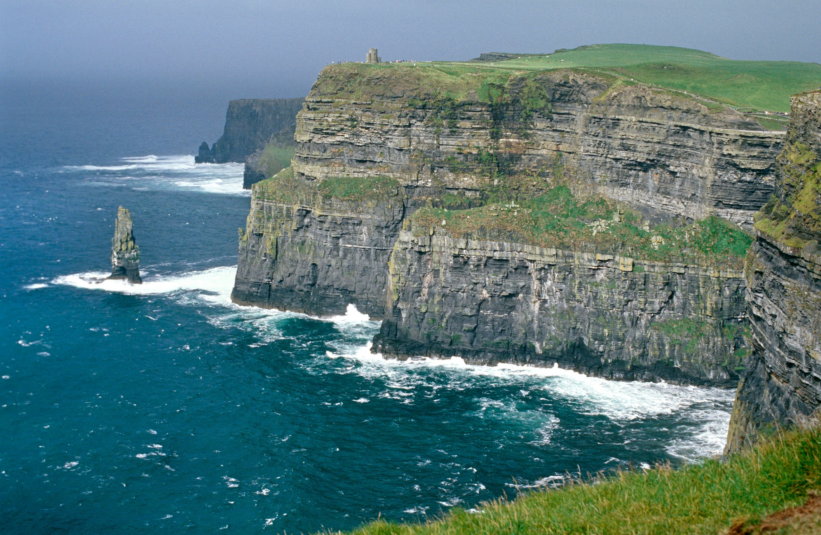
The Cliffs of Moher

Slide 5
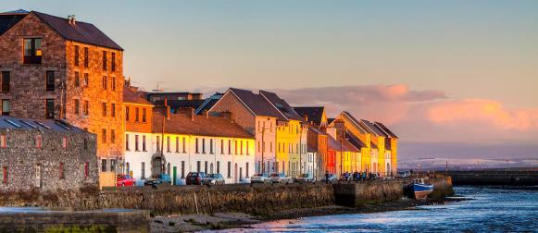
buildings, Galway

Slide 6
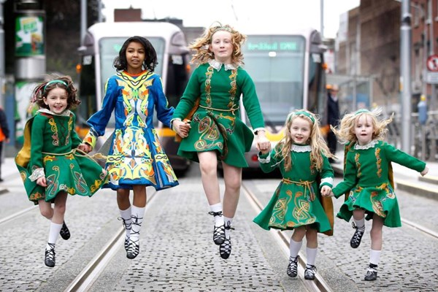
dancing

Slide 7
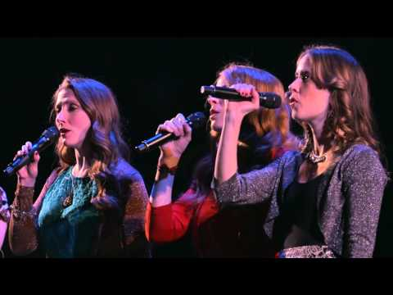
Overture

Slide 8
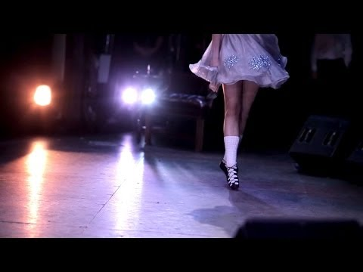
Slip Jig

Slide 9
Citations
Slide 2: https://nature-other.ambient-mixer.com/irish-countryside
Slide 3: www.ireland.com
Slide 4: http://www.kinlaygalway.ie/things_to_do/199-2/
Slide 5: http://www.galwayhostel.ie/about.html
Slide 6: https://www.pinterest.com/pin/408279522441055377/
Slide 7: https://www.youtube.com/watch?v=8XPSjwL78tY&t=301s
Slide 8: https://www.youtube.com/watch?v=NACU8NPHoVE

