Slide 1
Drum Dream Girl Images
Text Talk Week 2, Days 1 and 2

Slide 2
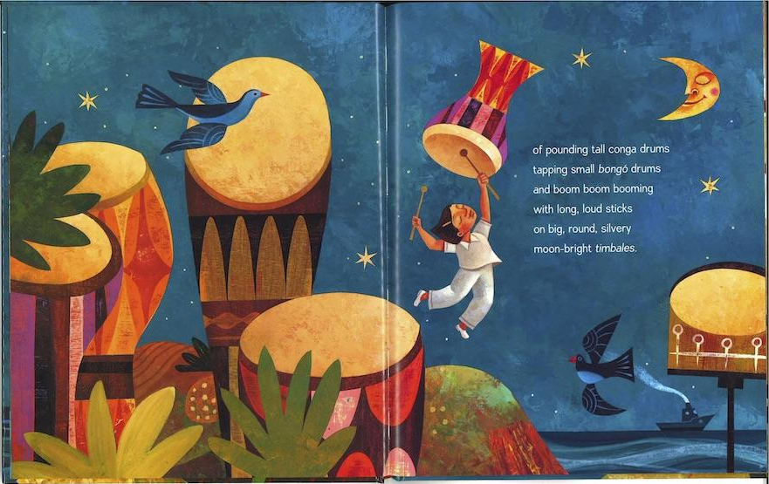

Slide 3
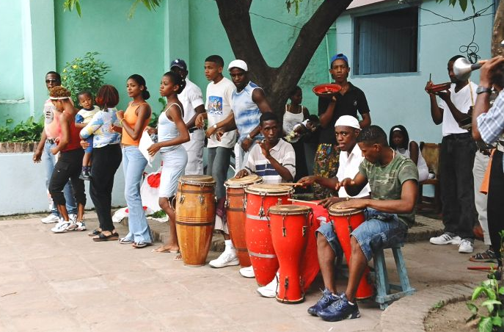
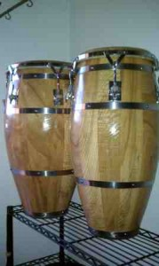
conga drums

Slide 4
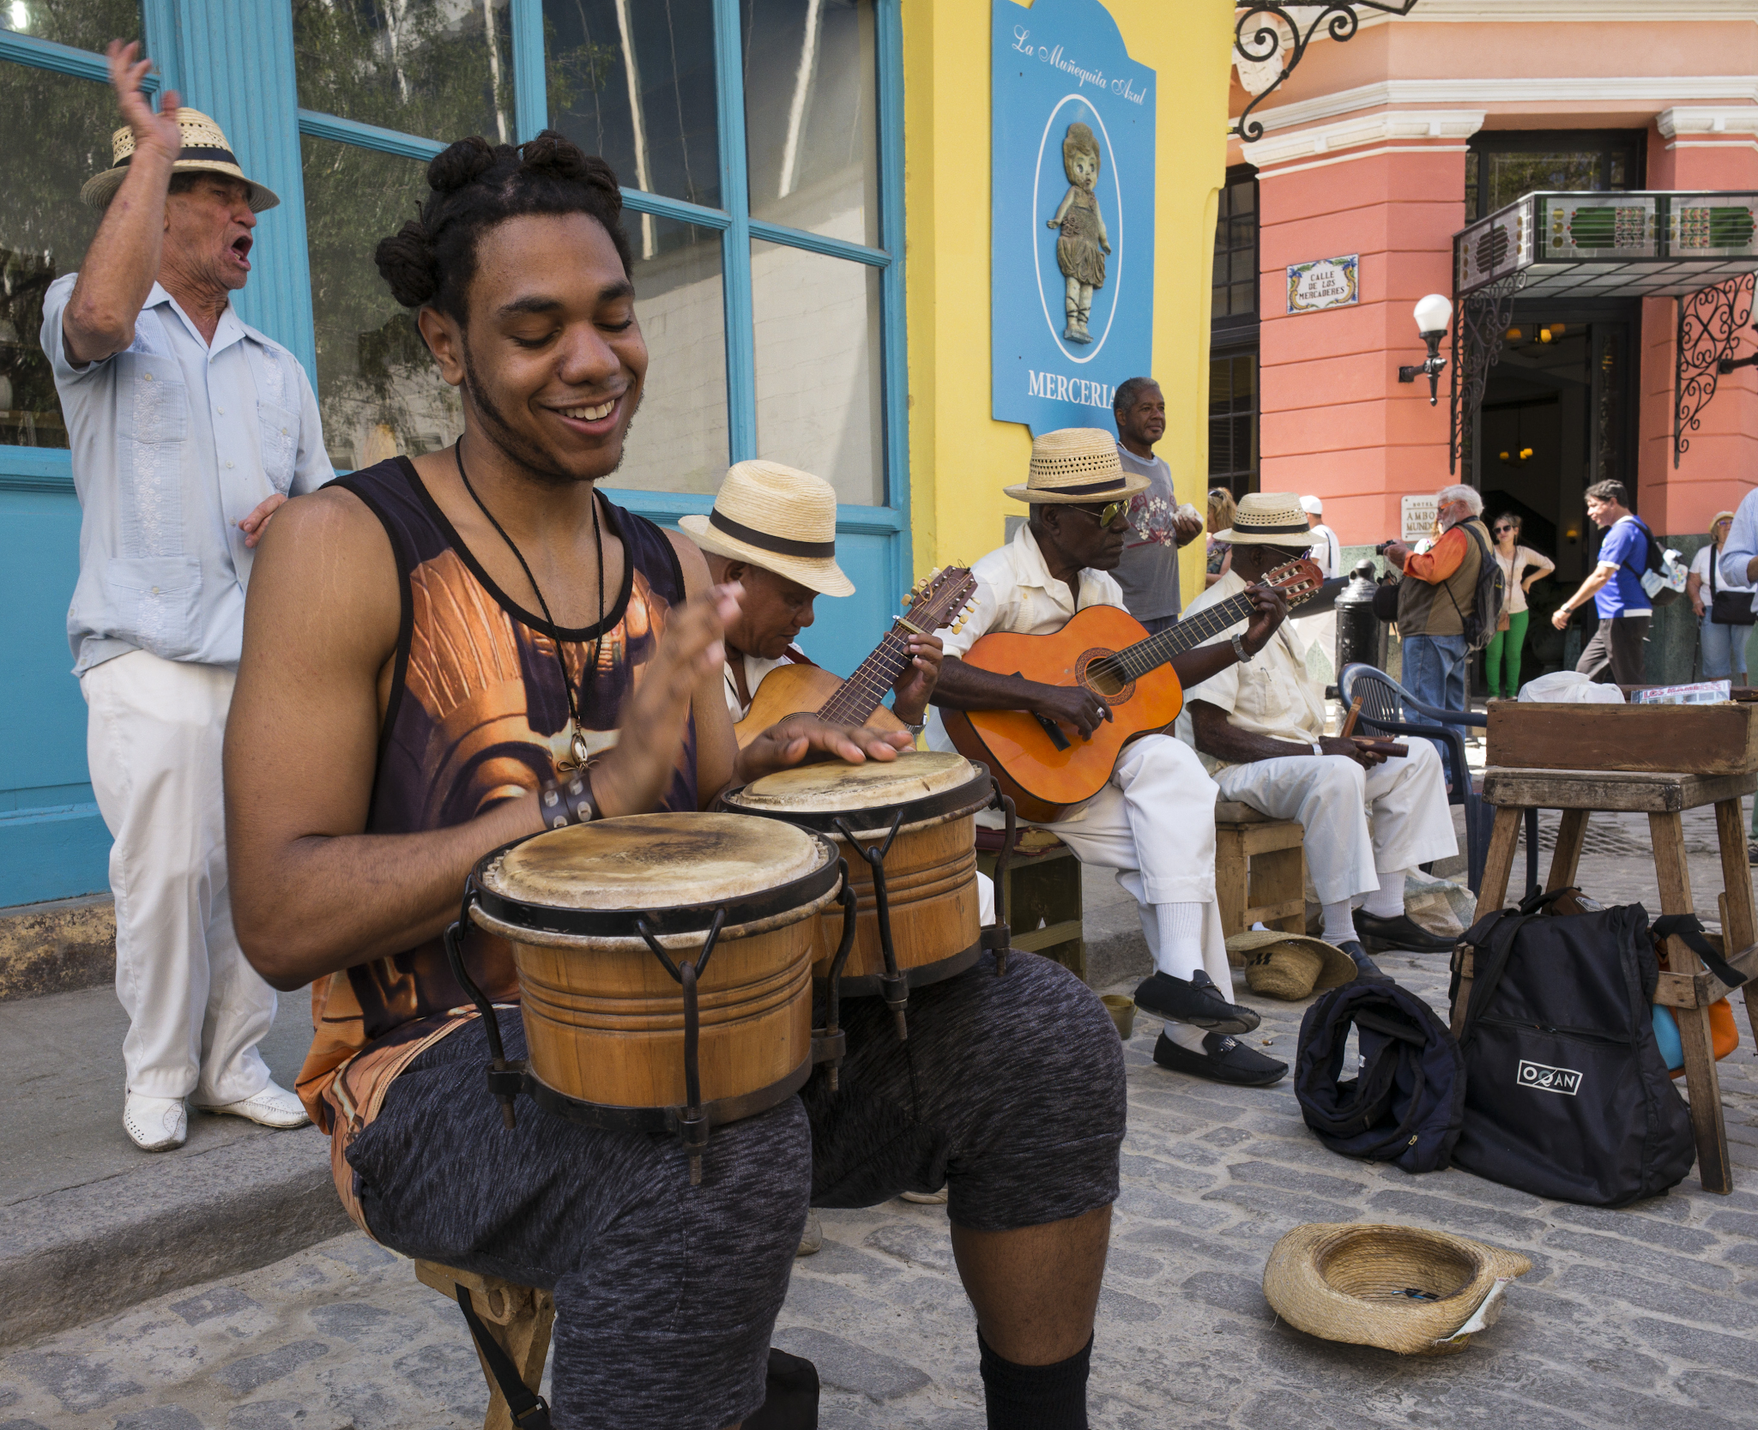
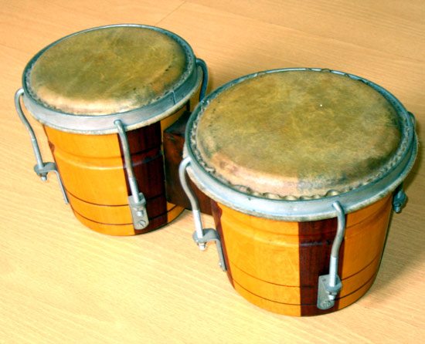
bongo drums

Slide 5
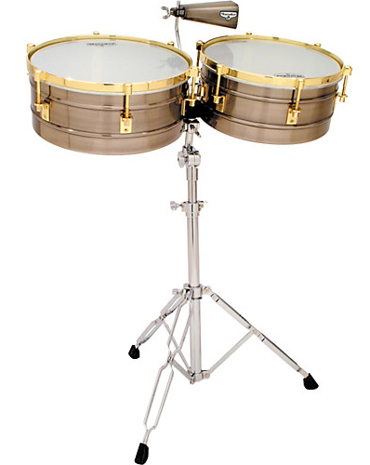
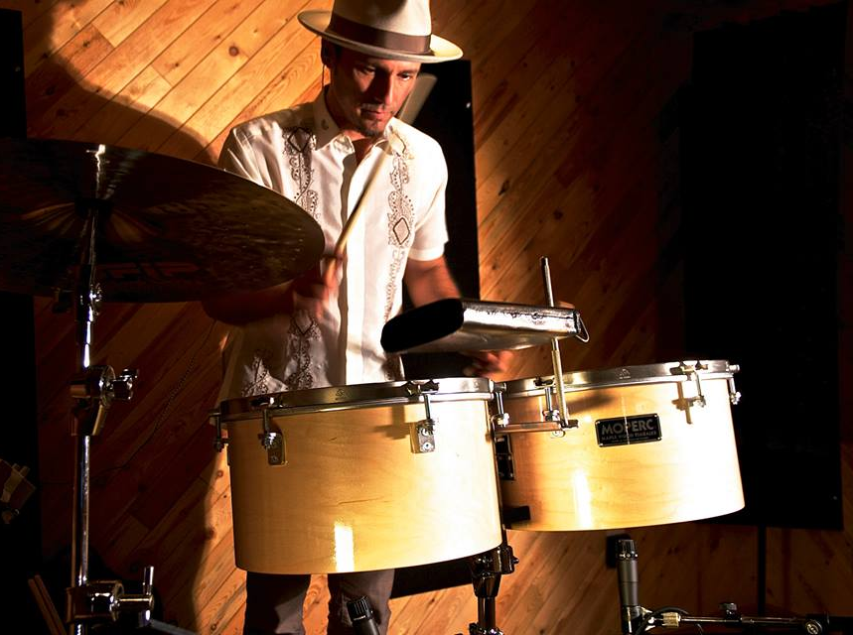
timbales

Slide 6
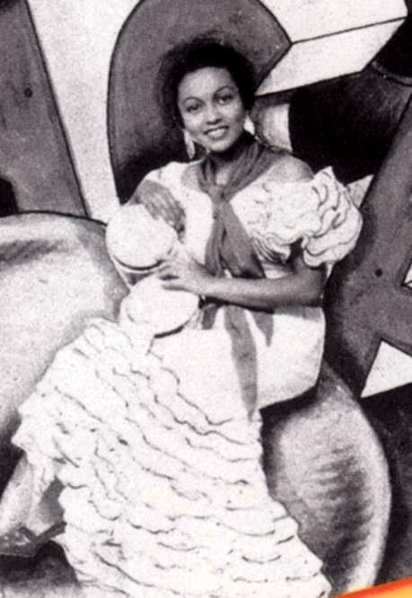
Millo Castro Zaldarriaga

Slide 7
Citations
Slide 2: from Drum Dream Girl, illustration by Rafael Lòpez
Slide 3: http://www.percussionconga.com/where-to-get-conga-lesson-in-cuba/; http://michaelpluznick.com/the-ten-best-conga-drums-the-best-congas-on-the-market-today/
Slide 4: http://arts.umich.edu/news-features/the-beating-heart-of-cuba/; https://www.britannica.com/art/bongo-drum
Slide 5: http://www.musiciansfriend.com/drums-percussion/lp-matador-timbales; http://moperc.com/en/video.php
Slide 6: http://2.bp.blogspot.com/-pn_EWHlh1xM/VXKr3QFKjxI/AAAAAAAALMU/Ugcg5YS9ObU/s1600/Millo.jpg

