Slide 1

“Music for Fun and Profit”
by Gary Soto
Writing Unit 3 Week 1 Day 3

Slide 2
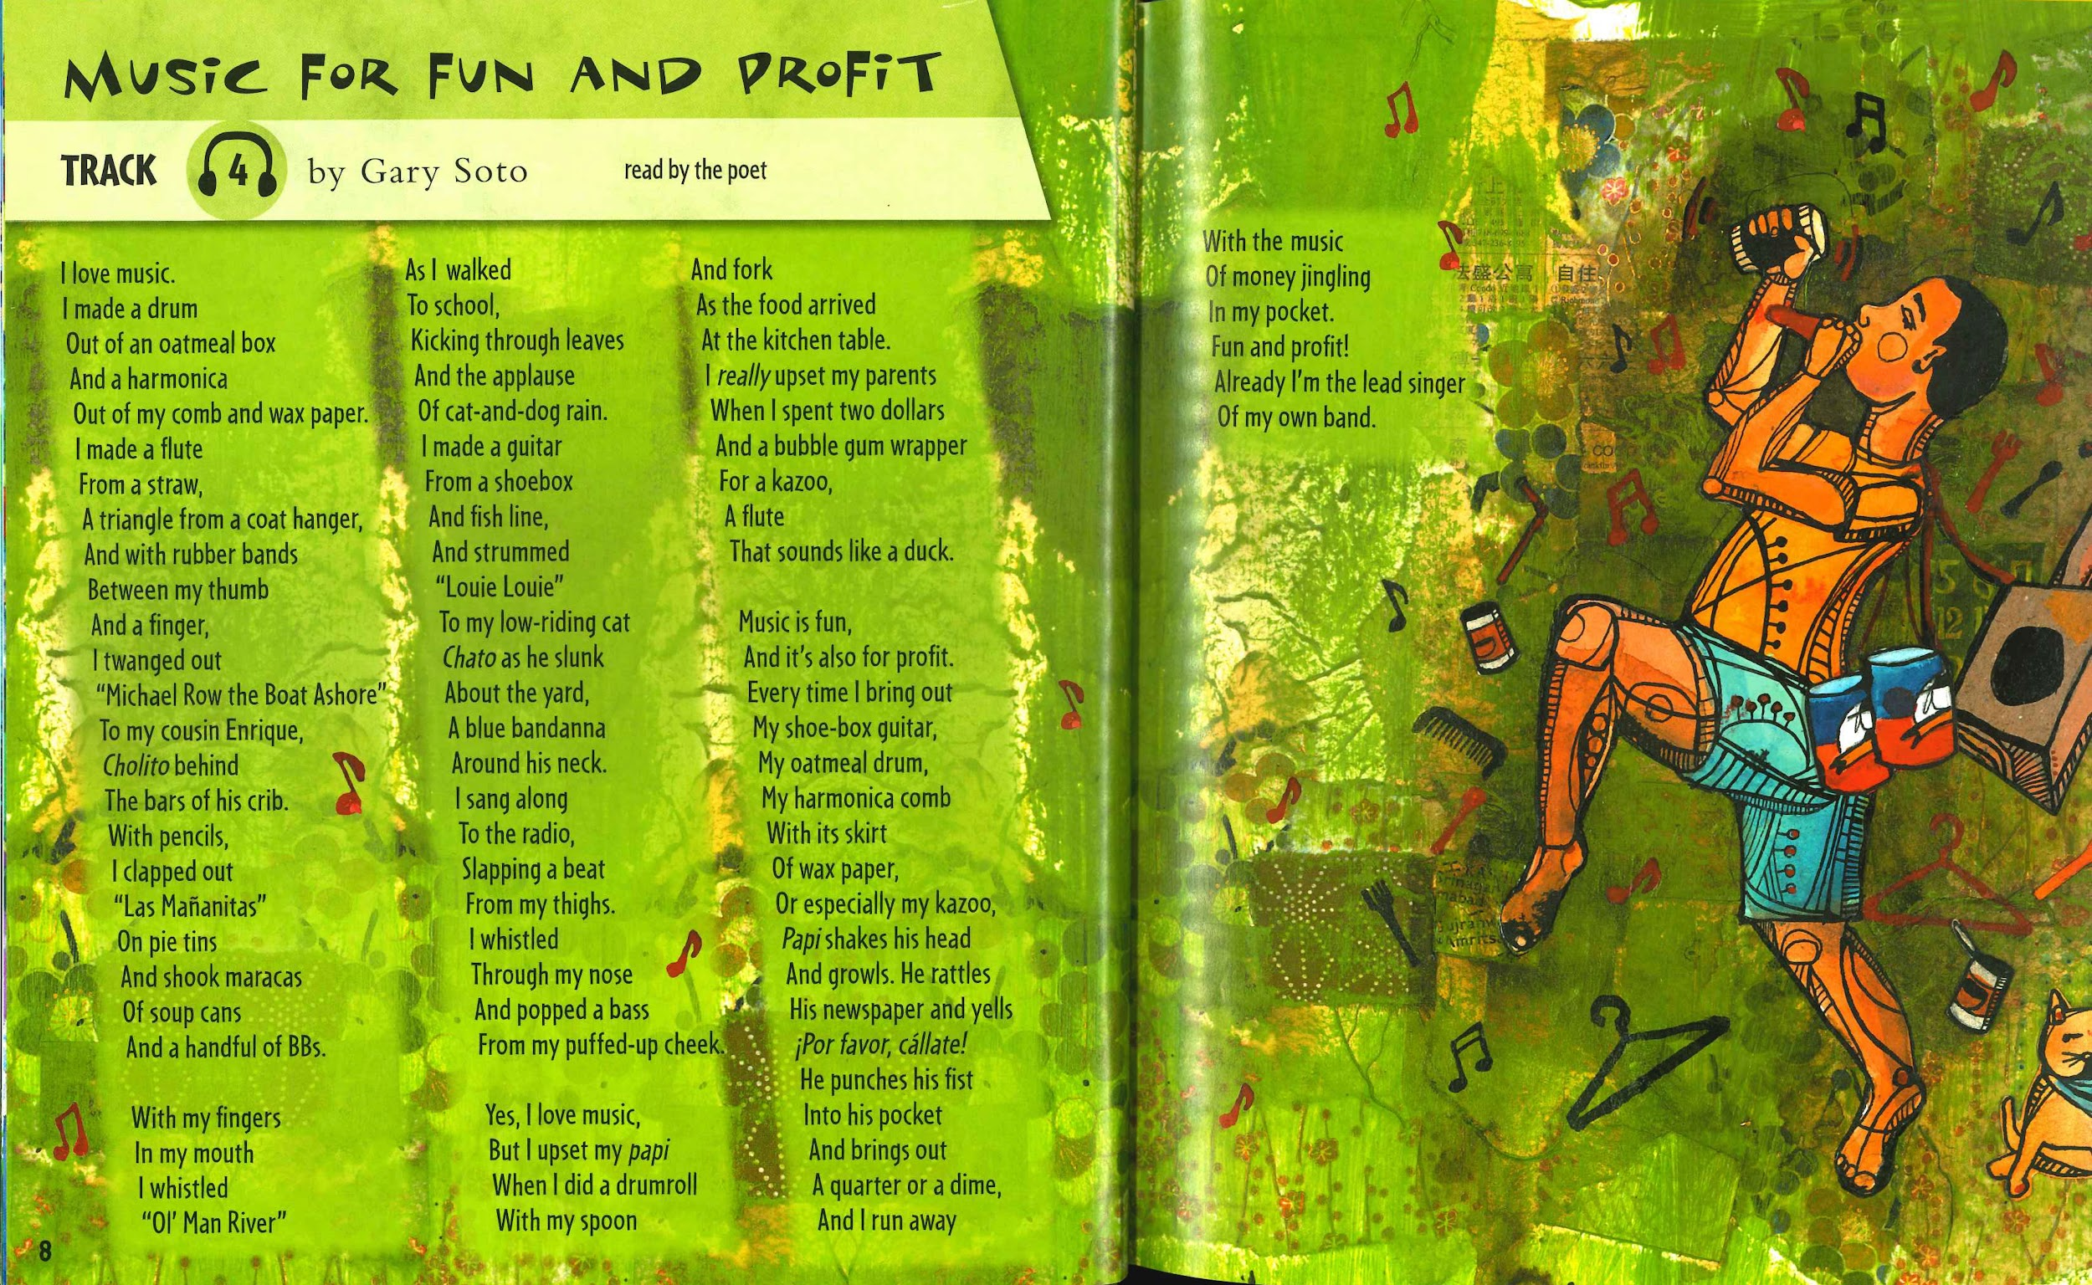

Slide 3
Music for Fun and Profit by Gary Soto, Stanza 1
I love music.
I made a drum
Out of an oatmeal box
And a harmonica
Out of my comb and wax paper.
I made a flute
From a straw,
A triangle from a coat hanger,
And with rubber bands
Between my thumb
And a finger,
I twanged out
“Michael Row the Boat Ashore”
To my cousin Enrique,
Cholito behind
The bars of his crib.
With pencils,
I clapped out
“Las Mañanitas”
On pie tins
And shook maracas
Of soup cans
And a handful of BBs.

Slide 4
Music for Fun and Profit by Gary Soto, Stanza 2
With my fingers
In my mouth
I whistled
“Ol’ Man River”
As I walked
To school,
Kicking through leaves
And the applause
Of cat-and-dog rain.
I made a guitar
From a shoebox
And fish line,
And strummed
“Louie Louie”
To my low-riding cat
Chato as he slunk
About the yard,
A blue bandana
Around his neck.
I sang along
To the radio,
Slapping a beat
From my thighs.
I whistled
Through my nose
And popped a bass
From my puffed-up cheek.

Slide 5
Music for Fun and Profit by Gary Soto, Stanza 3
Yes, I love music,
But I upset my papi
When I did a drumroll
With my spoon
And fork
As the food arrived
At the kitchen table.
I really upset my parents
When I spent two dollars
And a bubble gum wrapper
For a kazoo,
A flute That sounds like a duck.

Slide 6
Music for Fun and Profit by Gary Soto, Stanza 4
Music is fun,
And it’s also for profit.
Every time I bring out
My shoe-box guitar,
My oatmeal drum,
My harmonica comb
With its skirt
Of wax paper,
Or especially my kazoo,
Papi shakes his head
And growls. He rattles
His newspaper and yells
¡Por favor, cállate!
He punches his fist
Into his pocket
And brings out
A quarter or a dime,
And I run away with the music
Of money jingling
In my pocket.
Fun and profit!
Already I’m the lead singer
Of my own band.

