Slide 1
Weekly Words
Unit 3, Week 1
Notes:
bond: a strong, positive feeling or shared interest that brings people together
connect: to join together, to link
custom: a way of acting that is usual for a person or group
foreign: having to do with a country that is not one's own; unfamiliar
identity: all of the parts that communicate how a person or thing is known
immigrant: someone who comes from one place to settle in another place
infer: to make a guess based on facts and observation
unfamiliar: not known or recognized

Slide 2
bond
noun
a strong, positive feeling or shared interest that brings people together
Notes:
bond (noun)
Elaboration:
A bond is a connection, a feeling of closeness. We create bonds with people who enjoy activities we enjoy, or with people who feel the same way we do about something. It feels good to have a bond with someone.
Think, Pair, Share prompt:
How would you describe the bond between this person and her dog? Why might this bond be important?
https://www.wshs-dg.org/resource-center/ask-the-vet-pet-watch/132-ask-the-vet/273-human-animal-bond

Slide 3

connect
verb
to join together, to link
Notes:
connect (verb)
Elaboration:
People find lots of ways to connect with others who are close by and far away. This group of people is gathered close together, so we can infer that they know each other well; they are connected to each other. And it looks like they are also connecting with other people they care about who are not close by, through technology.
Let’s add the suffix: -tion to the base word “connect”: connec-tion: connection. When we remove the t from the base word and add this suffix, we get a noun, “connection.”
Think, Pair, Share prompt:
What are two ways you connect with people you care about?
https://www.prudential.com.sg/opus/articles/long-distance-relationships-family-friends

Slide 4
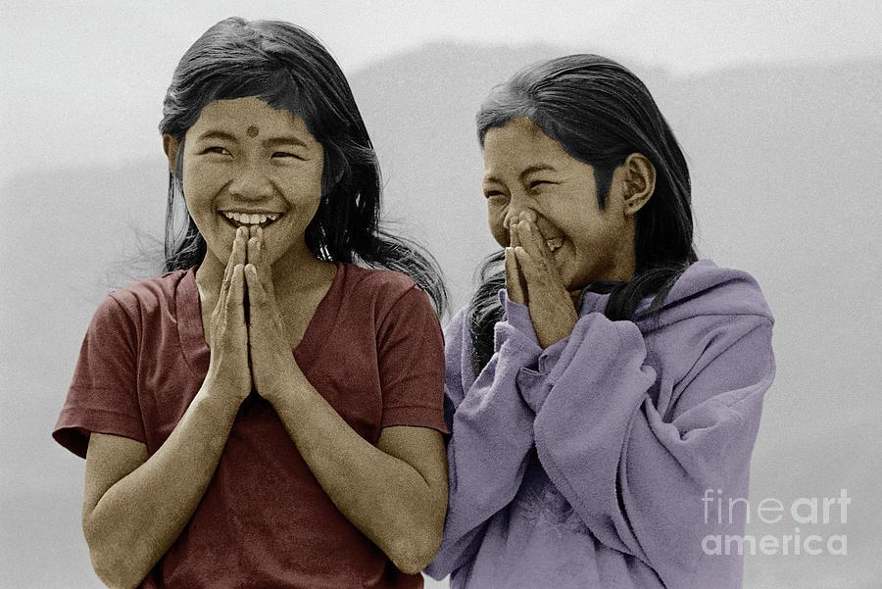
custom
noun
a way of acting that is usual for a person or group
Notes:
custom (noun)
Elaboration:
Greetings are one kind of custom. In India, Nepal, and Bangladesh, people have a custom of greeting each other with this gesture and the word “Namaste.” It is a greeting that shows great respect and also joy.
Other examples of customs are how a group of people celebrates special holidays, how they dress, and the music, art, and dances they create.
Think, Pair, Share prompt:
What is a special custom in your family or community? [Offer a relevant example such as Boston’s First Night, a neighborhood celebration, or a particular school custom.]
https://fineartamerica.com/featured/nepali-girls-namaste-greeting-himalayas-craig-lovell.html

Slide 5
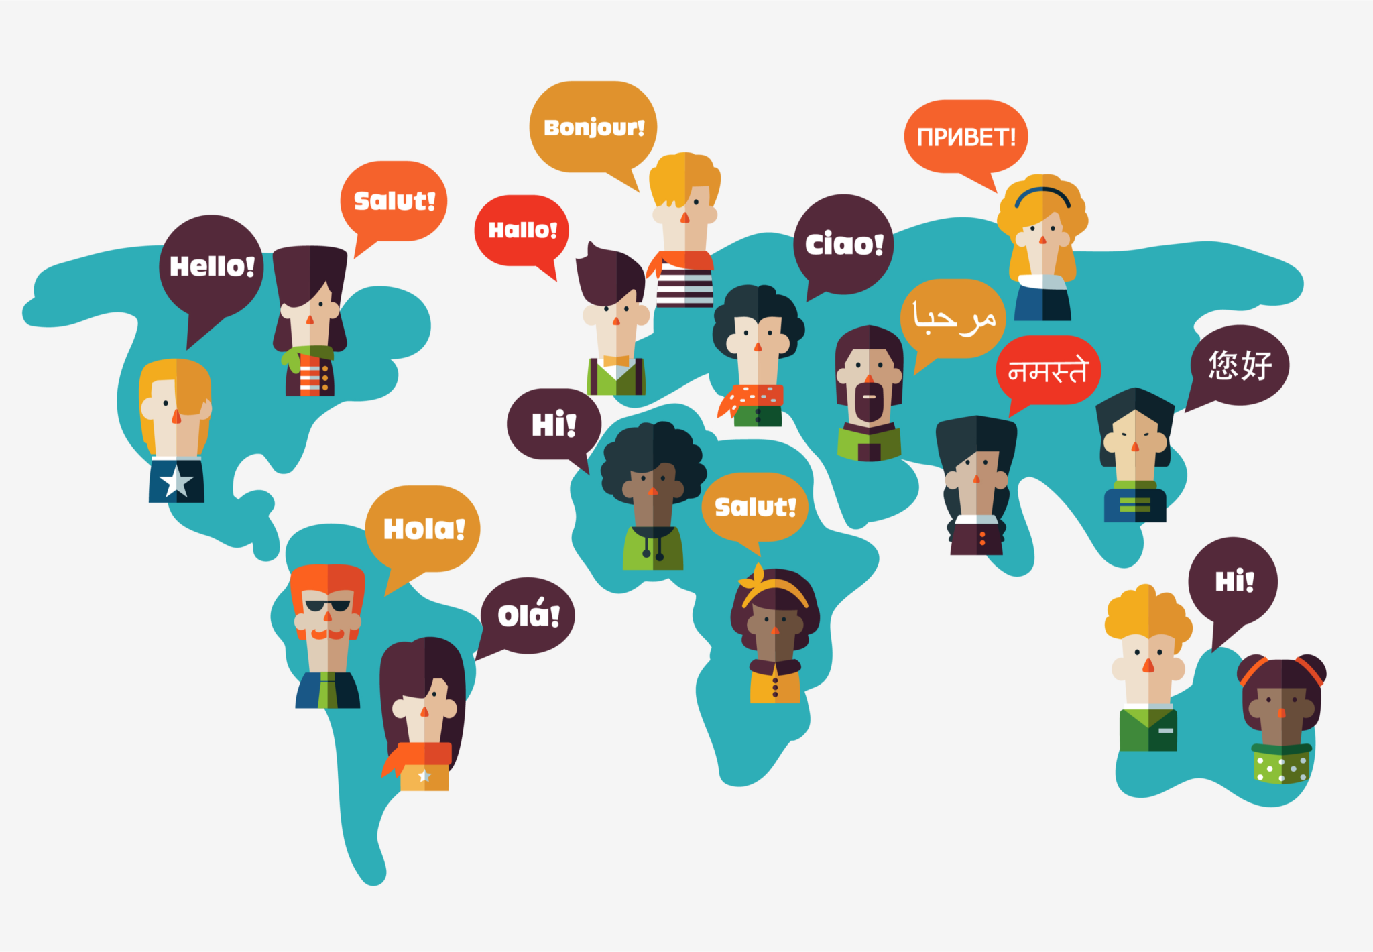
foreign
adjective
having to do with a country that is not one’s own; unfamiliar
Notes:
foreign (adjective)
Elaboration:
If something is not familiar to you, it’s foreign. Often, the adjective “foreign” describes something that is unfamiliar because it comes from a different place. A foreign language is one that is spoken in a different country.
When we add the suffix -er to “foreign” we get “foreigner.” The word becomes a noun meaning a person from another country.
Think, Pair, Share prompt:
What foreign language would you like to learn to speak?
What foreign country would you like to visit?
https://kaleela.com/five-of-the-top-foreign-languages-to-learn-in-2021/

Slide 6

identity
noun
all of the parts that communicate how a person or thing is known
Notes:
identity (noun)
Elaboration:
The language you speak, the things you love to do, the way you look, the place your family comes from… these are parts of your identity—who you are and how people know you.
Think, Pair, Share prompt:
What are some important parts of your identity?
https://hbr.org/2019/09/the-benefits-of-bringing-your-whole-identity-to-work

Slide 7
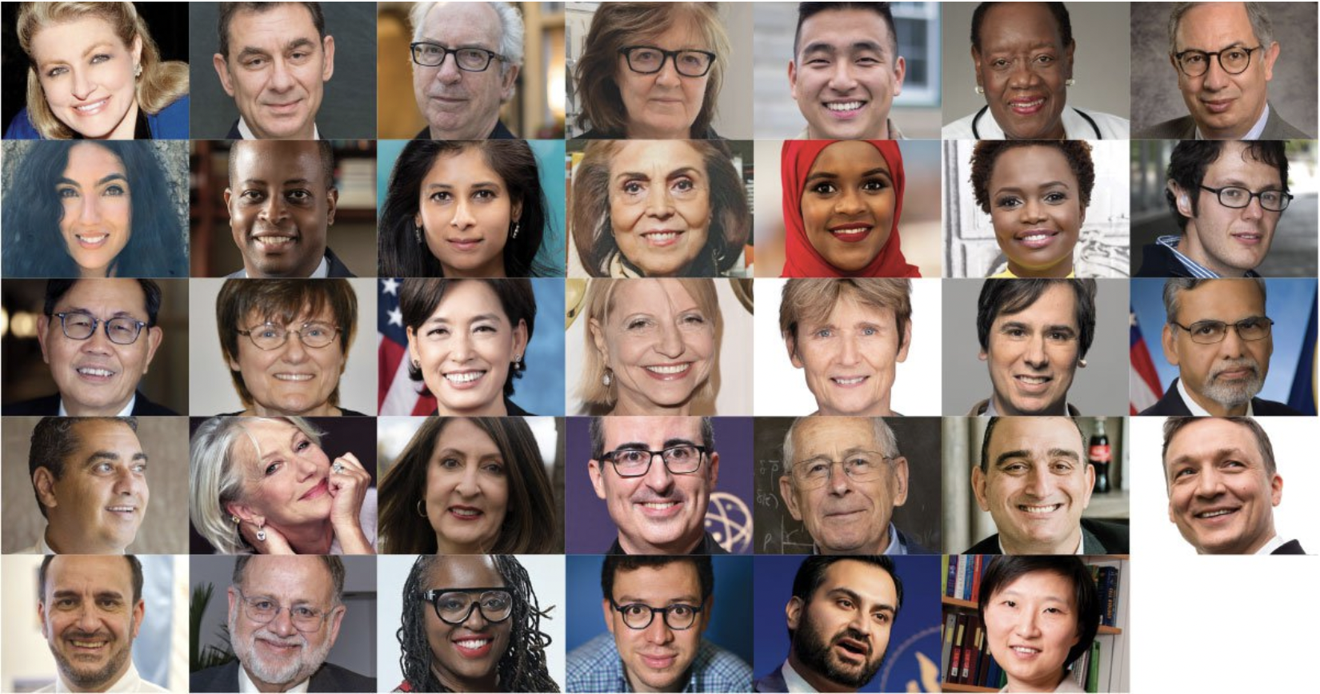
immigrant
noun
someone who comes from one place to settle in another place
Notes:
Immigrant (noun)
Elaboration:
People move from one country to another for many different reasons. Immigrants come to the US from many different parts of the world. They bring important things with them. There are often many things immigrants have to figure out, because they are in a new place.
Think, Pair, Share prompt:
What are some things people could do to make a new immigrant feel welcome here in Boston?
If you or your family are immigrants, what are some things you can do to make another new immigrant feel welcome here?
https://www.carnegie.org/awards/award/great-immigrants/

Slide 8
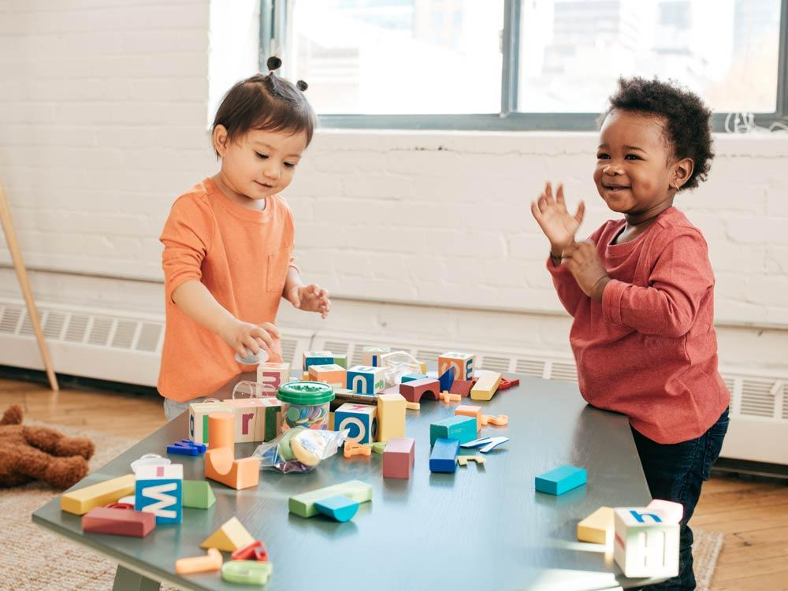
infer
verb
to make a guess based on facts and observation
Notes:
infer (verb)
Elaboration:
Sometimes we don’t get a lot of information just from what someone says or just from words in a text. We can pay attention to facial expressions, body language, illustrations, and other clues to get more meaning.
Think, Pair, Share prompt:
What do you infer about how these children are feeling based on what you see in the photo?
https://raisingchildren.net.au/autism/school-play-work/play-learning/playing-with-others-autistic-children

Slide 9
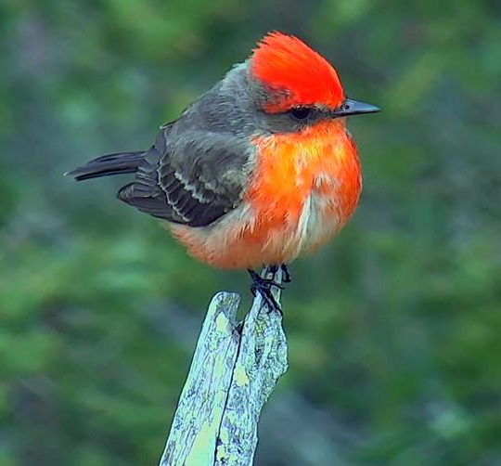
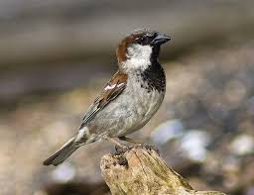
unfamiliar
adjective
not known or recognized
Notes:
unfamiliar (adjective)
Elaboration:
The prefix “un” means not. “Familiar” means we have seen it before, or we know about it.
This bird called a vermillion flycatcher is unfamiliar to us because it doesn’t live around Boston. The house sparrow is probably familiar to all of you—it’s very common in Boston and many other places.
Think, Pair, Share prompt:
When you see something that is unfamiliar, you might feel excited, or you might feel nervous. Imagine you are an immigrant from a place where it never snows, and now that you are living in Boston there is a big snow storm. The snow is unfamiliar to you! How might you feel?
https://lcnme.com/currentnews/back-back-sightings-rare-birds-astonish-delight-local-birdwatchers/, https://www.birdwatchersdigest.com/bwdsite/learn/identification/sparrows-allies/house-sparrow.php

