Slide 1
Vietnam
Text Talk Week 1, Day 1

Slide 2
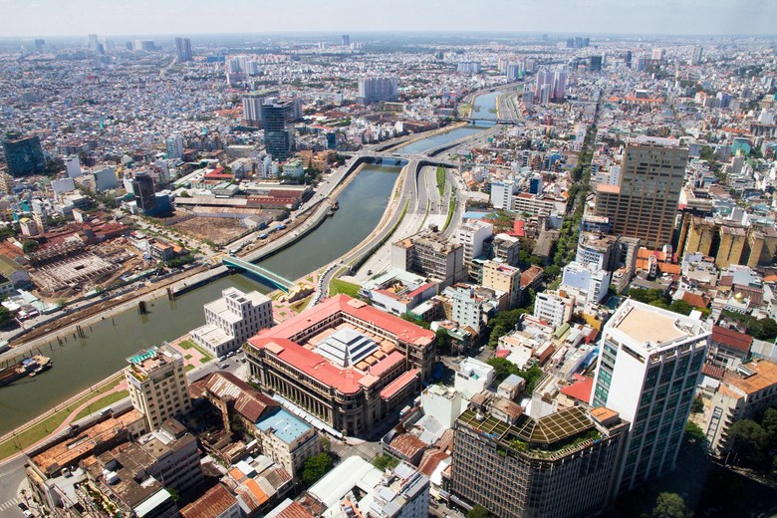
Ho Chi Minh City

Slide 3
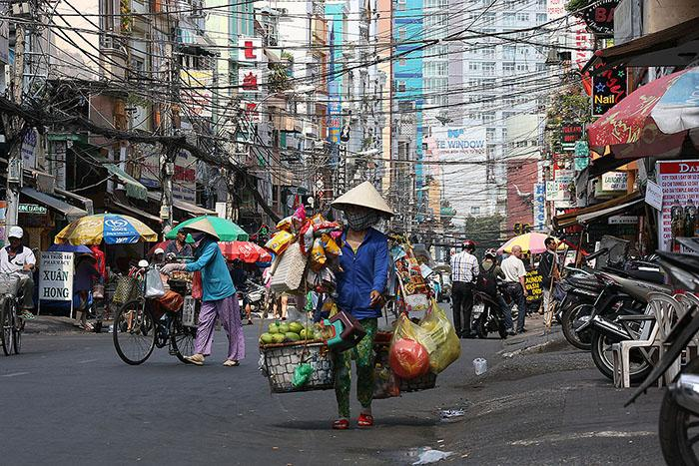
busy streets

Slide 4
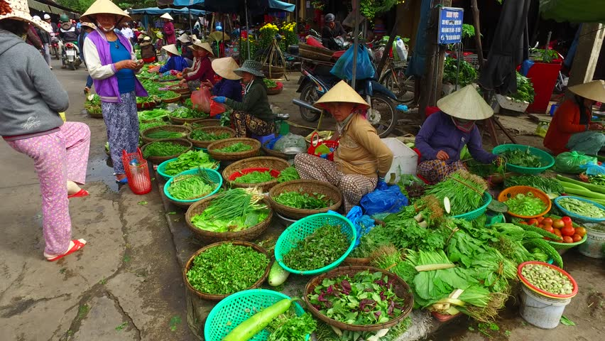
outdoor market
Notes:
T

Slide 5
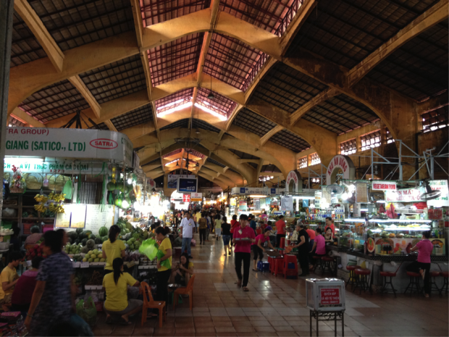
indoor market

Slide 6
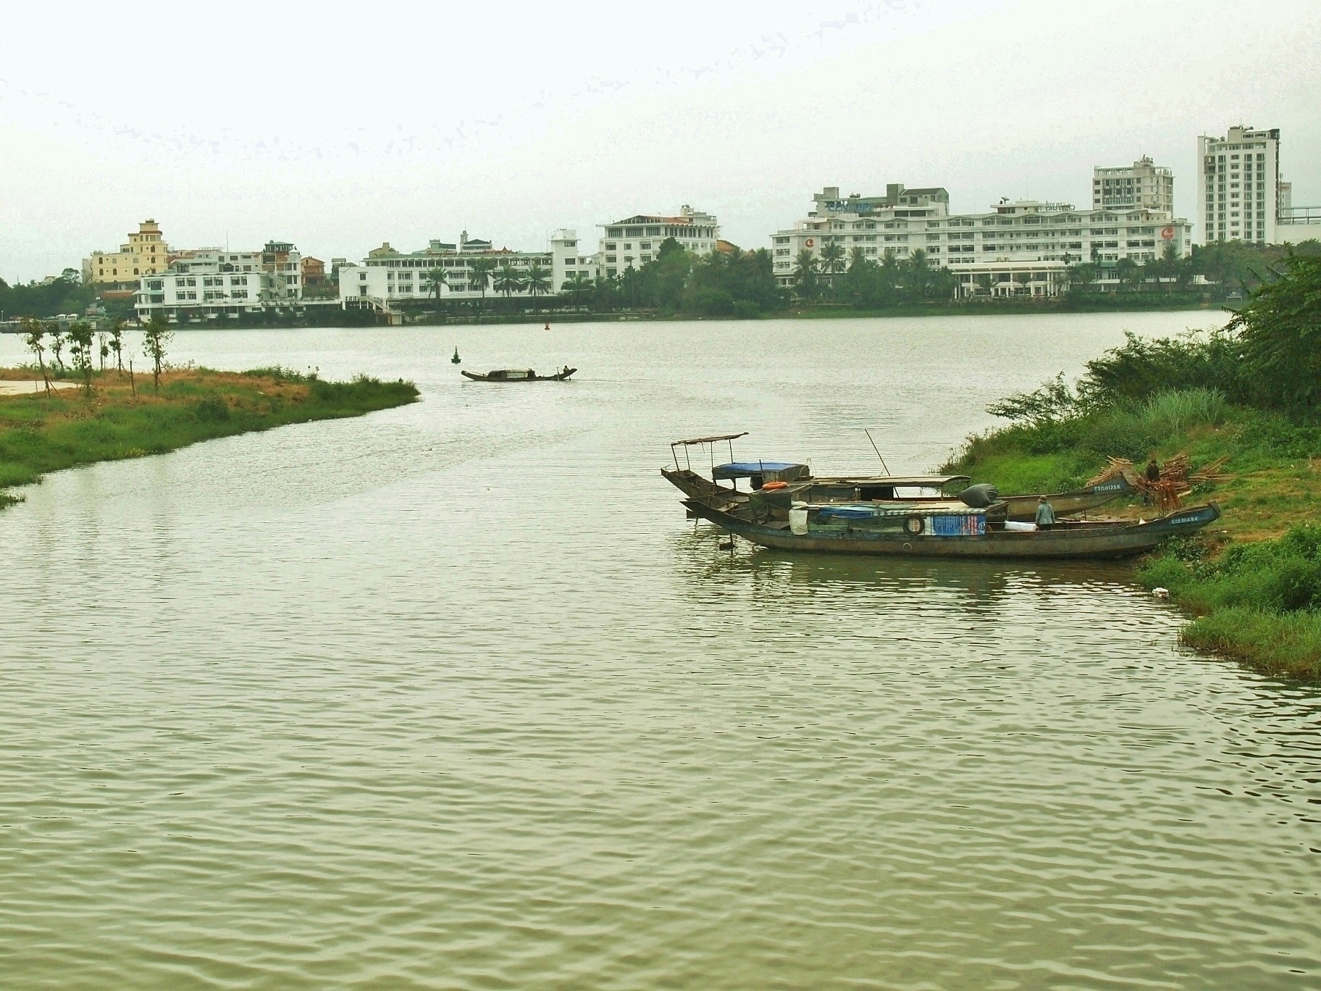
boats on the Hue River

Slide 7
Citations
Slide 2: http://www.bbc.com/travel/story/20170317-living-in-h-ch-minh-city
Slide 3: http://www.foxyandthefox.com/2013/03/saigon-aka-ho-chi-minh-city-vietnam/
Slide 4: https://www.shutterstock.com/video/clip-24220636-stock-footage-hoi-an-vietnam-february-outdoor-markets-in-the-streets-of-hoi-an-vietnam.html?src=rel/25636625:1/gg
Slide 5: http://www.theculturemap.com/48-hours-ho-chi-minh-city-vietnam-3/
Slide 6: https://lifetoreset.wordpress.com/2014/02/19/hue/

