Slide 1
Personal Pronouns
Vocabulary & Language Week 1, Days 3-4

Slide 2
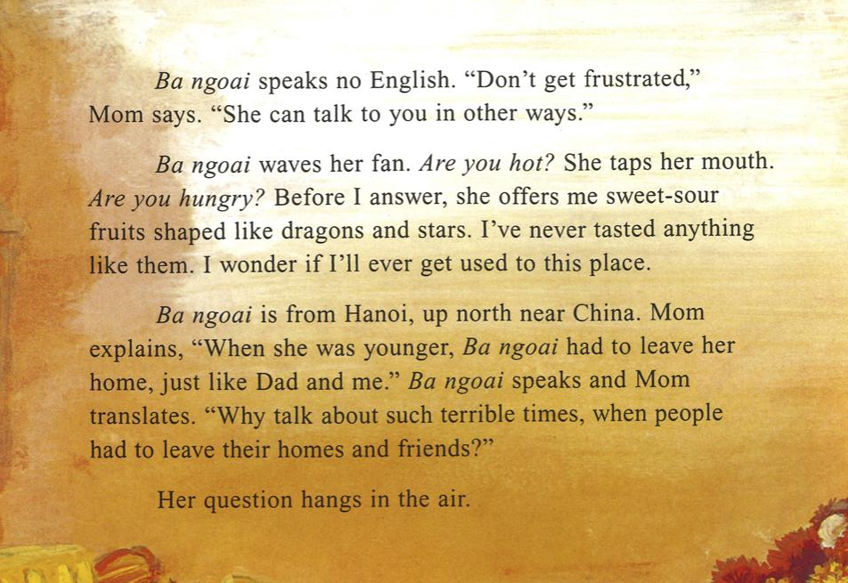


Slide 3
Ba ngoai speaks no English. “Don’t get frustrated,” Mom says. “She can talk to you in other ways.”

Slide 4
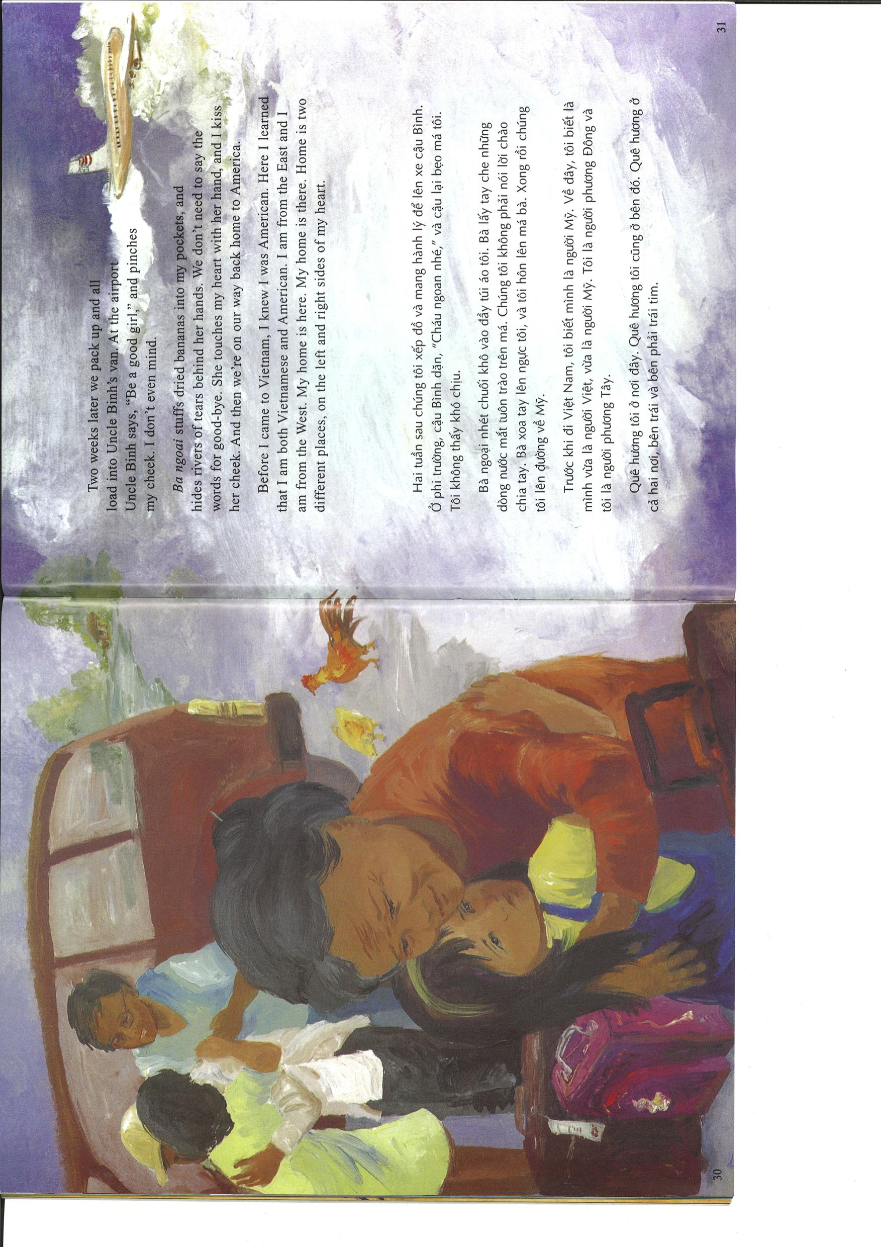

Slide 5
Ba ngoai stuffs dried bananas into my pockets, and hides rivers of tears behind her hands. We don’t need to say the words for good-bye. She touches my heart with her hand, and I kiss her cheek, And then we’re on our way back home to America.

Slide 6
The squirrels can leap far. The squirrels need to sleep sometimes.

Slide 7
The squirrels can leap far. They need to sleep sometimes.

Slide 8
Your turn!
Copy the two sets of sentences.
Underline the subject of the sentences.
In the second sentence of each set, cross out the subject. Replace it with a pronoun.
Zendaya is a student. Zendaya is very smart.
The person and her dog have a bond. The person and her dog are connected.

