Slide 1
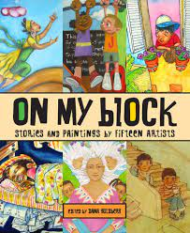
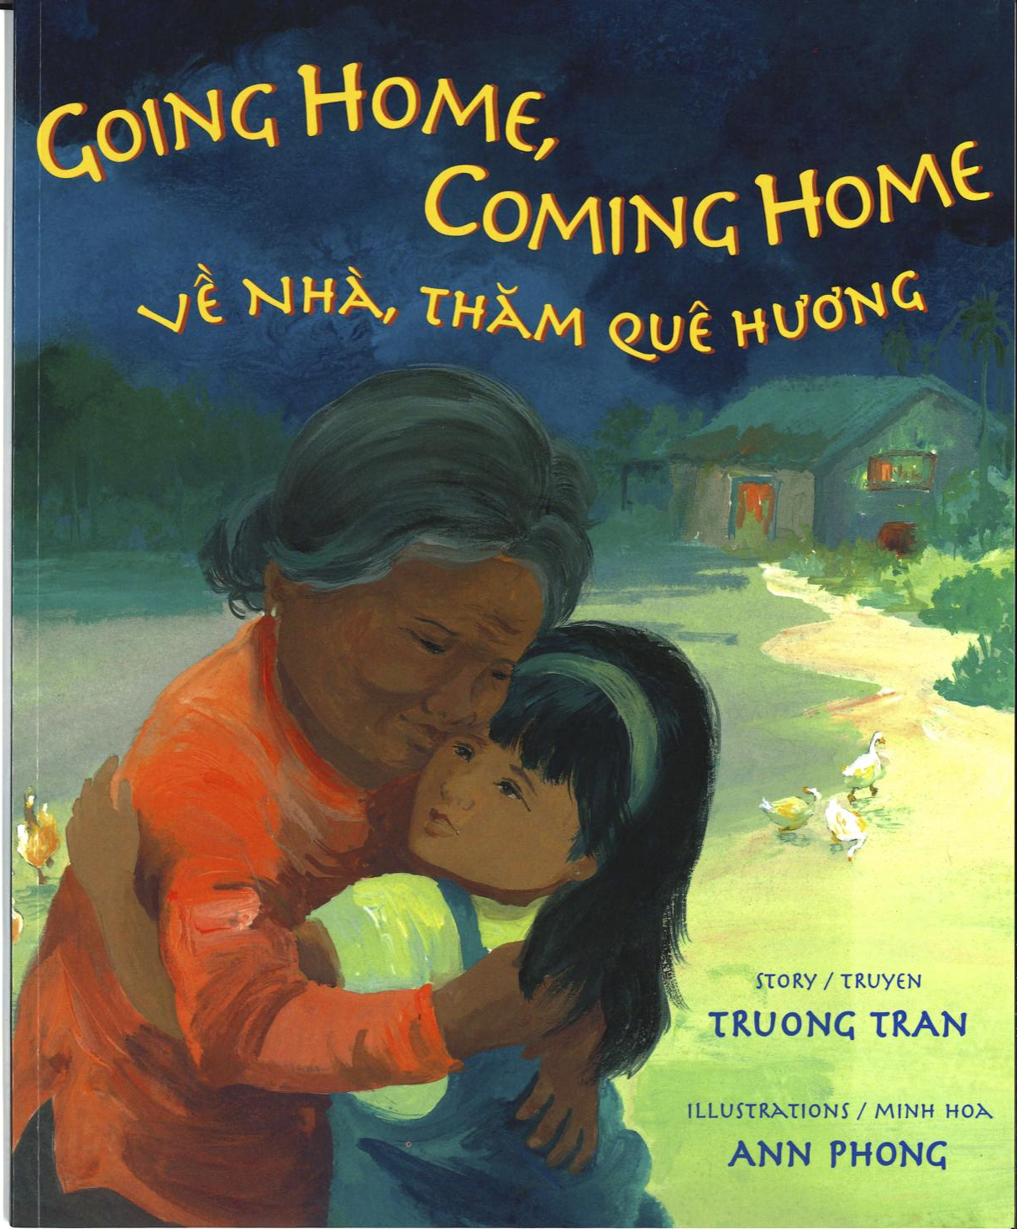
On My Block
Stories and Paintings
by Fifteen Artists
excerpt, “The Pacific Shoreline”
Going Home, Coming Home
excerpt, Illustrations
Text Talk Week 1, Day 3

Slide 2
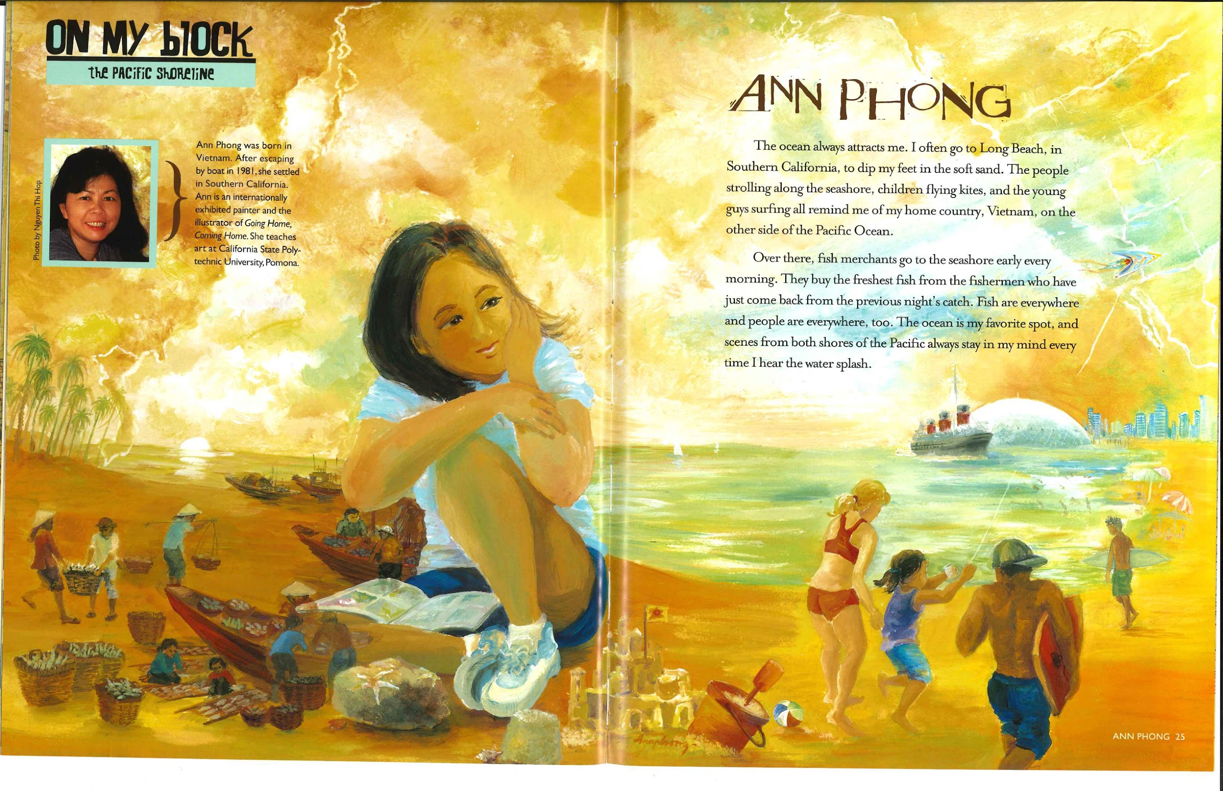

Slide 3
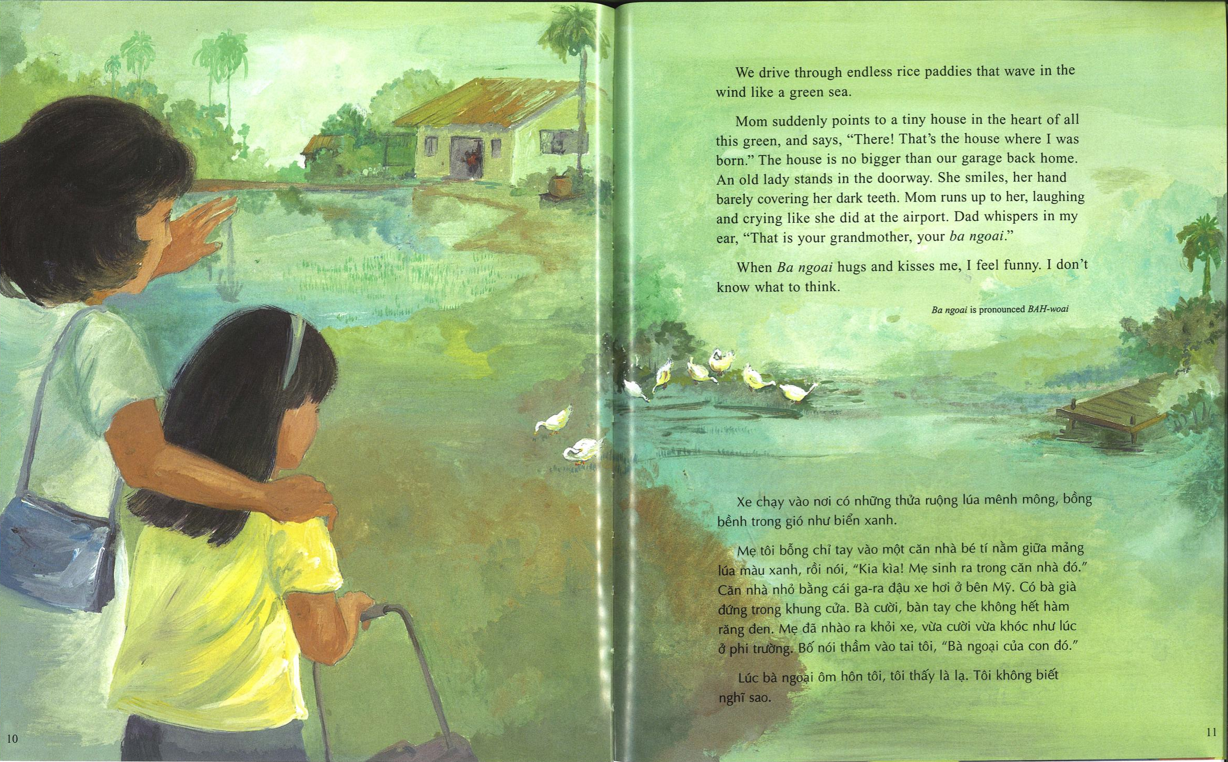

Slide 4
