Slide 1
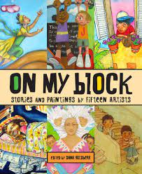
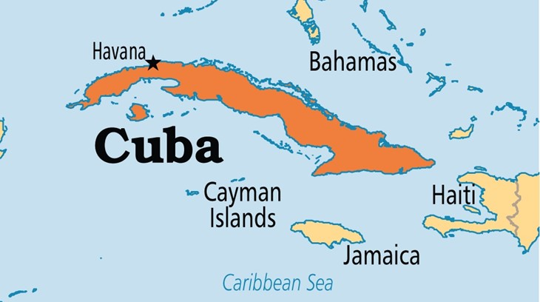
On My Block
Stories and Paintings by Fifteen Artists
excerpt, “Joseíto’s Little Farm”
and
Images of Havana, Cuba
Text Talk Week 1, Day 5

Slide 3
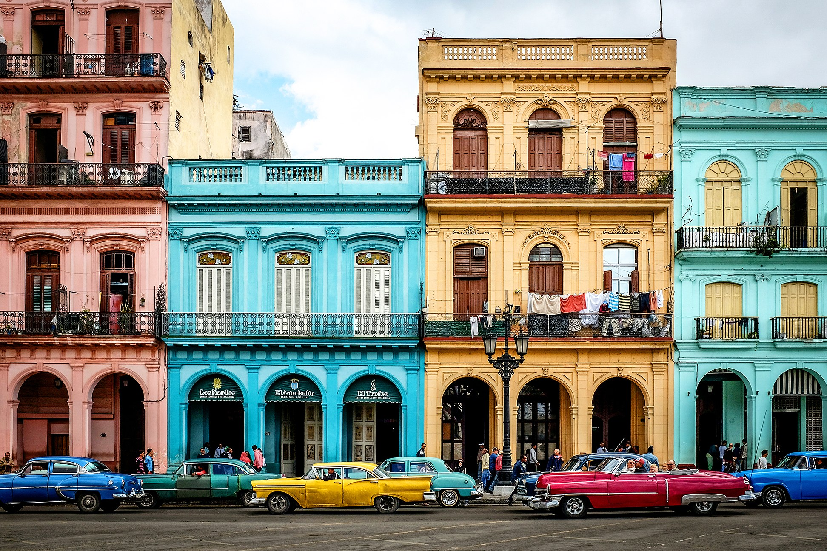
Old Havana

Slide 4
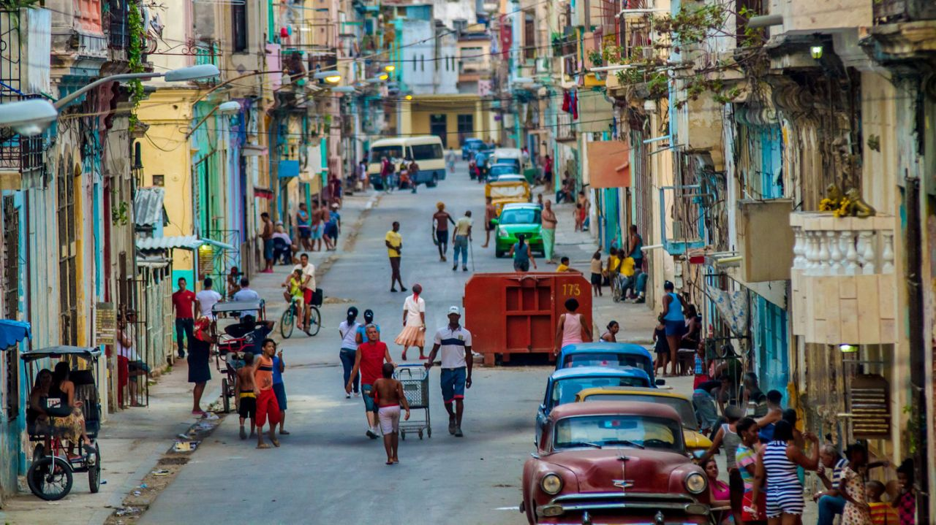

Slide 5
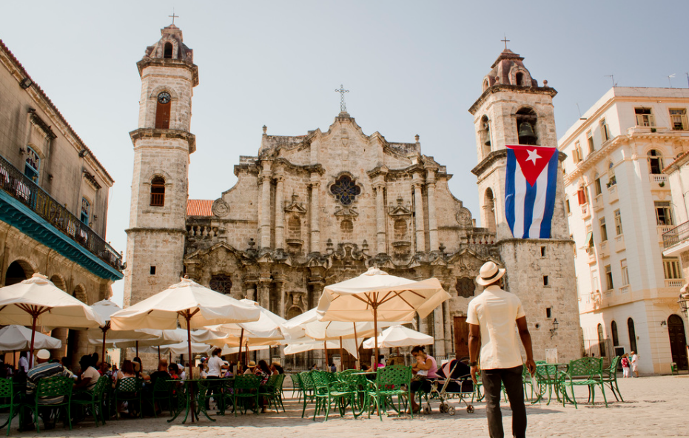

Slide 6
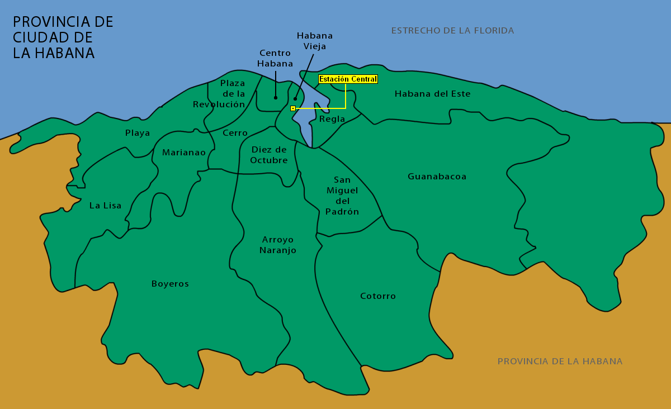

Slide 7
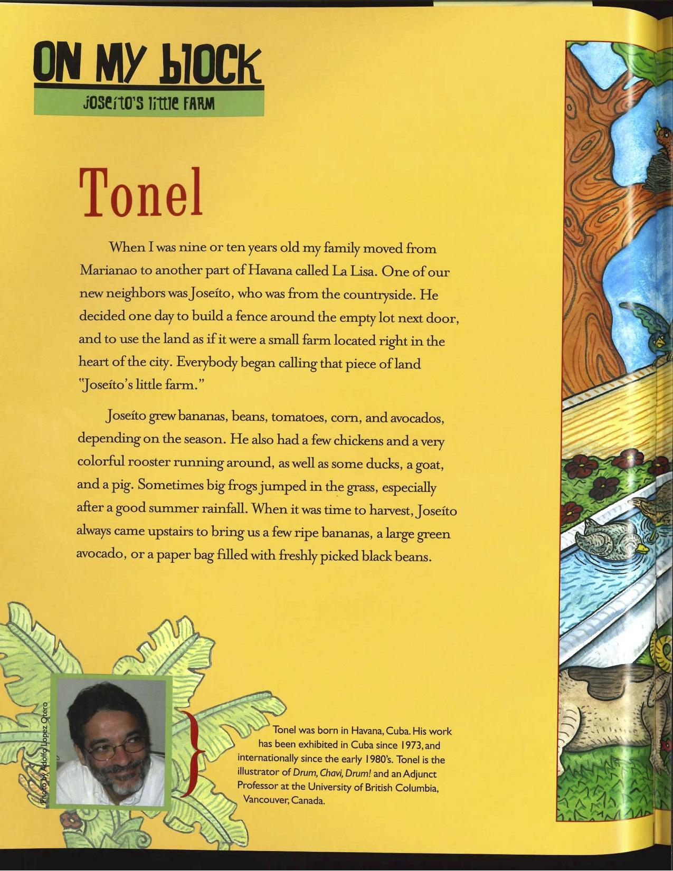
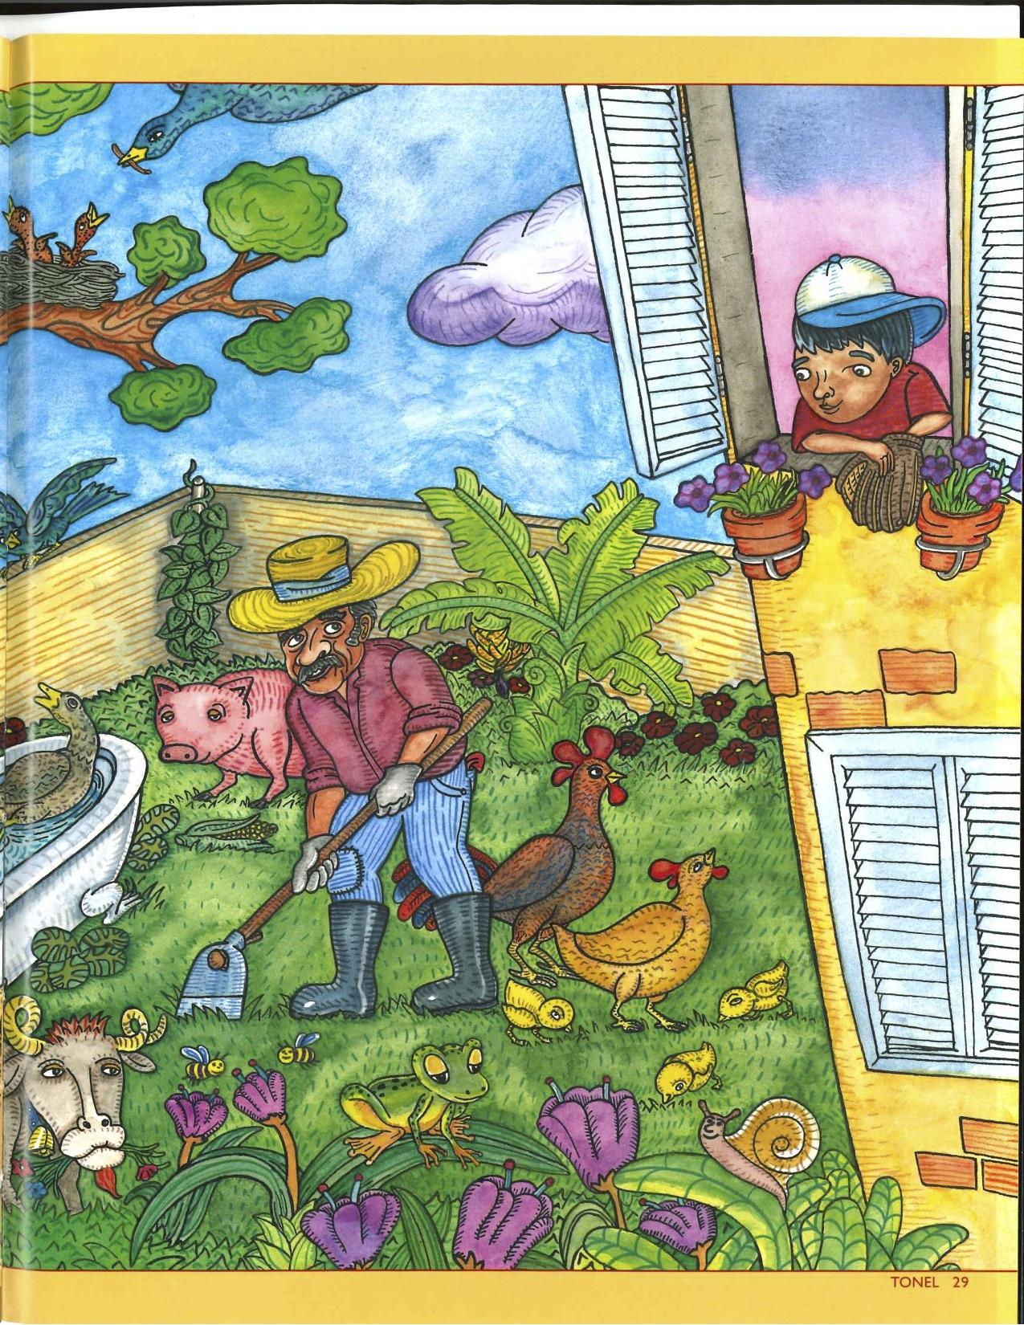

Slide 8
Can you find Marianao and La Lisa?

Slide 9
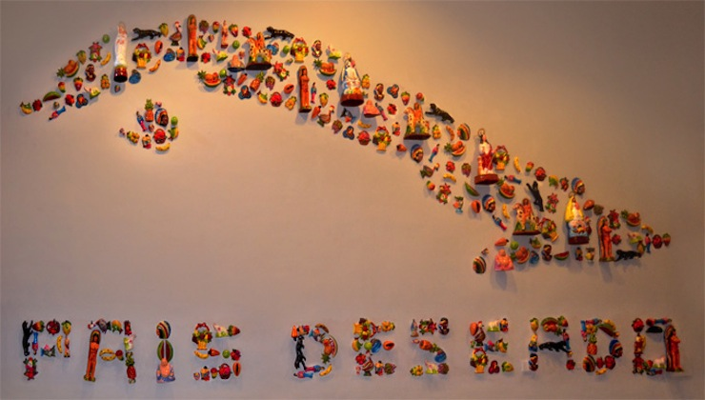
“Pais Deseado”

Slide 11
Citations
Slides 2 and 10: https://business.ohio.edu/about/centers-institutes/center-for-international-business/international-study-program-cuba/
Slide 3 :https://www.gq.com/story/old-havana-neighborhood-guide-travel-advice
Slide 4: https://www.amny.com/things-to-do/things-to-do-in-havana-cuba-now-just-a-direct-flight-away-1.12779401
Slide 5: https://www.grindtv.com/travel/cheap-and-deep-immerse-yourself-in-havana-cuba-on-a-budget/
Slides 6 and 8: http://www.wikiwand.com/en/Havana_Central_railway_station
Slide 9: http://www.cubanartnews.org/news/cuban-art-news-marks-5th-anniversary/4174

