Slide 1

Going Home,
Coming Home
excerpt, pages 11, 26, 31
Text Talk Week 1, Day 2

Slide 2
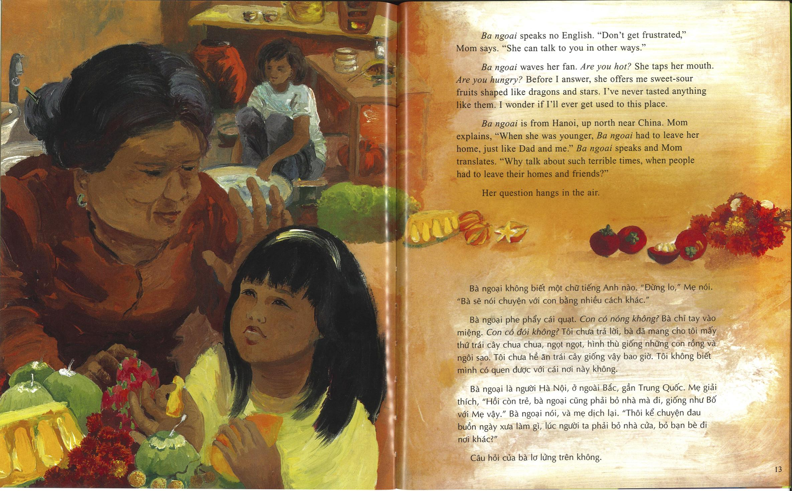

Slide 3
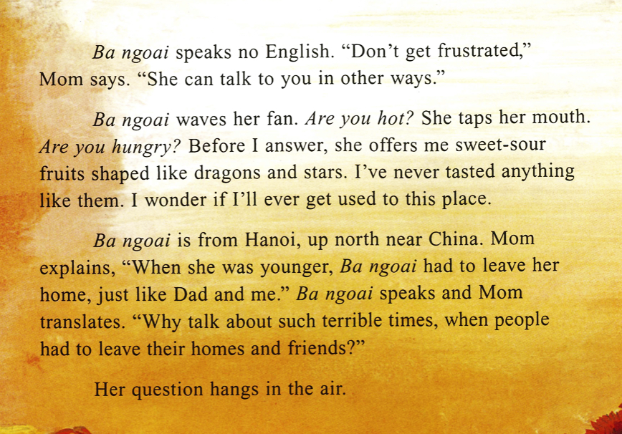

Slide 4
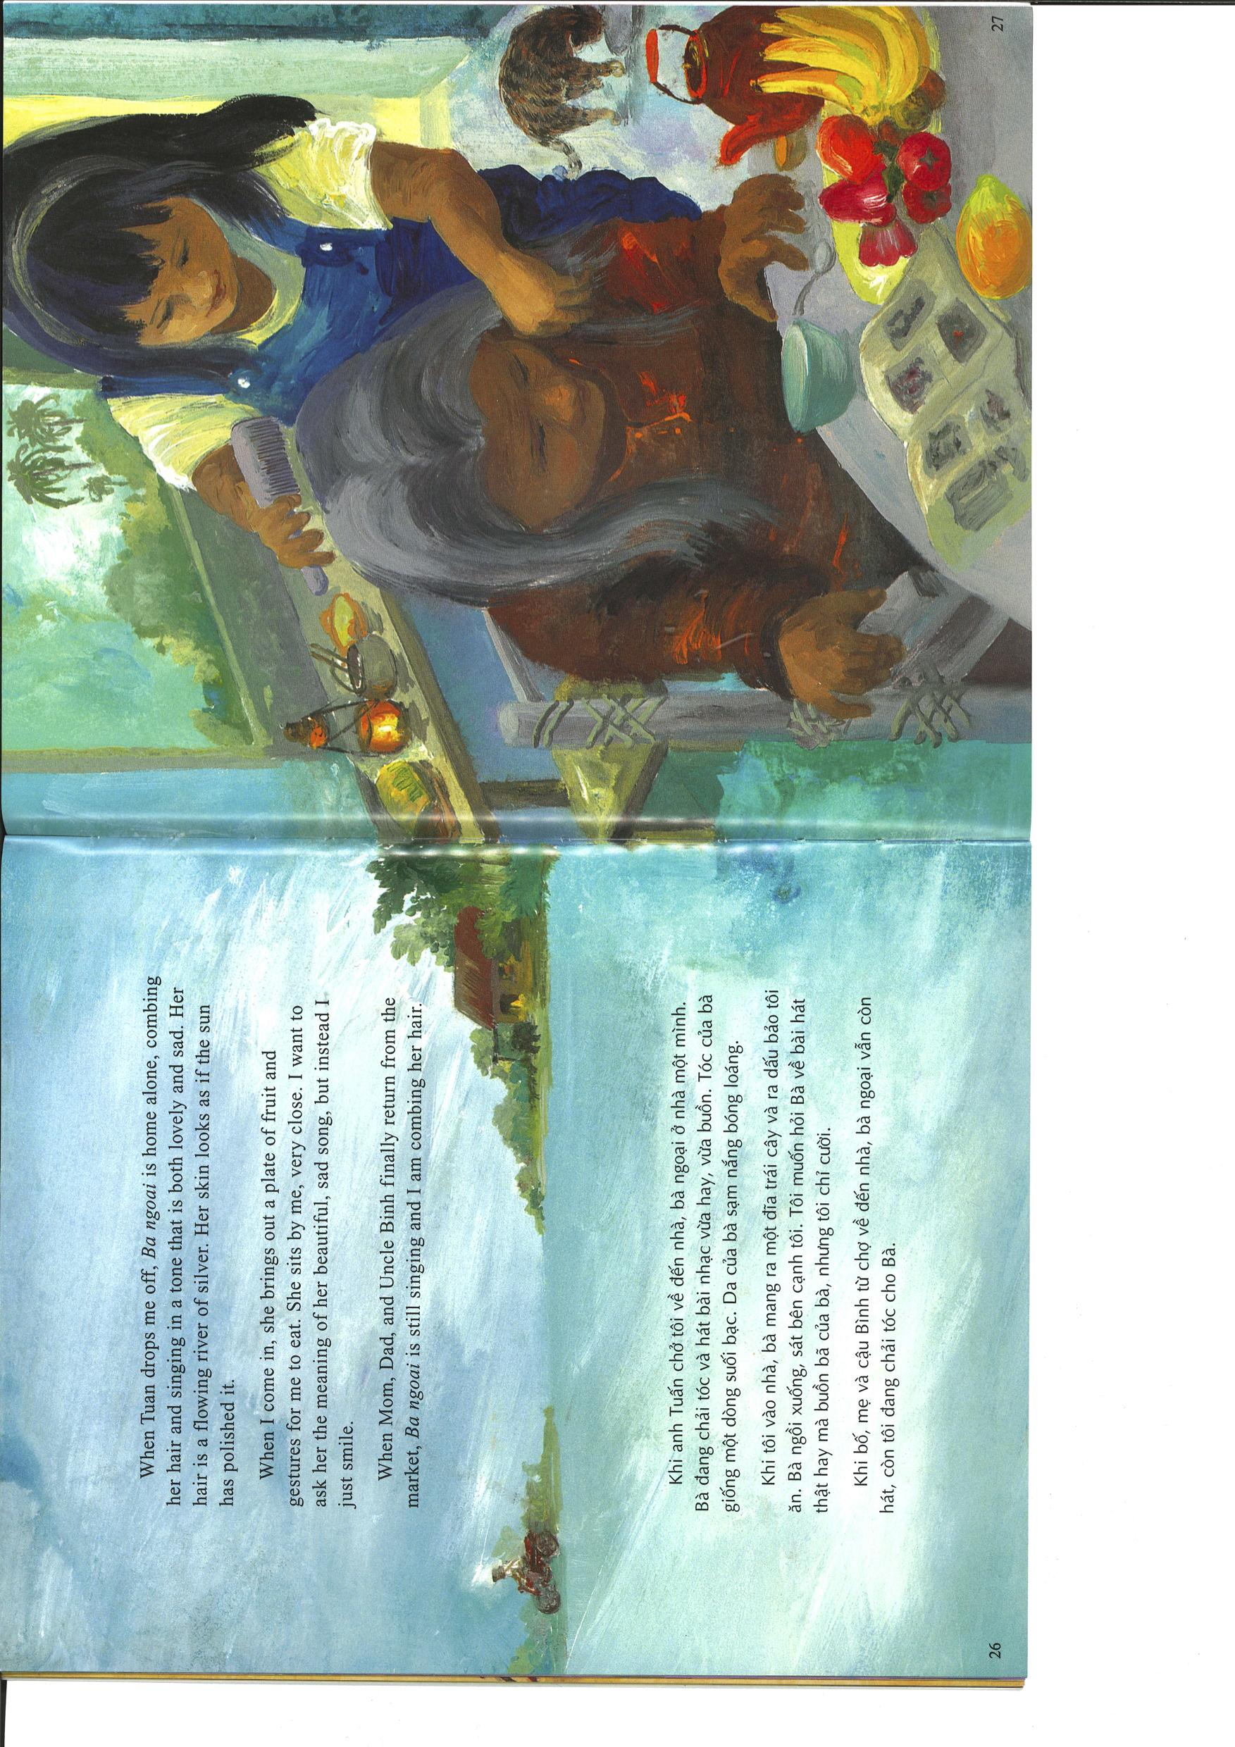

Slide 6
