Slide 1
Popham Beach Caption
Writing Week 4, Day 4

Slide 2
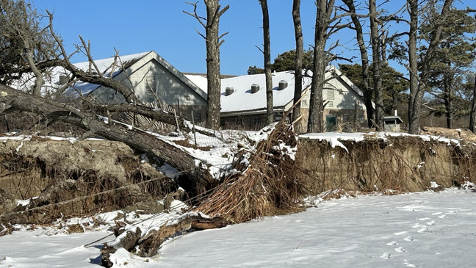
Notes:
Thompson Island, Boston

Slide 3
What is this landform’s name?
Popham Beach
What type of landform is it?
Coastal landform
Where is it located?
Coast of Maine

Slide 4
Possible captions:

Slide 5
Caption:

Slide 6
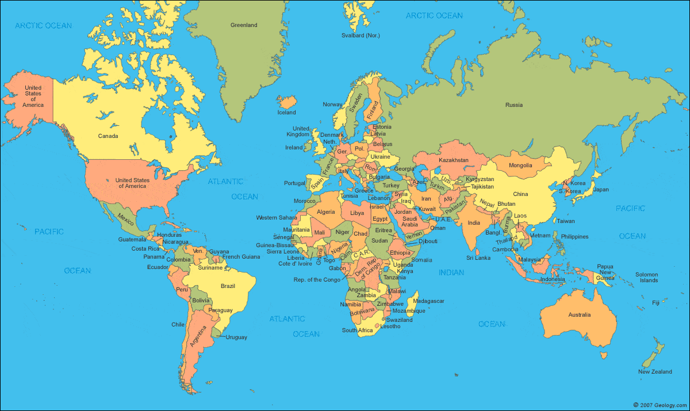

Slide 7
Write a Caption
Review the research information on your Caption Template.
Say out loud one sentence that includes that information.
Write your sentence on page 1 of the Caption Template, under the photograph of your landform.
Draw a star on the world map to show where your landform is located.
Read your sentence.
Does it include adjectives to pack information?
If you need to, revise your sentence by adding more information.

