Slide 1
Yangtze River
Text Talk Week 1, Day 5

Slide 2
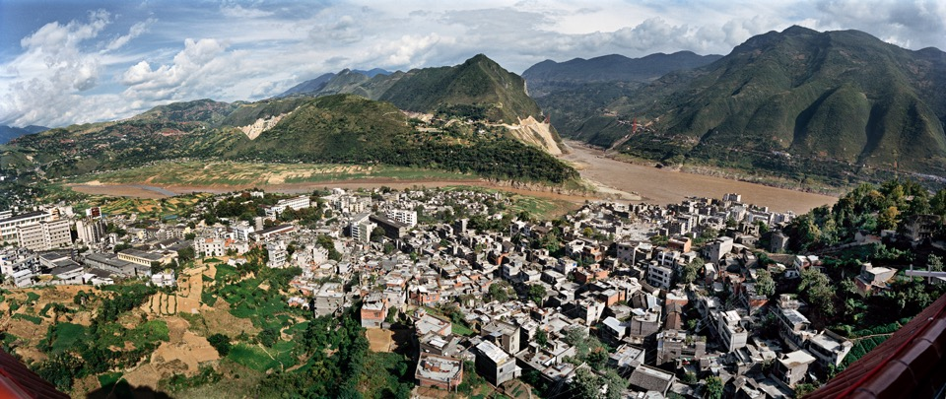
Edward Burtynsky, Wushan #1, Yangtze River, China, 2002
Notes:
Used with special permission from the Office of Edward Burtynsky

Slide 3
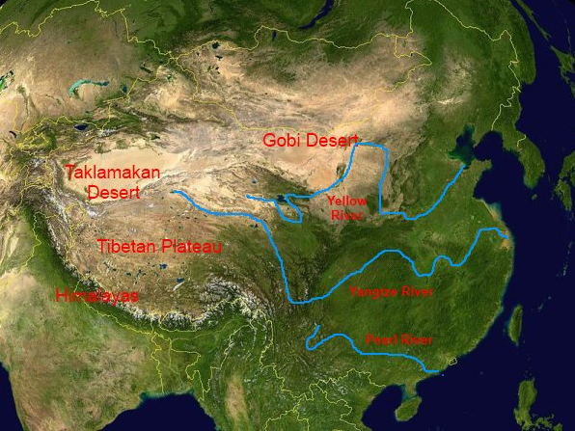

Slide 4
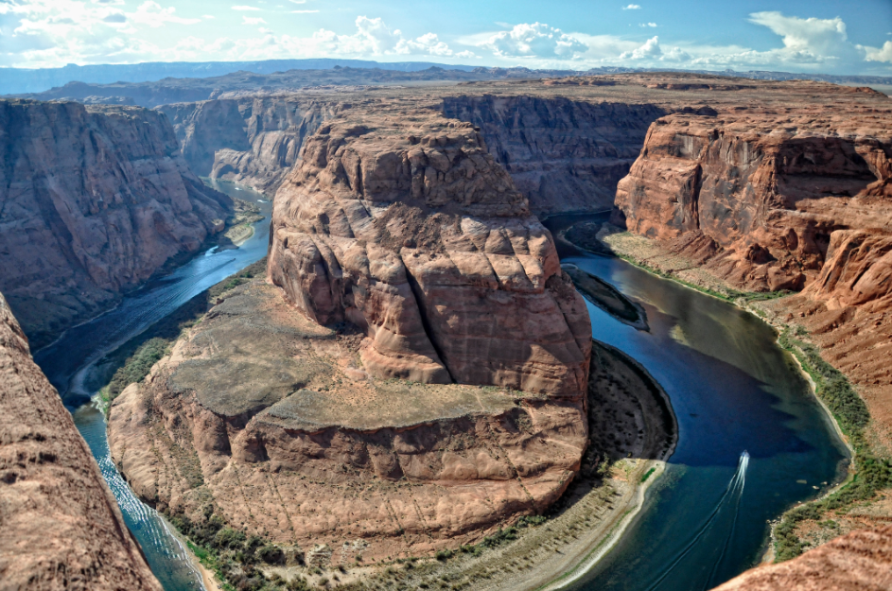

Slide 5
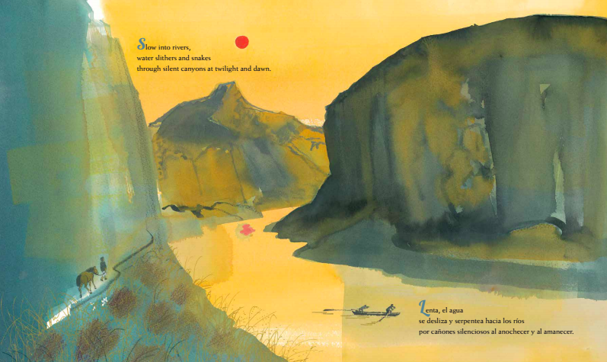

Slide 6
Citations
Slide 2: Used with special permission from the Office of Edward Burtynsky
Slide 3: http://www.china-family-adventure.com/physical-map-of-china.html
Slide 4: https://en.wikipedia.org/wiki/Colorado_River; Used with special permission from the Office of Edward Burtynsky
Slide 5: Meilo So, from Water Rolls Water Rises

