Slide 1
Weekly Words
Unit 2, Week 1
Notes:
area: place or region
cause: to make happen
feature: a part or quality of something
raised: elevated
steep: at a sharp angle
surface: the top layer
surround: to circle around on all sides
wear: to cause to become damaged through long use, friction, or exposure

Slide 2
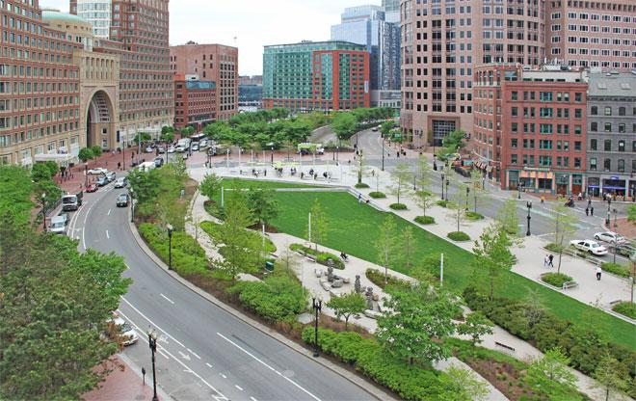
area
noun
place or region
Notes:
area (noun)
Elaboration:
This field and park area is a large and stretches across this city.
Think, Pair, Share prompt:
What is an area of our schoolyard where you like to be? What is special about that area?
https://www.asla.org/guide/site.aspx?id=40674

Slide 3
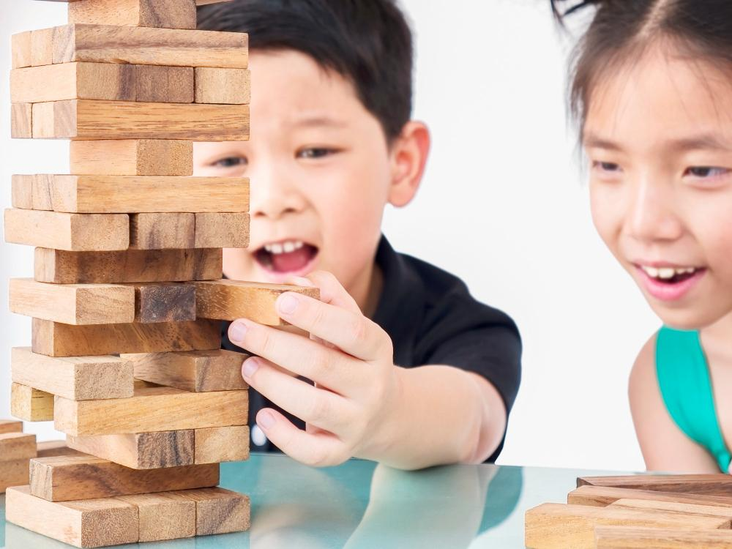
cause
verb
to make happen
Notes:
cause (verb)
Elaboration:
You might know this game—Jenga. Pulling a block out might cause the whole tower to fall down. Players try not to let that happen!
Think, Pair, Share prompt:
What is something that causes you to feel happy?
https://www.freepik.com/free-photo/children-are-playing-jenga-wood-blocks-tower-game_3762448.htm

Slide 4
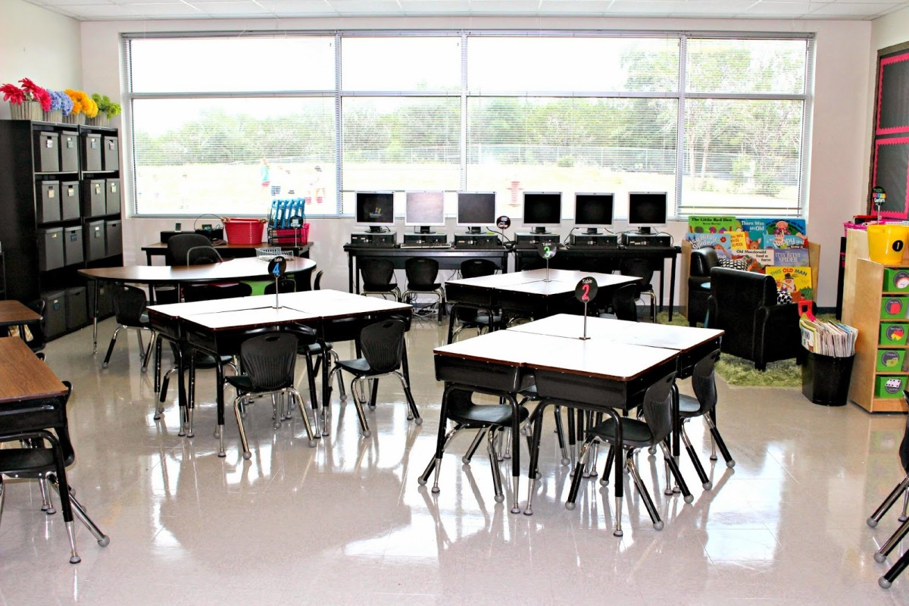
feature
noun
a part or quality of something
Notes:
feature (noun)
Elaboration:
One feature of this classroom is its large windows that let in lots of natural light.
Think, Pair, Share prompt:
What is a feature of our school that you think is positive?
https://www.tunstallsteachingtidbits.com/2014/08/classroom-tour-2014-2015.html

Slide 5
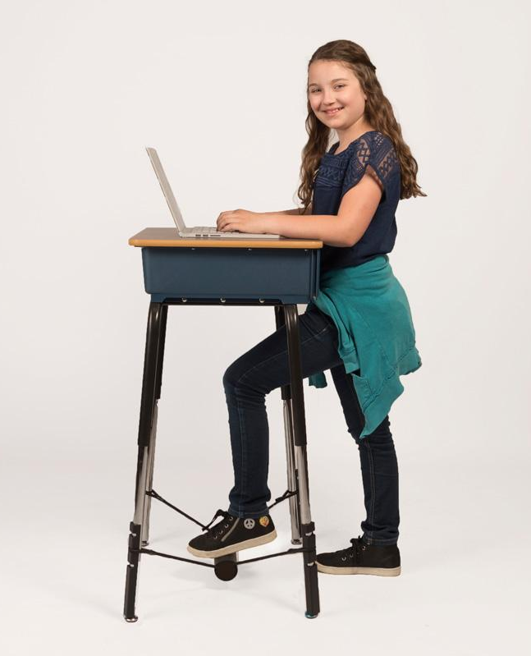
raised
adjective
elevated
Notes:
raised (adjective)
Elaboration:
We learned the verb raise, meaning to go up or to make more. When we add the suffix -ed, we make it an adjective, raised. This picture shows a raised desk; it’s higher, or taller, than a regular desk.
Think, Pair, Share prompt:
Why might someone want to work at a raised table or desk?
https://www.flaghouse.com/Furniture-Storage/Classroom-Furniture/Desks/Standing-Desk-Conversion-Kit-2-0-with-FootFidget---1-diameter-24-long-leg-extension.axd

Slide 6
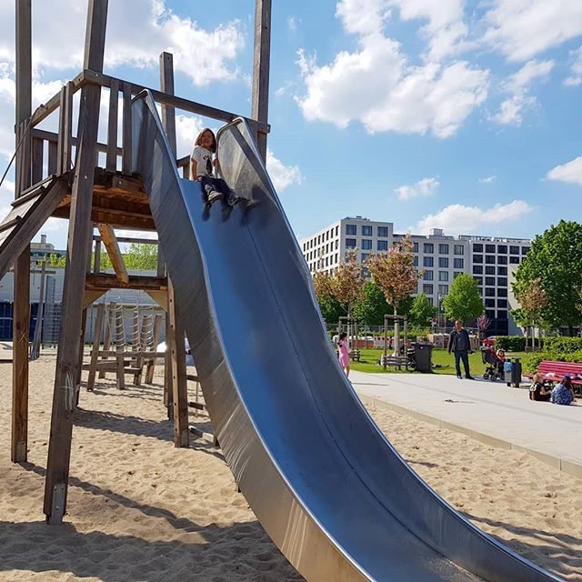
steep
adjective
at a sharp angle
Notes:
steep (adjective)
Elaboration:
What a steep slide! It doesn’t have a low or gentle angle or slope.
Think, Pair, Share prompt:
What does it feel like to walk up a steep hill?
https://www.pinterest.nz/pin/39054721753977339/?amp_client_id=CLIENT_ID(_)&mweb_unauth_id=&simplified=true

Slide 7
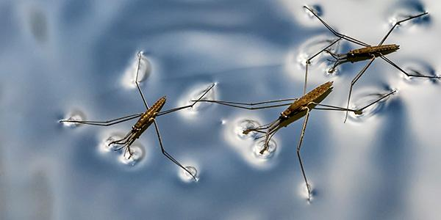
surface
noun
the top layer
Notes:
surface (noun)
Elaboration:
This insect, called a water strider, can stay and move on the surface of the water. It doesn’t sink; it stays right on the top of the water.
Think, Pair, Share prompt:
Put your hand on the surface of something near you [rug, floor, table] and describe it. You can say, “The surface of the _____ feels _____.”
https://www.nwf.org/Educational-Resources/Wildlife-Guide/Invertebrates/Water-Striders

Slide 8
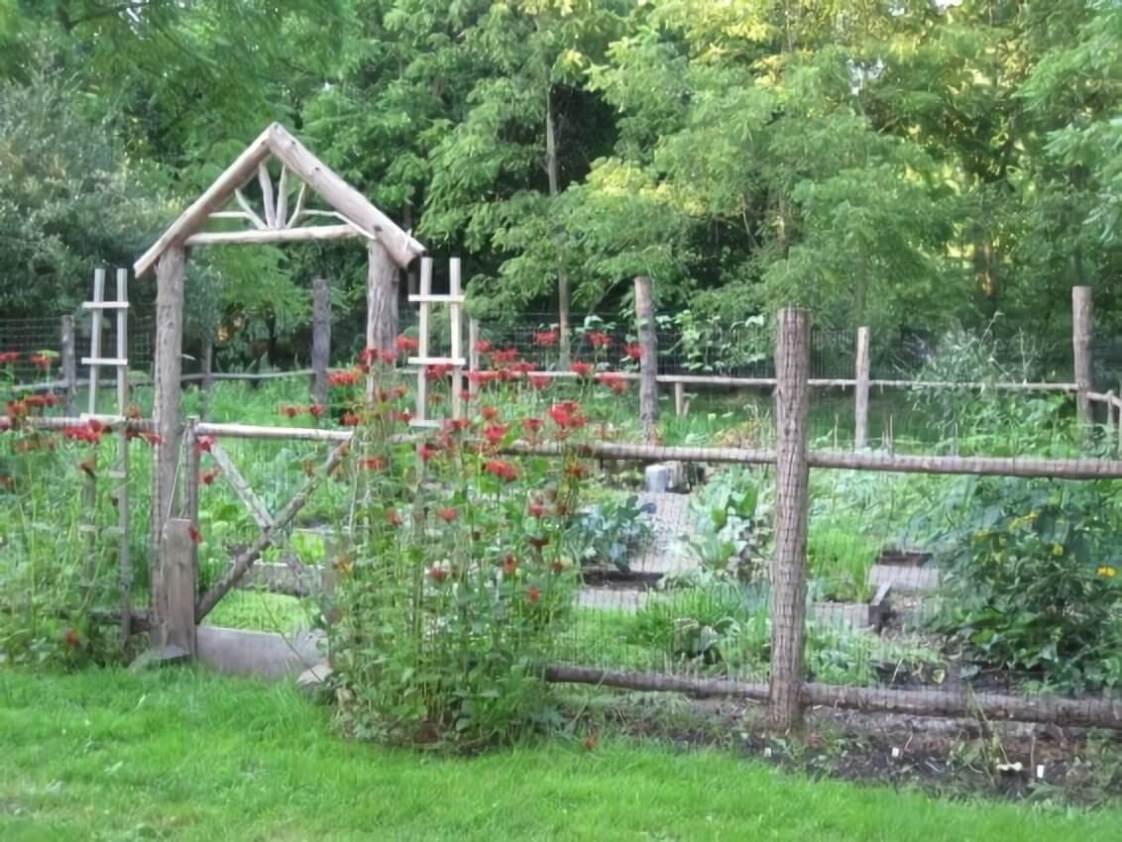
surround
verb
to circle around on all sides
Notes:
surround (verb)
Elaboration:
A fence surrounds a garden. It’s made of wood and wire, it has a gate for people to come in, and it goes all the way around the garden to protect it from animals that might come by to nibble the plants.
Think, Pair, Share prompt:
Think of places where you might find a fence. Why does a fence surround one of those places?
https://enthusiasthome.com/diy-garden-fence-ideas/

Slide 9
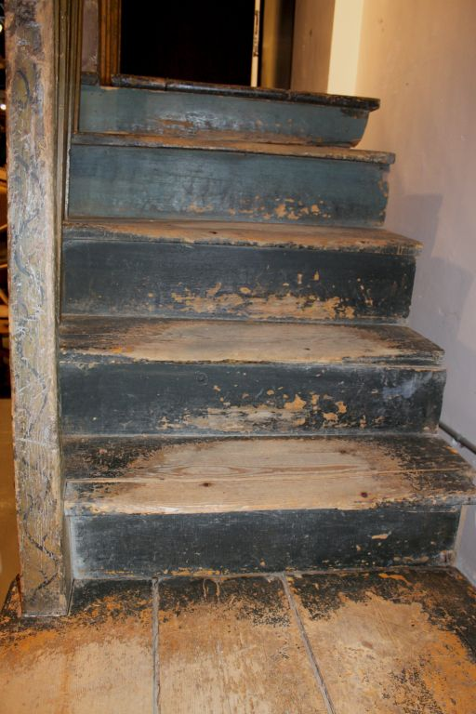
wear
verb
to cause to become damaged through long use, friction, or exposure
Notes:
wear (verb)
Elaboration:
People have been walking up and down these stairs, causing them to wear. We can see that the paint and wood don’t look fresh anymore.
Think, Pair, Share prompt:
What might cause our clothes or shoes to wear?
https://www.pinterest.com/pin/318981586079857600/

