Slide 1
Compound Words
Vocabulary & Language Week 1, Days 3-4

Slide 2
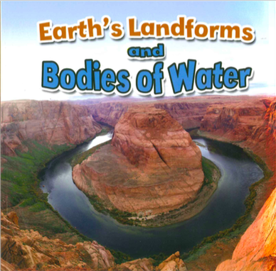
Compound Words
Compound words are made when two or more words are put together to form a word with a new meaning.

Slide 3
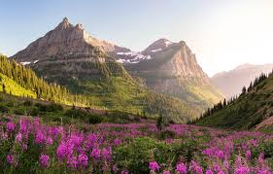
landform
land form
Notes:
https://sciencing.com/4-main-types-landforms-8072044.html

Slide 4
landform
a feature of the Earth’s surface, how the land is shaped
Notes:
https://sciencing.com/4-main-types-landforms-8072044.html

Slide 5
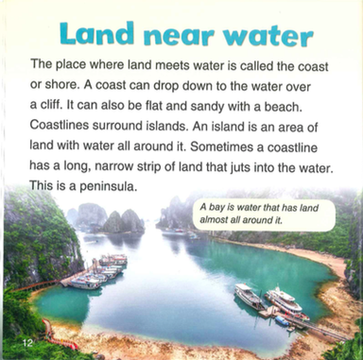


Slide 6
Compound Words
coastline
coast line

Slide 7
Compound Words
sometimes
some times

Slide 8
Compound Words
Remember, compound words are made when two or more words are put together to form a word with a new meaning.

Slide 9
Compound Words
Today you will write 3 compound words.
You can use the words below to get started, or you can write your own words.
foot | basket | ball | print | base | street
flower | sun | moon | light | shine | where
no | some | in | out | side

Slide 10
Compound Words
After you write your compound words, tell them to a partner.
Show and read your first word.
Say what the first part of the compound word means.
Say what the second part of the compound word means.
Say what the compound word means.
Repeat Steps 1-4 for your other two words.

