Slide 1


End of Unit 1 Assessment
Week 8, Day 1

Slide 2



Slide 3
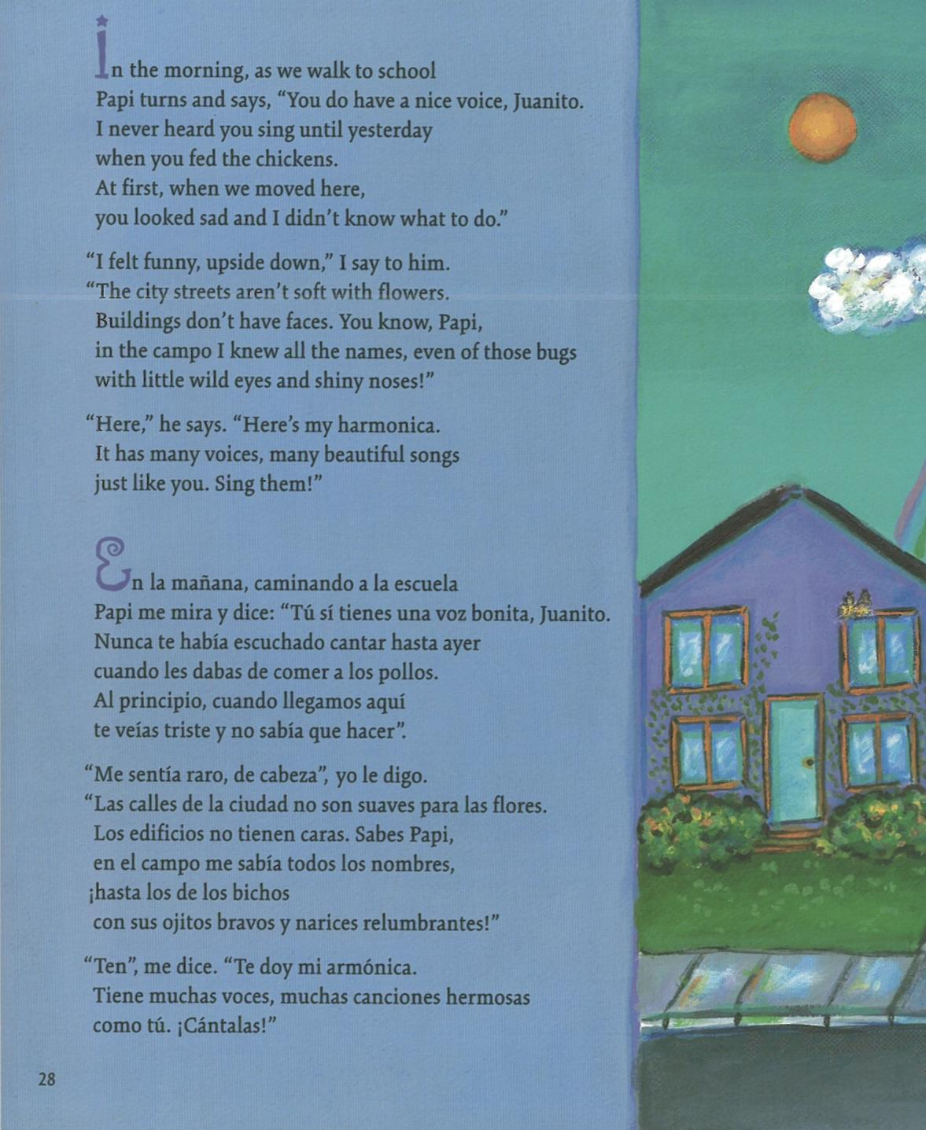
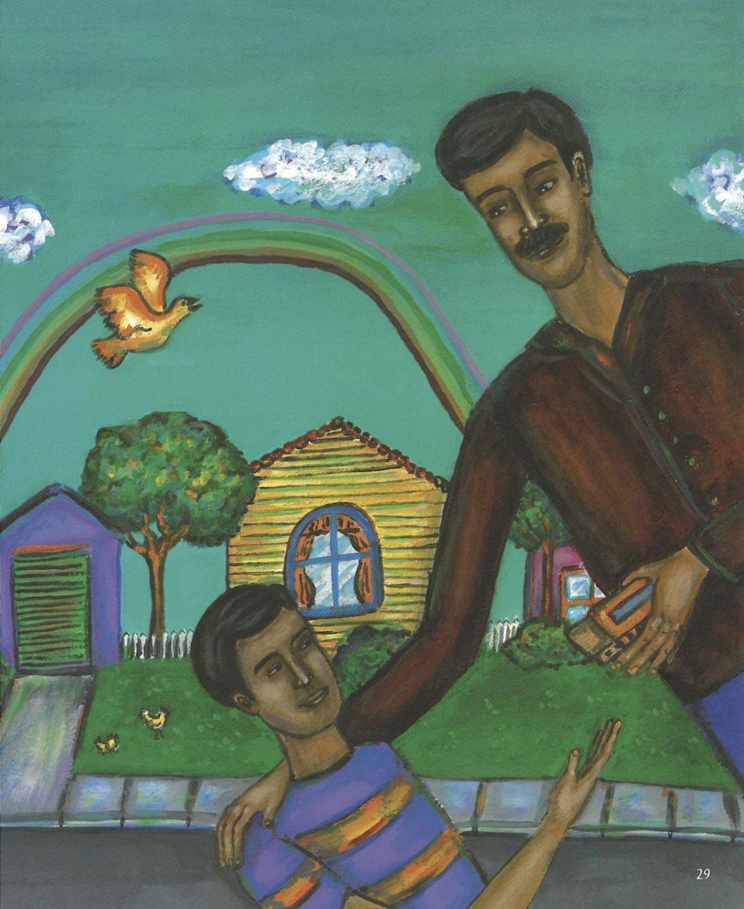

Slide 4



