Slide 1
Weekly Words
Unit 1, Week 7
Notes:
clever: quick to understand
contribute: to give to help achieve a goal
leader: a person who leads a group
recognize: to identify, from having seen someone or something before
resolve: to find a solution
responsibility: duty or task that a person has to do, that others count on them to do
simplify: to make something easier, less complicated
trait: a quality or characteristic that distinguishes one from another

Slide 2
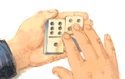
clever
adjective
quick to understand
Notes:
clever (adjective)
Elaboration:
Louis Braille was so clever in coming up with ways to understand the world, even with his disability of blindness.
Think, Pair, Share prompt:
What other clever characters have we met in books so far this year? What makes you say they are clever?
From Six Dots: A Story of Young Louis Braille, illustration by Boris Kulikov

Slide 3
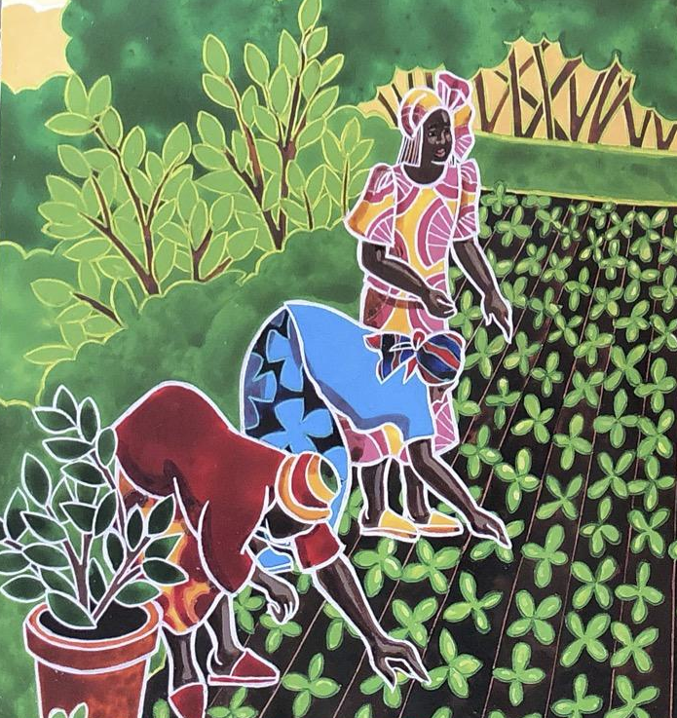
contribute
verb
to give to help achieve a goal
Notes:
contribute (verb)
Elaboration:
Julius Rosenwald contributed to building schools for Black communities in the 1800s, and the communities contributed, too.
Think, Pair, Share prompt:
What have women in Wangari Maathai’s community contributed to their country, Kenya, and the world?
From Seeds of Change: Planting a Path to Peace, illustration by Sonia Lynn Sadler

Slide 4
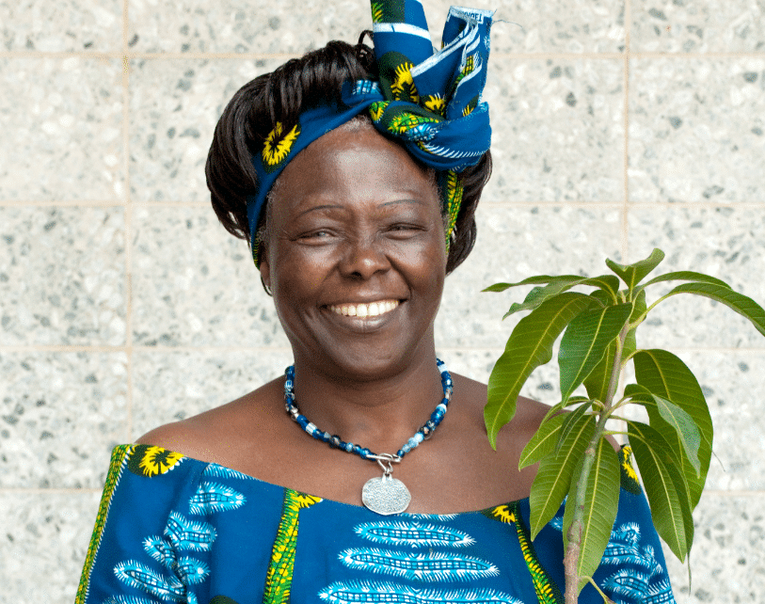
leader
noun
a person who leads a group
Notes:
leader (noun)
Elaboration:
Wangari Maathai is one kind of leader—she led a community to act on an important idea.
Think, Pair, Share prompt:
What other kinds of leaders do you know?
https://littlesun.org/celebrating-wangari-maathai-and-her-tree-planting-movement/

Slide 5
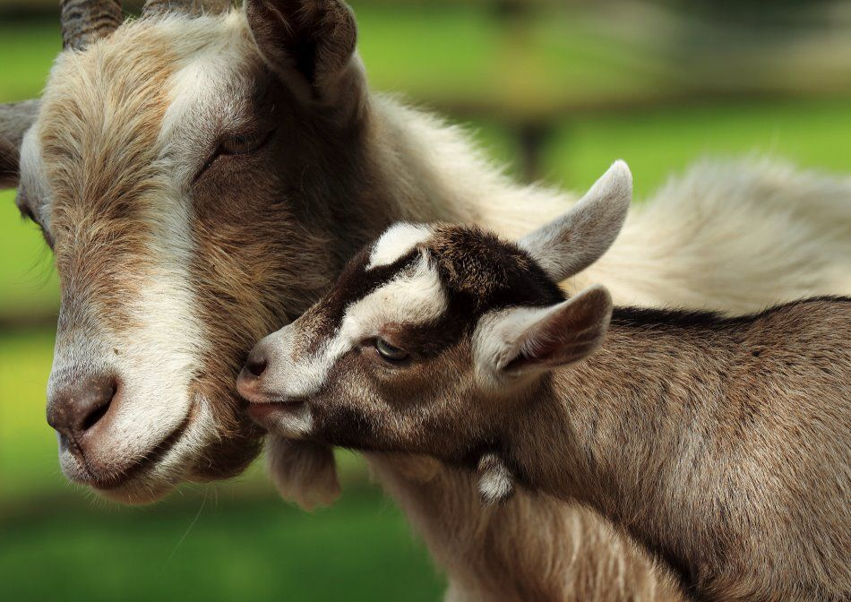
recognize
verb
to identify, from having seen someone or something before
Notes:
recognize (verb)
Elaboration:
This young kid goat and its mother recognize each other by sight and also by voice.
Think, Pair, Share prompt:
What qualities helps us recognize someone as a leader?
https://www.livescience.com/21057-goats-remember-kids-voices.html

Slide 6
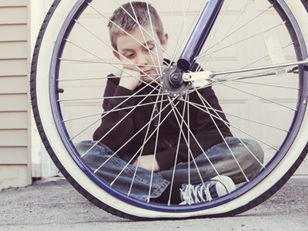
resolve
verb
to find a solution
Notes:
resolve (verb)
Elaboration:
All day long, every day, we work to resolve big and small challenges or problems—with materials, how things work, disagreements.
Think, Pair, Share prompt:
What should this child do first to start to resolve the problem of the flat tire? Then what?
https://bicycle.kendatire.com/vi-vn/tin-t%E1%BB%A9c/bicycle-news/tire-expert-flat-tires/

Slide 7
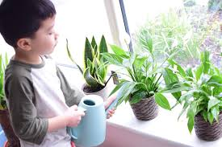
responsibility
noun
duty or task that a person has to do, that others count on them to do
Notes:
responsibility (noun)
Elaboration:
When people take care of their responsibilities, their communities work better.
Think, Pair, Share prompt:
Quickly with your partner, take turns naming as many of your own responsibilities as you can. They can be in or out of school responsibilities. Go!
https://www.pinayhomeschooler.com/2019/01/montessori-practical-life-indoor-plant.html

Slide 8

simplify
verb
to make something easier, less complicated
Notes:
simplify (verb)
Elaboration:
If you can’t figure out what to do, you can ask someone to simplify the directions, to not have so many steps for getting it done.
Think, Pair, Share prompt:
When you are working on a complicated task, what can you do to simplify it?
https://stockton.edu/general-studies/disability-studies-minor.html

Slide 9
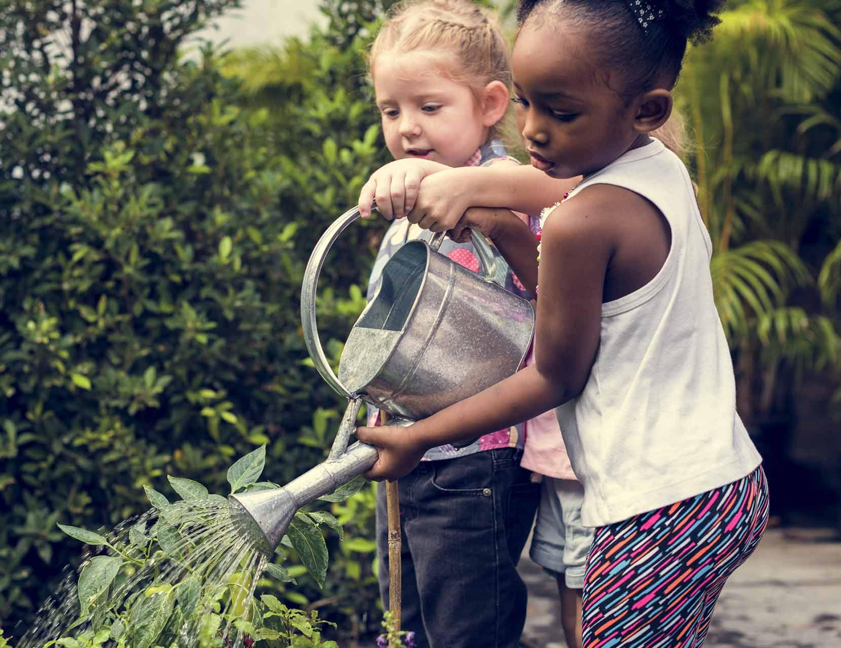
trait
noun
a quality or characteristic that distinguishes one from another
Notes:
trait (noun)
Elaboration:
The characters we meet in our texts have traits that help move the story along. Sympathetic, understanding, compassionate, and clever are traits we have seen. These children are helpful; that’s also a trait.
Think, Pair, Share prompt:
What would you say are three of your most important traits? Take turns with your partner. You can say, “One of my traits is _____.”
Or:
Tell your partner a trait that you notice and appreciate about them. You can say, “One trait I like about you is _____.”
https://penfieldbuildingblocks.org/health-and-wellness/planting-a-kid-friendly-garden/

