Slide 1
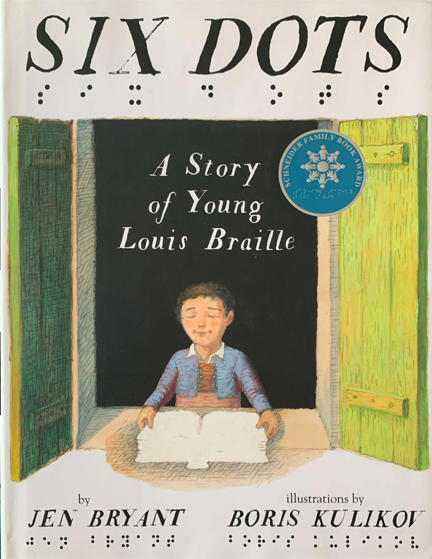
Six Dots: A Story of Young Louis Braille
excerpt
Text Talk Week 7, Day 4

Slide 2
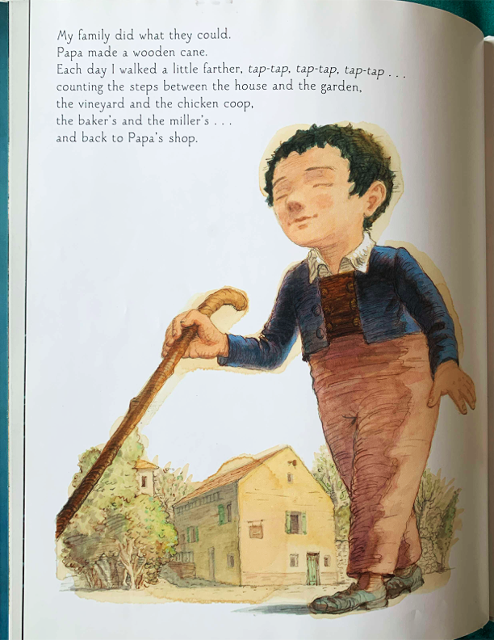
My family did what they could.
Papa made a wooden cane.
Each day I walked a little farther, tap-tap,
tap-tap, tap-tap…
counting the steps between the house and
the garden,
the vineyard and the chicken coop,
the baker’s and the miller’s…
And back to Papa’s shop.

Slide 3
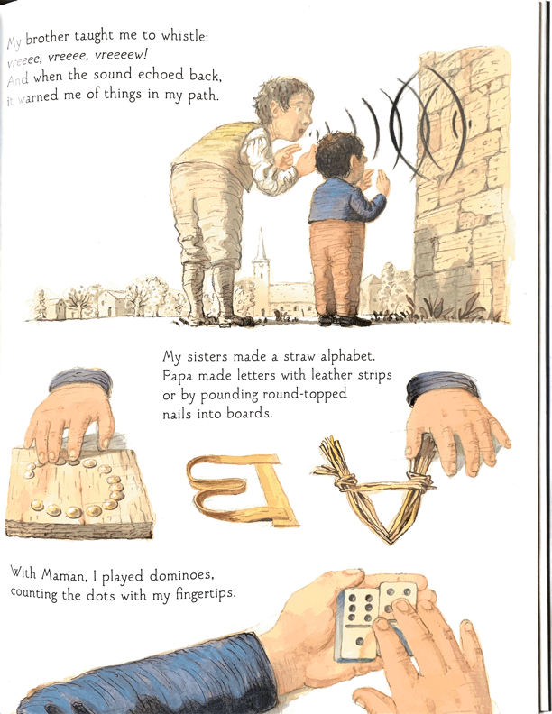
My brother taught me to whistle:
vreeee, vreeee, vreeeew!
And when the sound echoed back,
It warned me of things in my path.
My sisters made a straw alphabet.
Papa made letters with leather strips or by pounding round-topped
nails into boards.
With Maman, I played dominoes,
counting the dots with my fingertips.

Slide 4
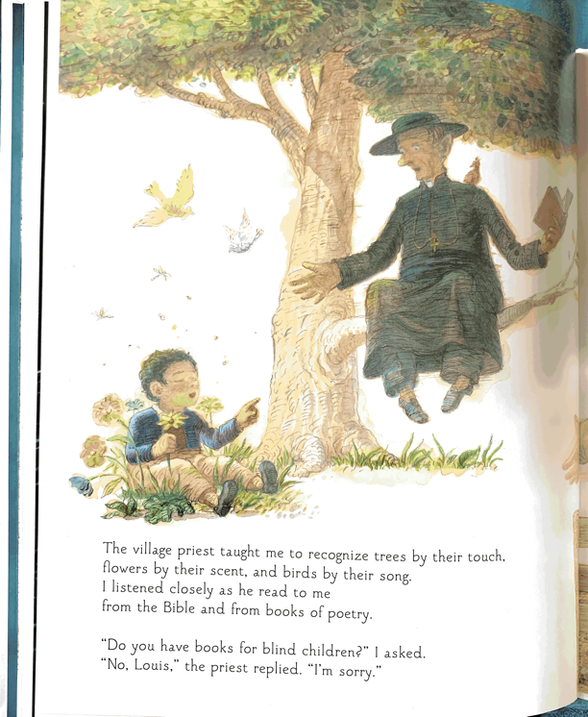
The village priest taught me to recognize
trees by their touch,
flowers by their scent, and birds by their song.
I listened closely as he read to me
from the Bible and from books of poetry.
“Do you have books for blind children?” I asked.
“No, Louis,” the priest replied. “I’m sorry.”

Slide 5
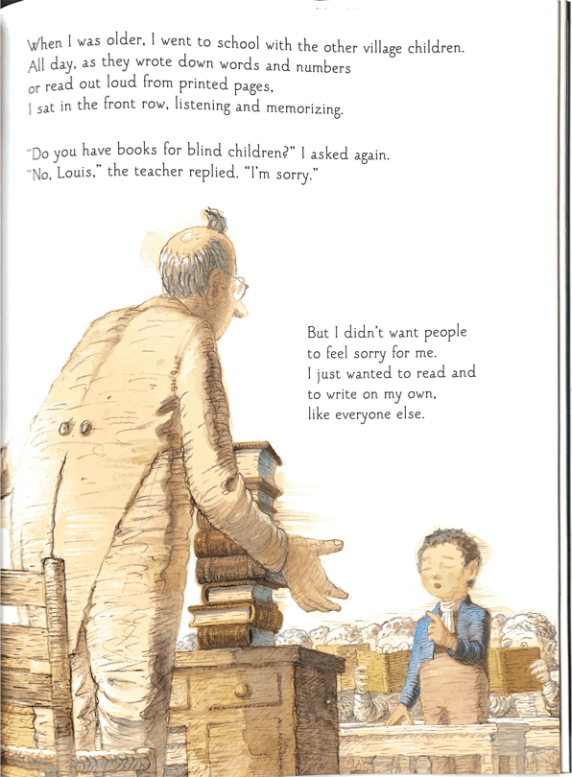
When I was older, I went to school with the other
village children.
All day, as they wrote down words and numbers
or read out loud from printed pages,
I sat in the front row, listening and memorizing.
“Do you have books for blind children?” I asked again.
“No, Louis,” the teacher replied. “I’m sorry.”
But I didn’t want people
to feel sorry for me.
I just wanted to read and
to write on my own,
like everyone else.

Slide 6
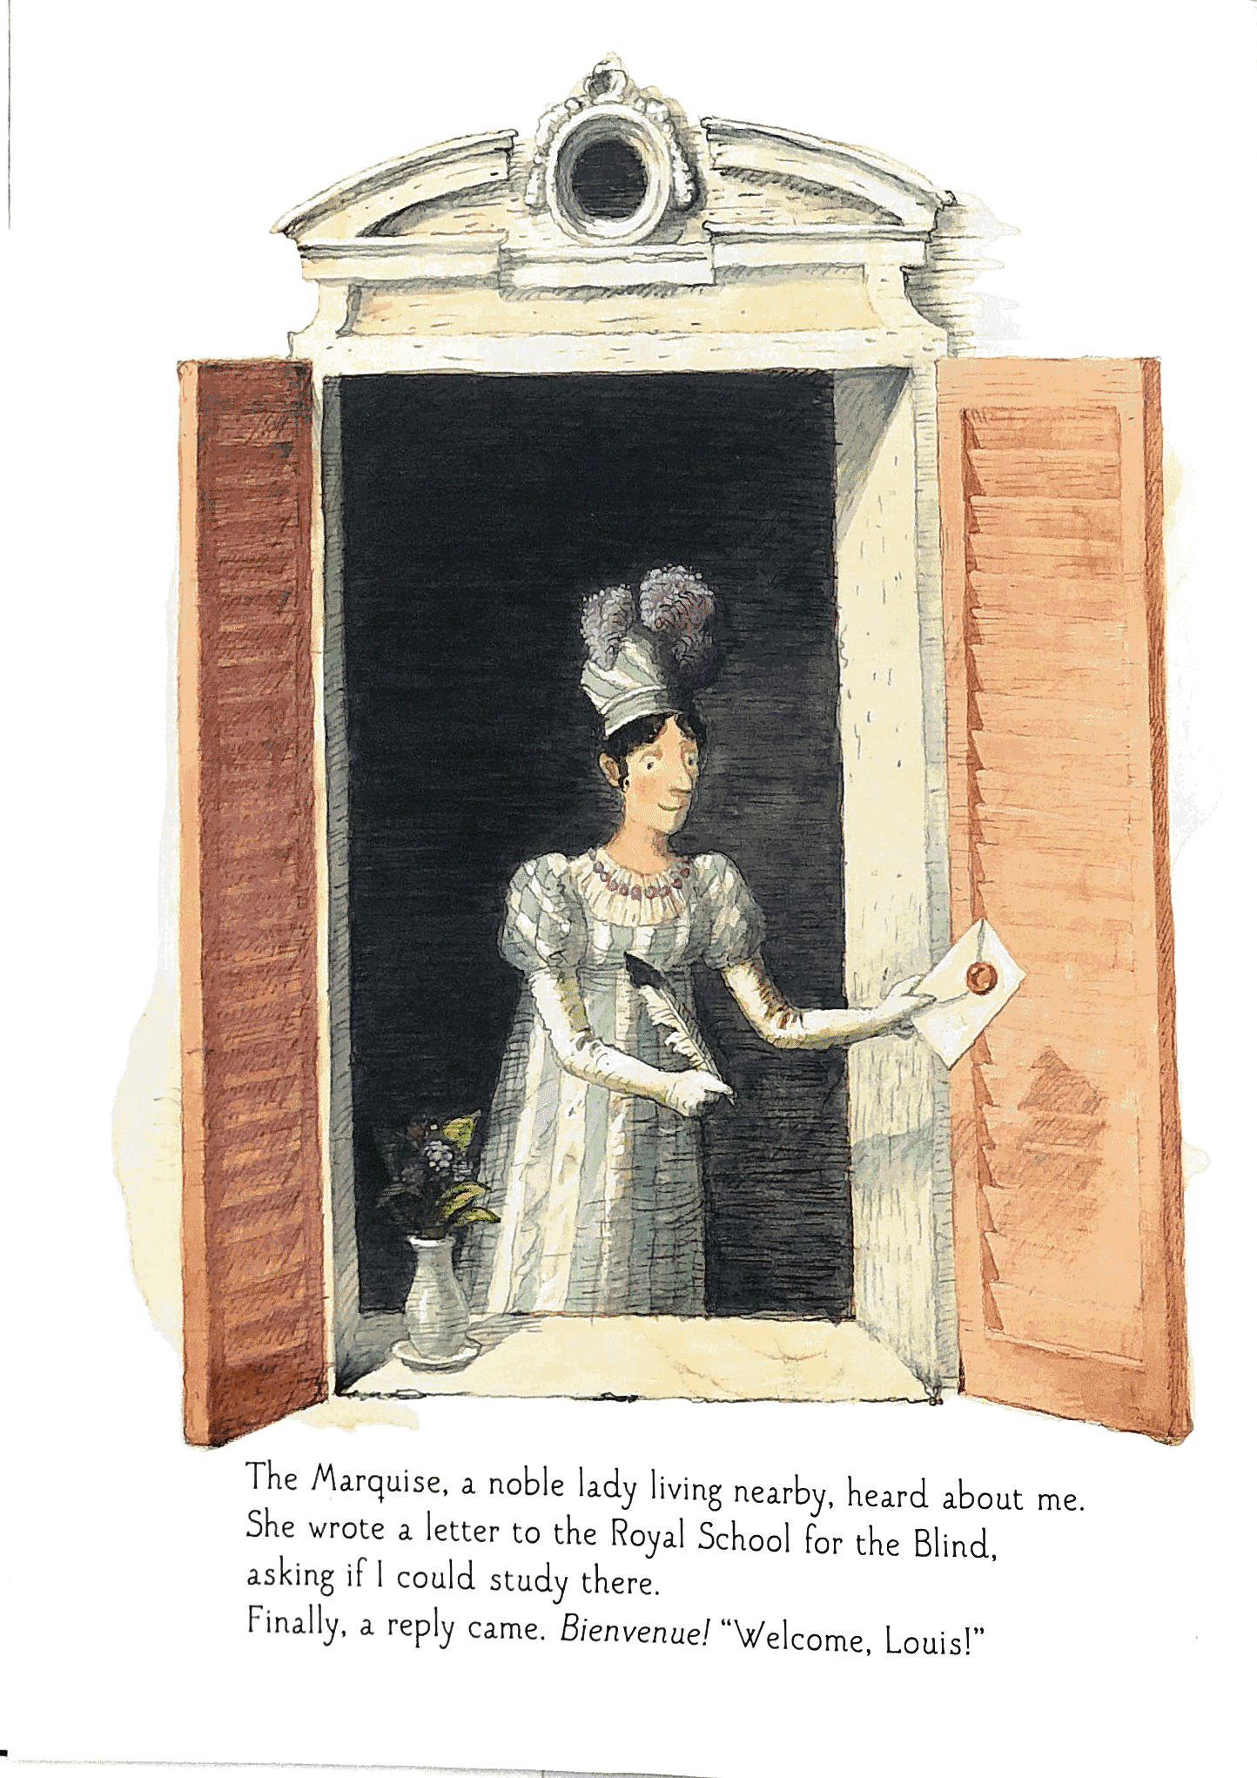
The Marquise, a noble lady living nearby, heard
about me.
She wrote a letter to the Royal School for the Blind,
asking if I could study there.
Finally, a reply came. Bienvenue! “Welcome, Louis!”

Slide 7
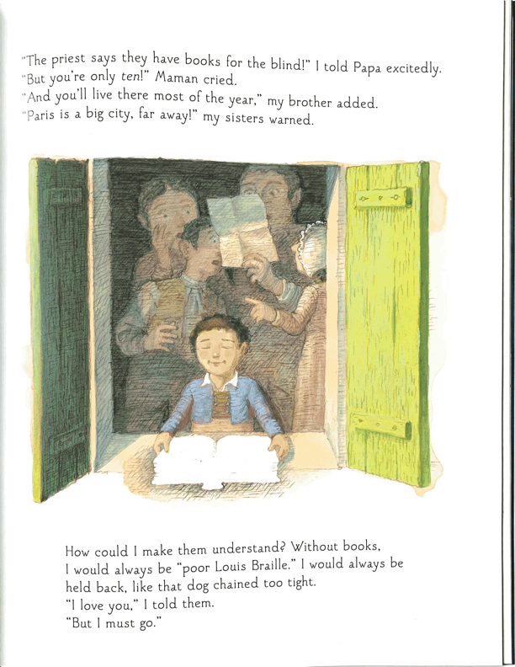
“The priest says they have books for the blind!” I told
Papa excitedly.
“But you’re only ten!” Maman cried.
“And you’ll live there most of the year,” my brother
added.
“Paris is a big city, far away!” my sisters warned.
How could I make them understand? Without books,
I would always be “poor Louis Braille.” I would always be held back, like that dog chained too tight.
“I love you,” I told them.
“But I must go.”

