Slide 1
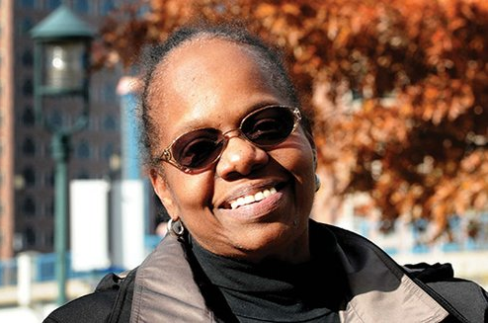
Slide 1
JERI ROBINSON
A Leader in Education
This text talk lesson is about a leader on the Boston School Committee. You can use these slides OR you can replace the slides about someone in your community.

Slide 2
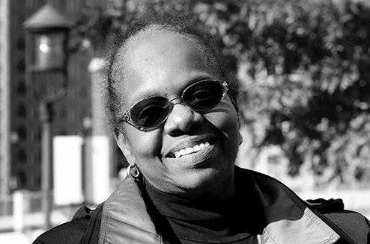
Slide 2
Look at this person.

Slide 3
Slide 3
Her name is Jeri Robinson.
She is an important person to children in Boston.

Slide 4
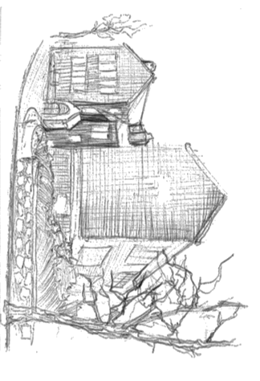
Slide 4
Jeri has lived in Boston her whole life. When she was a child, she attended the Nathan Hale School, a public school in Roxbury.

Slide 5
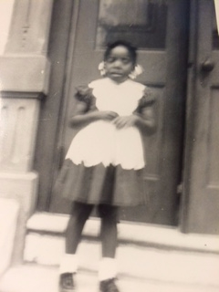
Slide 5
“I thought it was the best school in the whole world.”
Jeri on her first day of kindergarten

Slide 6
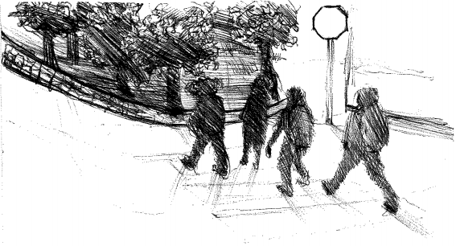
Slide 6
“The Nathan Hale was only across the street and up the hill from where I lived, so I could walk to school every day. On some days, because my teachers used to come to school on the bus, I would wait outside my house for my teachers to come up the street from the bus stop, and I would walk up the street to school with them in the morning.”

Slide 7
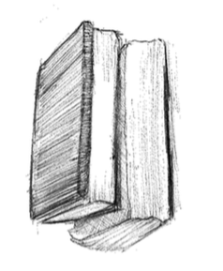
Slide 7
In second grade, Jeri’s favorite subjects were math and reading.
“We learned a lot of poetry. In those days we didn’t have a lot of homework, but the two things we consistently had were spelling words and poems. So we learned lots and lots of poetry.”

Slide 8
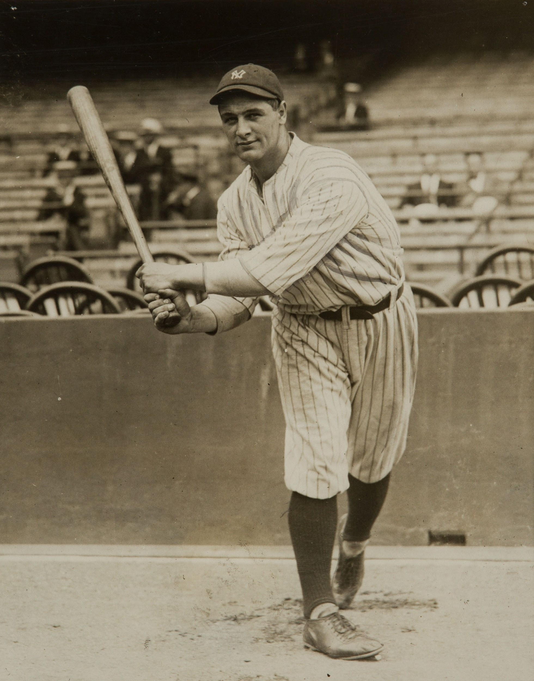
Slide 8
“My favorite book to read in the second grade was a book about Lou Gehrig, who was a baseball player. And the reason I liked that book was that he was left-handed and I am left-handed.”

Slide 9
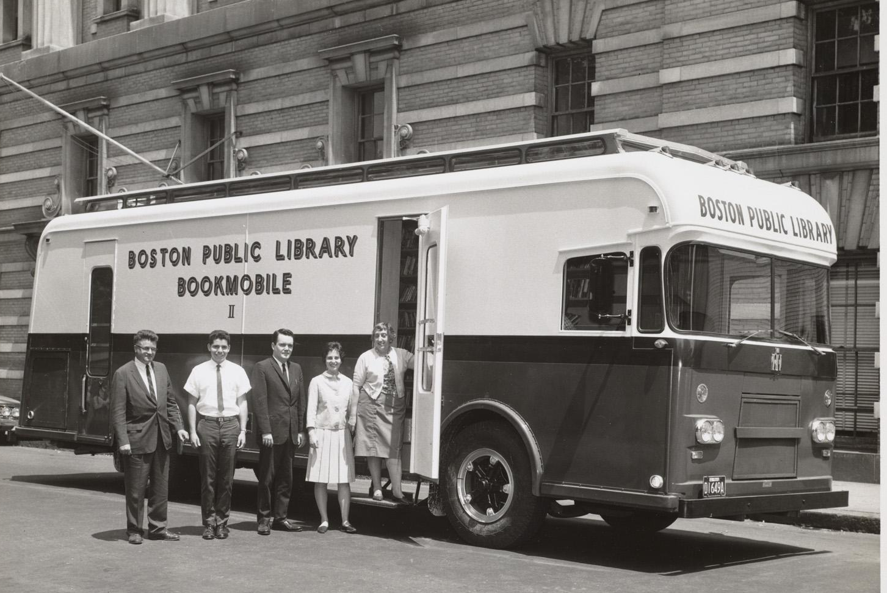
Slide 9
“Because we were a small school, there were lots of things we didn’t have in our school. The Nathan Hale did not have a lunchroom; it did not have an auditorium; but it had a big hall upstairs. So we would get together and have music out in the hallway. And sing.”
“We did not have a library in our school, but the bookmobile used to come every week. You could go outside to the bookmobile, and you could take out three books and take them home. And every week you got to bring them back again.”

Slide 10

Slide 10
Everyone participated in the Nathan Hale School community. Adults and students had responsibilities to make sure it was a great place for learning.
“The fifth grade teacher was in charge of the building. When I got to the fifth grade, we acted as the staff of the school. For example, the fifth grade students used to order the milk that got delivered to the school, count out the cartons, and deliver the milk to the classrooms. That was a fifth grade job.”

Slide 11

Slide 11
“If there were notices, then somebody was given the job of taking the notices and going from classroom to classroom. We didn’t have intercoms. Teachers didn’t have cellphones; there was only one phone in the office.
Another job was to sit near the door, so if the doorbell rang, somebody went to answer the doorbell.”
Having responsibilities in school helped students become leaders.

Slide 12
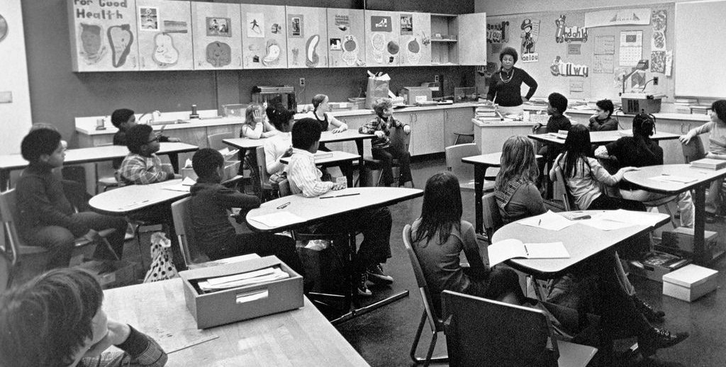
Slide 12
Jeri continued learning all the way through high school.
A Boston classroom in 1973.

Slide 13
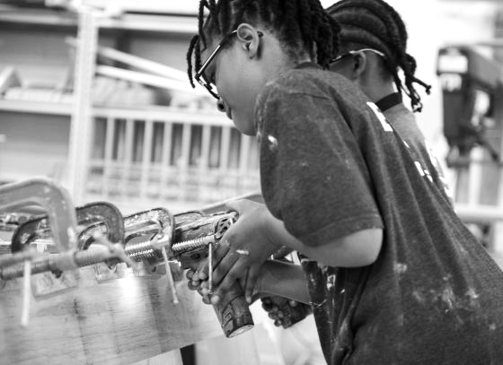
Slide 13
Today, Jeri continues to think about learning for young children. She wants to help children have a wonderful education.
“School is the place you can go to learn. There are so many different kinds of things to learn about in the world, and lots of interesting things you can learn when you do it with lots of people. In school you get to have friends; you get to learn about their families and the things they like to do.”
5th graders learn to build boats in a Coast Guard program.

Slide 14
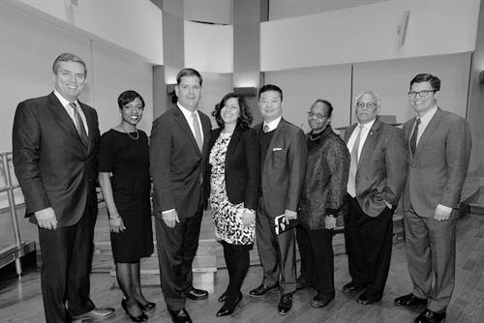
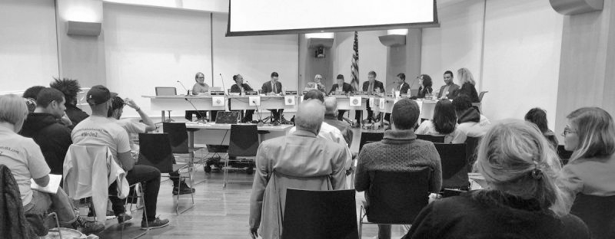
Slide 14
Jeri is a leader in the Boston Public Schools. She works with the Mayor and the Superintendent as a member of the School Committee.

Slide 15
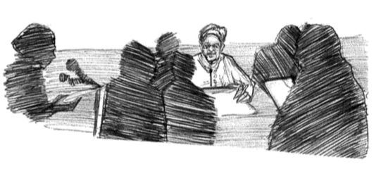
Slide 15
“Our job is to help make decisions about what will happen with schools. We listen to the successful things that are happening; we listen to the complaints and concerns that people have; and we try to help get all of those things resolved.”

Slide 16
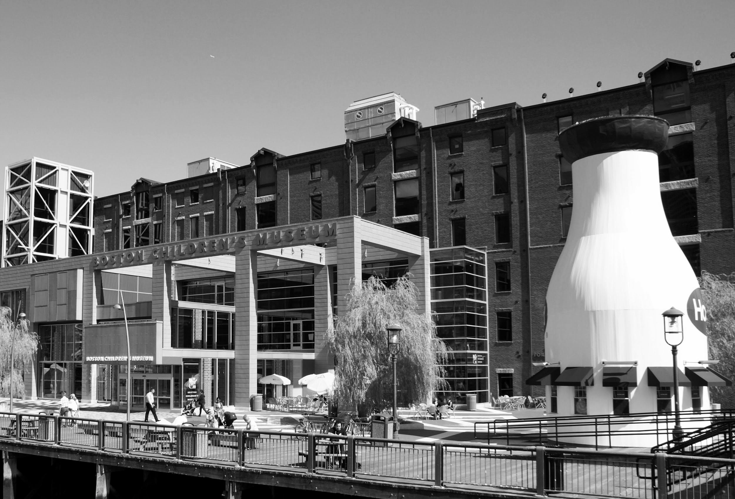
Slide 16
Jeri was also leader at the Boston Children’s Museum.
At the museum, children explore exhibits, interact with materials, and participate in programs. This is another place where children learn.

Slide 17
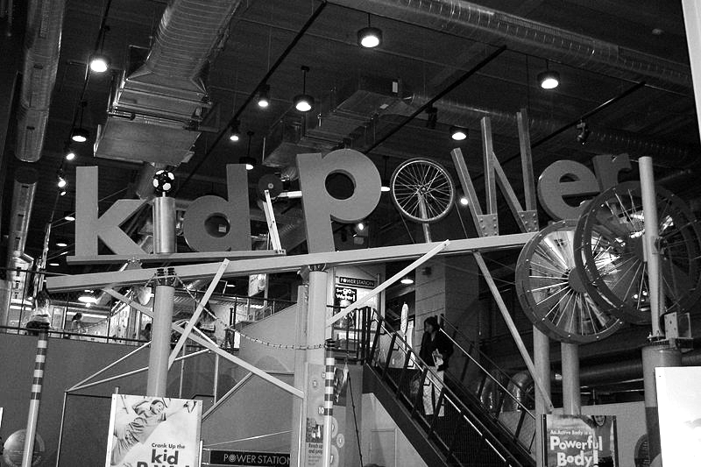
Slide 17
“We want to have lots of different opportunities for kids to explore and learn about the different ways that they learn and the things that they’re interested in.”
Kid Power exhibit at the Boston Children’s Museum

Slide 18
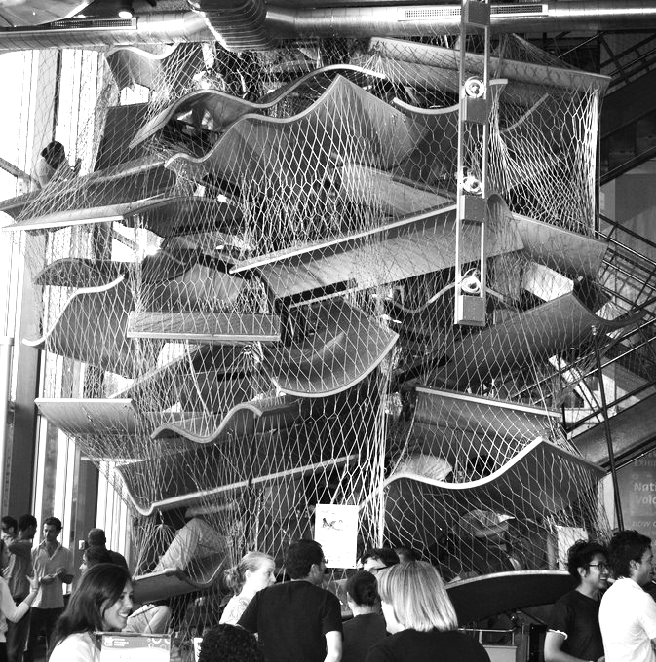
Slide 18
“I am responsible for lots of the different things we do with very young children and their families. I work on exhibits and programs; I try to raise money.”
New Balance Foundation Climb, a play space at the Boston Children’s Museum

Slide 19
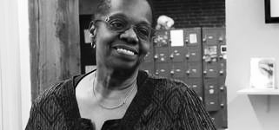
Slide 19
Jeri Robinson’s experiences in school inspired her to become involved with children and their learning.
She is a leader in education.

Slide 20
Citations
slides 1, 2, 3 Jeri Robinson: http://baystatebanner.com/news/2014/nov/19/news-jeri-robinson/
slide 4: illustration by Rosa Booth
slide 5: Jeri Robinson personal collection
slide 6: illustration by Rosa Booth
slide 7: illustration by Rosa Booth
slide 8: Lou Gerhig: https://commons.wikimedia.org/wiki/File:Lou_Gehrig_as_a_new_Yankee_11_Jun_1923.jpg
slide 9: bookmobile: https://www.flickr.com/photos/boston_public_library/5229432227
slide 10: illustration by Rosa Booth
slide 11: doorbell: https://www.google.com/url?sa=i&rct=j&q=&esrc=s&source=images&cd=&ved=0ahUKEwj4lfGvtPrWAhVV0GMKHbogDo0QjBwIBA&url=https%3A%2F%2Fupload.wikimedia.org%2Fwikipedia%2Fcommons%2F1%2F1a%2FDoorbell_%2528Wheaton%252C_MD%2529.jpg&authuser=2&psig=AOvVaw1x8bhnlX5kSuBM1sklEfk7&ust=1508424247184472
slide 12: classroom: https://www.flickr.com/photos/cityofbostonarchives/26819504892
slide 13: fifth graders: http://coastguard.dodlive.mil/2017/01/building-bright-futures-in-boston/
slide 14: School Committee: https://www.bostonpublicschools.org/cms/lib/MA01906464/Centricity/Domain/162/SCGroupPhoto2016.jpg and https://patch.com/massachusetts/boston/boston-school-committee-unanimously-votes-oppose-question-2
slide 15: illustration by Rosa Booth
slide 16: Boston Children’s Museum: https://www.flickr.com/photos/masstravel/7115836379
slide 17: Kid Power: https://commons.wikimedia.org/wiki/File:Kid_Power.JPG
slide 18: New Balance Foundation Climb: https://c1.staticflickr.com/9/8308/7846964502_a9725dda04_b.jpg
slide 19: Jeri Robinson photo: http://worldchannel.org/programs/episode/amgrad-champion-jeri-robinson/

