Slide 1
Words with Multiple Meanings
Vocabulary & Language Week 7, Days 3-4

Slide 2
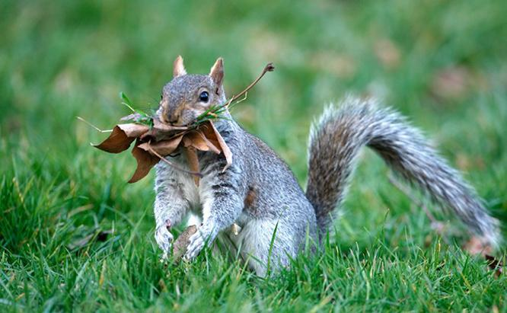
still
adjective
not moving
Notes:
https://www.perkypet.com/articles/squirrel-nests

Slide 3
It has been ten minutes, and it is still not their turn.

Slide 4
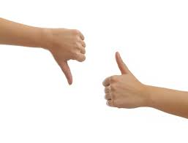
judge
verb
to form a positive or negative opinion about something
Notes:
https://www.houstonchronicle.com/opinion/editorials/article/Thumbs-up-thumbs-down-12295067.php

Slide 5

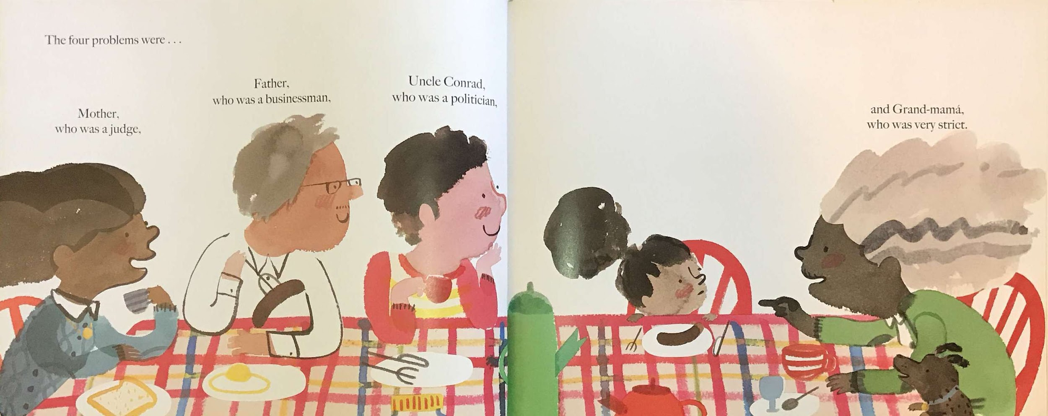

Slide 6
Don’t judge a book by its cover.

Slide 7

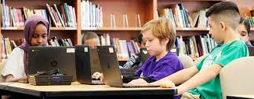
foundation
noun
an organization or institution that offers money to support the work of other organizations or people
Notes:
https://www.ifse.ca/financial-services-needs-female-leaders-next/
https://digitalpromise.org/2019/04/29/equity-in-schools-access-technology/

Slide 8
The foundation will donate 100 tablets.

Slide 9
Words with Multiple Meanings
Choose one of the other words we explored yesterday: still, judge, or foundation.
Write two sentences with that word, one showing each meaning of the word.

