Slide 1
Weekly Words
Unit 1, Week 6
Notes:
activist: someone who advocates and works for change
advocate: to strongly suggest or recommend
audience: an individual or group for whom a piece of writing is composed
data: information collected from experiences and other resources
improve: to make better
investigate: to carry out research to make a discovery
present: to give in a formal way
voice: the right to express one’s opinion

Slide 2
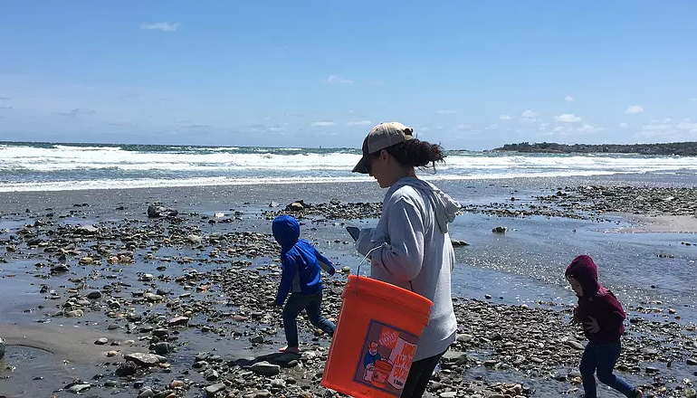
activist
noun
someone who advocates and works for change
Notes:
activist (noun)
Elaboration:
Today during Text Talk we’ll meet two activists: high school students who have ideas about making the world better and more fair.
Think, Pair, Share prompt:
Tell your partner what you already know about activists.
https://fonb-hull.wixsite.com/website

Slide 3
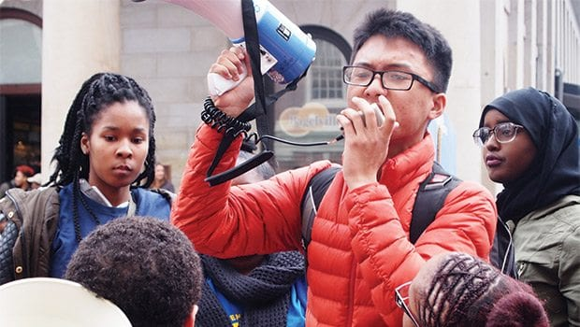
advocate
verb
to strongly suggest or recommend
Notes:
advocate (verb)
Elaboration:
Any time you tell someone, “I think we should do or change this…” you are advocating. This week we are thinking about a change in our school that we want to advocate.
Think, Pair, Share prompt:
Is there something you would like to advocate for where you live? More time to play outside? Reading together every day? A special job you could do with independence?
https://www.baystatebanner.com/2016/03/16/bps-student-walkout-wins-half-victory/

Slide 4
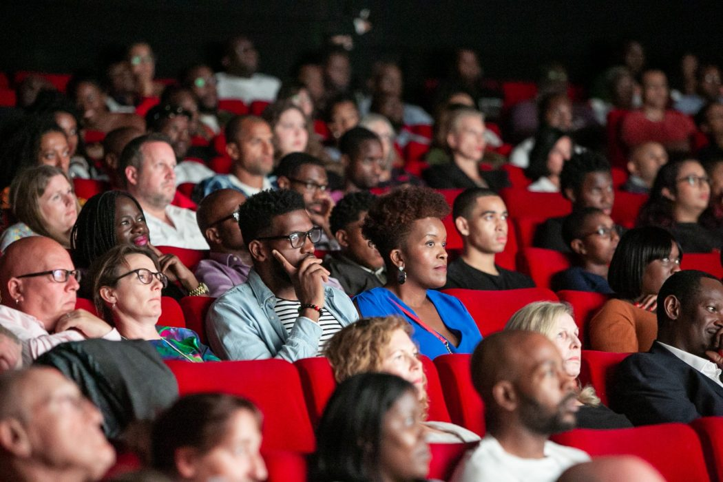
audience
noun
an individual or group for whom a piece of writing is composed or a performance is presented
Notes:
audience (noun)
Elaboration:
This group of people is an audience for… we don’t know! Maybe a presentation, or a reading, or a film, or a dance performance? They look like they are paying attention.
Think, Pair, Share prompt:
In our classroom community, when one person speaks, the rest of us become your audience. What do you expect from us as your audience?
https://www.the-bigger-picture.com/articles/black-audiences-returning-to-cinemas/

Slide 5
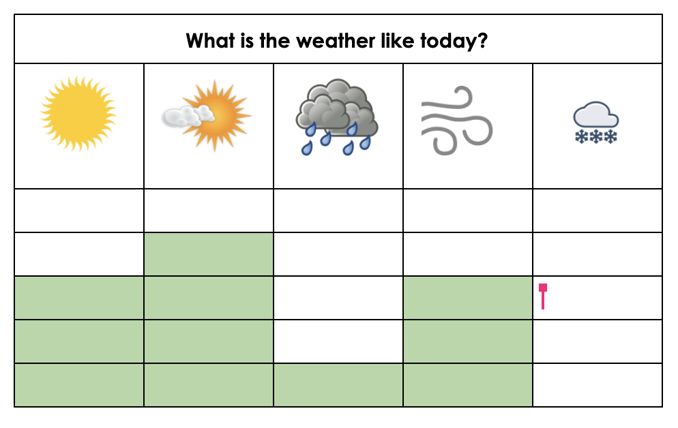
data
noun
information collected from experience and other sources
Notes:
data (noun)
Elaboration:
You will find this word, data, relating to math, to science, to observations. You can collect and record data in many ways. Here is a calendar for recording weather data.
Think, Pair, Share prompt:
Where have we been collecting data so far this year?
created by Ana Vaisenstein

Slide 6

improve
verb
to make better
Notes:
improve (verb)
Elaboration:
One way to get better at, or improve, how we do something is to practice.
Think, Pair, Share prompt:
Think of something you know how to do. Tell your partner one thing you did or might do to improve how you do it.
https://monkeysee.com/how-to-improve-handwriting/

Slide 7
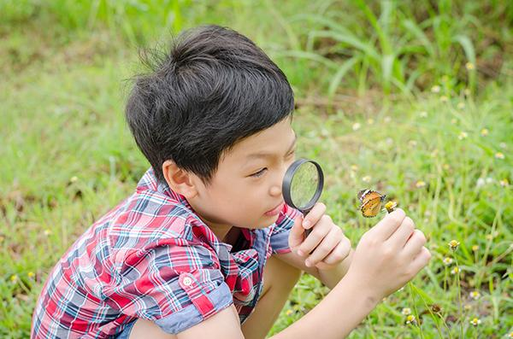
investigate
verb
to carry out research to make a discovery
Notes:
investigate (verb)
Elaboration:
This child is investigating the world outside and has discovered a butterfly! I wonder how they will record what they found in this investigation.
Think, Pair, Share prompt:
What is something you are curious about? What could you do to investigate and find out more about it?
https://paulcholinger.com/discovering-our-childrens-interests/

Slide 8
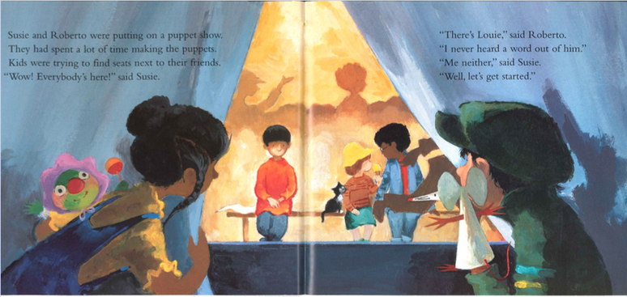
present
verb
to give in a formal way
Notes:
present (verb)
Elaboration:
In the book, Louie’s friends present a puppet show. They let the audience know it’s time to begin, and they perform.
Think, Pair, Share prompt:
Imagine you have a surprise for your partner. Think of what the surprise is. Then act out how you would present it.
From Louie, Ezra Jack Keats

Slide 9
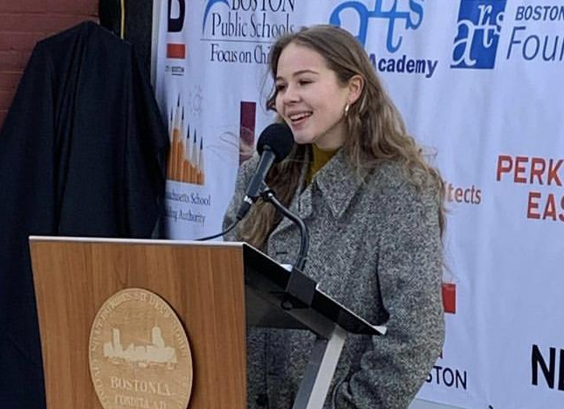
voice
noun
the right to express one’s opinion
Notes:
voice (noun)
Elaboration:
When I speak, you hear my voice.
Voice also means having courage to speak up, to present your opinions or ideas, to advocate for something that is important to you and your community.
Think, Pair, Share prompt:
Tell your partner: What does it mean when people say, “Use your voice!”?
https://www.bostonpublicschools.org/bostonartsacademy

