Slide 1
Adverbs
Vocabulary & Language Week 6, Days 3-4

Slide 2

Adverbs
Adverbs describe verbs by answering questions such as
How?
Where?
When?

Slide 3

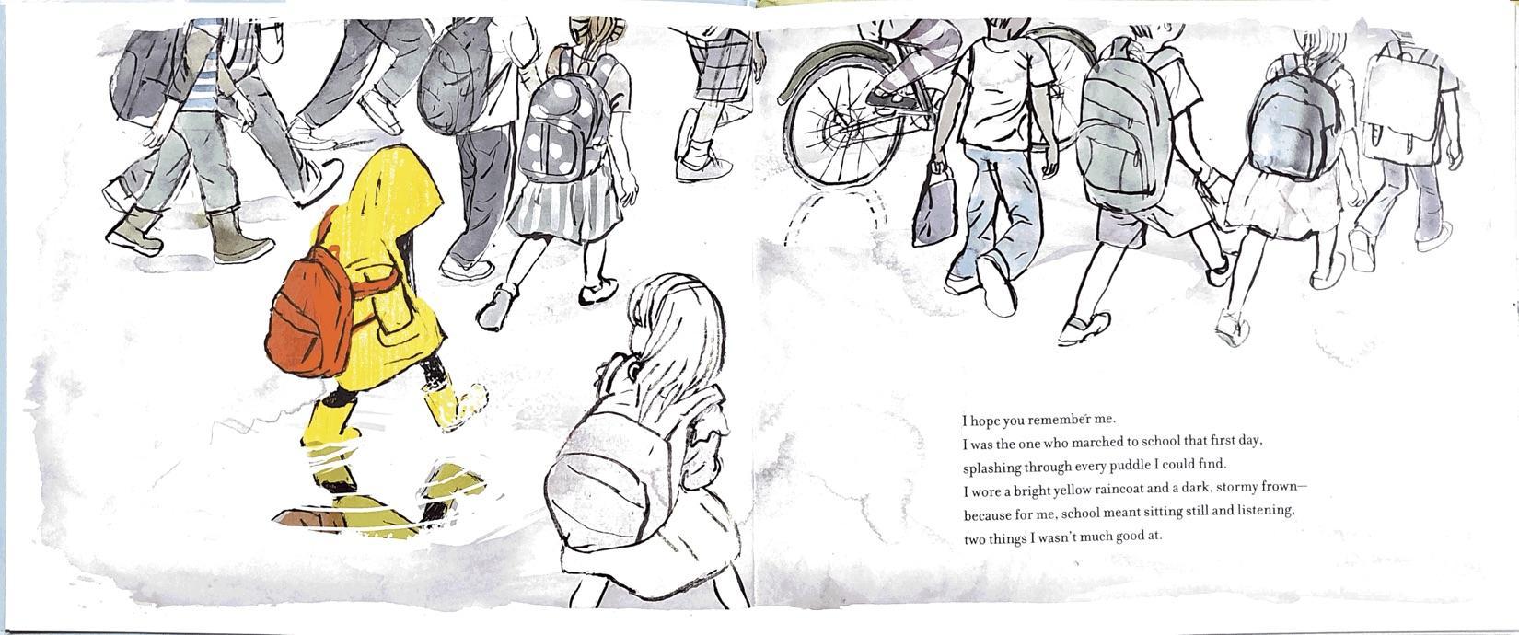

Slide 4
Adverbs
Verb: marched
Where?
to school
I was the one who marched to school that first day, splashing through every puddle I could find.

Slide 5
Adverbs
Verb: marched
When?
that first day
I was the one who marched to school that first day, splashing through every puddle I could find.

Slide 6
Adverbs
Verb: marched
How?
splashing through every puddle I could find
I was the one who marched to school that first day, splashing through every puddle I could find.

Slide 7
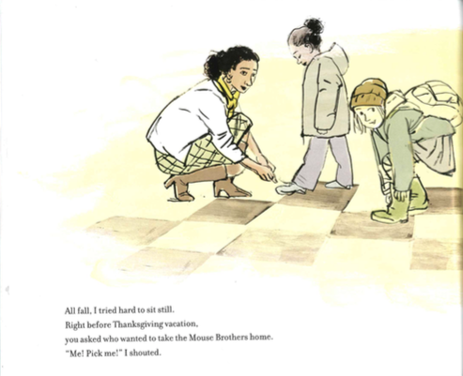
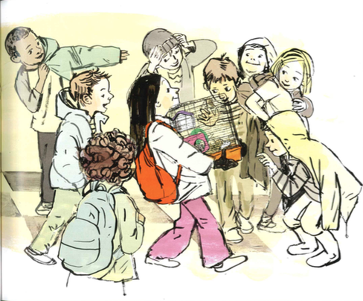

Slide 8
Adverbs
Verb: tried
When?
all fall
All fall, I tried hard to sit still.

Slide 9
Adverbs
Verb: tried
How?
hard
All fall, I tried hard to sit still.

Slide 10
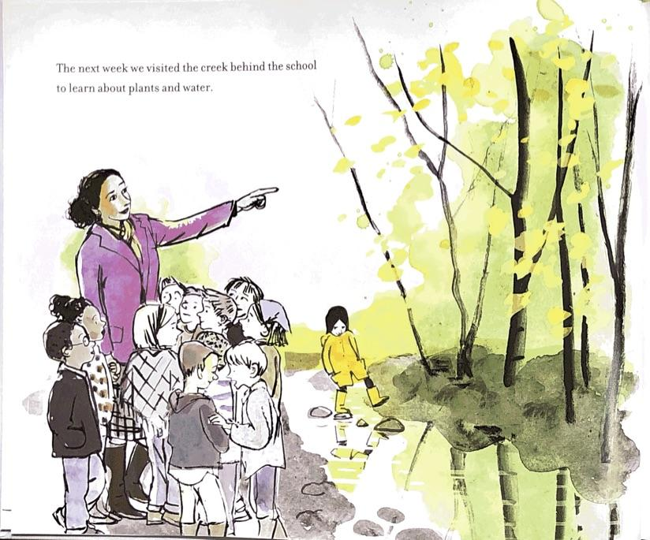
Verbs
Verbs show thoughts, feelings, and actions.
Write your own sentence—it can be about anything!
Go back to your sentence and underline the verb.

Slide 11
Adverbs
Remember, adverbs describe verbs.
Use these questions to help you add one adverb to your sentence.
How?
Where?
When?
Circle the adverb(s) you added.

