Slide 1
Gathering Data About Our School
Text Talk Week 6, Day 2
Inspired by Design on a Shoestring, New Vista Design www.newvistadesign.net

Slide 2
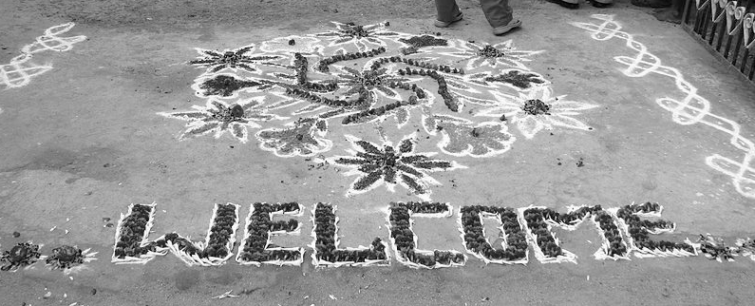

Arriving at our school
Some schools around the world have signs in different languages when you walk in.
What is it like to enter our school each day?
Is it easy to know where to go?

Slide 3
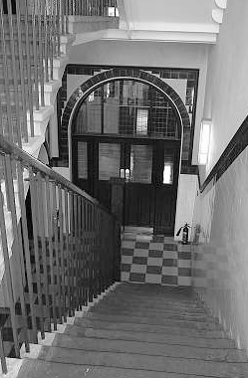
Getting around our school
Some schools around the world have different textured walls to know where classrooms are.
How do members of our school community get where they need to go?
How do people know where they are?
How do people find the people they need?

Slide 4
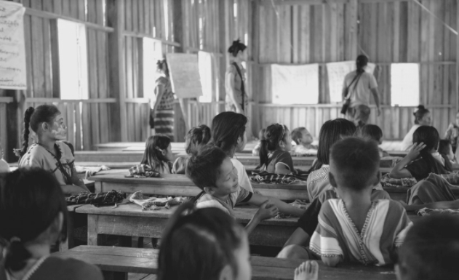
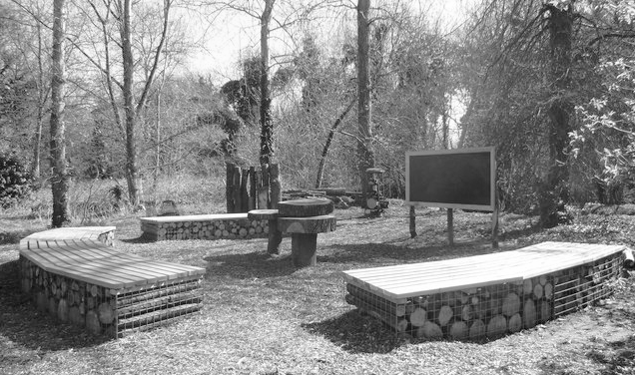
Our Building
Some schools around the world have classrooms that are open to the air.
What is our school like on the inside?
What is our school like on the outside?

Slide 5
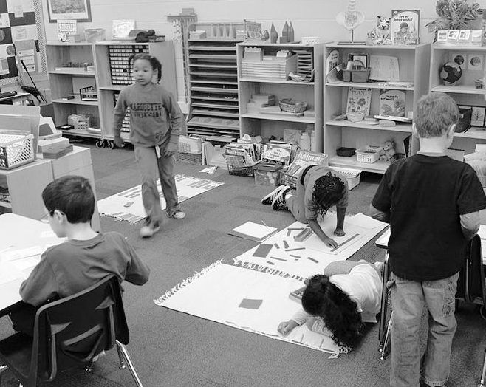
Spaces for learning
Some schools around the world have different kinds of spaces to learn.
What are our spaces for learning like in big groups and small groups?
How do we move around in our class?
How do the spaces in our classroom help us concentrate?

Slide 6
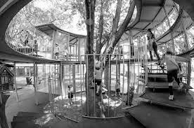
Spaces to Play
Some schools around the world have places to play outdoors.
Where do we play at school?
What do children use to play?

Slide 7
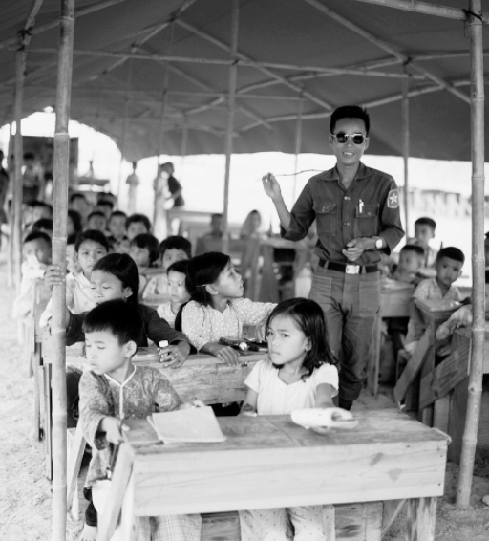
In our classrooms
Some classrooms around the world have different kinds of places to sit.
How do learners and teachers sit in our classroom?
Where are spaces to put our tools and materials?
How does everyone see and reach what’s important in our classroom?

Slide 8
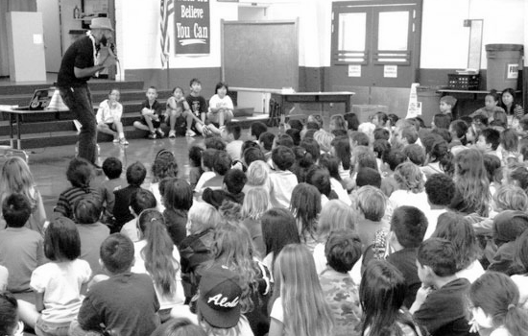
Learning together
Some schools have community meetings all together in one place.
Where do large groups gather in our school?
What does it look like in that space?
How does this space help us learn?
Where do teachers go to work together?

Slide 9
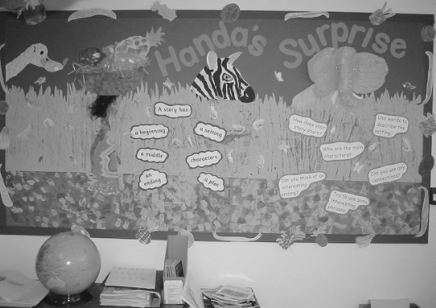
Showing our work
Some schools around the world use the hallways to show children’s learning.
How do we know what people outside our classroom are learning?
How do other people know what we are learning in our classroom?

Slide 10
Citations
These slides are inspired by Design on a Shoestring, New Vista Design www.newvistadesign.net
Slide 2: File:India - Sights & Culture - Chalk & flower welcome drawings.jpg - Wikimedia Commons, https://www.zazzle.com/welcome_in_many_languages_white_personalize-137580320252807496,
Slide 3: http://www.armin-grewe.com/crm/crm-schools.htm
Slide 4: https://pxhere.com/en/photo/1396732, http://www.geograph.org.uk/photo/2871284
Slide 5: https://commons.wikimedia.org/wiki/File:Montessori_Classroom.jpg
Slide 6: https://ideas.ted.com/inside-the-worlds-best-kindergarten/
Slide 7: https://www.flickr.com/photos/13476480@N07/5852203854
Slide 8: http://sunetric.com/blog/post/employee-profile-anthony-garrnett/
Slide 9: https://www.flickr.com/photos/lindah/160947979

