Slide 1
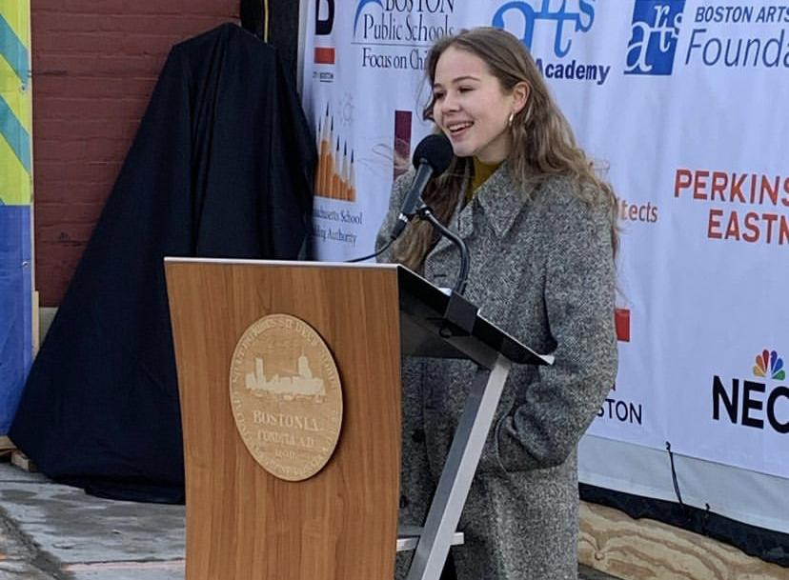
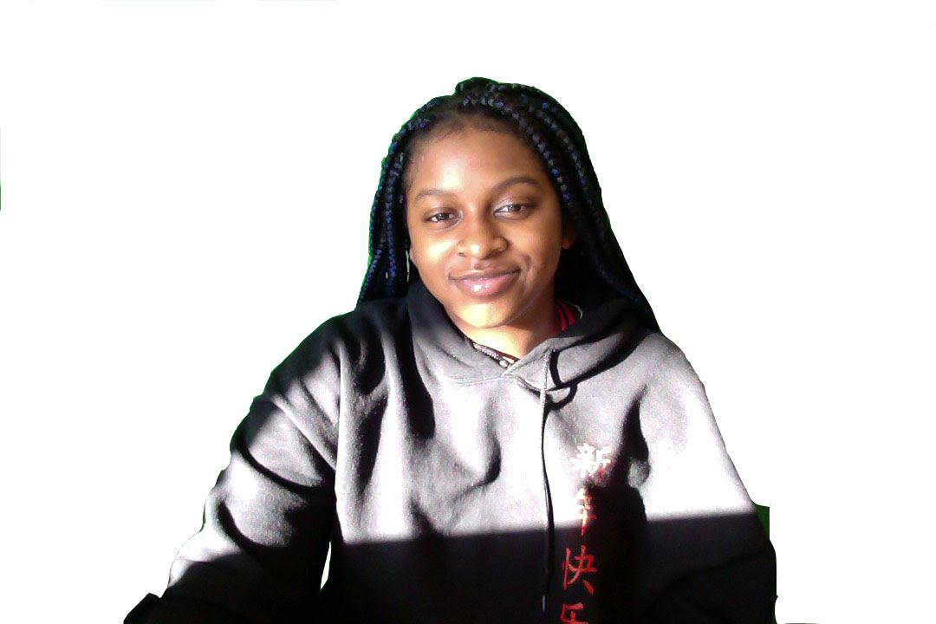
Interview with Youth Activists:
Anya Edwards and
Tayjairine Arrieta
Text Talk Week 6, Day 1

Slide 2

Slide 2
Anya Edwards and Tayjairine Arrieta have some ideas about how we can create positive change in our communities. They both study theater in a city called Boston. They are also both student activists. In this interview we find out what activism means to them.
Notes:
https://www.facebook.com/bostonartsacademy/
Property of Tayjairine Arrieta

Slide 3
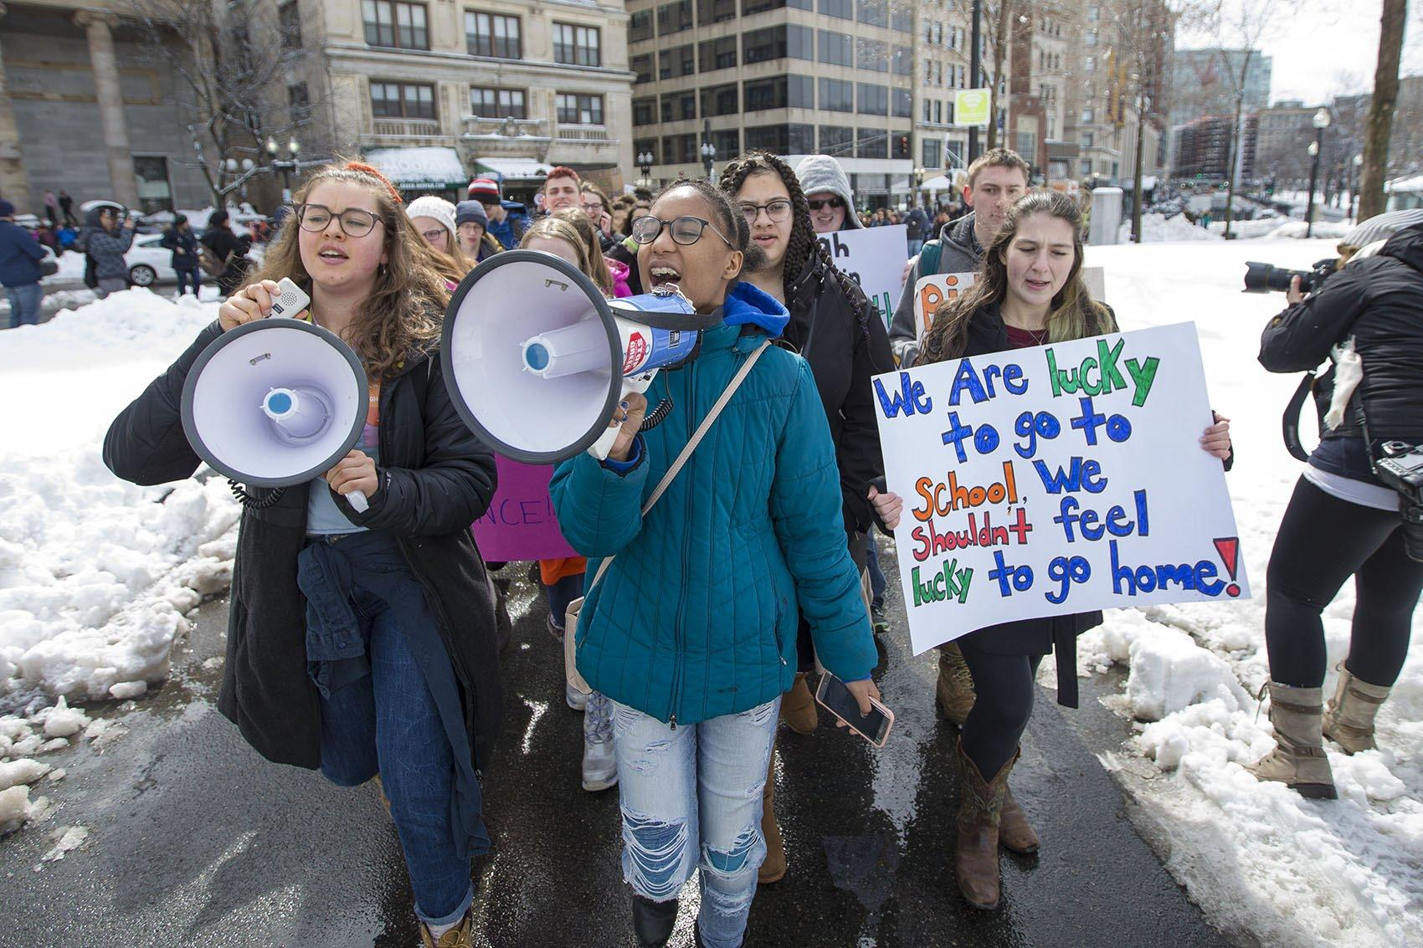
Slide 3
What does it mean to be a student activist?
Tay: Being a student activist means understanding that the world isn't perfect. You can think outside of yourself to do the best you can to make change in the world. Everyone has the power to do that.
Anya: On a basic level, a student activist is a student who sees the change they want to see and actively tries to change it.

Slide 4
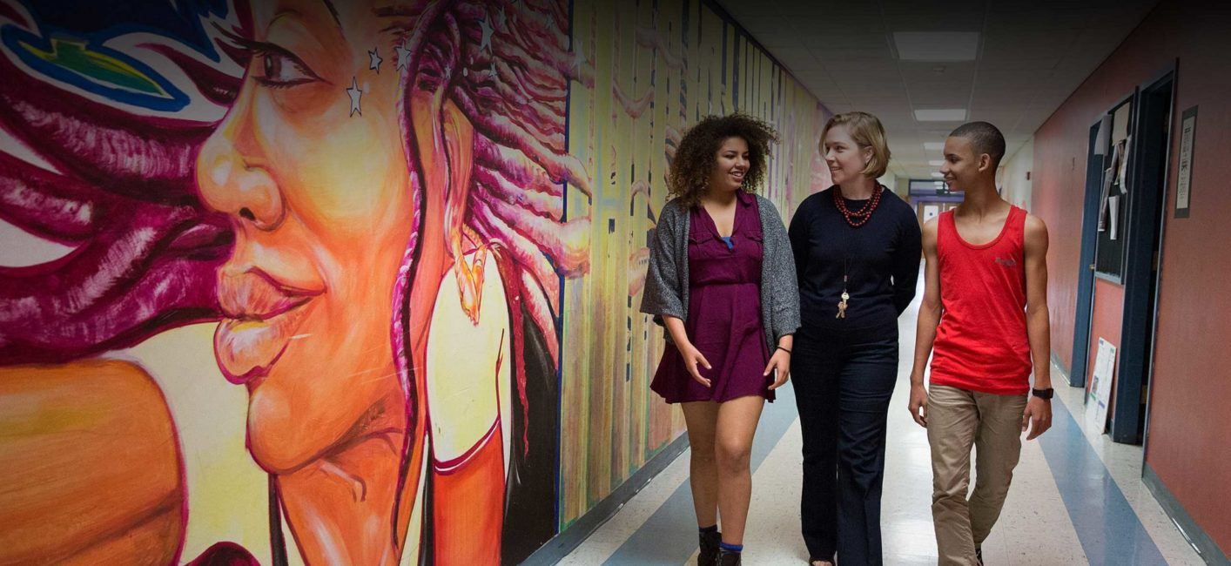
Slide 4
What influenced you to become a student activist?
Tay: In middle school, I wasn’t aware of things going on around me. Then I moved to a high school with a more diverse group of students, and my eyes were opened to the struggles of others.
Anya: Going to school has influenced me because from the first day a lot of the work is centered around being an artist activist. This is part of my everyday life.

Slide 5
Slide 5
What kind of things have you done as a student activist? What was one of your first experiences?
Anya: I went to protests with my mom at a really young age. But the first things that made me consider myself a student activist were things I’ve done this year. This year in the pandemic of Covid-19, I saw there was a push to open schools, and that this would put students and teachers in danger. The pressure was especially on schools with students of color and in families with low incomes. So I formed a student activist group. I gathered people without help from adults and facilitated meetings.

Slide 6
Slide 6
Anya continues: I was asked to speak to the press, and that day school leaders decided to delay school openings. Everyone worked together with a clear goal. We felt happy because we felt people at the top were listening to all the people asking for more time and more resources. That was quite a victory.
Notes:
https://www.wbur.org/earthwhile/2019/09/20/environmental-protest-massachusetts-photos-sunrise-movement

Slide 7
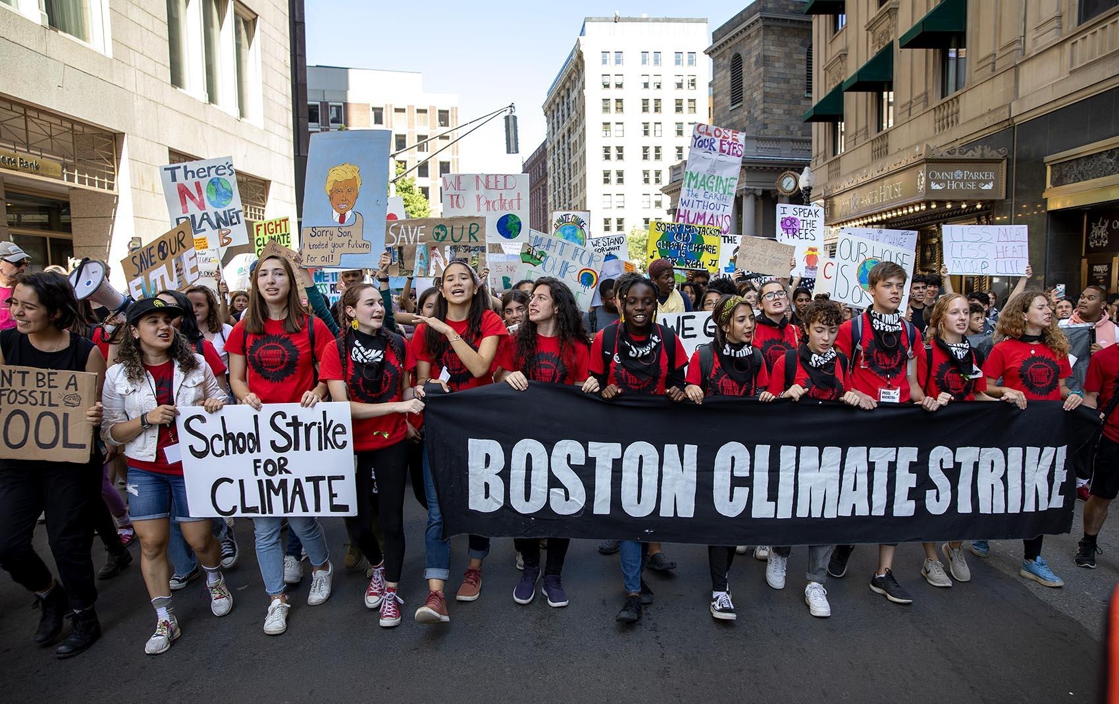
Slide 7
Tay: My first experience was last year. I went to the climate strike. Everyone there was from a different background, it was huge, and everyone shared a common goal.

Slide 8

Slide 8
What have you enjoyed most? What’s been challenging?
Tay: It has been challenging to understand that people have different opinions.
Anya: A challenge is being brave. Speaking at a press conference was terrifying. Public speaking is very scary for me, and there were a lot of cameras.
I agree about community. Also, when the scary things pay off it’s joyful. The moment after you step down from the press conference, for example, is a different type of joy.
I enjoy the community. Through the Black Lives Matter movement, people have been coming out from all over to protest, dancing in the streets and enjoying themselves while trying to bring out change.

Slide 9
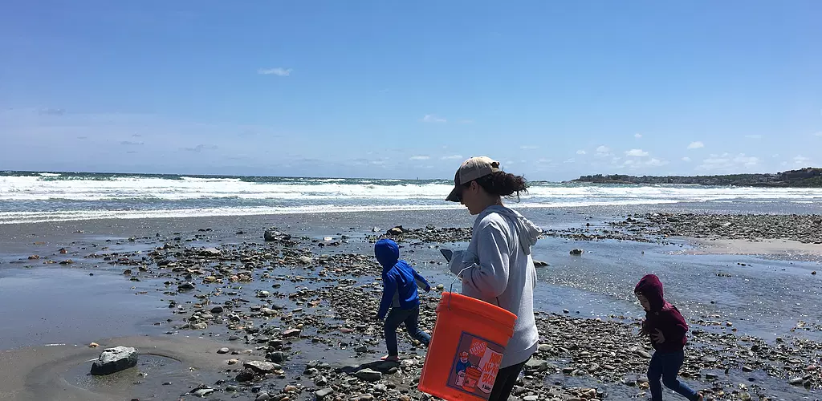
Slide 8
Is there something you are working on now or something coming up?
Anya: I am student body president. The work we’ve been doing this year is focussed on creating space for student voice at my school.
Tay: Outside of school, I’m planning a beach clean up day. My little brother—he’s six— is into the environment. If I use plastic at all, he gets upset! So I planned a thing for him to clean up a beach.

Slide 10
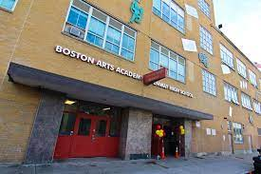
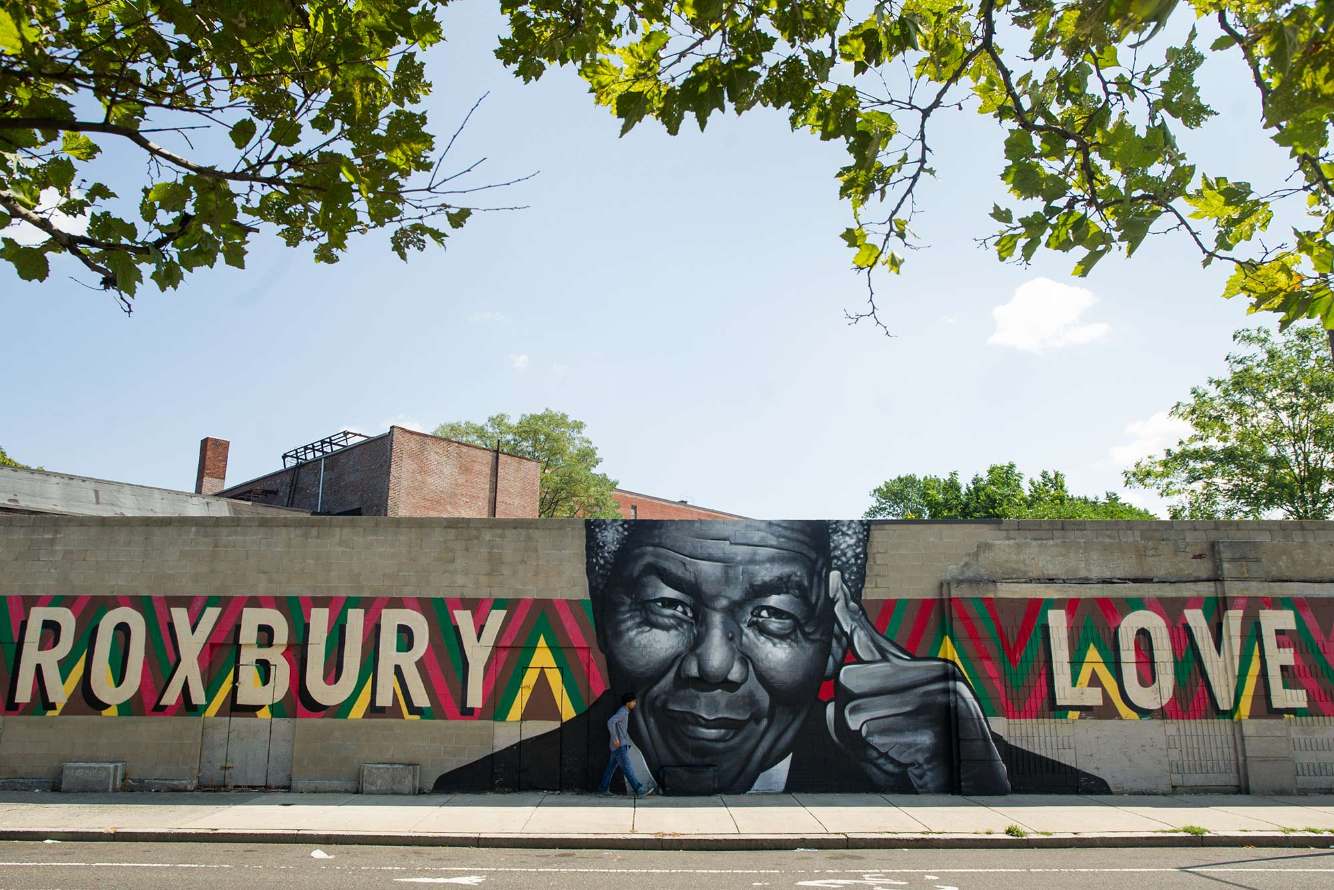
Slide 9
Do you feel like your activism has made a change in your school?
Anya: All of the tiny things you do can create change. Nothing I did individually caused change, but in the greater picture there was definitely change. I was part of that.
Notes:
https://www.bostonpublicschools.org/bostonartsacademy
http://www.bu.edu/articles/2020/getting-to-know-your-neighborhood-roxbury/

Slide 11
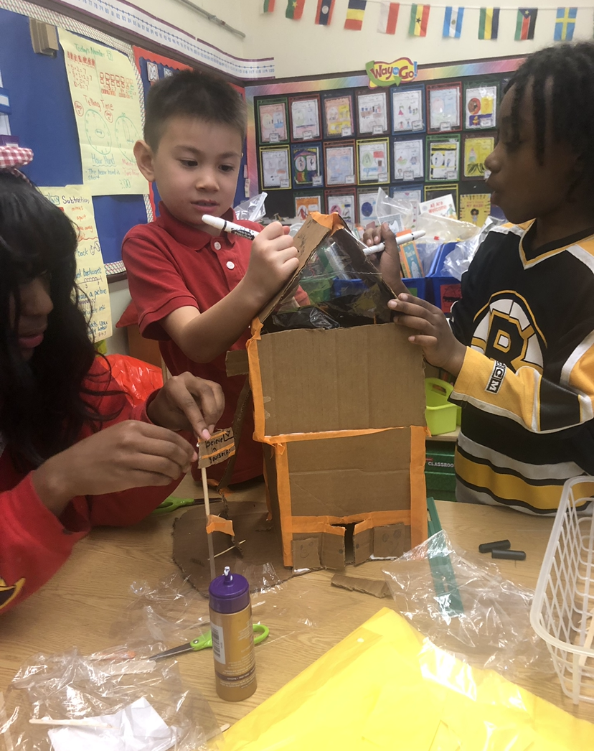
Slide 10
Anything else you would like to share with second graders?
Anya: Be brave; you can do it. The only thing you have to do is take action, and this can be very small steps.
Tay: You don’t have to be a big kid to be an activist. If you see something you feel is wrong, speak up, because your voice is just as powerful as someone who’s older than you.
Notes:
Property of Lea-Antionette Serena

Slide 12
Glossary
activist: someone who advocates and works for change
advocate: to strongly suggest or recommend
Black Lives Matter movement: people thinking about and working toward making sure that Black people have what they need to live in ways that are healthy and safe
climate strike: protest about changes in the environment
common goal: shared hope, something people agree to work for together
Covid-19: an illness caused by the coronavirus; a global pandemic
diverse: from many different backgrounds, with different identities
influence: have an effect on
low incomes: not having much money
pressure: overly strong influence
protest: a place or event where people speak out against things they think are wrong
student body president: leader of student government
students of color: schoolchildren and youth who are people of color
theater: plays and acting
voice: the right to express one’s opinion

Slide 13
Citations
Slide 2: https://www.facebook.com/bostonartsacademy/ (Anya); Property of Tayjairine Arrieta (Tay)
Slide 3: https://www.wbur.org/edify/2018/03/14/student-walkouts-state-house-protests
Slide 6: https://www.bostonpublicschools.org/bostonartsacademy
Slide 7: https://www.wbur.org/earthwhile/2019/09/20/environmental-protest-massachusetts-photos-sunrise-movement
Slide 8: https://www.amazon.com/Black-Lives-Matter-Symbol-Sticker/dp/B08BXZRQFX
Slide 9: https://fonb-hull.wixsite.com/website
Slide 10: https://www.bostonpublicschools.org/bostonartsacademy; http://www.bu.edu/articles/2020/getting-to-know-your-neighborhood-roxbury/
Slide 10: Property of Lea-Antionette Serena

