Slide 1

How do we sit?
Text Talk Week 6, Day 5

Slide 2
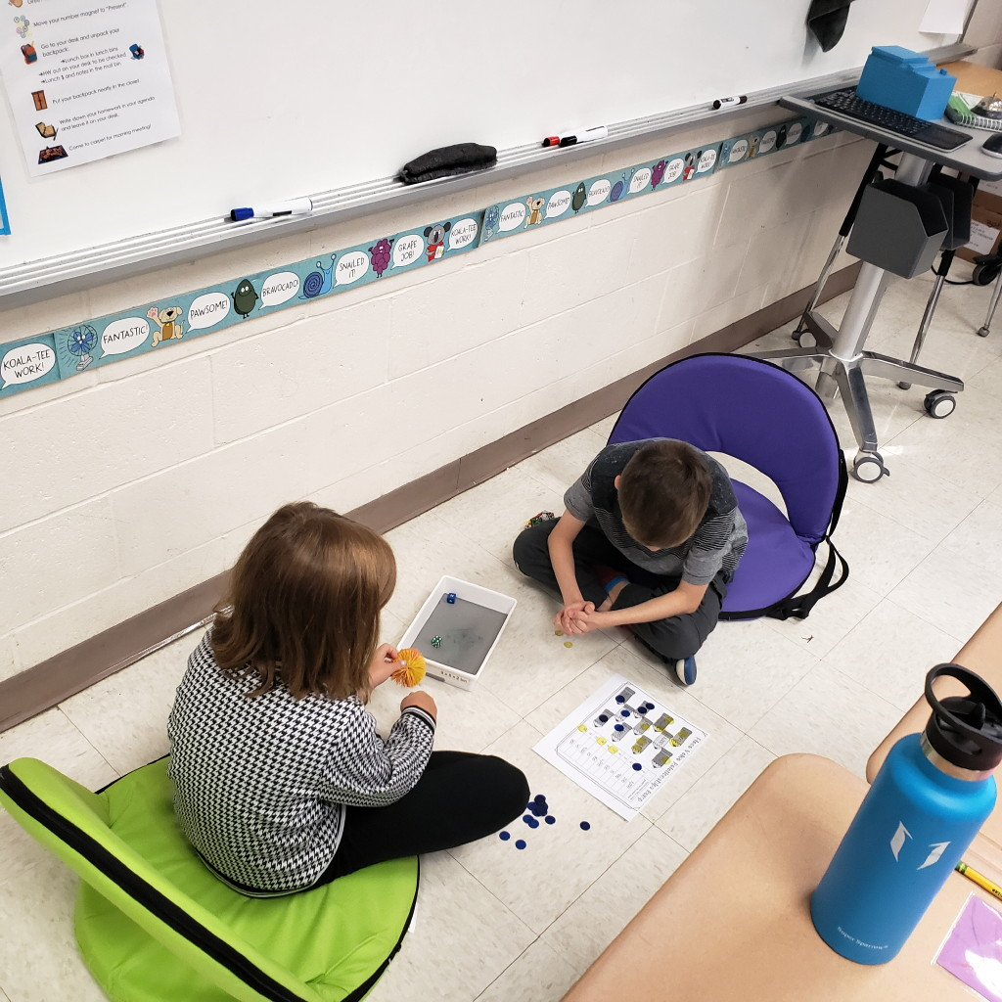
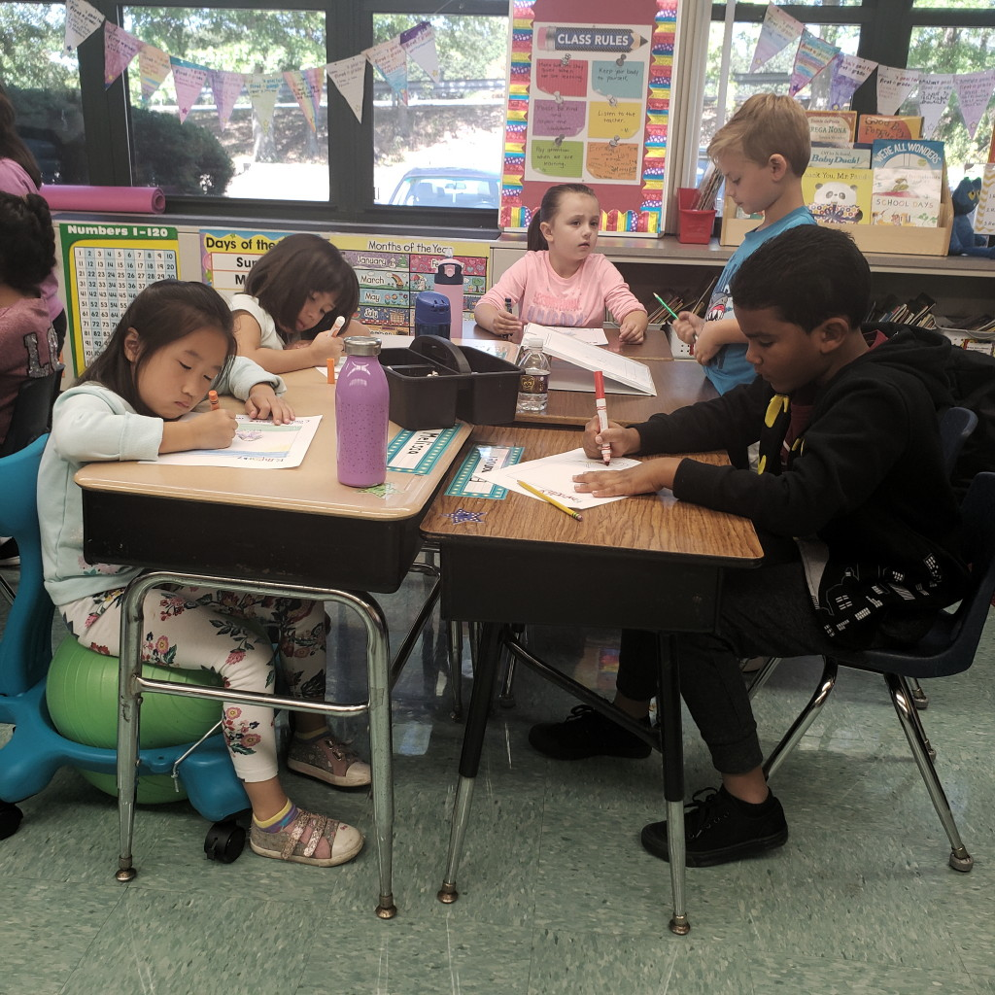

Slide 3
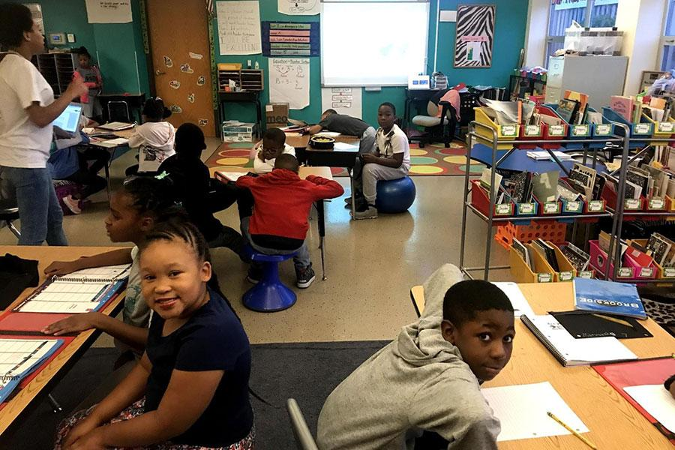

Slide 4
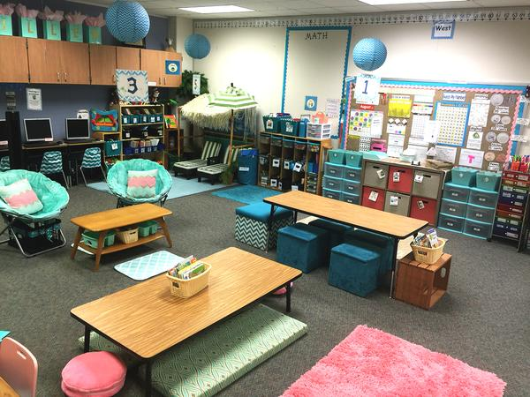

Slide 5
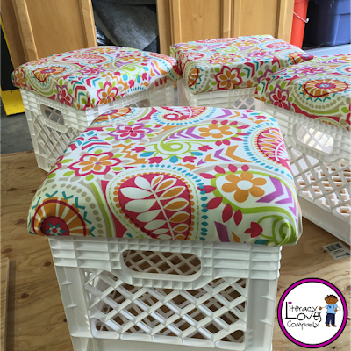
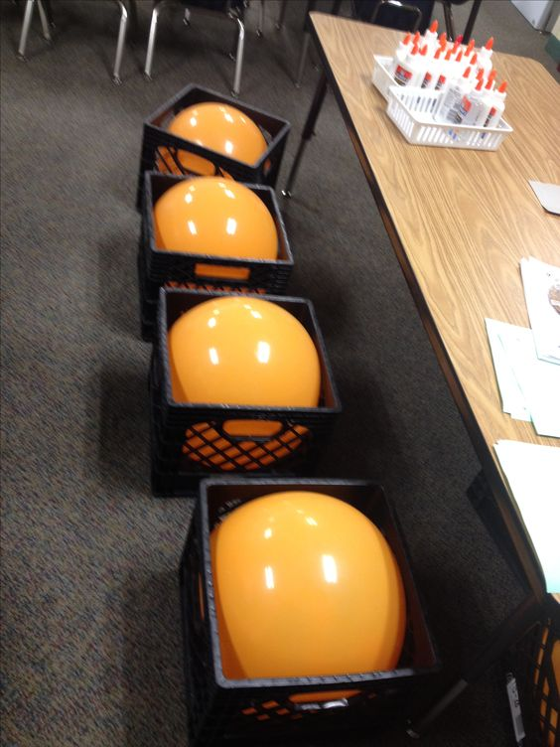

Slide 6
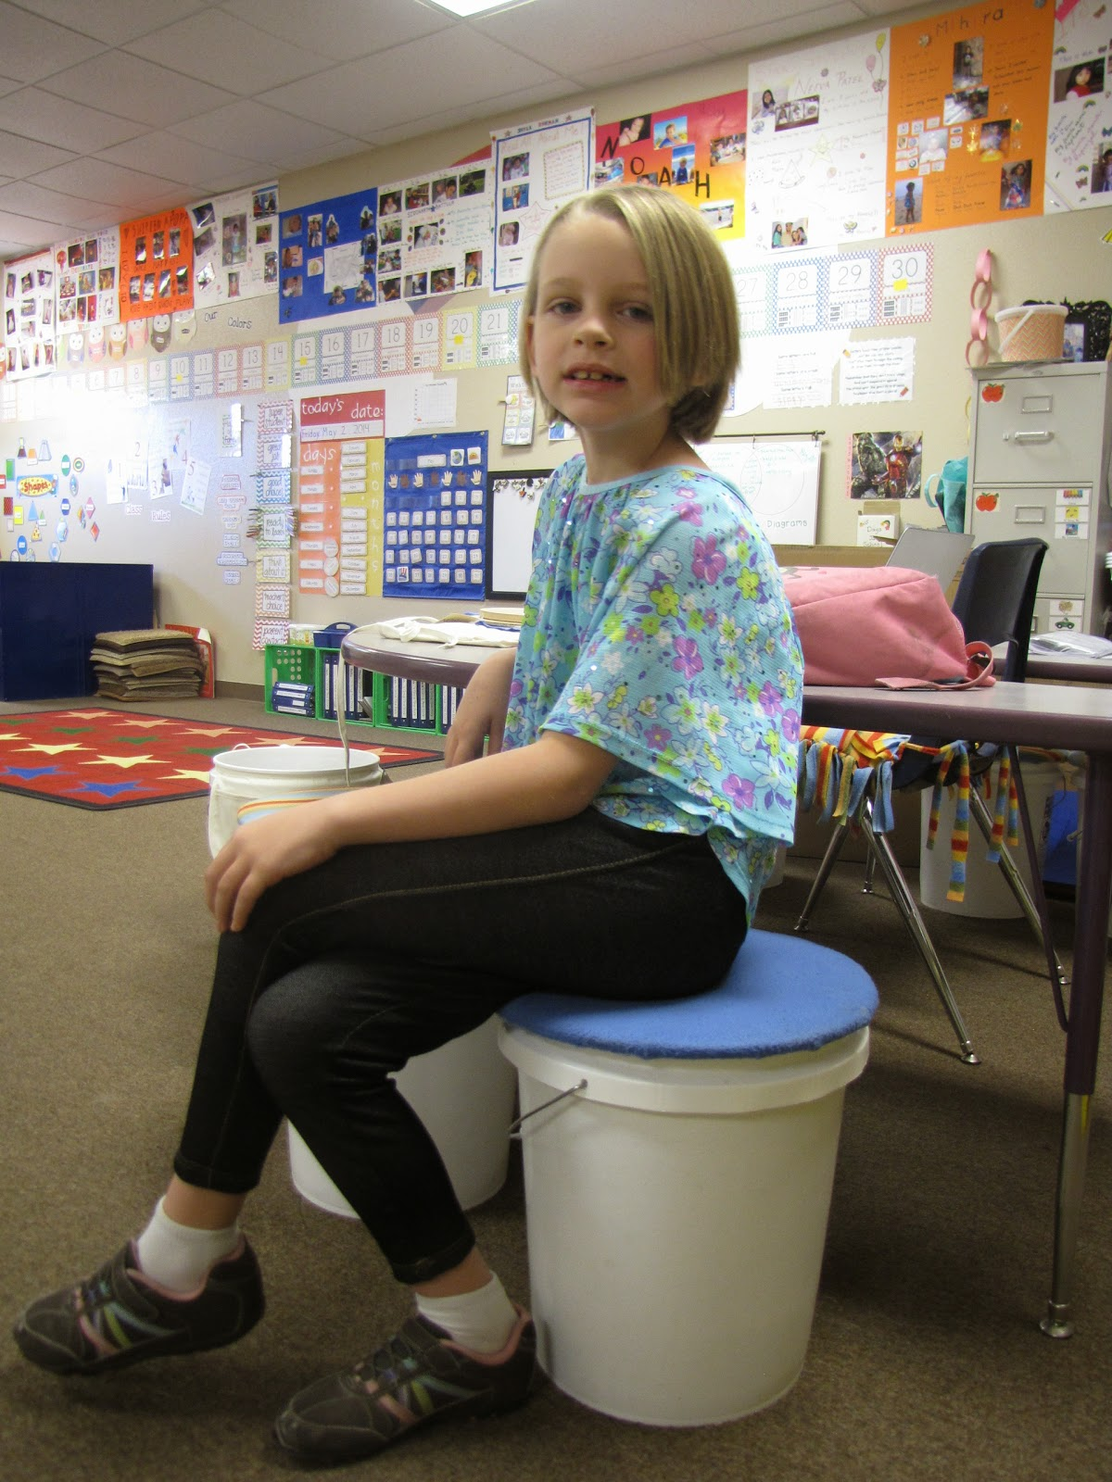
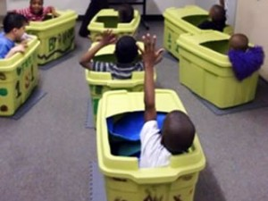

Slide 7
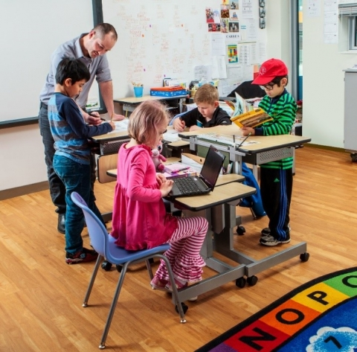

Slide 8
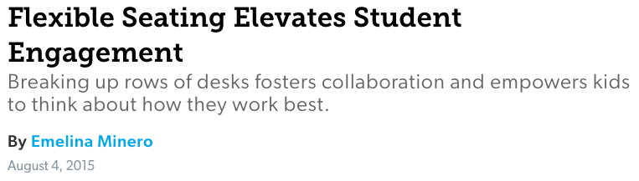
Flexible Seating Elevates Student Engagement, edutopia.org

Slide 9
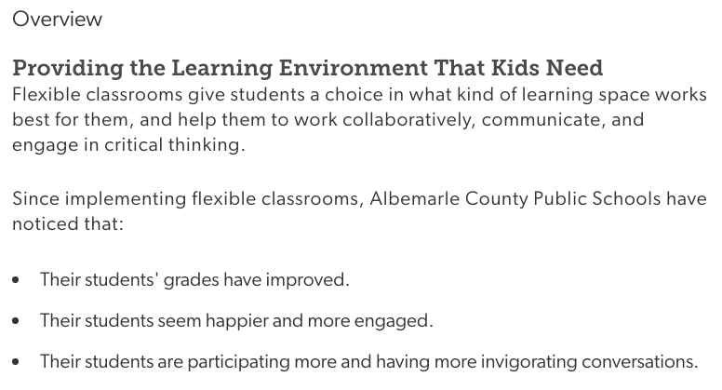

Slide 10
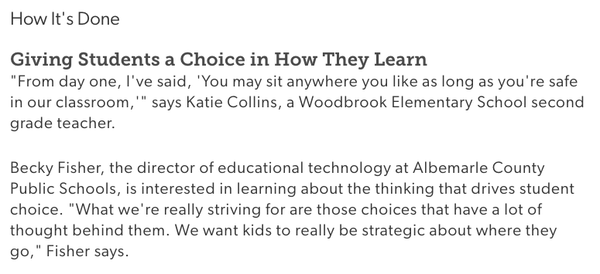
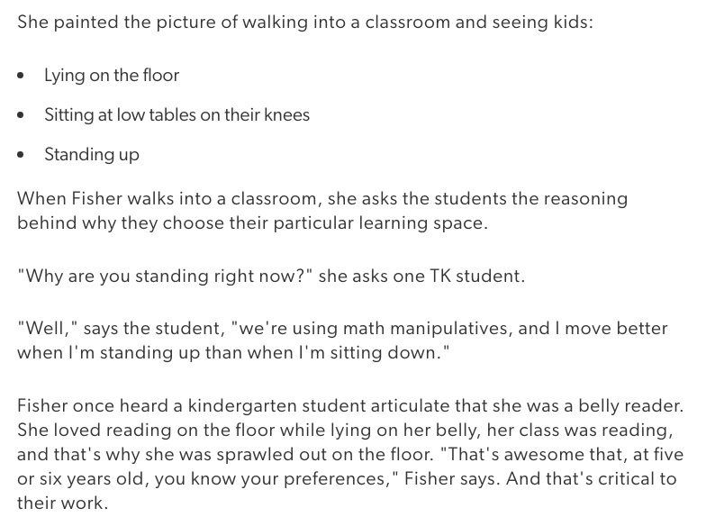

Slide 12
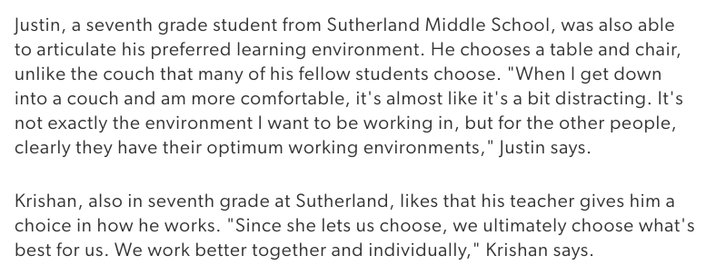

Slide 13
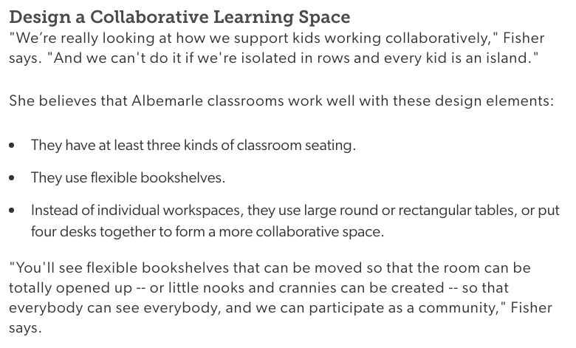

Slide 14
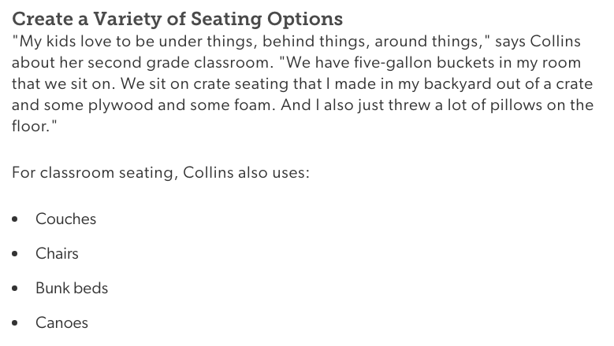

Slide 15
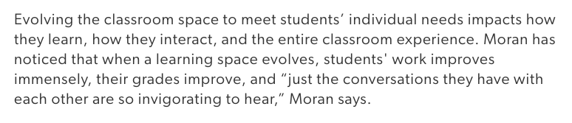

Slide 16
Citations
Slide 2: https://centraljersey.com/2019/09/24/flexible-seating-allows-students-to-learn-in-their-own-ways-in-milltown/
Slide 3: https://showmekcschools.org/wp-content/uploads/2019/01/tour-brookside-elementary-26.jpg
Slide 4: http://goldenappleofrockford.com/Announcements-News/classroom-re-design-flexible-seating-blended-learning.html
Slide 5: http://www.literacylovescompany.com/2016/03/classroom-diy-crate-seats.html, https://www.earlyvention.com/blogs/news/158877127-thrifty-sensory-hacks-instead-of-a-chair-try-these
Slide 6: https://www.earlyvention.com/blogs/news/158877127-thrifty-sensory-hacks-instead-of-a-chair-try-these
Slide 7: https://thelearningcounsel.com/article/5-most-important-considerations-when-choosing-standing-classroom-desk
Slides 8-15: excerpted from Flexible Seating Elevates Student Engagement, edutopia.org

