Slide 1
Who Makes Decisions in Our Schools?
Text Talk Week 6, Day 4
The slides that follow need to be revised to fit your context.
MAKE A COPY

Slide 2
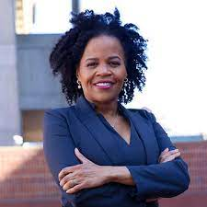
Kim Janey is the current Mayor of Boston. She is the first woman and the first black person to serve as mayor. As mayor, she values education. She is responsible for overseeing all of the city’s education programs.
Mayor Janey says that being the first Black woman mayor is important for “all children — to see diversity and leadership in the city of Boston.”

Slide 3
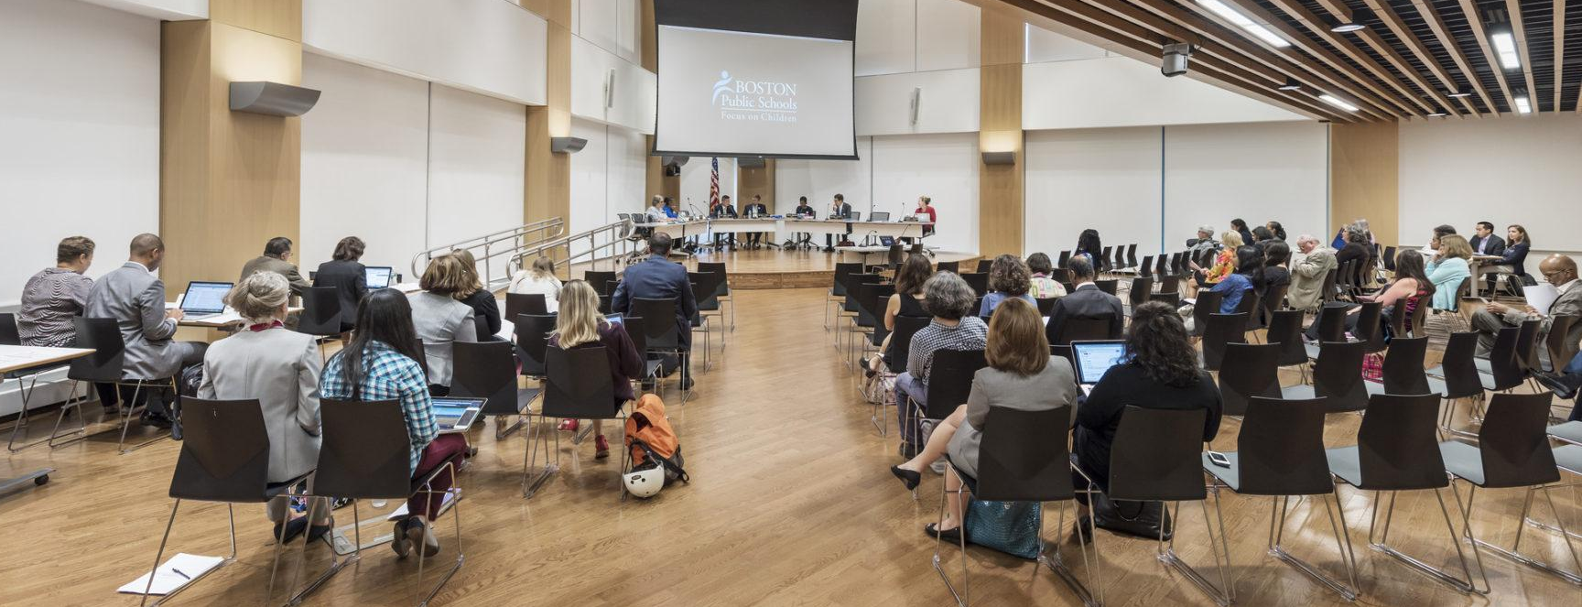
The school committee is appointed by the mayor. This group includes seven people who help make decisions about schools in Boston. They are responsible for defining the vision and goals of the Boston Public Schools. They meet together and listen to community members to make decisions.

Slide 4
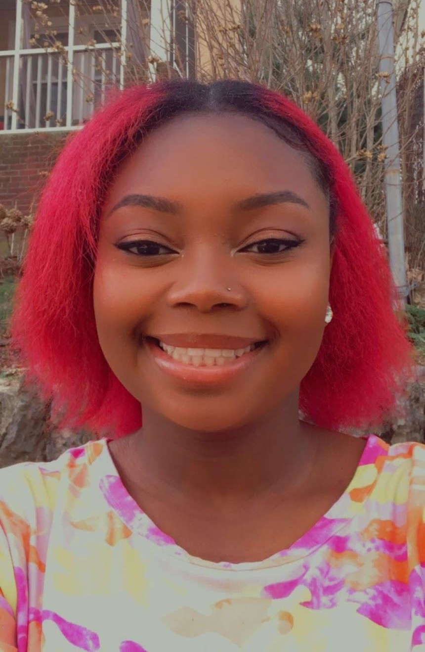
Xyra Mercer is the student school committee representative. As a member of the school committee, she is responsible for giving a voice to Boston Public Schools students.

Slide 5
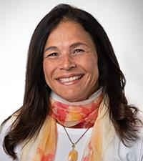
The Superintendent of our schools is Brenda Cassellius. She is the leader of all of the Boston Public Schools. She says that she is “committed to making sure that every child receives an equitable, exceptional, and joyful education.”
There are 125 schools in BPS, and over 53,000 students. She is responsible for all of them!

Slide 6
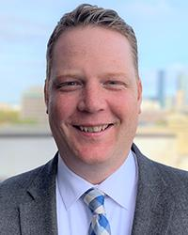
Nate Kuder is the Chief Financial Officer of Boston Public Schools. He is the leader of a team of people who decide how money is spent in our school community.
He also has two children who attend Boston Public Schools.

Slide 7
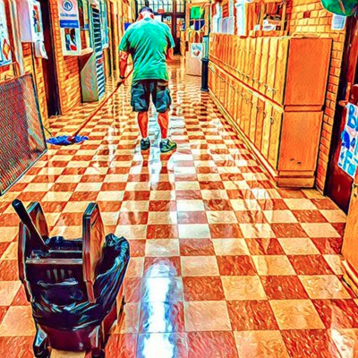
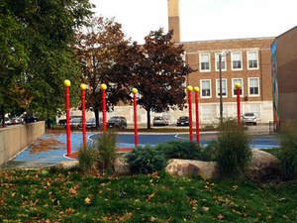
In Boston Public Schools many people work in Building Services. They take care of our school buildings. This team includes custodians, groundskeepers, and repair people.

Slide 8
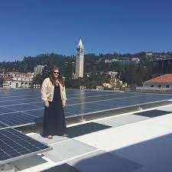
Katherine Walsh is in charge of a team of people who make sure our buildings are healthy places to learn. They are responsible for making sure schools:
have clean water,
circulate air,
have sustainable trash and recycling systems,
use energy efficiently, and
have spaces for learning outdoors.

Slide 9
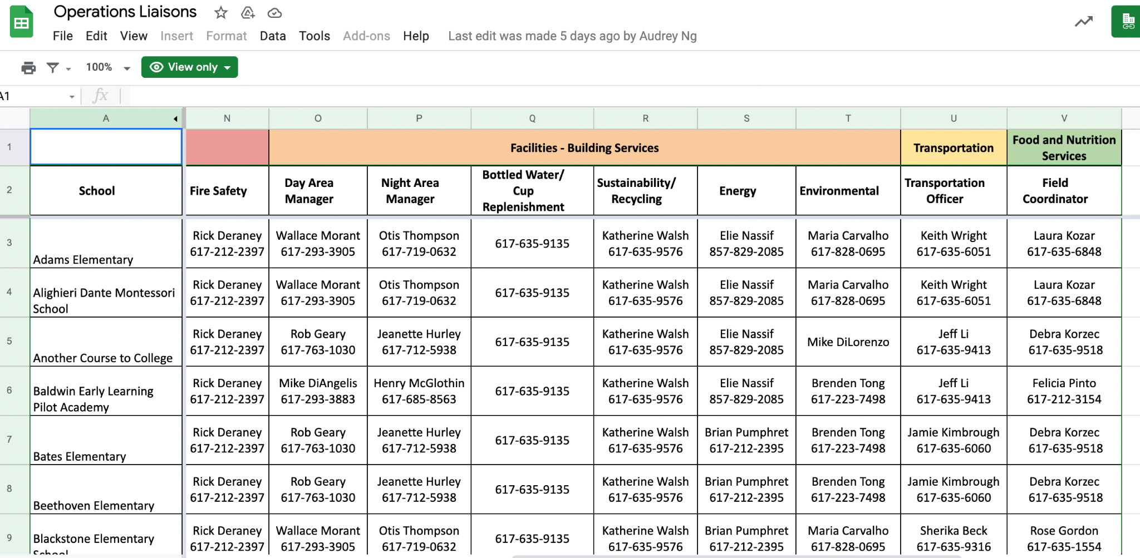
Each school has an Operations Liaison. This person is responsible for making sure that school buildings are taken care of and have what they need to be excellent places to learn. Who is our school’s Operations Liaison?
Click to open.

Slide 10
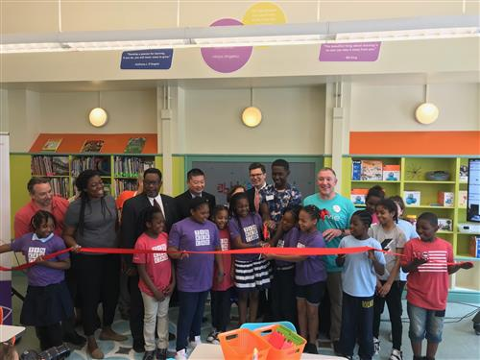
Deborah Froggatt is the Director of Library Services. She and her team are responsible for working with schools, other BPS departments, local libraries, and other organizations to give all students access to digital, multimedia, and print resources.

Slide 11

School Parent and Site Councils include parents and guardians, teachers, school leaders, students, and other community members. They are responsible for making many decisions that affect the school, including setting goals and deciding how to spend money.
Notes:
More info & links: https://www.bostonpublicschools.org/school-councils
https://www.dayoneearlylearning.org/community/parent-council/

Slide 12
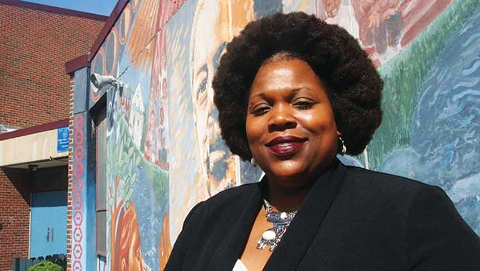
School principals make sure their school is a safe and fun place for learning. They are responsible for creating the school budget and purchasing the materials teachers and children need for learning. Principals supervise the teachers. They also listen to families to make sure they are satisfied with what the school provides.

Slide 13
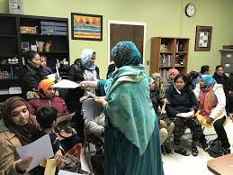
A school’s Family Coordinator communicates with families to inform them about opportunities to get involved with their children’s education. These opportunities include family conferences, celebrations, workshops, and participating in the school council. The Family Coordinator also connects families with services they might need outside of school, such as medical care, counseling, housing, child care, food, and fun.

Slide 14
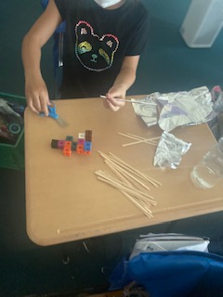
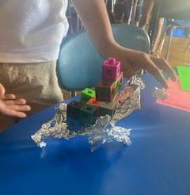
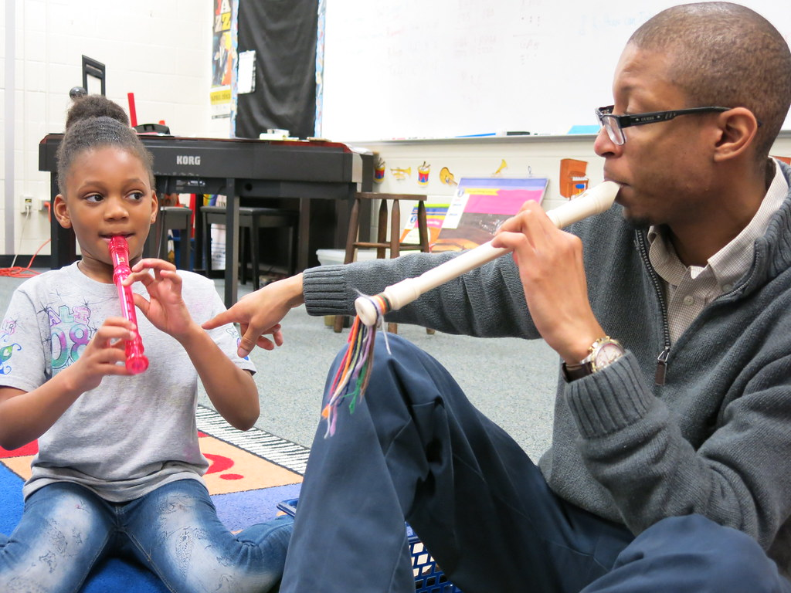
The Science, Music, Computer Science, Physical Education, and Art teachers are called specialists. Specialists teach subjects they are experts at so children can broaden their knowledge of the world.
Notes:
https://www.labmanager.com/news/for-girls-learning-science-outside-linked-to-better-outcomes-25631
https://www.flickr.com/photos/richlandtwo/16761204639
Property of Lea-antionette Serena

Slide 15
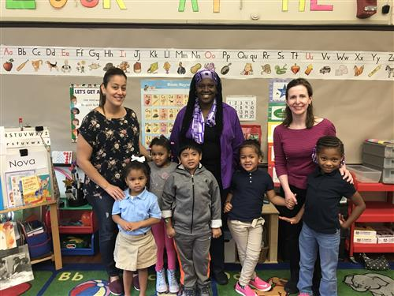
Teachers create classroom learning communities. They are responsible for helping all children build new skills and learn about many different topics. They give children opportunities to participate positively in their communities. They work with their students to take care of their classrooms.
Teachers collaborate with each other to think about the best ways to make school a joyful place for all learners.

Slide 16
Glossary
appointed: chosen without a vote
chairperson: head of a committee
circulate: to move around
committee: group that makes decisions together
current: happening now
digital: involving or relating to the use of computer technology
efficient: quick and thorough
equitable: fair
exceptional: extremely excellent
media: means of communication
print resources: texts in writing
purchasing: buying
specialist: someone who knows a lot about a topic and can teach it
sustainable: can last a long time

Slide 17
Citations
Slide 2: Boston Mayor Kim Janey, Kim Janey 'will make the decisions that I need to make' as Boston acting mayor
Slide 3: https://www.sasaki.com/projects/bruce-c-bolling-municipal-building/ (image cropped for fit)
Slide 4: https://www.bostonpublicschools.org/Page/311
Slide 5: Photo: Boston Public Schools
Slide 6: Photo: Boston Public Schools
Slide 7: https://twitter.com/bpscustodians?lang=en, Projects | Completed Projects | Curley School
Slide 8: Photo: Boston Public Schools
Slide 9: Screenshot from Boston Public Schools website
Slide 10: Volunteers Transform Holmes School Library With One-Day Makeover
Slide 11: School Site Council Manual
Slide 12: Trotter's new principal readies for school
Slide 13: What's New With Community Engagement Team (CET) Outreach Work?
Slide 14: For Girls, Learning Science Outside Linked to Better Outcomes Property of Lea-Antoinette Serena
Slide 15: Dorchester Elementary School Exits Turnaround Status, Numerous Boston Public Schools Meet or Exceed Goals

