Slide 1
Weekly Words
Unit 1, Week 5
Notes:
accessible: able to be used by all
deserve: to be in a position to receive something
disability: a trait that might limit movement, senses, or other activities
foundation: an organization or institution that offers money to support the work of other organizations or people
independence: freedom to do things oneself
pride: a feeling of pleasure in one’s own accomplishments
progress: forward movement, development toward something better
raise: to lift up; to increase the amount of something

Slide 2
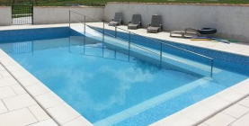
accessible
adjective
able to be used by all
Notes:
accessible (adjective)
Elaboration:
This swimming pool was designed to be accessible for people who cannot easily use stairs or a ladder to get into the water.
Think, Pair, Share prompt:
Sometimes we hear announcements on the loudspeaker here at school. What tool might make these announcements accessible to someone who does not hear?
http://www.bespokefrance.com/holidays/holiday.php?property=102

Slide 3
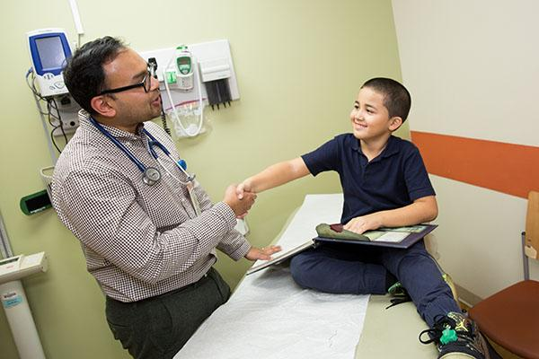
deserve
verb
to be in a position to receive something
Notes:
deserve (verb)
Elaboration:
You all deserve a high quality education; it’s your right. You deserve it just because you are children. People also say that workers deserve a raise—more money at a job—when they have been working really hard.
Think, Pair, Share prompt:
Little babies aren’t ready to go to school yet. What do you think little babies deserve to help them grow healthy and happy?
https://www.childrenshealthfund.org/all-children-deserve-to-be-happy-and-healthy/

Slide 4
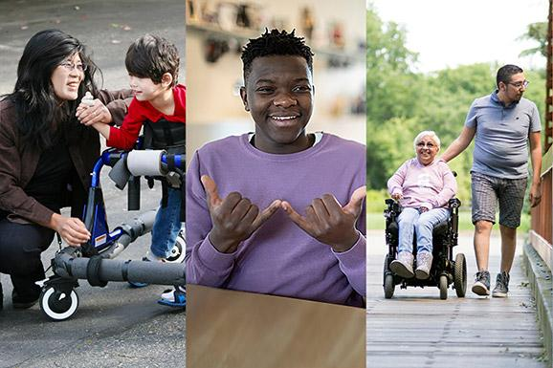
disability
noun
a trait that might limit movement, senses, or other activities
Notes:
disability (noun)
Elaboration:
A disability is a challenge. It makes it hard, but not impossible, to do some things. We can all help people with any disability by making sure we include each other.
Think, Pair, Share prompt:
Say you want to design a chair for people with a certain kind of disability. What would you consider in your design?
https://news.ok.ubc.ca/2021/06/02/health-of-canadians-with-disabilities-suffering-during-the-pandemic/

Slide 5

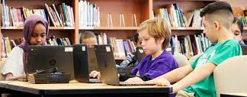
foundation
noun
an organization or institution that offers money to support the work of other organizations or people
Notes:
foundation (noun)
Elaboration:
A building’s foundation allows it to stand up. This is a different kind of foundation. A foundation is made of people who give and collect money to give to certain projects. For example, this foundation might give money so schools can buy computers.
Think, Pair, Share prompt:
If you created a foundation to have a positive impact in your community, what kind of project would that foundation support with money?
https://www.ifse.ca/financial-services-needs-female-leaders-next/, https://digitalpromise.org/2019/04/29/equity-in-schools-access-technology/

Slide 6
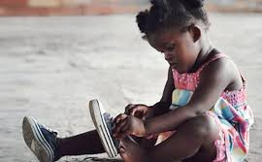
independence
noun
freedom to do things oneself
Notes:
independence (noun)
Elaboration:
If you offered to help this child as she tries to put her shoes on, she might say, “I can do it!” She is working toward her independence.
Think, Pair, Share prompt:
What is something that helps you or your family have independence?
https://canadianfamily.ca/kids/child/how-to-manage-an-independent-child/

Slide 7

pride
noun
a feeling of pleasure in one’s own accomplishments
Notes:
pride (noun)
Elaboration:
This athlete from Brazil probably feels pride in herself because she won a medal. She shows that she feels pride in being part of her country’s community by holding a flag.
Think, Pair, Share prompt:
Talk about a time when you felt pride in yourself or in your community.
https://go.chatwork.com/blog/en/2016/08/2016823how-the-olympics-deepens-cultural-pride.html

Slide 8
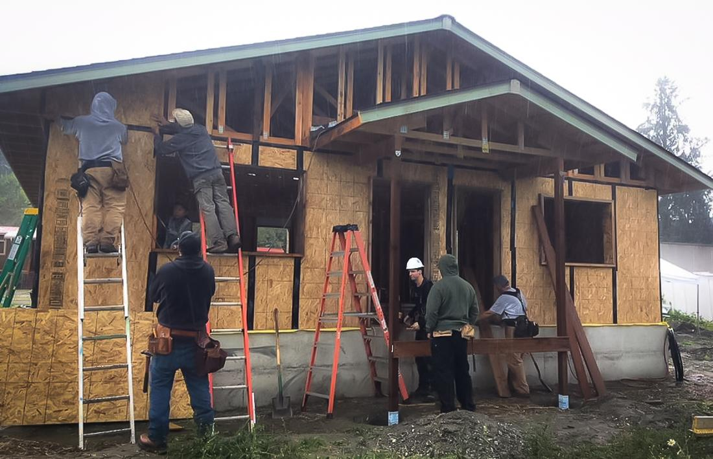
progress
noun
forward movement, development toward something better
Notes:
progress (noun)
Elaboration:
All through second grade, you will make progress as readers! You will become stronger and stronger readers.
These builders are making progress on this house, getting it built, bit by bit.
Think, Pair, Share prompt:
Why might making progress require persistence?
https://shelterforce.org/2019/05/13/to-build-affordable-and-green-consider-passive-houses/

Slide 9
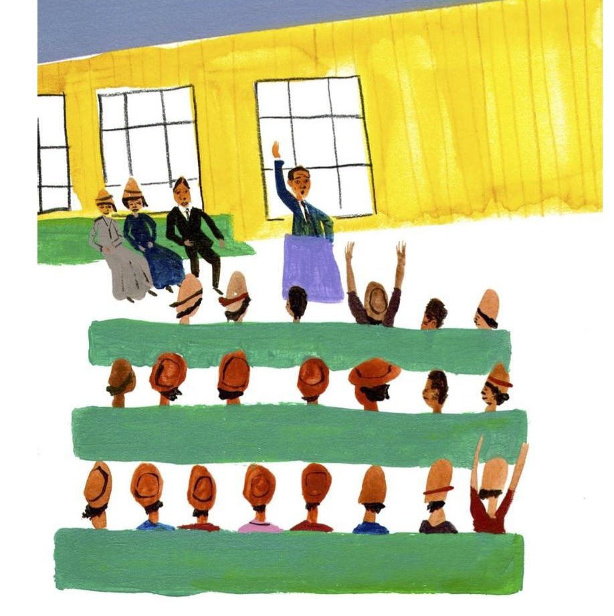
raise
verb
to lift up; to increase the amount of something
Notes:
raise (verb)
Elaboration:
The verb raise has several meanings. In each of them, though, there is an idea of more or going up. When Ovella’s community raised money, they got more money. When we raise the roof, we make a building taller. When I raise my expectations, I think you are able to do more.
Think, Pair, Share prompt:
What is something you might like to raise money for? Why?
From Dear Mr. Rosenwald, illustrated by Gregory Christie

