Slide 1
Shades of Meaning: Verbs
Vocabulary & Language Week 5, Days 3-4

Slide 2
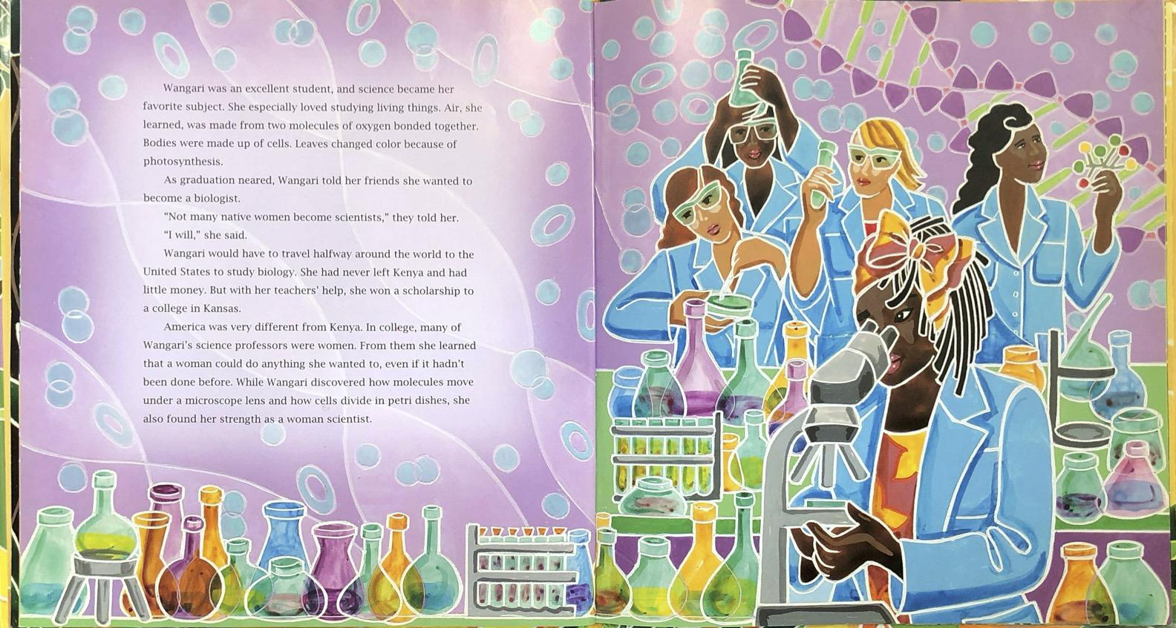
While Wangari discovered how molecules move under a microscope lens and how cells divide in petri dishes, she also found her strength as a woman scientist.

Slide 3
discovered

Slide 4
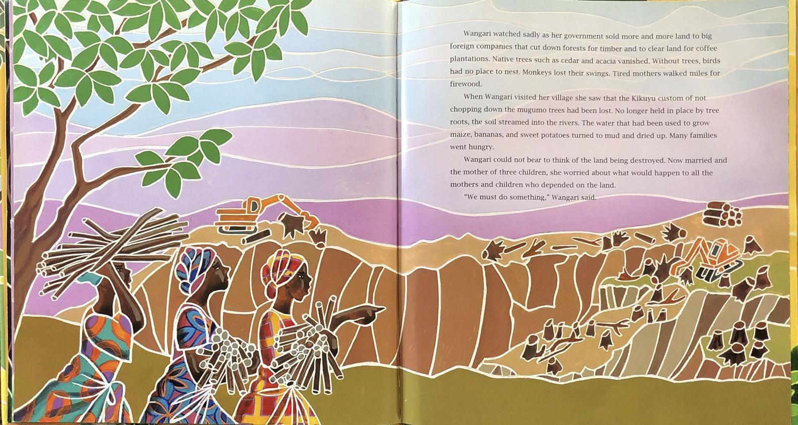
Native trees such as cedar and acacia vanished.

Slide 5
vanished

Slide 6
discovered

Slide 7
vanished

