Slide 1
Inclusive Playgrounds Around the World
Text Talk Week 5, Day 4

Slide 2
Article 31
You have the right to play and rest.

Slide 3
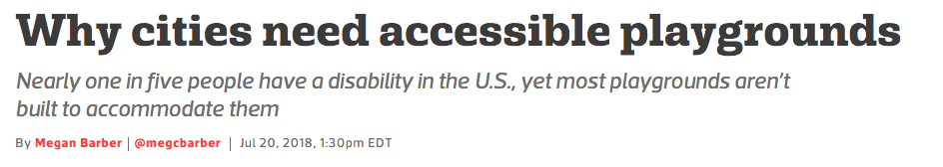
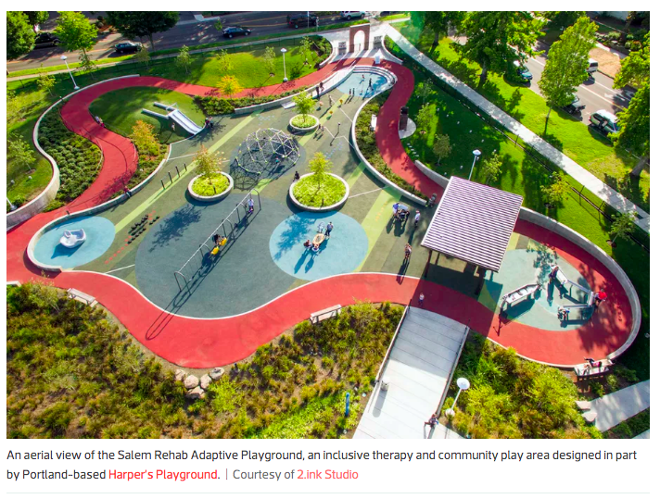
Notes:
Accessible playground design can build a more inclusive city

Slide 4
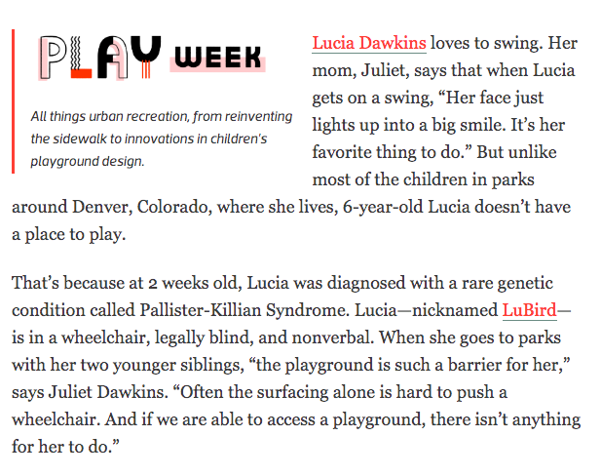

Slide 5
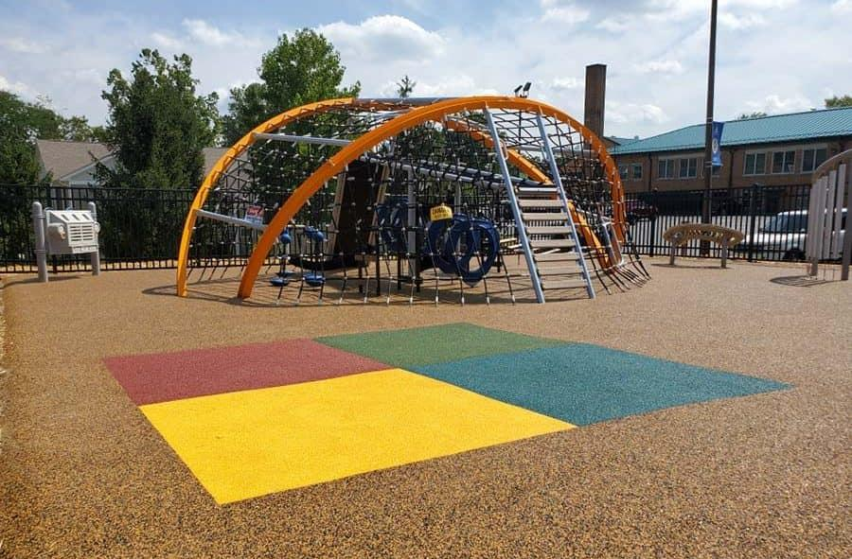
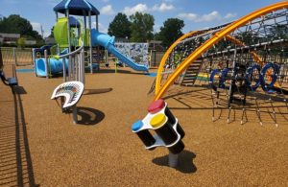
Playgrounds that don’t work for everyone: a problem people are solving
“The planning for this playground at Holy Trinity School in St. Matthews, Kentucky started with a child in a wheelchair sitting outside the school’s playground watching while her friends played. She wasn’t able to access the entire area, and there weren’t any activities for her to engage in. People began to take note and from there conversations began expressing the need for change.”

Slide 6
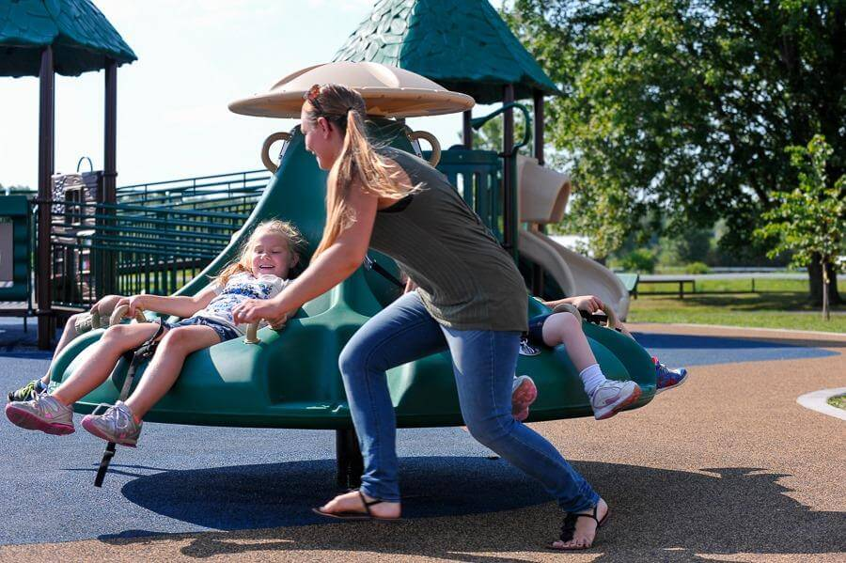
What experts say
“Play areas should be designed to challenge children of different ages and abilities. At an inclusive playground, kids can learn to take risks together; none of them are left on the sidelines wishing they could participate.”

Slide 7
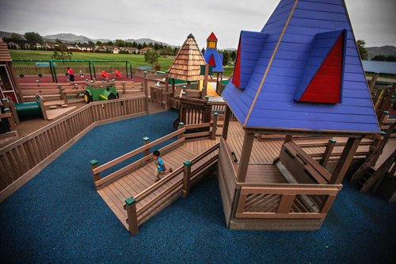
Inclusive Spaces to Play in the United States and Around the World
Brooklyn’s Playground was named after Brooklyn Fisher, a child with spina bifida. When Brooklyn was a toddler, her dad sat her in a swing at a play park. The swing had no back support. Brooklyn fell out and hurt her head. Her parents had the idea of a playground that kids of all abilities could enjoy. In less than a year the park was built. The park features ramps, smooth surfaces, and therapeutic swings. Visitor Amanda Bakker took her child to the park and placed her in a swing. She noticed a child in a wheelchair playing on the pirate ship with her friends. “This is what it means to be included,” she said.
Brooklyn’s Playground, Pocatello, Idaho, United States
Notes:
https://www.special-education-degree.net/30-most-impressive-accessible-and-inclusive-playgrounds/

Slide 8
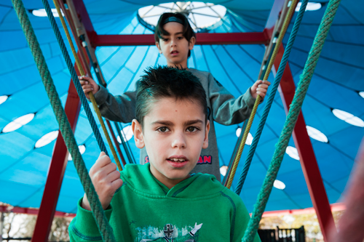
Friendship Park was designed to support visitors with various special needs. It was overseen by a sensory therapy expert Michele Shapiro. Shapiro said that the social and physical aspects of the outdoor space go hand in hand. Opened in 2005, Friendship Park made history as the first inclusive playground in Israel.
Friendship Park, Ra’anana, Israel

Slide 9
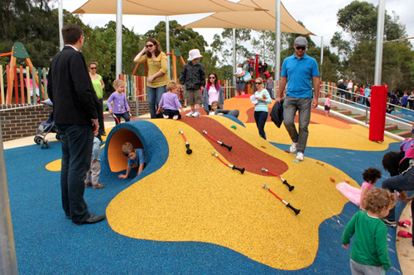
Livvi’s Place in Five Dock, New South Wales is the first all-inclusive playground in Australia. The idea for Livvi’s Place started with John and Justine Perkins, whose daughter Olivia died when she was less than a year old as a result of a rare condition. The Perkinses established the Touched by Olivia Foundation, which works to develop inclusive play parks. The park features swings, musical equipment, a wheelchair- accessible carousel, and more. In 2010, the playground got a prize for being Australia’s top play space.
Livvi’s Place, Five Dock, New South Wales, Australia

Slide 10
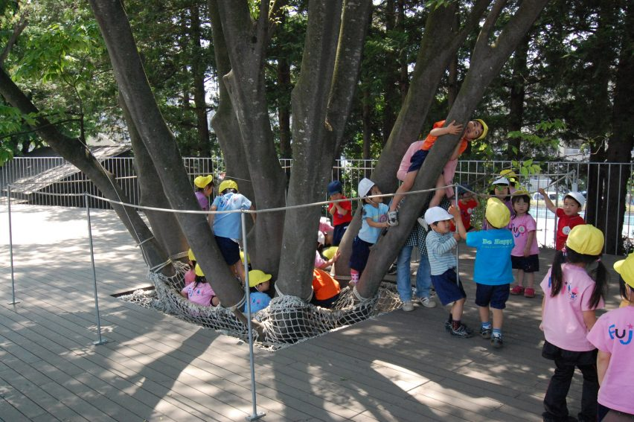
Kindergarten, Tokyo, Japan

Slide 11
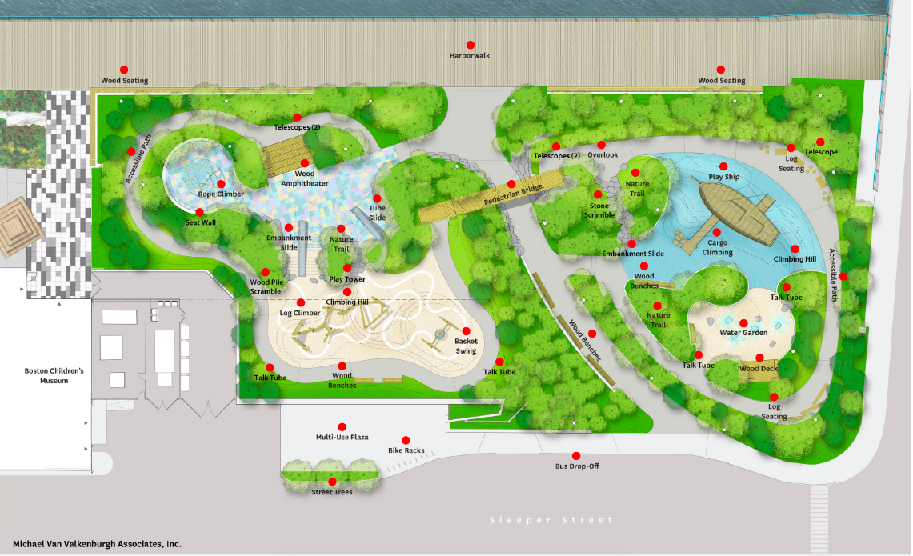

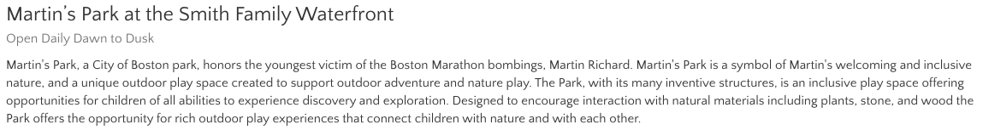
An inclusive playground
at the

Slide 12
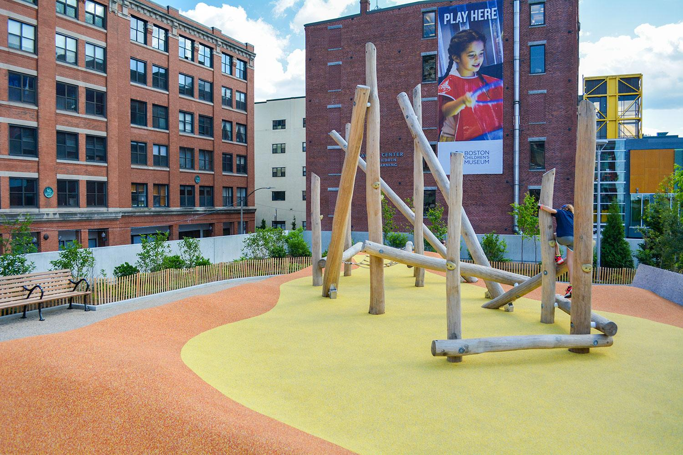

Slide 13
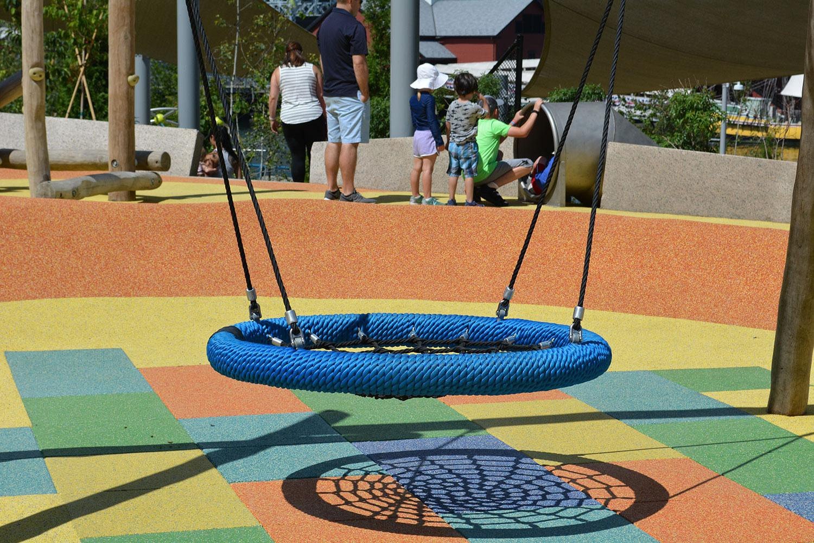

Slide 14
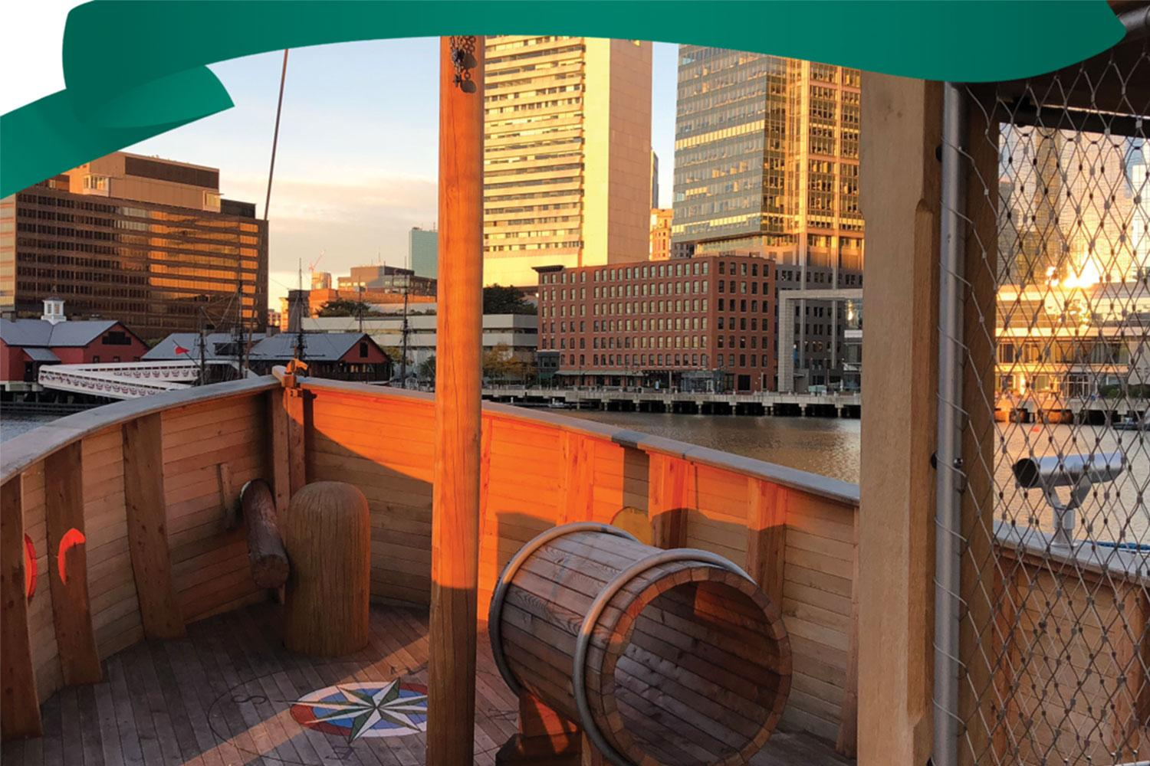

Slide 15
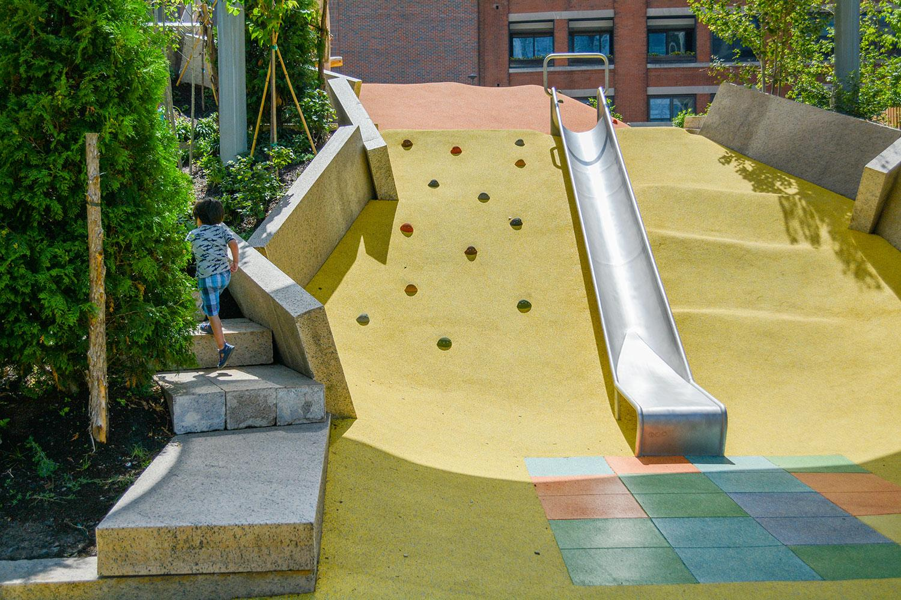

Slide 16
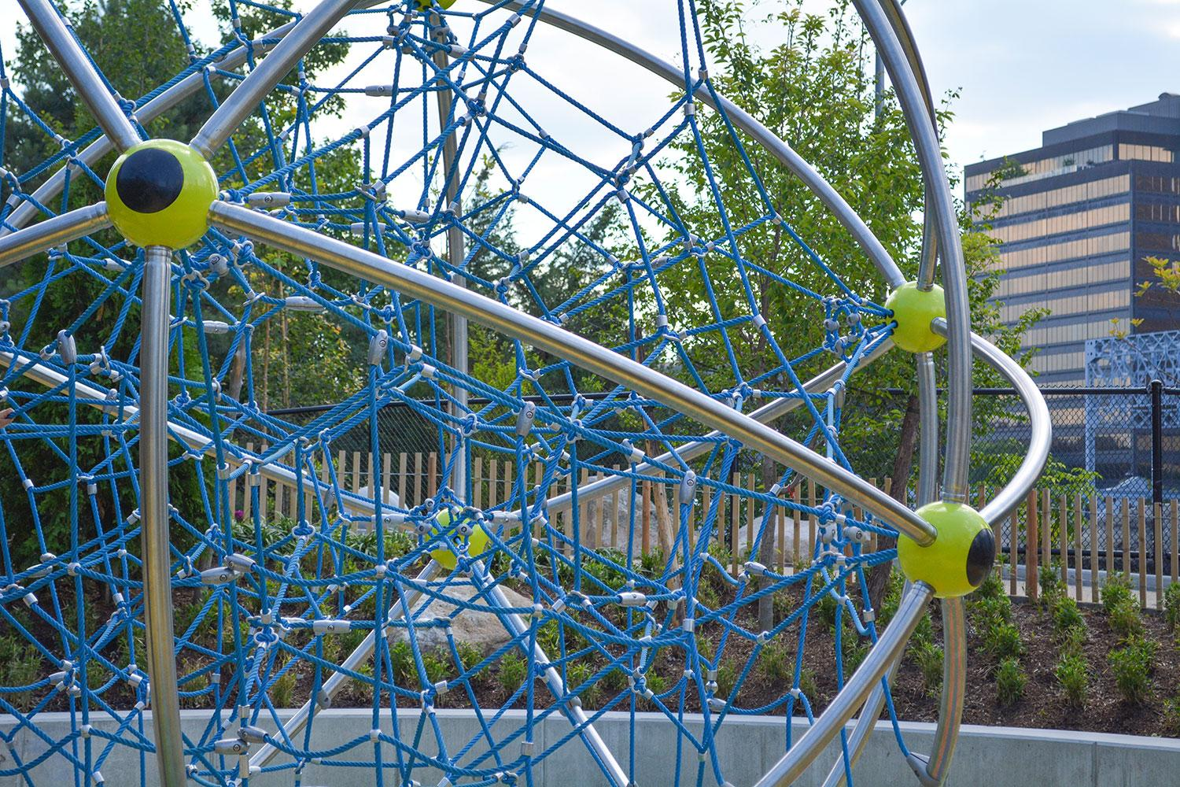

Slide 17
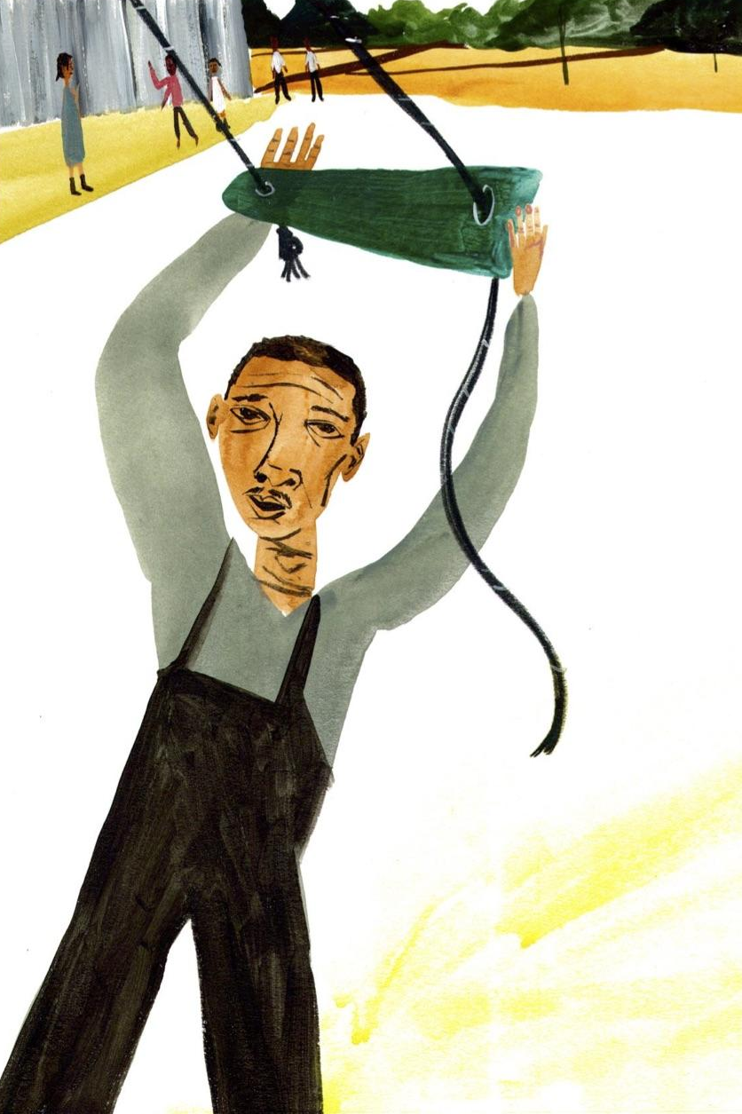
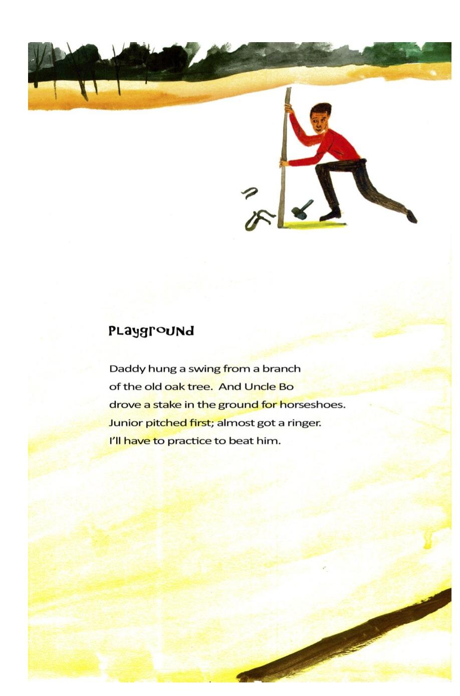

Why is a playground
an important part of a school?

Slide 18
Citations
Slide 2: from the UN Convention on the Rights of the Child
Slides 3- 4: Accessible playground design can build a more inclusive city
Slide 5: Holy Trinity School Inclusive Playground, St. Matthews, Kentucky | No Fault
Slide 6: Accessible or Inclusive? Playgrounds for Everyone Go Beyond ADA
Slides 7-9: https://www.special-education-degree.net/30-most-impressive-accessible-and-inclusive-playgrounds/
Slide 7: http://brooklynsplayground.org/
Slide 9: http://www.touchedbyolivia.com.au/
Slide 10: Video: https://www.youtube.com/watch?v=gLb2jEUq-5o, Image: https://www.dezeen.com/2017/10/02/fuji-kindergarten-tokyo-tezuka-architects-oval-roof-deck-playground/
Slides 11-16: https://bostonchildrensmuseum.org/martins-park
Slide 17: from Dear Mr. Rosenwald: The School that Hope Built, Carole Boston Weatherford and Gregory Christie

