Slide 1
Weekly Words
Unit 1, Week 4
Notes:
ability: skill or talent
commitment: dedication to something or to an idea
education: the act of learning and being taught, especially in school
equal rights: when all people have access to the same things and ideas
government: leadership of a country, state, or town
persistence: the ability to keep going, even through challenges
quality: being excellent
right: what someone should have and be able to do

Slide 2

ability
noun
skill or talent
Notes:
ability (noun)
Elaboration:
We often think of what babies can’t do, but look: this baby has the ability to crawl, and is working on the ability to walk!
Think, Pair, Share prompt:
What is an ability your partner has? Do you have that same ability?
https://www.zerotothree.org/resources/202-steps-toward-crawling

Slide 3
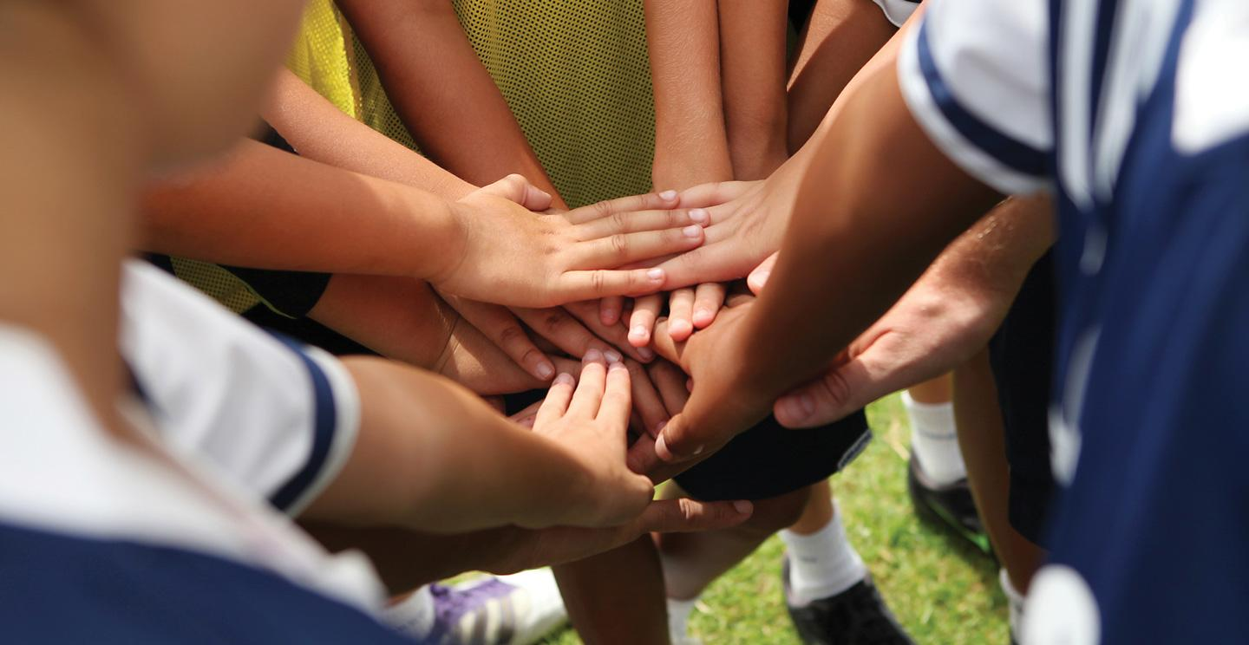
commitment
noun
dedication to something or to an idea
Notes:
commitment (noun)
Elaboration:
“We’re all in it together!” This expression shows that we feel a commitment to each other, to the team, to the goal we are aiming for. A commitment is a kind of promise. In our classroom community, we have made a commitment to _____.
Think, Pair, Share prompt:
How can you show that you have a commitment to making our classroom a positive place for all of us?
https://aurora.edu/academics/undergraduate/coaching/index.html

Slide 4
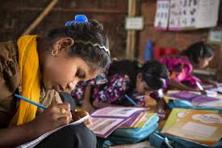
education
noun
the act of learning and being taught, especially in school
Notes:
education (noun)
Elaboration:
Education includes all of the things we are learning at school—writing, mathematics, science, reading, developing new skills with tools and materials… You come to school to get an education.
Think, Pair, Share prompt:
Why is education important?
https://www.unicef.org/education/girls-education

Slide 5

government
noun
leadership of a country, state, or town
Notes:
government (noun)
Elaboration:
Our government includes a Mayor, city councilors, and other people who make sure the people in our town have the services and resources they need.
Think, Pair, Share prompt:
With your partner, share what you know about something the government of the United States does for people who live here.
https://www.istockphoto.com/photo/state-capitol-building-augusta-maine-gm115205677-10184186?utm_source=pixabay&utm_medium=affiliate&utm_campaign=SRP_image_sponsored&utm_content=https%3A%2F%2Fpixabay.com%2Fimages%2Fsearch%2Fmaine%2520capitol%2F&utm_term=maine+capitol

Slide 6

persistence
noun
the ability to keep going, even through challenges
Notes:
persistence (noun)
Elaboration:
It might take you a long time and a lot of practice to learn to do a perfect cartwheel. This requires persistence, trying it over and over and over again, even when you feel like giving up!
Think, Pair, Share prompt:
Have we met any characters who showed persistence? What were they trying to accomplish?
https://dancingloud.wordpress.com/2013/06/26/cartwheel-challenged-some-strategies/

Slide 7

quality
adjective
being excellent
Notes:
quality (adjective)
Elaboration:
This word can be used in different ways. Here, we are talking about education being “high quality,” which describes something that is valuable and well done or well made. This is a quality chair I’m sitting in—it’s comfortable, sturdy, and it won’t fall apart easily. A high quality education includes children having strong teachers—and good quality materials.
Think, Pair, Share prompt:
What can communities do to make sure that all children receive a quality experience in school?
https://www.omnidetroit.top/products.aspx?cid=134&cname=baby+building+blocks+wooden

Slide 8
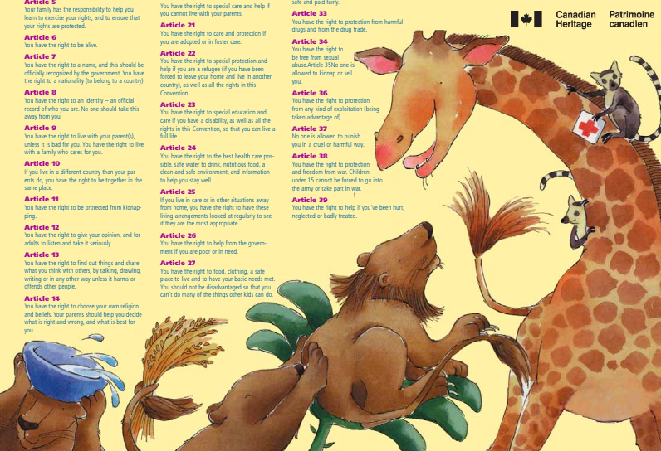
right
noun
what someone should have and be able to do
Notes:
right (noun)
Elaboration:
People have been talking and advocating for hundreds and hundreds of years about their rights—for fair pay, good housing for all, education, for example.
Think, Pair, Share prompt:
Finish these sentences with your partner:
You have a right to _____.
I have a right to _____.
We all have a right to _____ together.
https://drive.google.com/file/d/1goSnD3Udso6fcaWJV_zhlsKh0wGSrkwv/view?usp=sharing

Slide 9
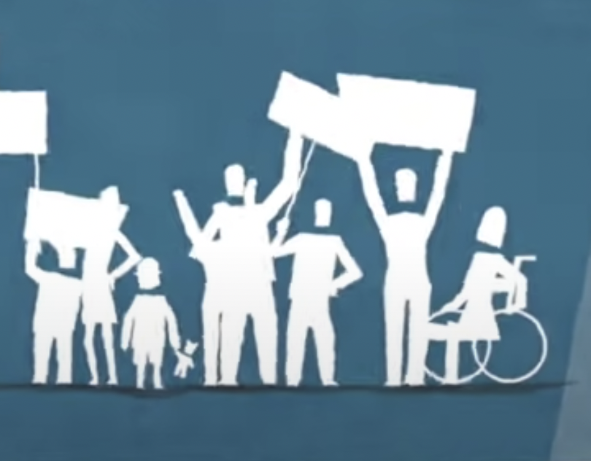
equal rights
plural noun
suggestion or guidance for doing something
Notes:
equal rights (noun) [Note: Teach after teaching right.]
Elaboration:
Equal means “same.” If children here have the right to rest and play and learn, that’s good for you. But if some children have to work and not receive an education, not everyone has equal rights.
Think, Pair, Share prompt:
Why is it important for children to have equal rights?
https://eachother.org.uk/know-rights-celebrate-protect-story-behind-human-rights-animation/

