Slide 1
Past Tense Verbs
Vocabulary & Language Week 4, Days 3-4

Slide 2
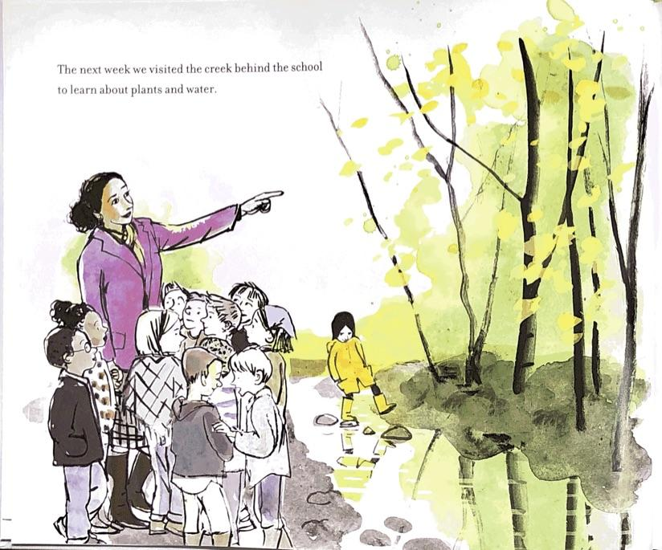
Verb Tense
The next week we visited the creek behind the school to learn about plants and water.

Slide 3
Verbs: The Past Tense
read
called
practiced
explored
played
wrote
explained

Slide 4
Verbs: The Past Tense
call - called
play - played
explain - explained

Slide 5
Verbs: The Past Tense
practice - practiced
explore - explored

Slide 6
Verbs: The Past Tense
write
wrote
read
read

