Slide 1
Phrases of Time
Writing Week 3, Day 1

Slide 2
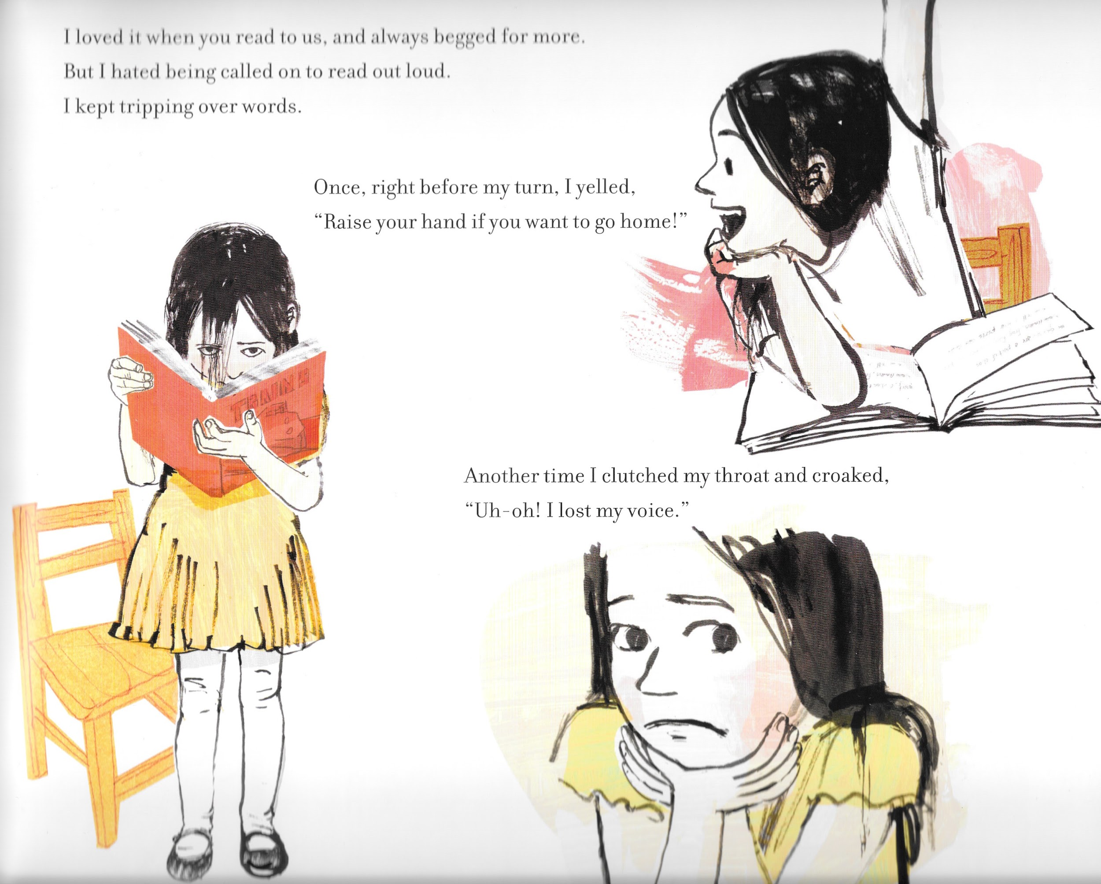
Slide 1

Slide 3
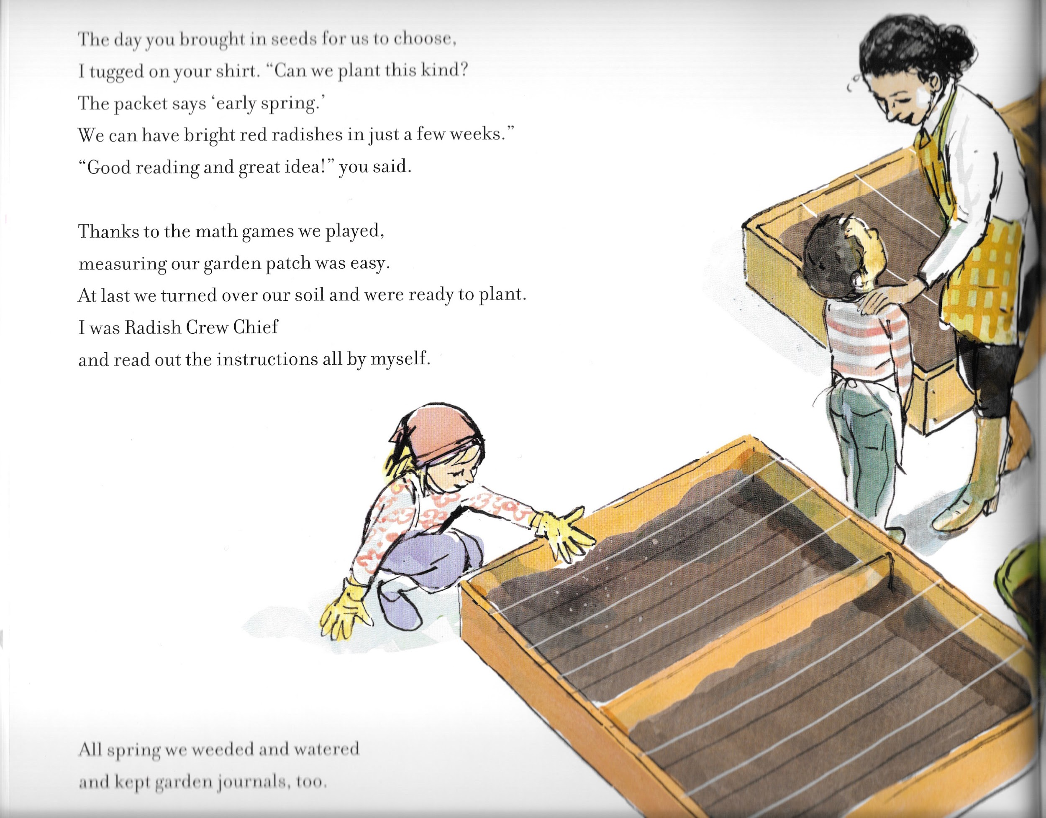
Slide 2

