Slide 1
Weekly Words
Unit 1, Week 3
Notes:
collaborate: to work together
compassionate: showing concern for others
imagination: the ability to form new ideas or images in your mind, thinking about things that may not be real
judge: to form an opinion about
respect (v): to admire deeply; (n): admiration
support: to give assistance
sympathetic: showing care for
understanding: aware of other people’s feelings, sympathetic

Slide 2
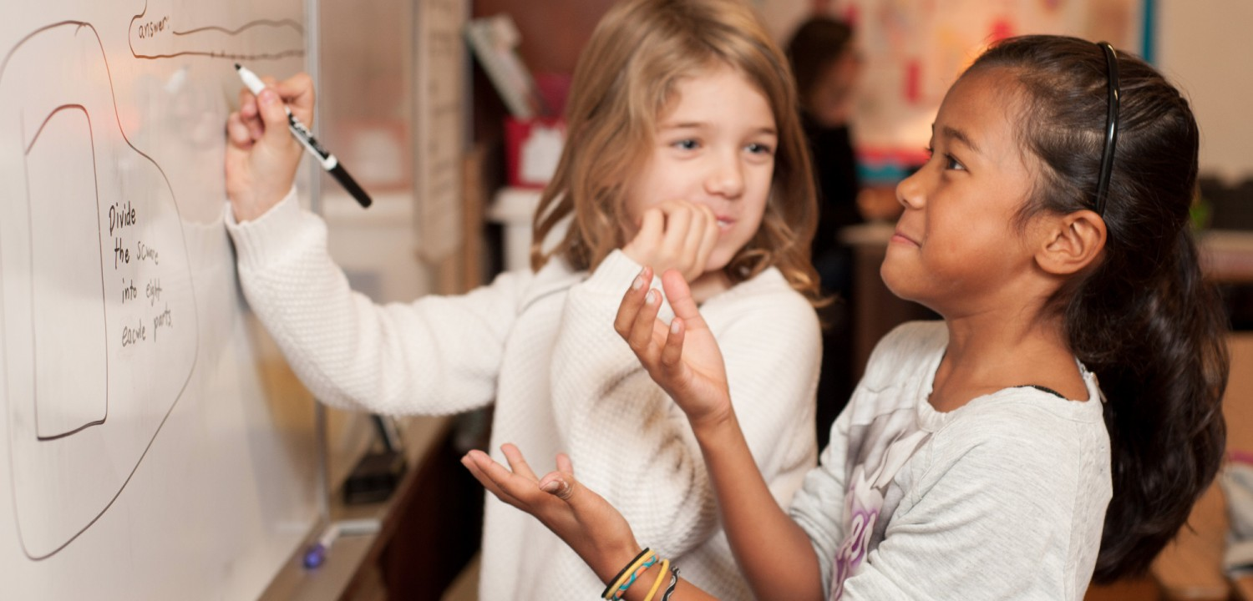
collaborate
verb
to work together
Notes:
collaborate (verb)
Elaboration:
So far in second grade you have had many opportunities to collaborate. When you collaborate, you don’t just sit next to each other, you work together to accomplish something. You can collaborate with just one person or with a whole group!
Think, Pair, Share prompt:
When are two times that you like to learn through collaborating with others?
https://www.cradlcase.com/giving/children-collaborating/

Slide 3
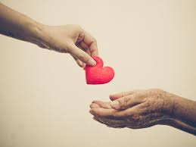
compassionate
adjective
showing concern for others
Notes:
compassionate (adjective)
Elaboration:
In the stories we are reading we see examples of characters feeling compassionate toward others.
Think, Pair, Share prompt:
What examples can you think of?
https://zenfulspirit.com/2017/10/12/cultivate-compassion-everyday-life/

Slide 4
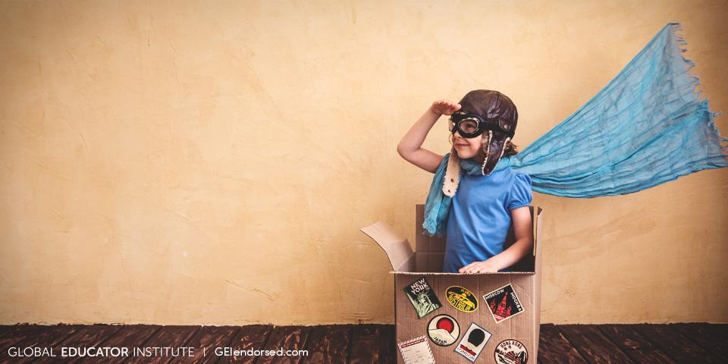
imagination
noun
the ability to form new ideas or images in your mind, thinking about things that may not be real
Notes:
imagination (noun)
Elaboration:
This child has used their imagination to create some kind of flying machine out of a box, a costume, and a story about travel.
Think, Pair, Share prompt:
Hold up a common object.
Use your imaginations: what could this become, besides just a plain old ___?
http://geiendorsed.com/blog/beyond-the-classroom/encouraging-childrens-pure-imagination/

Slide 5

judge
verb
to form an opinion about
Notes:
judge (verb)
Elaboration:
People do not always judge something in the same way, because we have different ideas and opinions about what we think is valuable or good or beautiful. A common expression is, “Judge for yourself.” It means, decide what you think of something.
Think, Pair, Share prompt:
Judge this: Point to a common area of the classroom. Is this a good space for learning? Tell your partner what you think about it and why.
https://www.houstonchronicle.com/opinion/editorials/article/Thumbs-up-thumbs-down-12295067.php

Slide 6
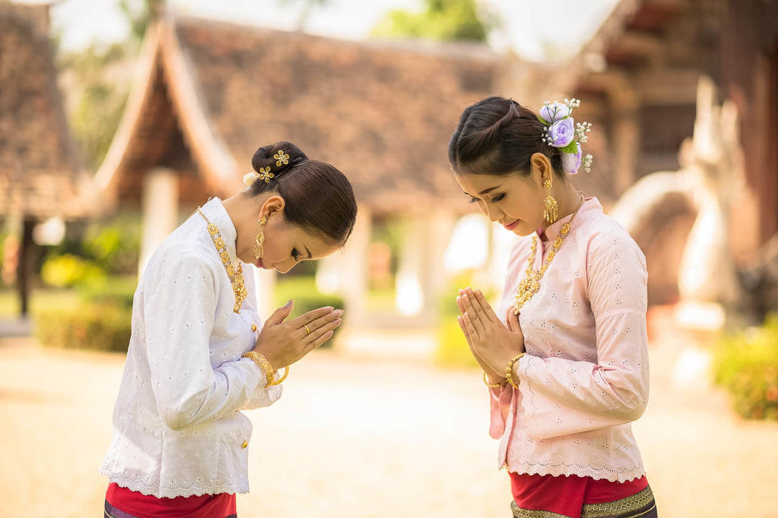
respect
verb: to admire deeply
noun: admiration
Notes:
respect (verb, noun)
Elaboration:
These two women respect each other. We can tell by their actions.
People can demonstrate respect for others through a greeting, through the words they use, and through actions.
Think, Pair, Share prompt:
What are some words or actions you use to show respect for someone?
https://www.asmallworld.com/explorer/articles/seven-ways-greeting-each-other-around-world

Slide 7

support
verb
to give assistance
Notes:
support (verb)
Elaboration:
Let’s agree to support each other this year in our classroom. That will make this a great learning community!
Think, Pair, Share prompt:
What is something someone can do to support you as a learner?
https://www.cnn.com/2020/05/30/us/how-to-be-an-ally-guide-trnd/index.html

Slide 8
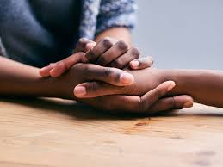
sympathetic
adjective
showing care for
Notes:
sympathetic (adjective)
Elaboration:
Sympathetic is a synonym of compassionate. Both words mean showing care for others. When you feel sympathetic towards someone, you might say, “I know how you feel.”
Think, Pair, Share prompt:
With your partner, finish this sentence: “I am sympathetic when someone in my family _____.”
https://www.merriam-webster.com/words-at-play/sympathy-empathy-difference

Slide 9
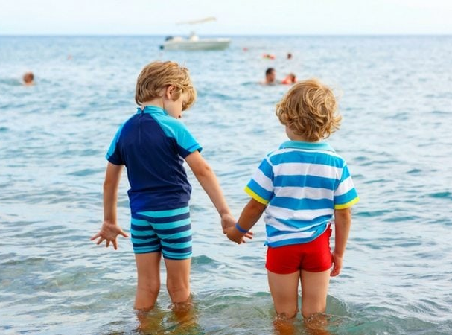
understanding
adjective
aware of other people’s feelings, sympathetic
Notes:
understanding (adjective)
Elaboration:
Here’s another synonym of compassionate and sympathetic. In this image, it looks like the bigger kid is understanding about the little one not being quite sure about going in the water. In A Letter to My Teacher, the teacher was understanding with the student.
Think, Pair, Share prompt:
What can you say or do to show someone that you feel understanding towards them?
https://www.twiniversity.com/2016/11/when-an-older-sibling-has-a-favorite-twin/untitled-design-741/

