Slide 1
Weekly Words
Unit 1, Week 2
Notes:
admire: to like very much
advice: guidance
aim: purpose, a wanted outcome
anxious: worried or nervous; also, wanting something very much
belong: to be part of
expert: someone who knows a lot about something or knows how to do something well
explain: to talk or write about something clearly and precisely, so someone else understands
fearful: afraid

Slide 2
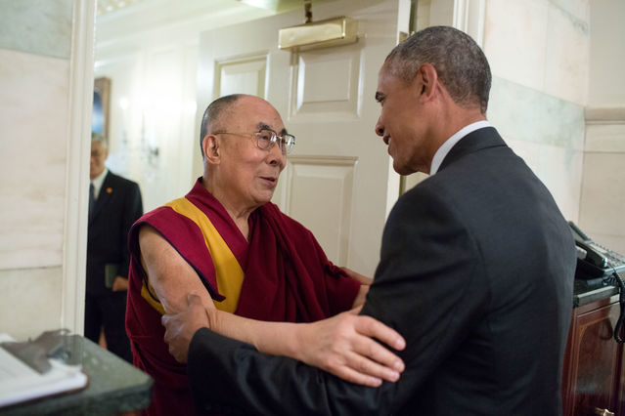
admire
verb
to like very much
Notes:
admire (verb)
Elaboration:
These two world leaders, Barack Obama in the United States and the Dalai Lama in Tibet, appreciate each other’s work for peace. We can see by how they greet each other that they think very positively about each other.
Think, Pair, Share prompt:
Who do you admire? Why do you admire that person?
https://www.psychologytoday.com/us/blog/putting-psyche-back-psychotherapy/201708/why-what-i-admire-in-you-also-says-something-about-me

Slide 3
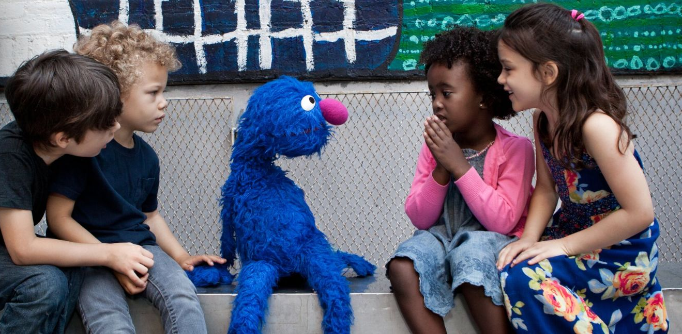
advice
noun
suggestion or guidance for doing something
Notes:
advice
Elaboration:
We might ask someone for their opinion about what we should do when we are uncertain. We might want to follow the advice they give us, and we might not!
During Thinking and Feedback, when we are giving suggestions, you could also say we are giving advice.
Think, Pair, Share prompt:
What advice do you think these children might be giving or receiving from the puppet?
Or:
What is a piece of advice you have received from or given someone lately?
https://www.sesameworkshop.org/what-we-do/racial-justice

Slide 4
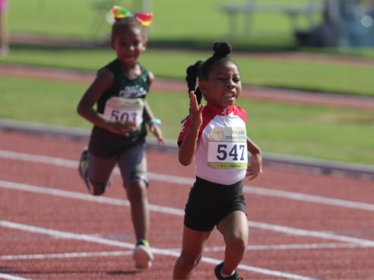
aim
noun
purpose, a wanted outcome
Notes:
aim (noun)
Elaboration:
You might know “aim” as a verb: You aim your arm in a certain direction and throw the paper airplane that way.
“Aim” as a noun is related; it’s what you are trying to do. My aim is to go to bed early each night so I get enough sleep. The aim of these young runners is to win their race!
Think, Pair, Share prompt:
Think about a studio you have started working in. What is your aim when you get to that area of our classroom? What do you hope to do there?
https://aausports.org/news.php?news_id=1801517

Slide 5
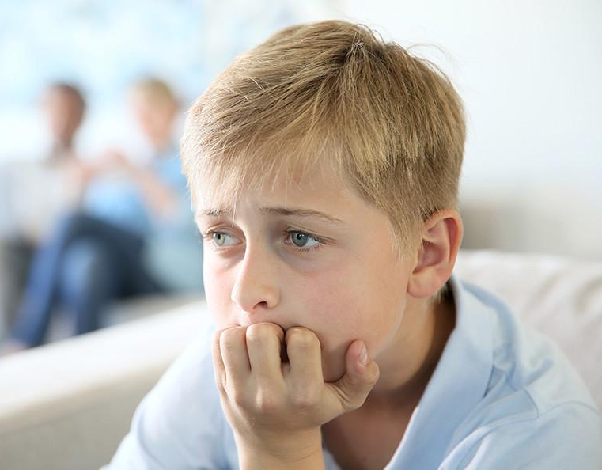
anxious
adjective
worried or nervous; also, wanting something very much
Notes:
anxious (adjective)
Elaboration:
We all know what it feels like to be anxious—worried about something, not sure how it’s going to turn out, and maybe a bit impatient to get it over with. Many people feel anxious about doing something for the very first time.
Think, Pair, Share prompt:
Share a time when you have felt anxious.
https://news.yale.edu/2019/03/12/new-way-combat-childhood-anxiety-treat-parents

Slide 6
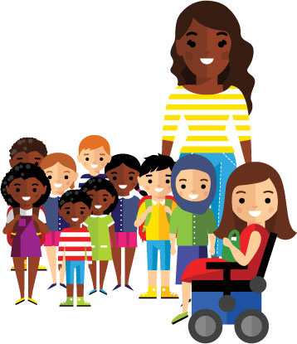
belong
verb
to be part of
Notes:
belong (verb)
Elaboration:
An important part of building a strong community is making sure every person feels that they belong. I want each of you to know that you belong here, in our classroom.
Think, Pair, Share prompt:
How can you help someone be sure that they belong?
https://connectability.ca/2019/05/24/we-all-belong/

Slide 7

expert
noun
someone who knows a lot about something or knows how to do something well
Notes:
expert (noun)
Elaboration:
This is a scientist. She is an expert. She knows a lot about a form of science.
We can be an expert at doing something, or we can be an expert about a topic—knowing a great deal about that topic.
Think, Pair, Share prompt:
Are you an expert at something? Share it with your partner. Also share something you would like to become an expert at or about.
https://www.premierguitar.com/articles/Bonnie_Raitt_Return_of_the_Blues_Baroness?page=2

Slide 8
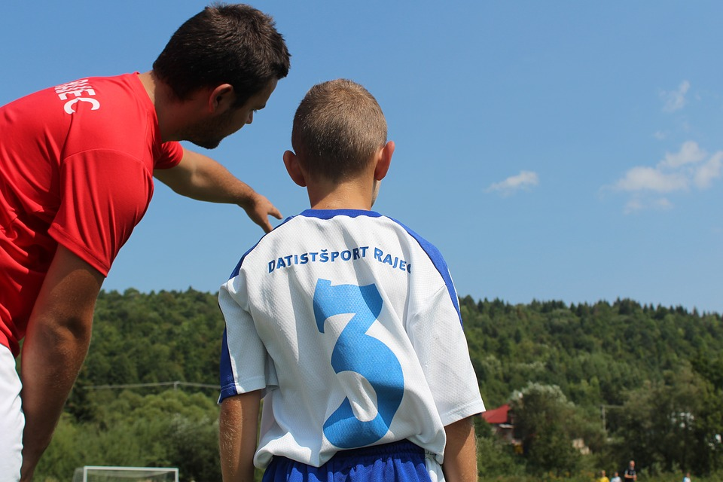
explain
verb
to talk or write about something clearly and precisely, so someone else understands
Notes:
explain (verb)
Elaboration:
During this lesson, I explain what words mean! When you want to tell someone else how to do something or about a topic you’re an expert about, you tell that person what you know; you explain.
Think, Pair, Share prompt:
Look at this picture. What do you think one person is explaining to the other?
https://www.calacademy.org/educators/lesson-plans/habitat-adaptation-matchup

Slide 9
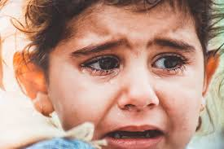
fearful
adjective
afraid
Notes:
fearful (adjective)
Elaboration:
Last week we saw the word fearless—having courage or not being afraid. The suffix less means “without.” Without fear.
Look at this word. The base word is again fear, and it has the suffix ful, which means “full of.”
Fearful means full of fear, or afraid. When you feel fearful, you might also feel anxious.
Just by changing the suffix, the words we make can be antonyms, or opposites.
Think, Pair, Share prompt:
Many situations can make people feel fearful. What situations can you and your partner think of?
https://www.attachmentproject.com/blog/fearful-avoidant-attachment-in-childhood/

