Slide 1
Adjectives
Vocabulary & Language Week 2, Days 3-4

Slide 2

Adjectives
Adjectives describe nouns.
They answer these questions:
How many/much?
What kind?
What like?
Which ones? Whose?

Slide 3

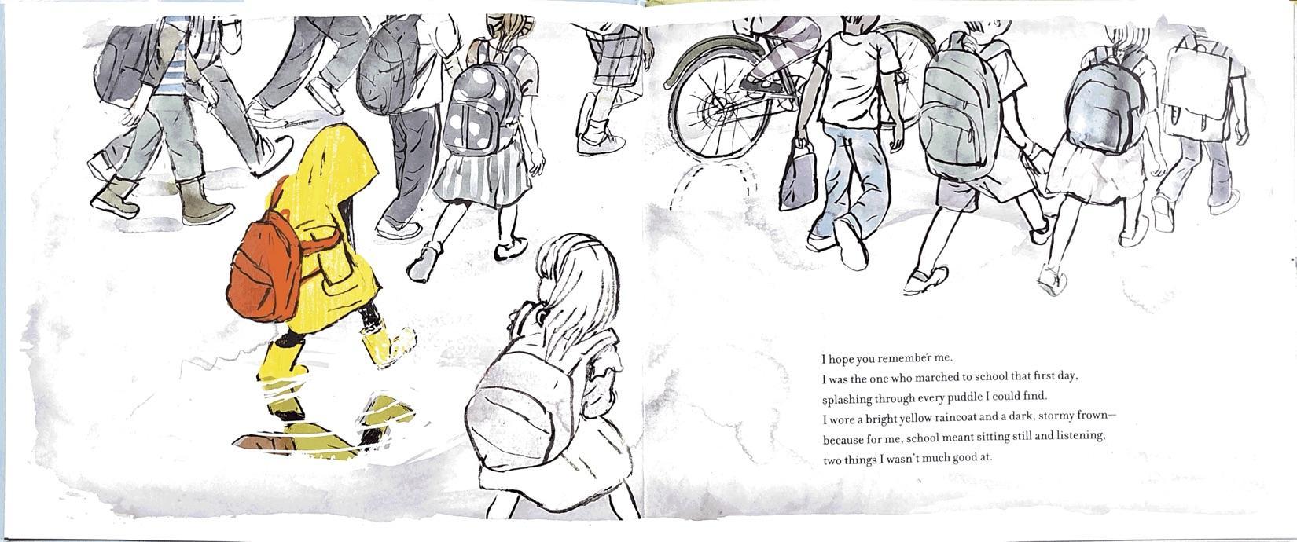

Slide 4
Adjectives
What? raincoat
What like?
bright yellow

Slide 5
Adjectives
What? frown
What like?
dark
stormy

Slide 6
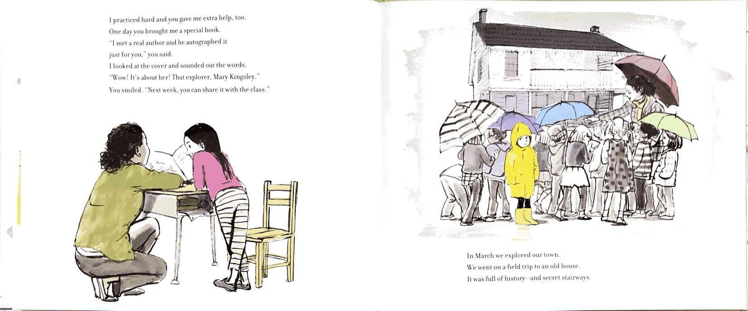

Slide 7
Adjectives
What? help
What kind?
extra

Slide 8
Adjectives
What? house
What like?
old

Slide 9
Nouns
Nouns name people, places, things, or ideas.
Write your own sentence—it can be about anything!
Go back to your sentence and underline the nouns.

Slide 10
Adjectives
Remember, adjectives describe nouns.
Use these questions to help you add at least one adjective to your sentence.
How many/much?
What kind?
What like?
Which ones? Whose?
Circle the adjective(s) you added.

