Slide 1
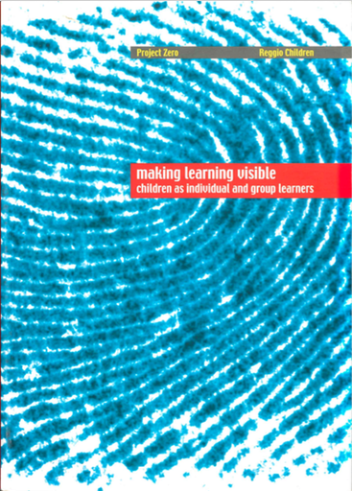
Children’s Comments on Group Learning
Text Talk Week 2, Day 4

Slide 2
Children’s Comments
on Learning Groups and Group Learning
Five and six year old children from the Villetta and Diana Schools, Reggio Emilia, Italy
Giudici, C., Rinaldi, C., & Krechevsky, M. (2001). Making learning visible: children as individual and group learners. Reggio Emilia, Italy: Reggio Children. Pgs. 322-329.

Slide 3
Paragraph 2
Angela V. I like working in groups, because it’s faster. When you work alone it takes longer… We can decide on things together. In a group you can do things together, so it’s more fun for us and for everyone else.

Slide 4
Paragraph 8
Anna Sometimes it’s better to do things by yourself. For example, I’m learning how to jump rope. When I practice I have to think really carefully about the jump and the rope. No one can be around or else I get confused and I do it wrong.

Slide 5
Paragraph 17
Luca We’re learning how to do a lot of things and when you learn a lot, you become an expert, too, and even more… a super expert! If you build stuff a lot, you turn into an expert builder because you’ve learned a lot of times how to do it. You can even do it with your eyes closed. I know how to do some things, but not everything.

Slide 6
Paragraph 20
Nicola You have to know how to do different things, because if everyone knows how to do different things the whole group knows how to do everything. Even the best things.

Slide 7
Paragraph 25
Nicola You argue, and then you don’t know what’s going on. You don’t know what you’re supposed to do and then you get tired of it and go and do something else.

Slide 8
Paragraph 34
Francesco For example, when you’re with a group you feel like you don’t know some things, because you’re not an expert, and someone else helps you and that way you learn stuff… and the thing you learned sticks inside and it never comes off because it sticks to the other ideas you’ve already got.

Slide 9
Francesco When you have to do something with your memories that only you know, or when there are things you have to think about by yourself.
Paragraph 40
Michele Let me ask a question: It’s not fun to be alone when you’re playing, but what about when you’re writing something that’s hard? … if I write it when there’s other people, it’s kind of hard for me.
Paragraph 43

Slide 10
Paragraph 44
Caterina It’s easier to share ideas with your friends, and you get new ideas. If someone doesn’t understand something, the other person helps her. It’s better when the ideas are all different; a group is for learning other things, not the things you already know. Friends can have different ideas. Being friends means always being happy about the ideas we said. When there are kids in a group who don’t know each other, the hardest thing is to explain so that they understand.

