Slide 1
Weekly Words
Unit 1, Week 1
Notes:
agreement: something that two or more people agree is true
brave: having courage
community: a group of people who share space and ideas
exasperating: frustrating
fearless: having courage, ready to do something that might be scary (without fear)
include: to make someone or something part of a group
patience: ability to wait calmly
still: not moving

Slide 2
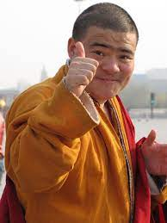
agreement
noun
something that two or more people agree is true
Notes:
agreement (noun)
Elaboration:
So far in second grade we have started making these agreements together… [Name agreements that are taking shape in the classroom.]
Think, Pair, Share prompt:
What is an agreement you would like to make with the people you live with?
https://en.wikipedia.org/wiki/Thumb_signal

Slide 3
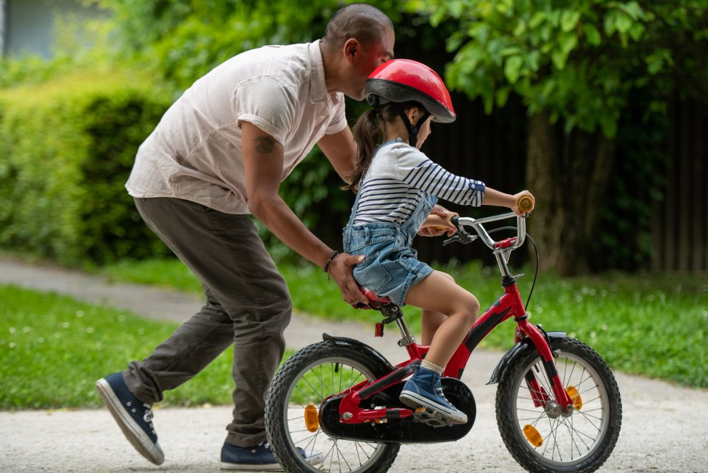
brave
adjective
having courage
Notes:
brave (adjective)
Elaboration:
This child is brave because she is trying to ride a bike on her own! She might feel nervous, but she is trying it anyway!
Think, Pair, Share prompt:
When have you needed to feel brave? Describe that situation to your partner.
https://activeforlife.com/how-to-teach-your-child-ride-bike/

Slide 4
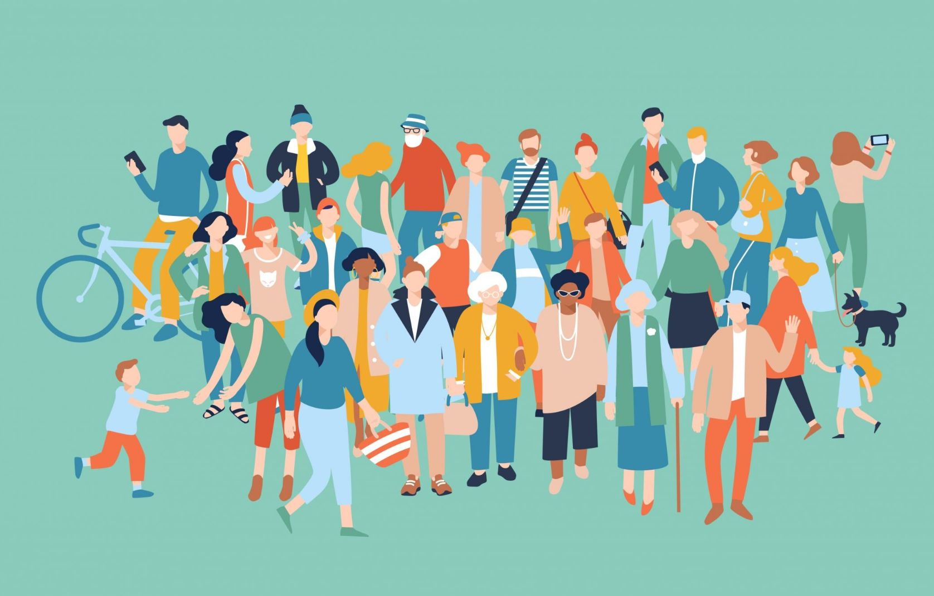
community
noun
a group of people who share space and ideas
Notes:
community (noun)
Elaboration:
When people are part of a group that workds together, when people live with or near each other, when people share an interest or beliefs, they make a community. Our classroom is a learning community.
Think, Pair, Share prompt:
What communities are you part of?
https://woodlibrary.org/our-investment-in-wood-library-builds-community/

Slide 5
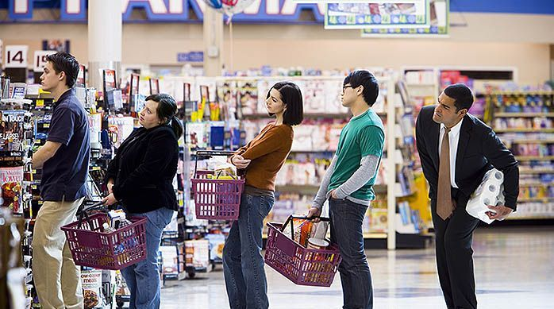
exasperating
adjective
frustrating
Notes:
exasperating (adjective)
Elaboration:
In A Letter to My Teacher, the teacher finds the narrator’s behavior exasperating—she feels frustrated and may not know the best thing to do. Sometimes waiting in a long line can be exasperating.
Think, Pair, Share prompt:
Imagine yourself in this exasperating line. What could you do to keep yourself from becoming too frustrated?
https://wwdaydream.com/2019/05/19/patience-is-a-virtue-or-a-learned-skill/

Slide 6
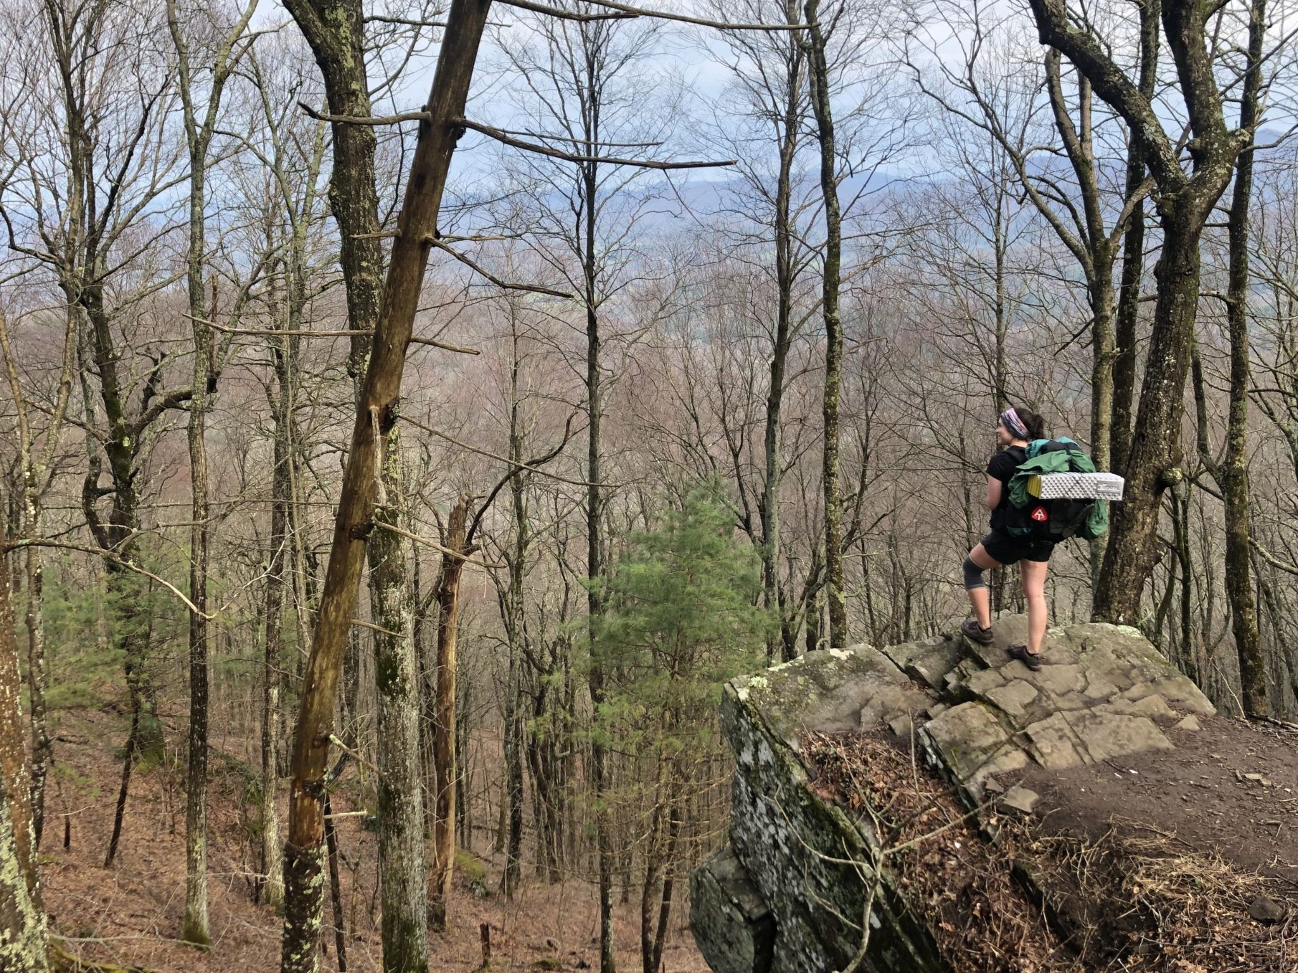
fearless
adjective
having courage, ready to do something that might be scary (without fear)
Notes:
fearless (adjective)
Elaboration:
This hiker is fearless, even in the woods, even at the top of a tall cliff. Instead of feeling afraid, they feel confident that they can keep going, even if there may be unknown things ahead.
Think, Pair, Share prompt:
Mary Kingsley was fearless as an explorer. How about you? Have you been fearless? What helps you feel that way?
https://thetrek.co/appalachian-trail/5-things-i-learned-thru-hiking-as-a-solo-female/

Slide 7
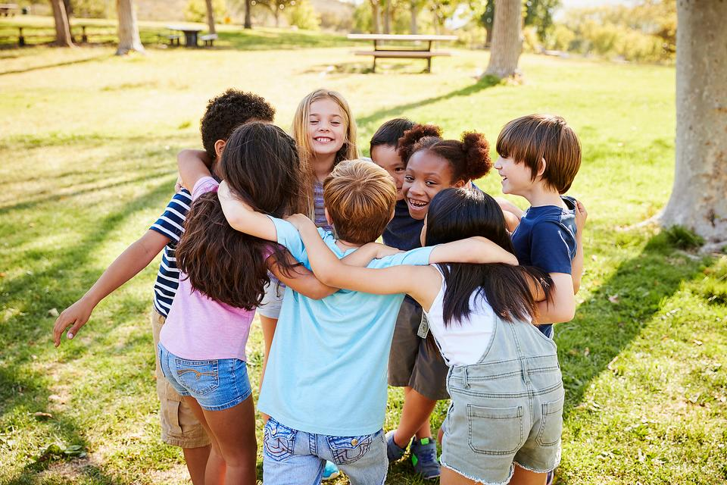
include
verb
to make someone or something part of a group
Notes:
include (verb)
Elaboration:
Everyone here is part of the huddle. If another child came along, this group would probably include them!
Think, Pair, Share prompt:
Why is it important to include others?
https://30seconds.com/mom/tip/17700/Kids-Should-Have-to-Play-With-Everyone-My-Thoughts-on-Teaching-Children-to-Be-Includers

Slide 8
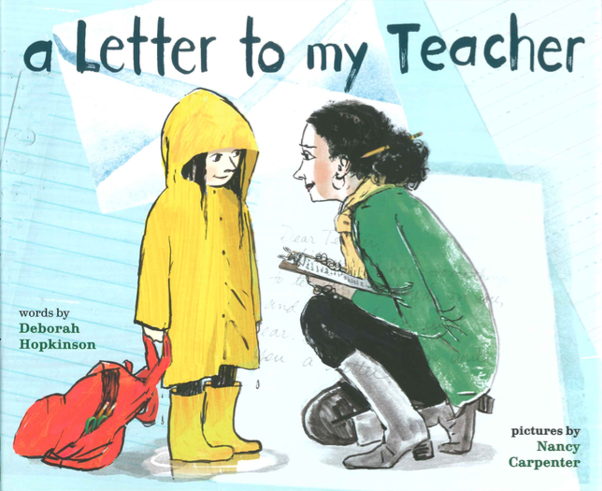
patience
noun
ability to wait calmly
Notes:
patience (noun)
Elaboration:
The teacher in this book shows patience as she got to know the children in her class. She takes her time to learn who they are and what they need, and she is gentle with the narrator’s mistakes.
Think, Pair, Share prompt:
Can you think of a time when you needed to show patience—maybe with a friend or with someone in your family? Tell your partner about it.
From A Letter to my Teacher, illustrated by Nancy Carpenter

Slide 9
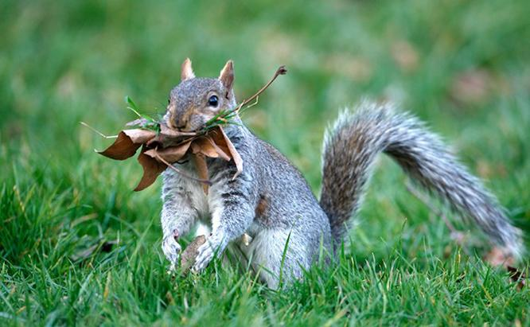
still
adjective
not moving
Notes:
still (adjective)
Elaboration:
Narcissa sits still; she doesn’t move. This squirrel is not moving. It is pausing its movement and staying still to collect information by listening and looking to see if there is danger.
Think, Pair, Share prompt:
Let’s all be completely still. [Pause for a moment.]
Now turn to your partner and tell what you noticed in your body and in the classroom.
https://www.perkypet.com/articles/squirrel-nests

