Slide 1
Wellfleet, Cape Cod
Writing Week 8, Day 4

Slide 2
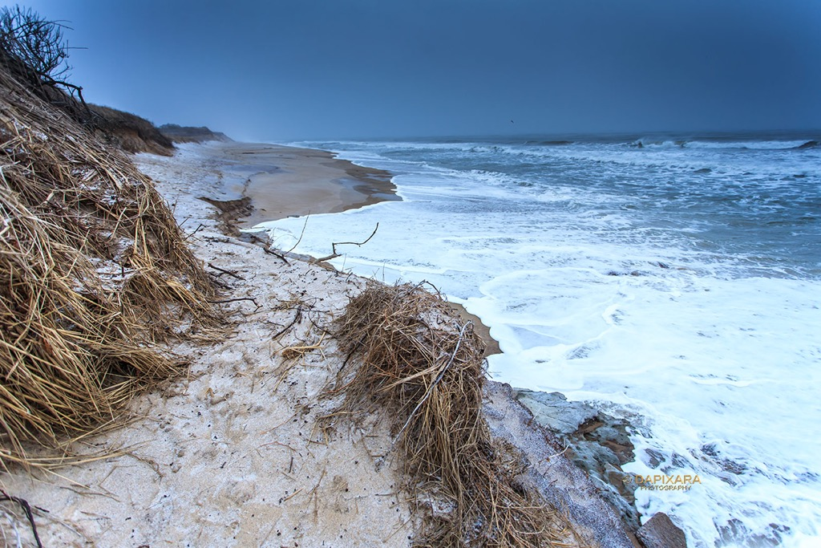
https://dapixara.com/News/files/category-storm.html
Notes:
Rio Negro, Patagonia

