Slide 1

Off to Class
Incredible and Unusual Schools Around the World
“Water, Water, Everywhere”
pages 8-9
Text Talk Week 8, Day 2

Slide 2
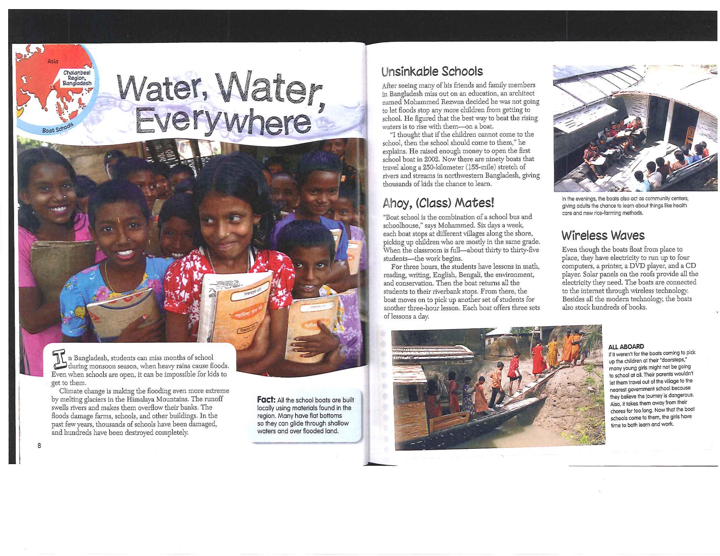

Slide 4
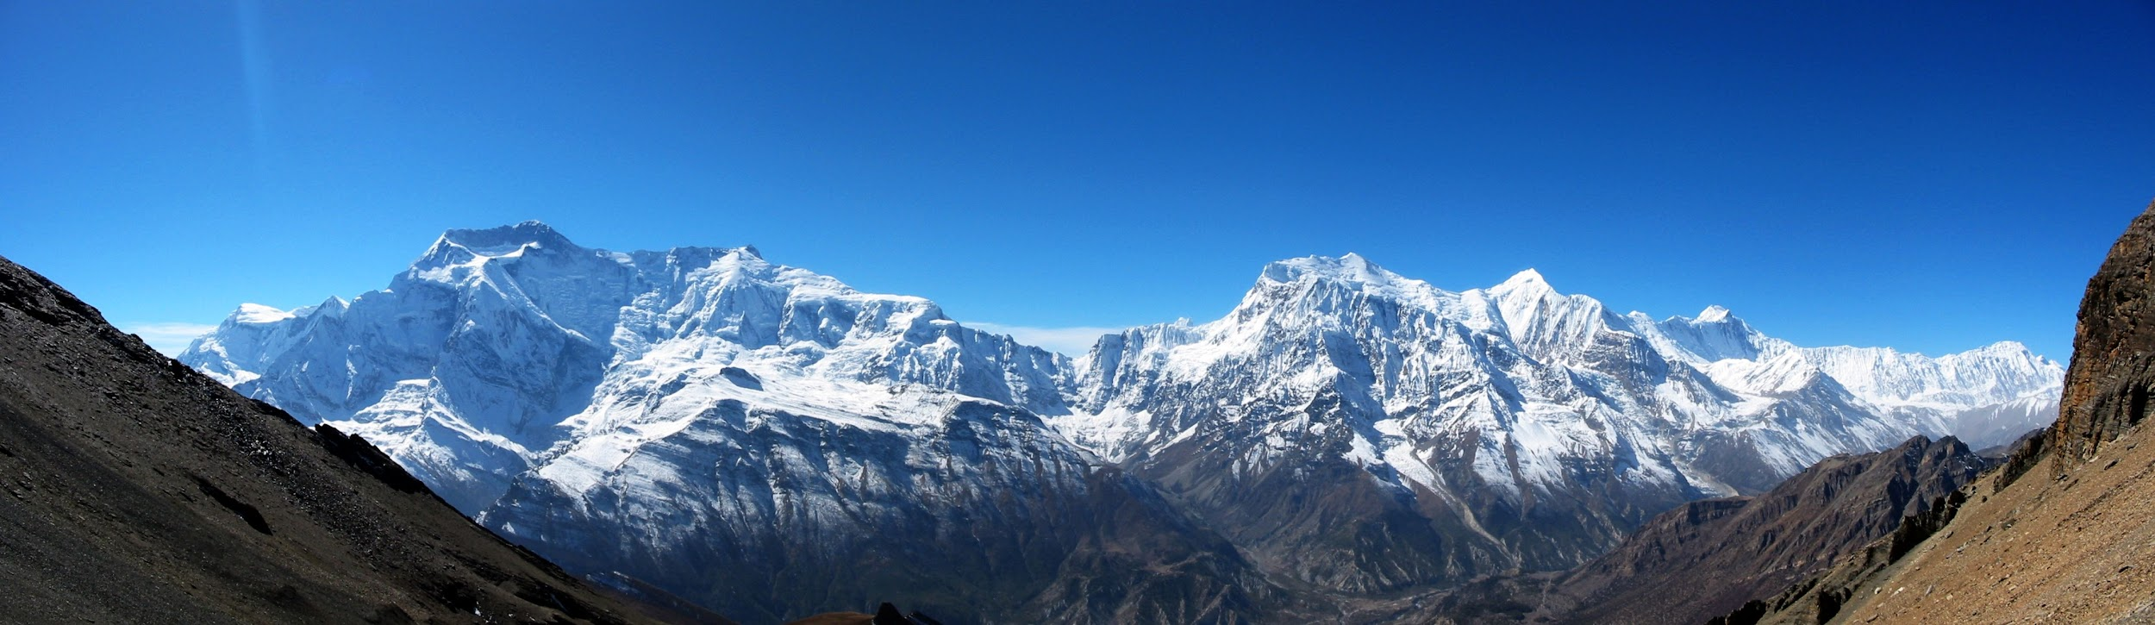
The Himalaya Mountains are the largest mountains in the world.
They are covered with glaciers.

Slide 5
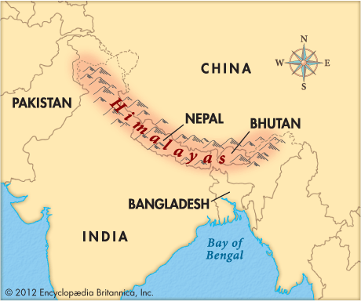

Slide 10
Citations
Slide 4: https://en.wikipedia.org/wiki/Annapurna_Massif
Slide 5: https://kids.britannica.com/kids/assembly/view/87509

