Slide 1
Unit 2 End of Unit Assessment
“Erosion! The Ever-Changing Earth”
Text images with Audio captions
Unit 2, Week 8

Slide 2

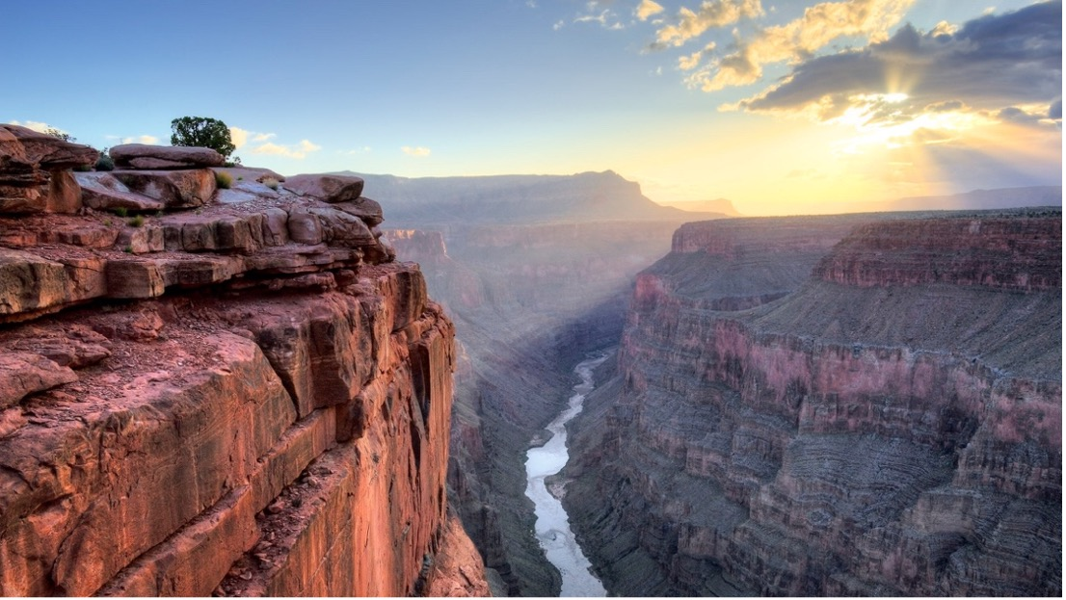
Photograph 1. Moving water created the Grand Canyon, which is about a mile deep and almost twenty miles wide in some parts. It took about 5 million years to form.

Slide 3
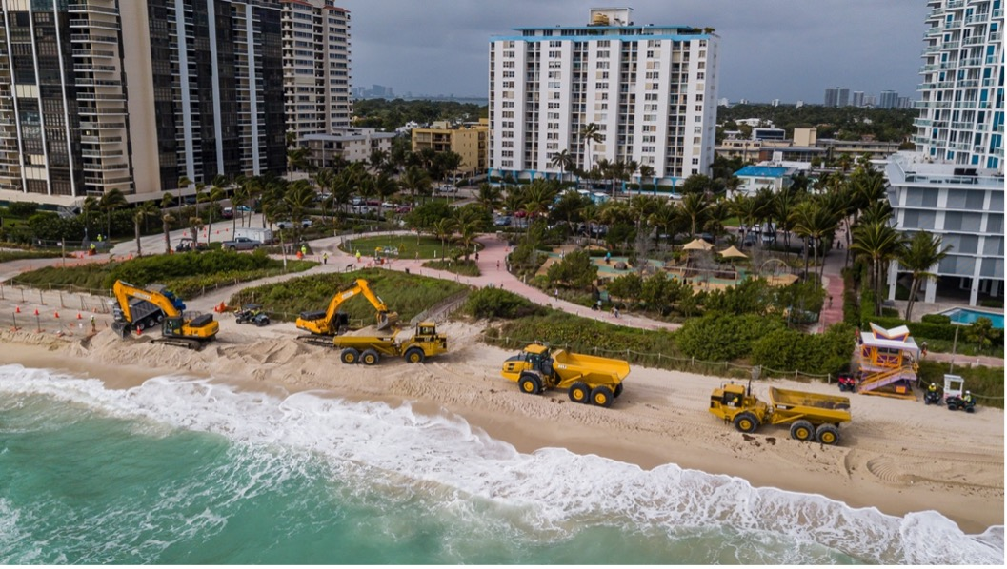
Photograph 2. In Miami Beach, people are trying to slow down the erosion caused by sea level rise, storms, and apartment buildings by adding more sand on the beach.

Slide 4
Citations
Slide 2: https://www.outsideonline.com/adventure-travel/national-parks/grand-canyon-travel-guide/
Slide 3: https://www.miamiherald.com/news/local/community/miami-dade/miami-beach/article239077713.html

