Slide 1
Weekly Words
Unit 2, Week 7
Notes:
evaluate: to judge the value of
intervene: to enter a situation to change what is happening
propose: to suggest
protect: to keep safe from harm
recommend (v): to suggest, to present as a good idea
recommendation (n): suggestion
respond: to answer, in words or in another way
restore: to return to the way something was before

Slide 2
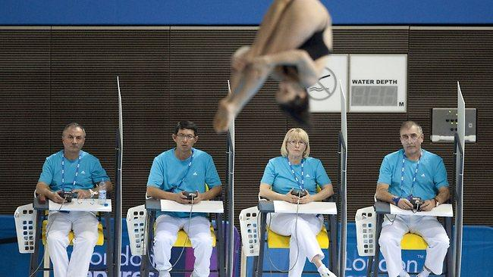
evaluate
verb
to judge the value of
Notes:
evaluate (verb)
Elaboration:
Look in the middle of this word: we can see the word “value.”
These judges are watching very closely, and they will give a score, based on what they value -- what they think is important about a diver’s performance: how she jumps, how she holds her body in the air, and how she enters the water. They will evaluate lots of divers and decide who is the best!
Think, Pair, Share prompt:
How do you evaluate a book?
https://www.theaustralian.com.au/sport/after-an-almost-four-year-break-loudy-wiggins-has-made-a-strong-start-for-her-olympic-diving-bid/news-story/a16da01c6e923ae5187fffaf211a769a

Slide 3

intervene
verb
to become involved in something to change what happens
Notes:
intervene (verb)
Elaboration:
Look! All these dominoes would have fallen down, but someone decided to intervene—they put their hand up to prevent the rest of the dominoes from toppling.
Think, Pair, Share prompt:
When you see two friends arguing, what can you do to intervene, or to prevent the argument from getting bigger?
https://safestart.com/news/why-dont-workers-intervene-when-they-see-unsafe-acts/

Slide 4
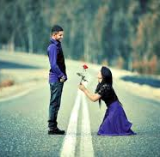

propose
verb
to put forward an idea for others to consider
Notes:
propose (verb)
Elaboration:
You might think of propose as when one person asks someone else to marry them. This is one kind of proposal—one person has an idea about getting married and shares that idea with the person they love to see what they think about it. But you can propose any kind of idea for other to think about.
Think, Pair, Share prompt:
If I asked you for an idea of a game we could play together at recess, what would you propose?
https://www.india.com/viral/leap-year-proposal-girls-propose-a-guy-today-and-if-he-refuses-he-gifts-you-a-gown-12-gloves-992765/, https://www.quora.com/How-do-you-propose-an-idea-to-a-company

Slide 5
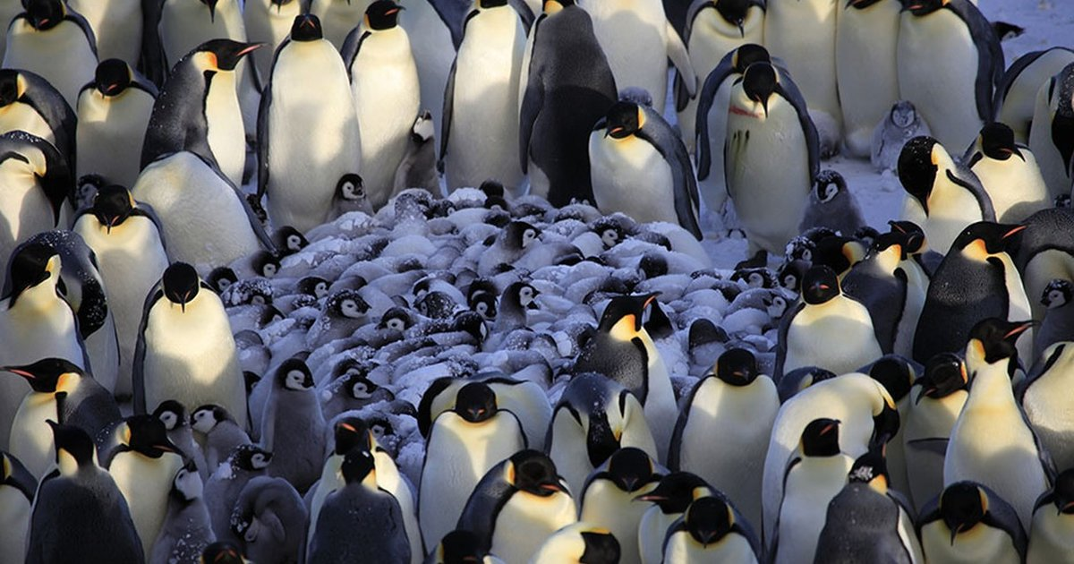
protect
verb
to keep safe from harm
Notes:
protect (verb)
Elaboration:
Animals protect themselves in lots of ways—they run away; they warn other animals to stay away; they hide; they change color; and sometimes they fight. These penguins are acting all together to protect their offspring, or babies.
Think, Pair, Share prompt:
In a big rain storm, how can people protect their feet and the rest of their bodies from getting soaked?
https://assets3.thrillist.com/v1/image/2550282/size/tmg-article_tall.jpg

Slide 6

recommend
verb
to suggest,
to present as a good idea
Notes:
recommend (verb)
Elaboration:
Doctors and nutritionists recommend that we all eat more fruit and vegetables than junk food. They recommend actions that will keep people healthy.
Think, Pair, Share prompt:
Remember what we recommended for the Our Schools Project. Why do you think that was important to recommend?
https://pixabay.com/photos/woman-doctor-nutritionist-fruit-5591780/

Slide 7

recommendation
noun
suggestion
Notes:
recommendation (noun)
Elaboration:
This word, “recommendation,” is “recommend” with a suffix. Let’s see how this suffix changes the meaning.
When you tell a friend to read a favorite book, you make a recommendation. This image is from an online news story that makes recommendations about books for kids that were published last year.
The suffix changes the verb into a noun.
Think, Pair, Share prompt:
What is a recommendation of a book or something else that you can make right now to your partner? Why are you making this recommendation?
https://www.npr.org/2020/08/31/905804301/welcome-to-story-hour-100-favorite-books-for-young-readers

Slide 8
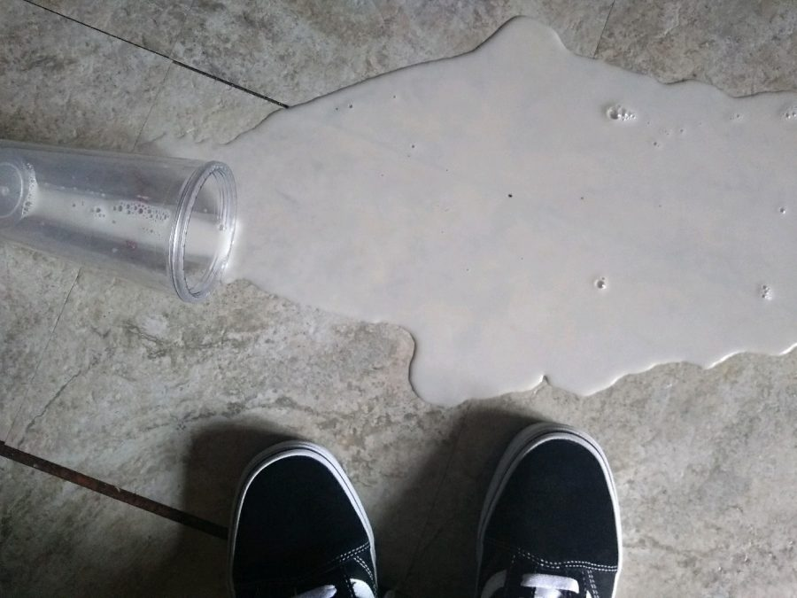
respond
verb
to do something as a reaction to something else
Notes:
respond (verb)
Elaboration:
When someone says hello, a simple way to respond is to wave or say hello back.
When someone proposes an idea, we can respond by saying what we think of it.
We can also respond to a challenge, such as erosion, by coming up with a plan.
We might respond to something with words, or facial expressions, or actions.
Think, Pair, Share prompt:
When something spills, like this milk, how do you respond?
https://meteamedia.org/12349/opinions/split-milk-in-some-eyes-is-the-same-as-split-blood-in-others/

Slide 9

restore
verb
to return something to the way it used to be
Notes:
restore (verb)
Elaboration:
We can restore objects, buildings, and relationships. Here an old house has been restored so that it looks more like it did when it was first built.
Think, Pair, Share prompt:
Do you have something that you would like to restore—such as a broken toy or other object?
Or, what have you seen around your neighborhood that could be restored?
http://rowiewalker.com/restore-old-buildings/

