Slide 1
The Muddy River
Text Talk Week 7, Day 2

Slide 2
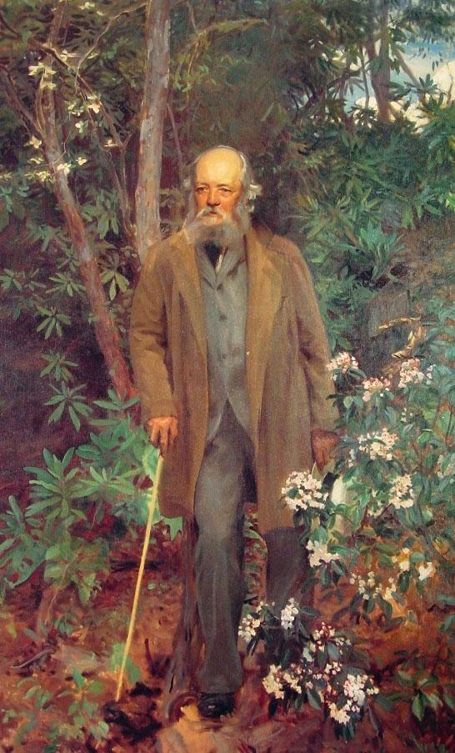
Frederick Law Olmsted
John Singer Sargent, American painter
1895

Slide 3
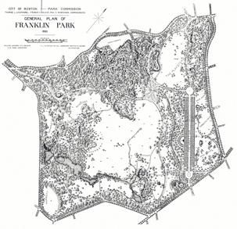
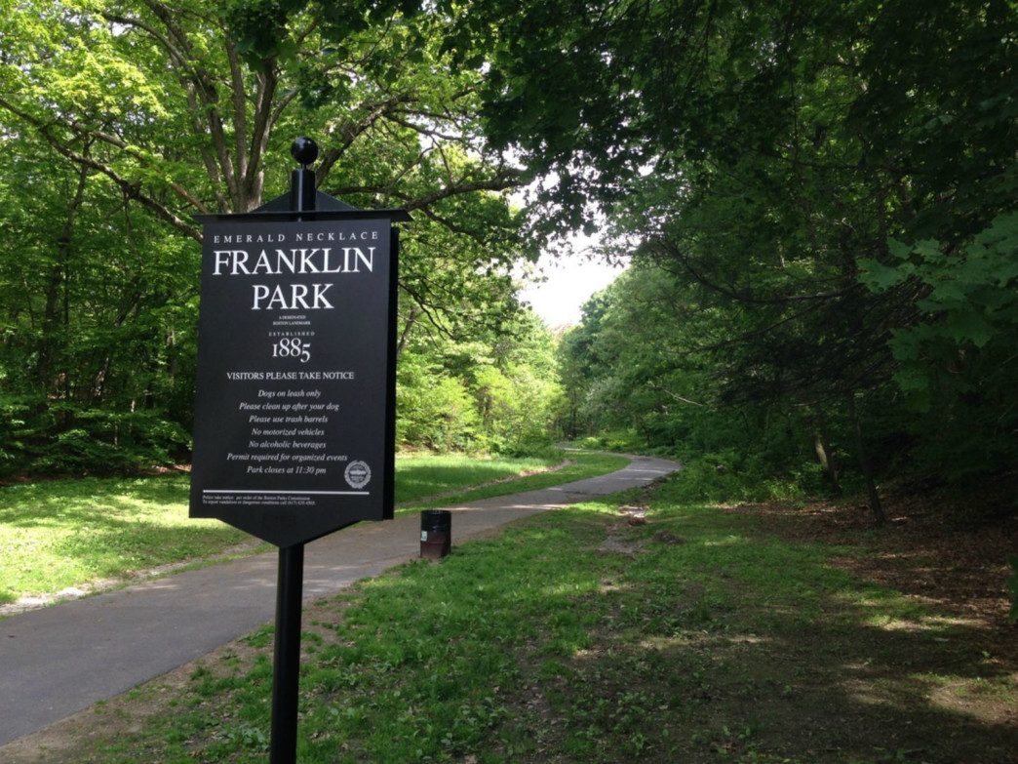
Franklin Park entrance now
1885 Franklin Park Plan

Slide 4
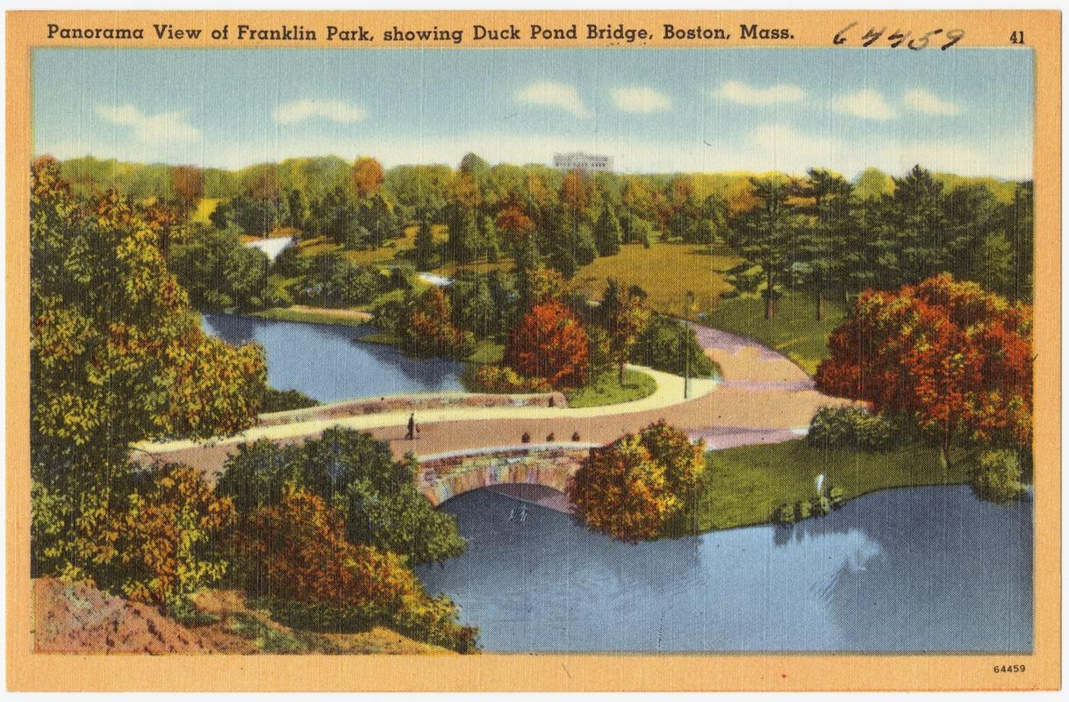

Slide 5
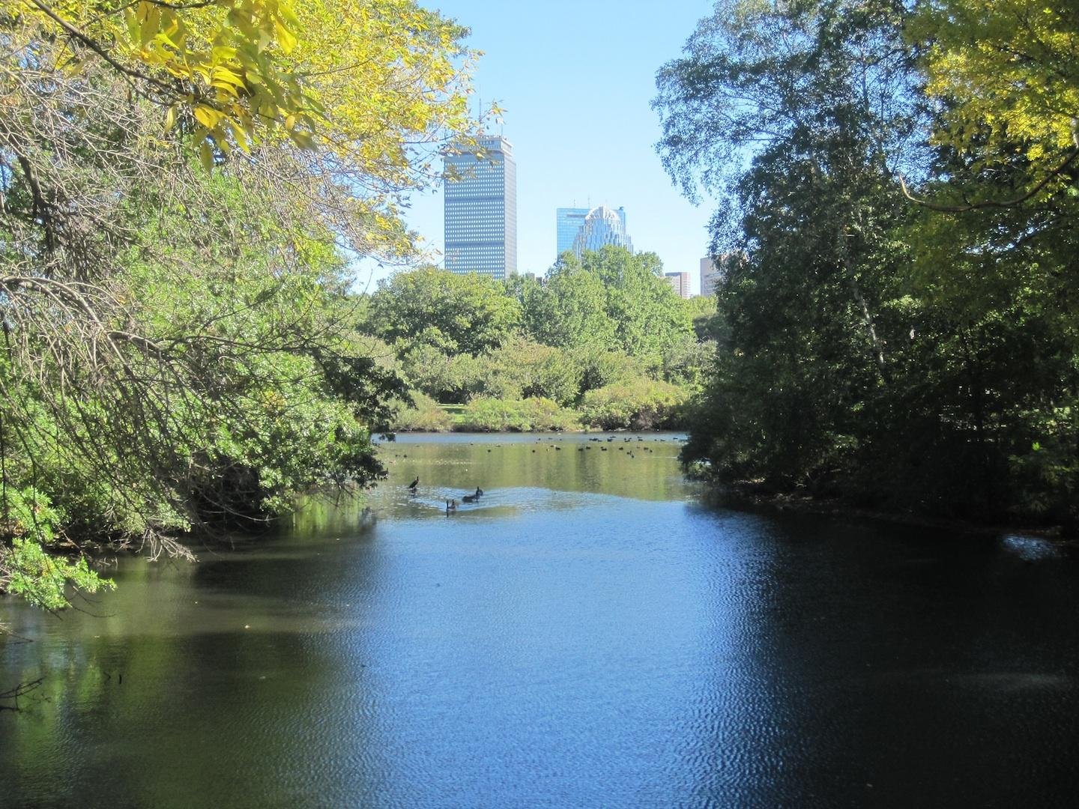

Slide 6
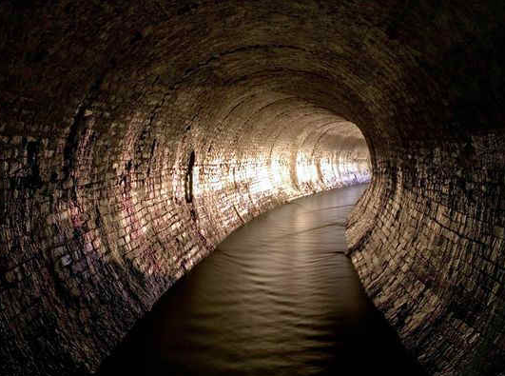
Tibbetts Brook, New York City

Slide 7
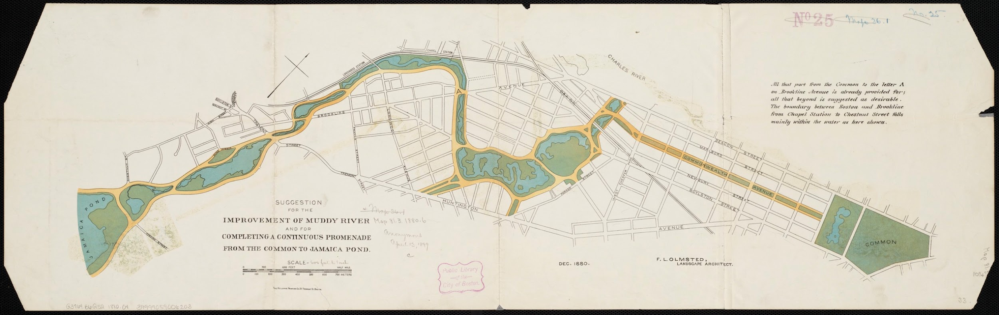
Suggestion for the improvement of Muddy River and for completing a continuous promenade (pathway) from the Common to Jamaica Pond
F.L. Olmstead, 1880

Slide 8
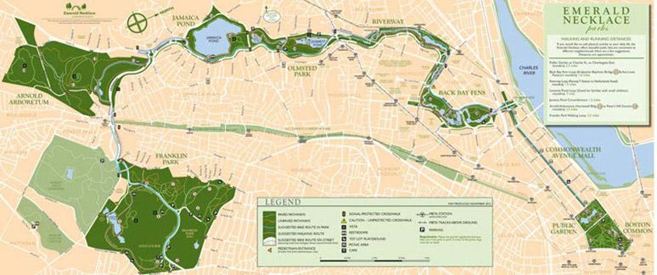

Slide 9
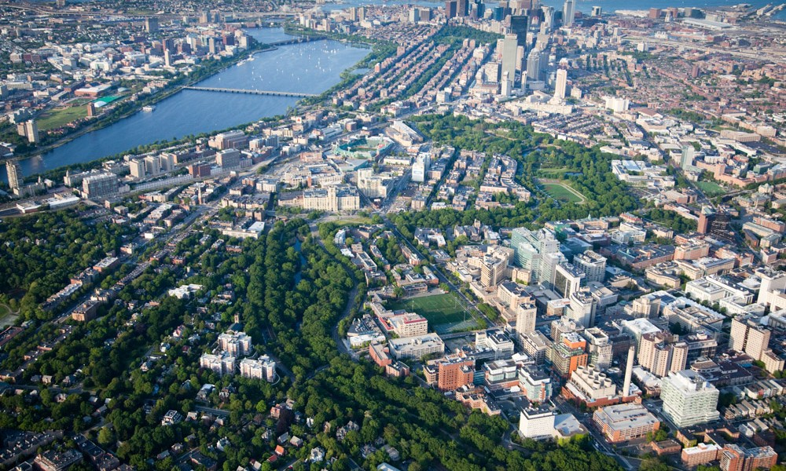

Slide 10
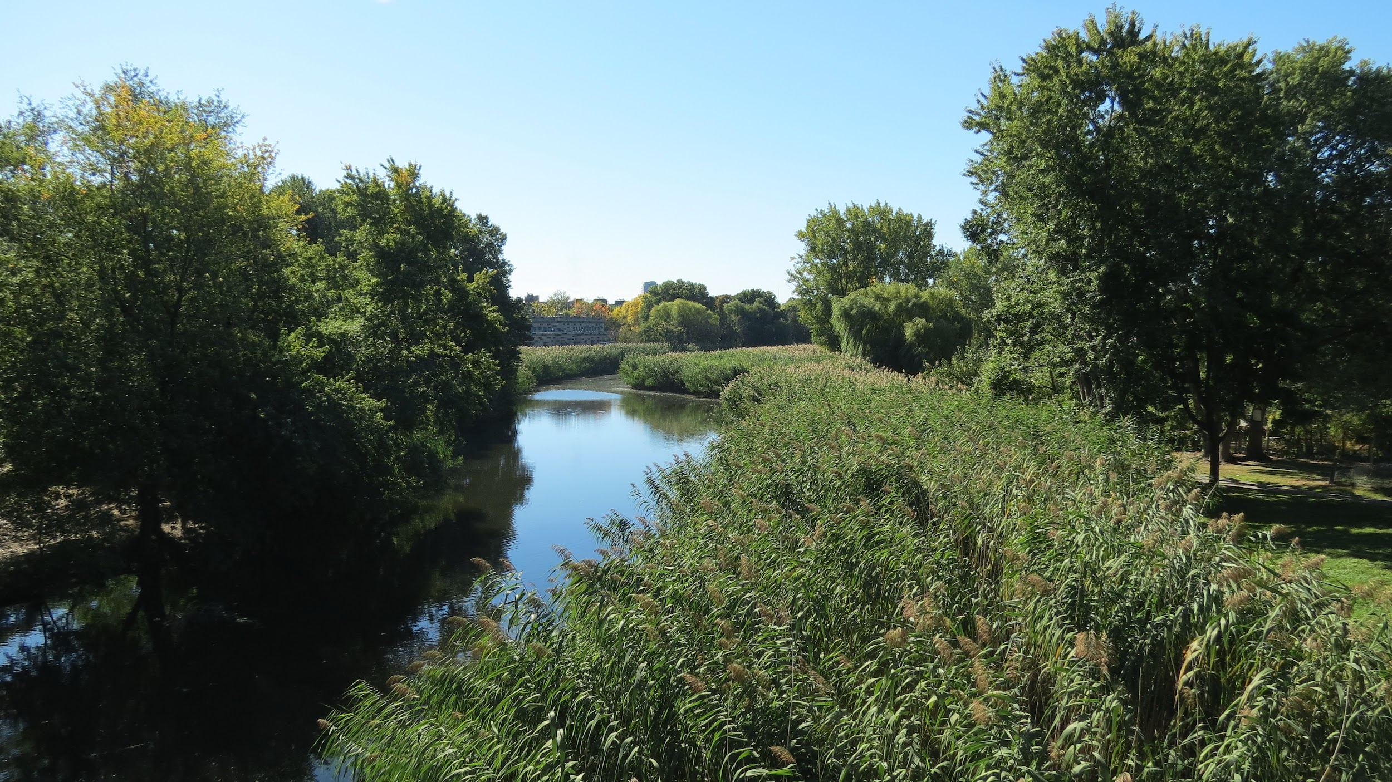
Notes:
The Fens

Slide 11
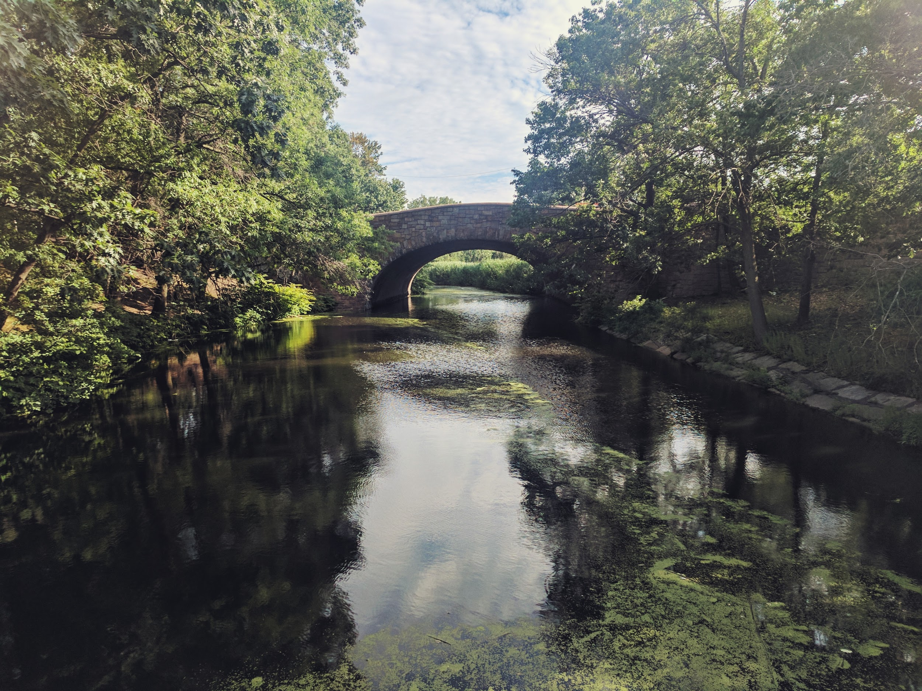

Slide 12
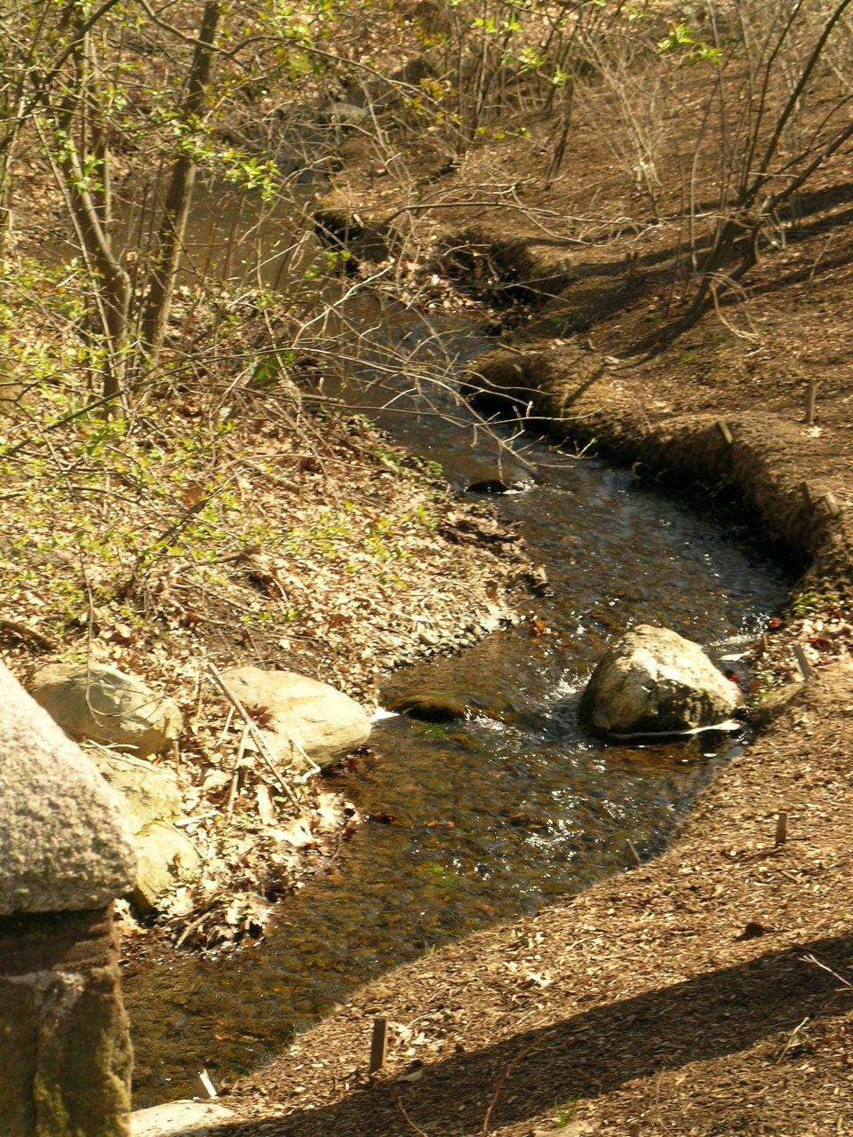
Notes:
Citation is

Slide 13
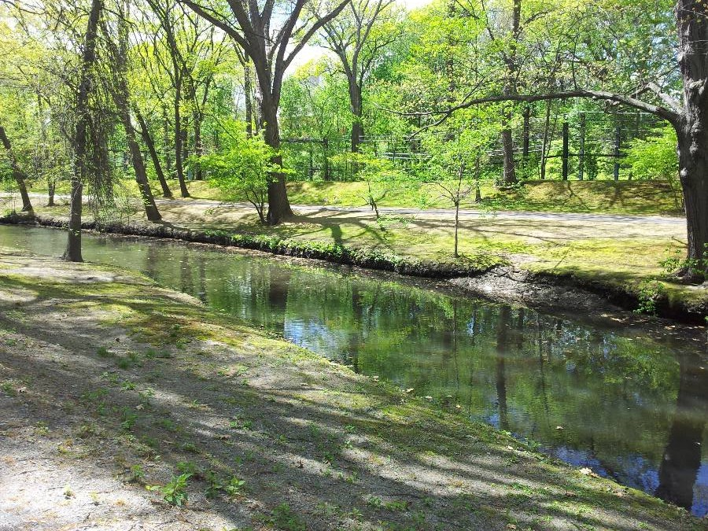

Slide 14
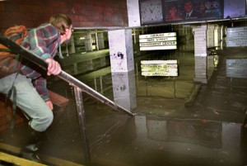
1996 flooding at the train station

Slide 15
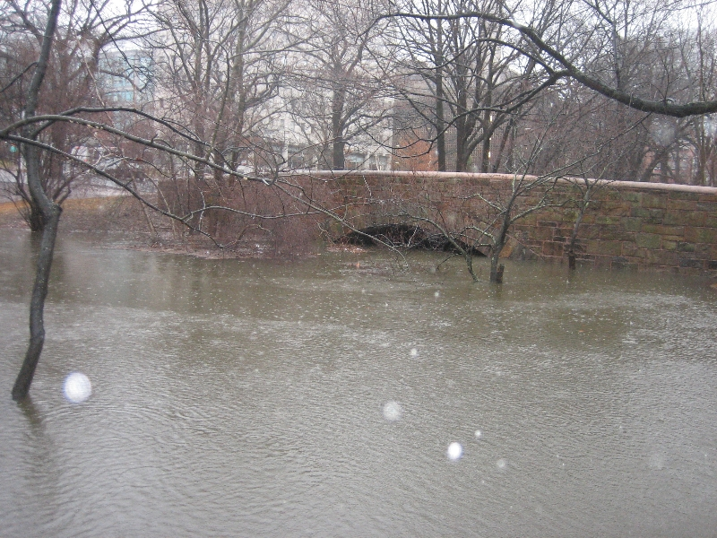
Muddy River rises March 14, 2010

Slide 16
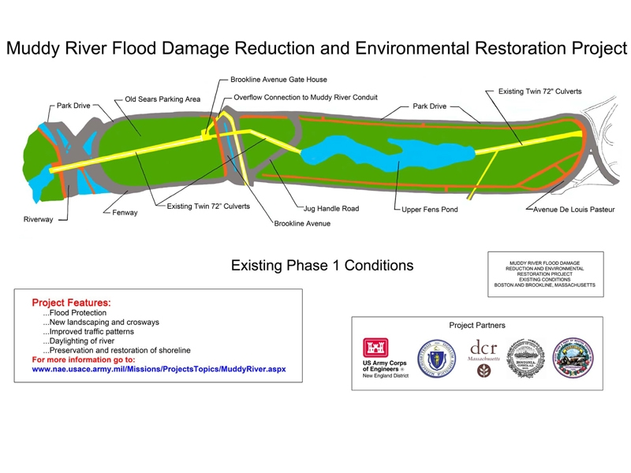

Slide 17
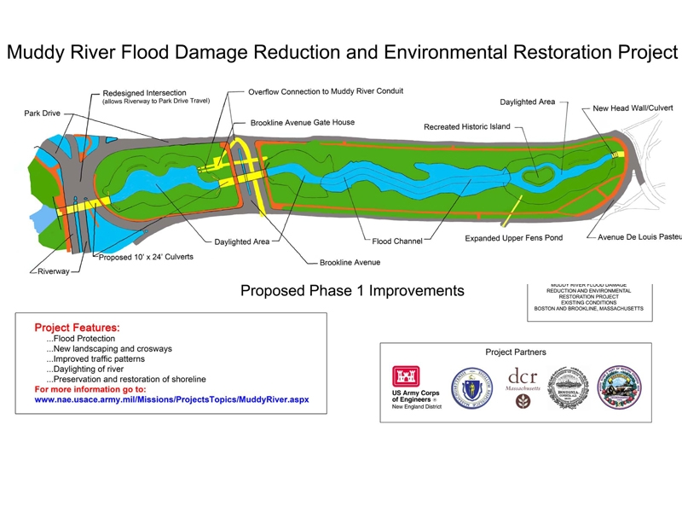

Slide 19
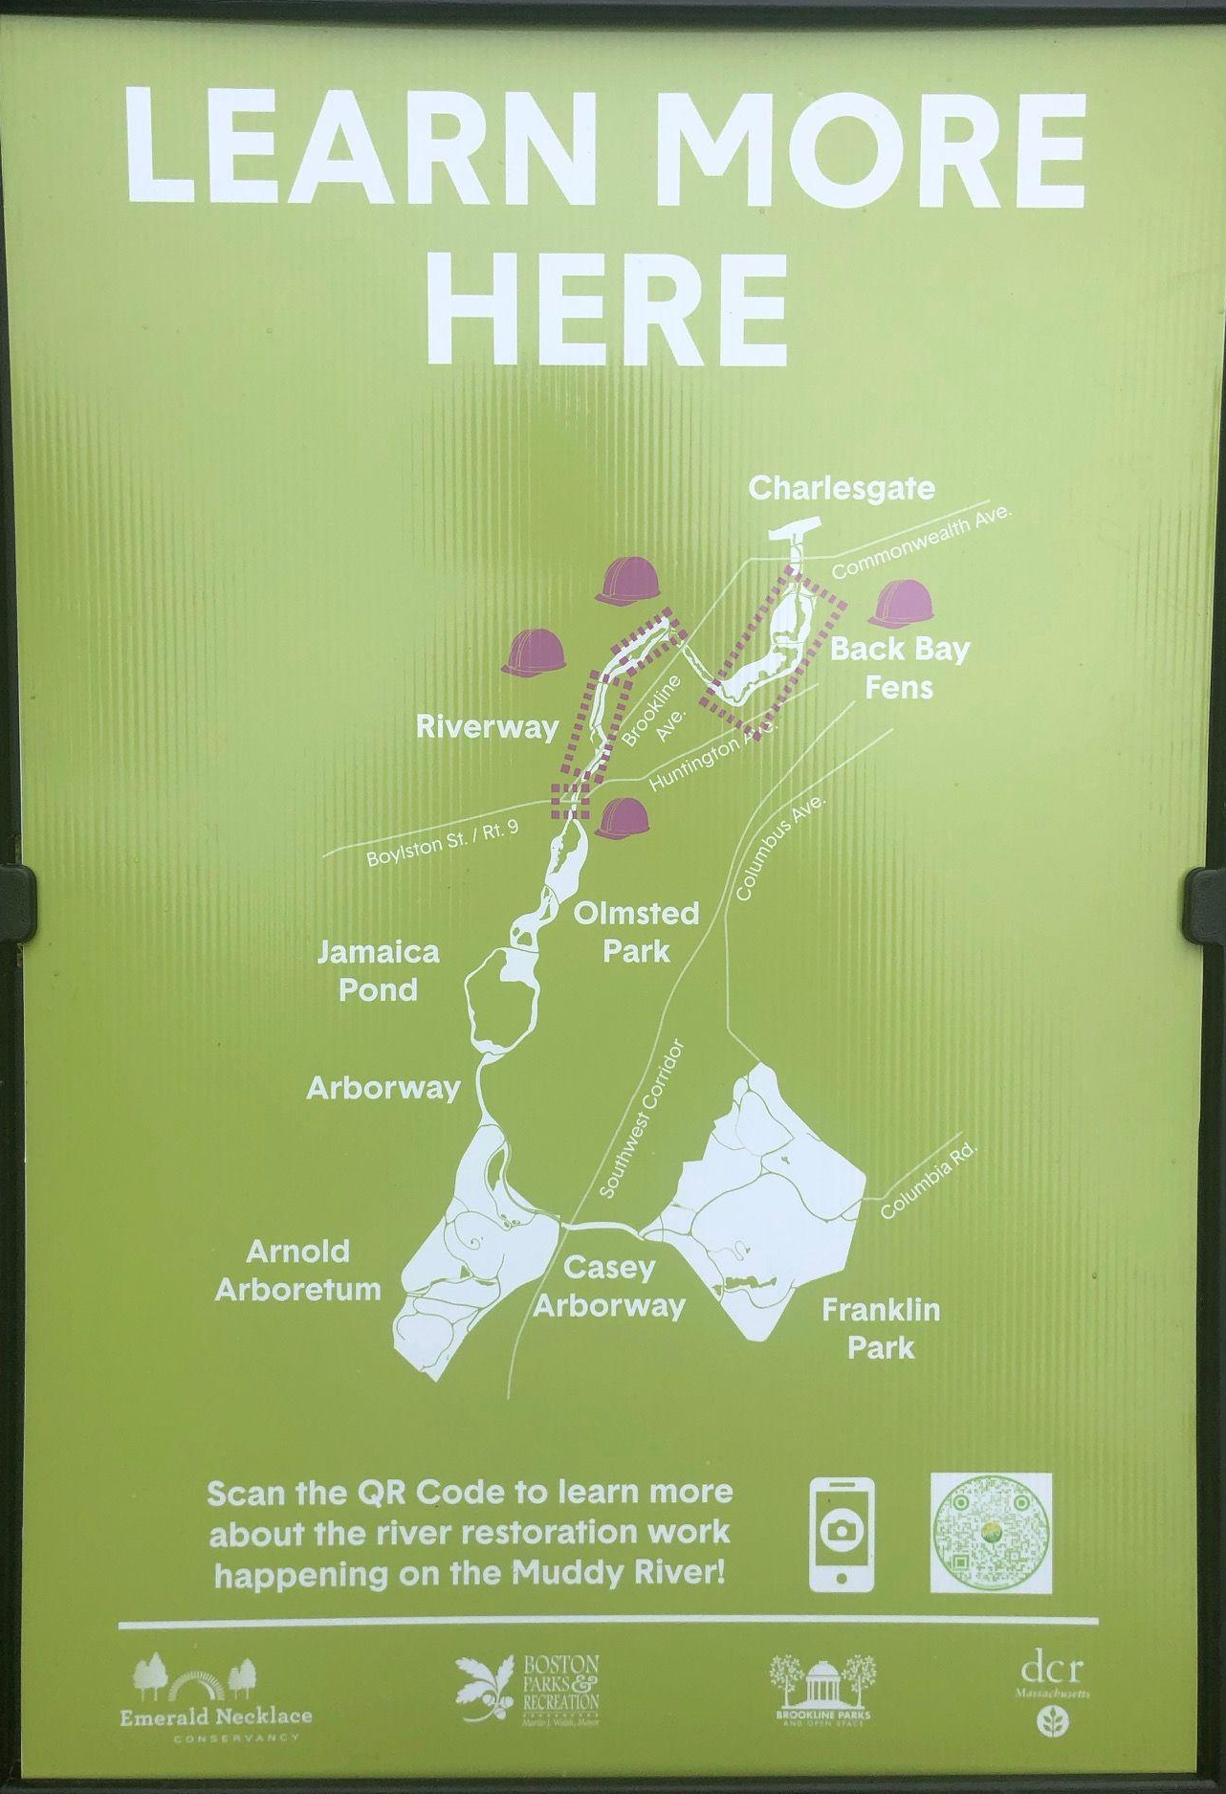
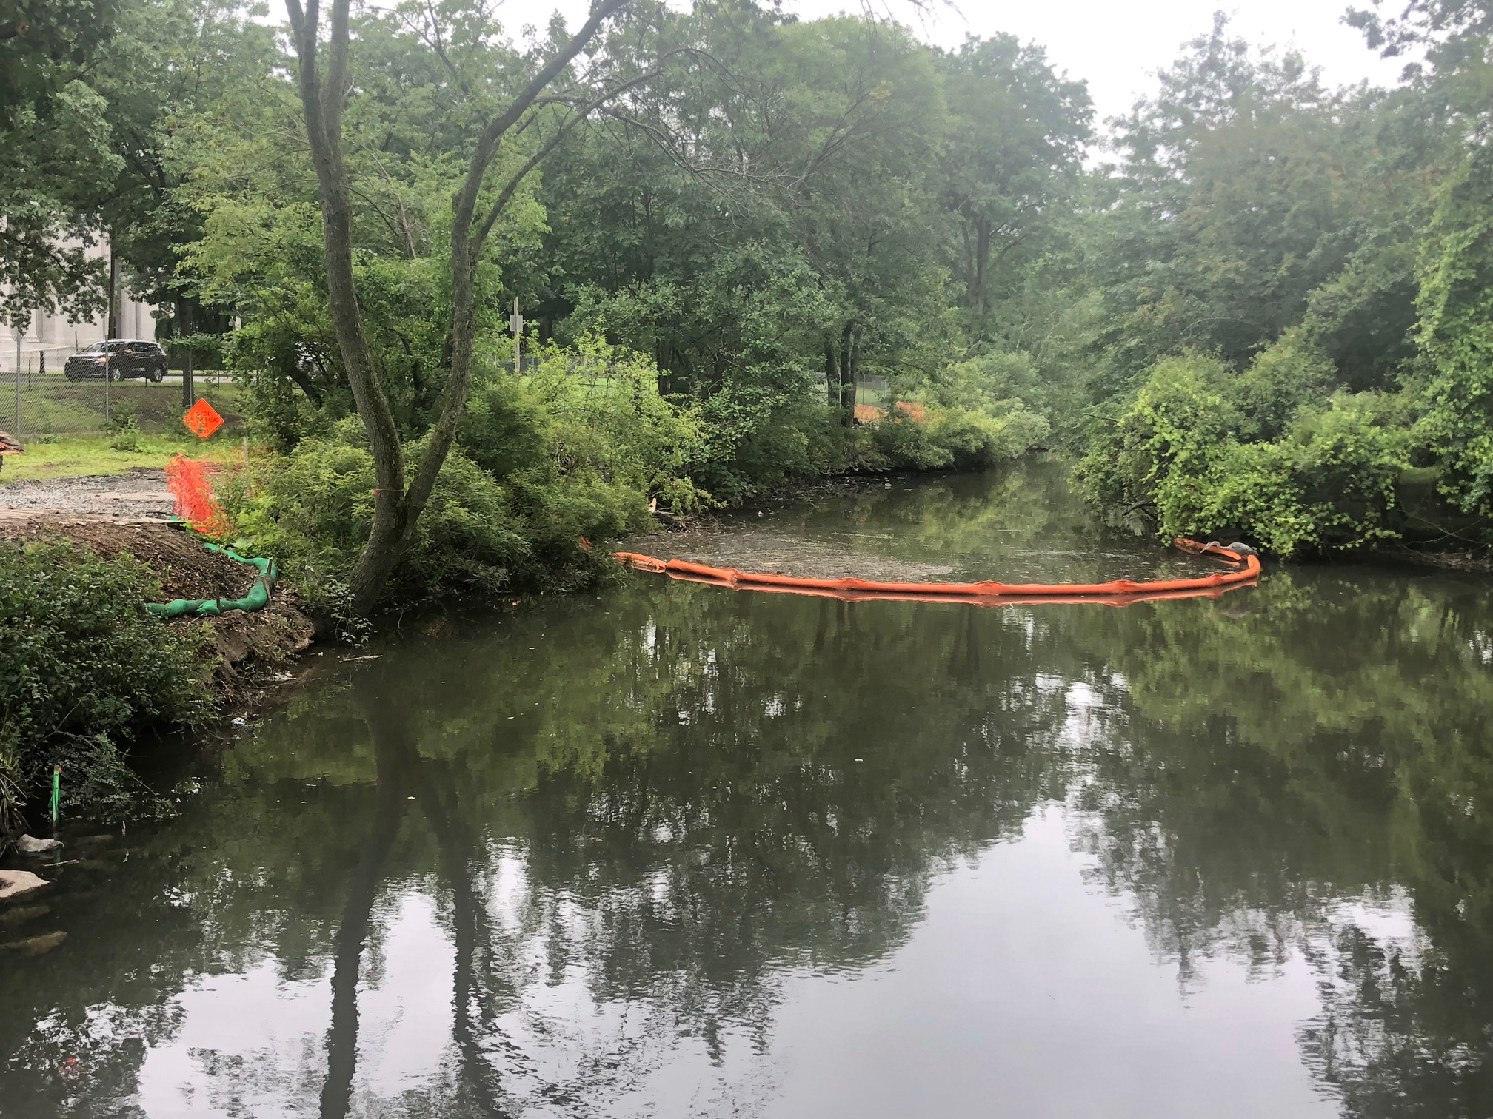

Slide 20
Citations
Slide 2: https://www.wikiart.org/en/john-singer-sargent/frederick-law-olmsted-1895
Slide 3:http://www.olmsted.org/the-twelve-volumes/volume-19/volume-8; https://rootsrated.com/boston-ma/trail-running/the-wilderness-at-franklin-park-trail-running
Slide 4: https://www.digitalcommonwealth.org/search/commonwealth:wh246s18x
Slide 5: http://images.huffingtonpost.com/2012-01-30-FensandviewtothePrudential.jpg
Slide 6: http://environment.nationalgeographic.com/environment/photos/underground-rivers/#/environment-underground-rivers-nyc-tibbetts_46403_600x450.jpg
Slide 7: https://collections.leventhalmap.org/search/commonwealth:9s161j57f
Slide 8: https://www.emeraldnecklace.org/park-overview/emerald-necklace-map/
Slide 9: http://www.touristsbook.com/boston/files/2014/11/Emerald-Necklace-Boston-1000x600.jpg
Slide 10: By Robert Linsdell from St. Andrews, Canada (The Fens Muddy River, Boston (493518)) [CC BY 2.0 (http://creativecommons.org/licenses/by/2.0)], via Wikimedia Commons
Slide 11: https://www.flickr.com/photos/ekilby/36120268951
Slide 12: John Stephen Dwyer [CC BY-SA 3.0 (https://creativecommons.org/licenses/by-sa/3.0)], via Wikimedia Commons
Slide 13: By Monika M. Wahi (Own work) [CC BY-SA 3.0 (https://creativecommons.org/licenses/by-sa/3.0)], via Wikimedia Commons
Slide 14: John Stephen Dwyer [CC BY-SA 3.0 (https://creativecommons.org/licenses/by-sa/3.0)], via Wikimedia Commons
https://www.americaninno.com/boston/construction-detours-fenway-traffic-project-could-prevent-future-flooding-video/
Slide 15: U.S. Army Corps of Engineers photos
http://www.muddyrivermmoc.org/flood-control/
Slide 16, 17 and 18: http://www.muddyrivermmoc.org/ Photos: US Army Corps of Engineers
Slide 19: photos: Melissa Tonachel

