Slide 1
Muddy River Sheets
Text Talk 7.2

Slide 2


Slide 3
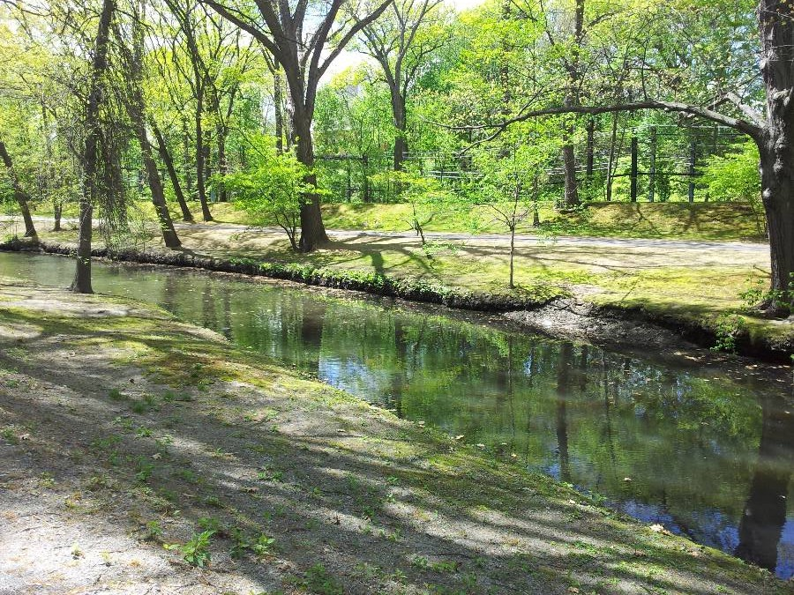

Slide 4
