Slide 1
Terracing and Windbreaks
Text Talk Week 7, Day 1

Slide 2
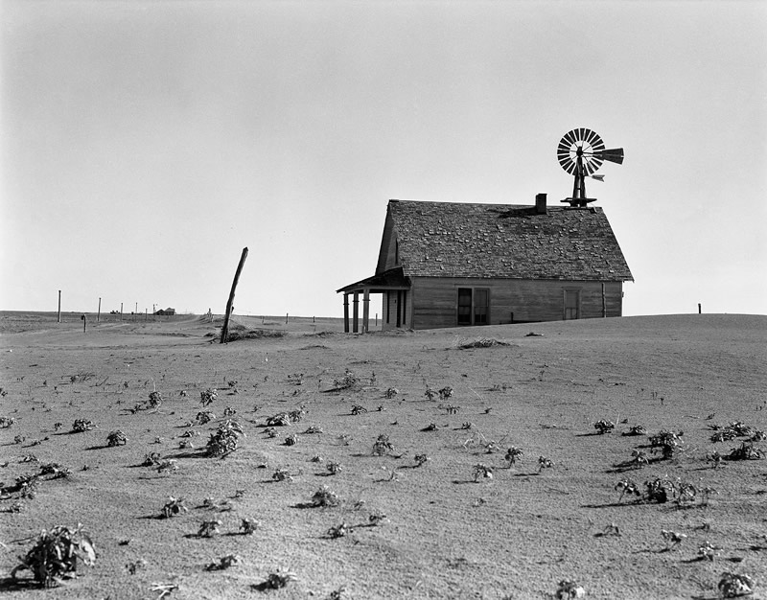
Dorothea Lange Abandoned farm north of Dalhart, Texas. 1938.

Slide 3
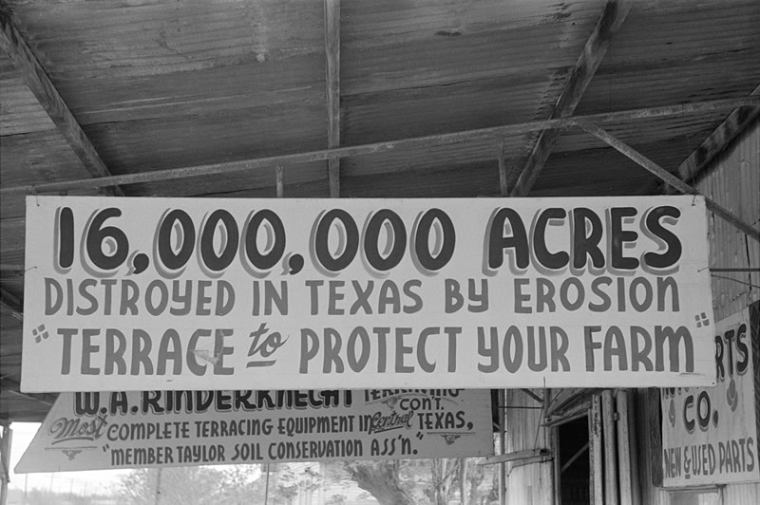
Russell Lee Government sign promoting land terracing to prevent erosion. Taylor, Texas. April 1939.

Slide 4
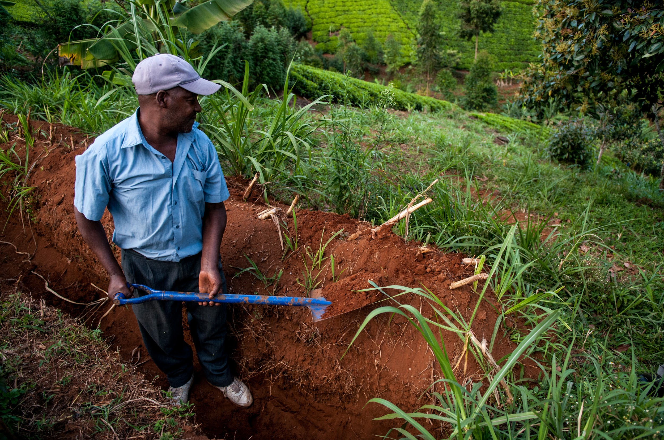
Making terraces is a form of soil erosion in the Tana River watershed in Kenya.

Slide 5
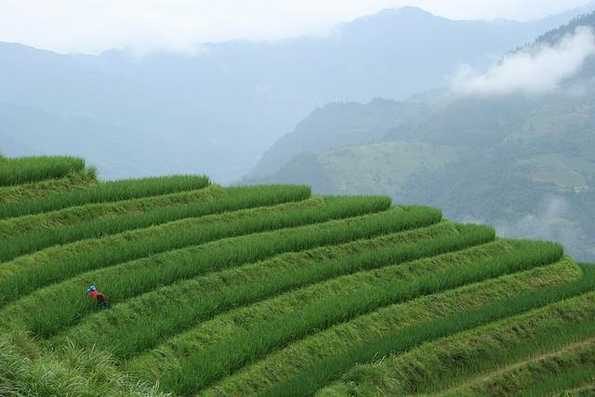
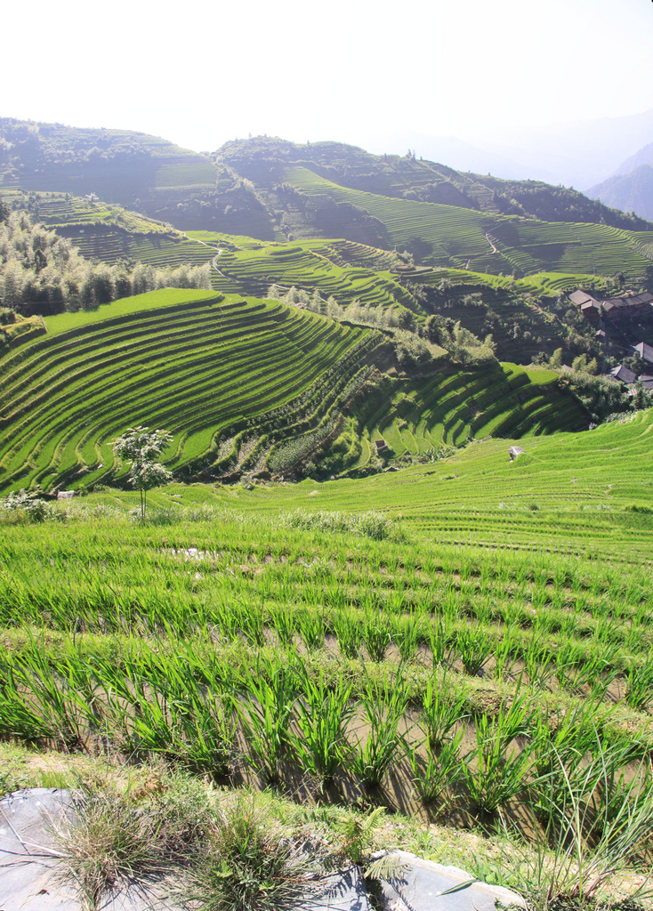
Rice Terraces in the Longsheng hills in the Guanxi province of China

Slide 6
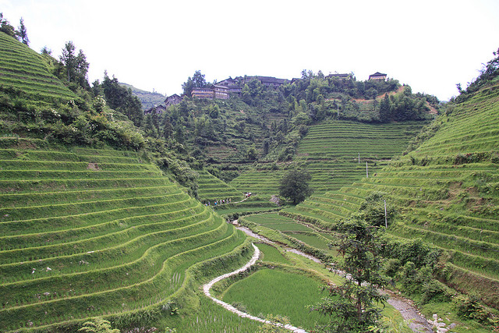
Rice Terraces in the Longsheng hills in the Guanxi province of China

Slide 7
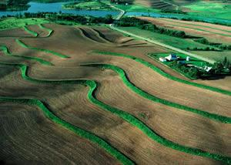
Rice terraces in Minnesota, United States

Slide 8
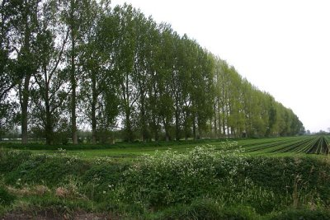
Trees planted as a windbreak, England

Slide 9
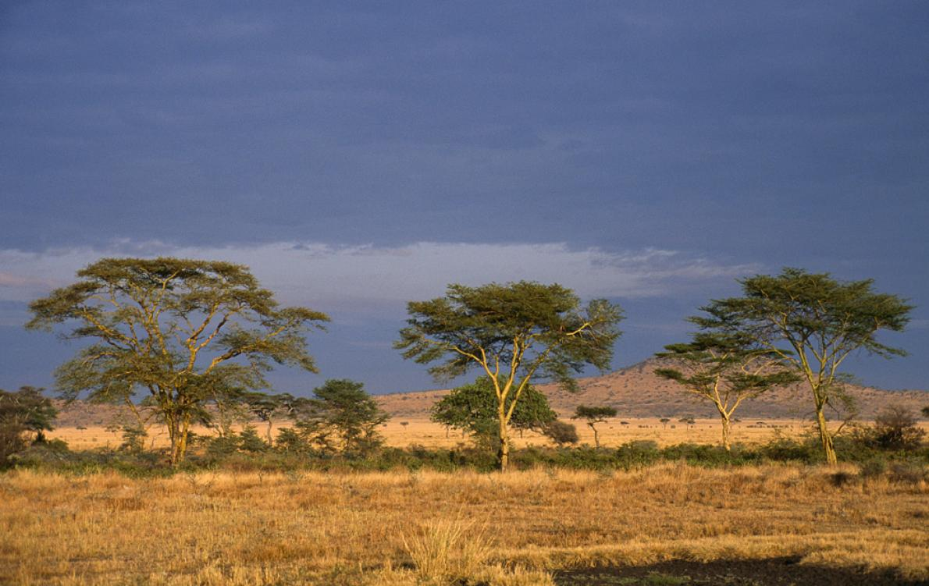
Acacia trees line an African landscape (possibly Senegal)

Slide 10
Citations
Slide 2: Dorothea Lange; The Library of Congress, Prints & Photographs Division; https://www.theatlantic.com/magazine/archive/1936/05/letters-from-the-dust-bowl/308897/
Slide 3: Russell Lee; The Library of Congress, Prints & Photographs Division
Slide 4: https://www.carbonbrief.org/guest-post-improving-africas-soils-cut-emissions-boost-food-security
Slide 5: https://www.flickr.com/photos/dondomingo/2764937891/; http://www.kuriositas.com/2011/07/amazing-longsheng-rice-terraces.html
Slide 6: http://www.kuriositas.com/2011/07/amazing-longsheng-rice-terraces.html
Slide 7: http://www.mda.state.mn.us/protecting/conservation/practices/terrace.aspx
Slide 8: https://www.benefitsof.org/what-are-the-benefits-of-planting-trees/
Slide 9: http://news.nationalgeographic.com/news/2010/01/091228-great-green-wall-trees-senegal-sahara-desert/

