Slide 1
Taking a Stand
Text Talk Week 7, Day 3

Slide 2
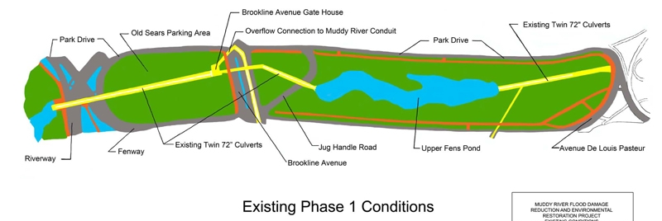
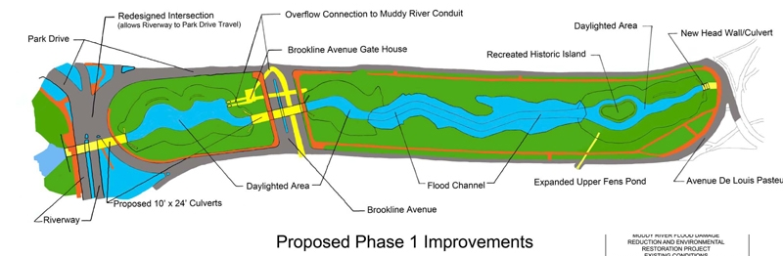

Slide 3
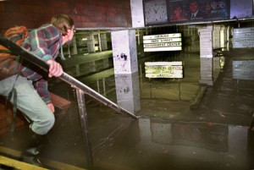
1996 flooding at Kenmore Station

Slide 4
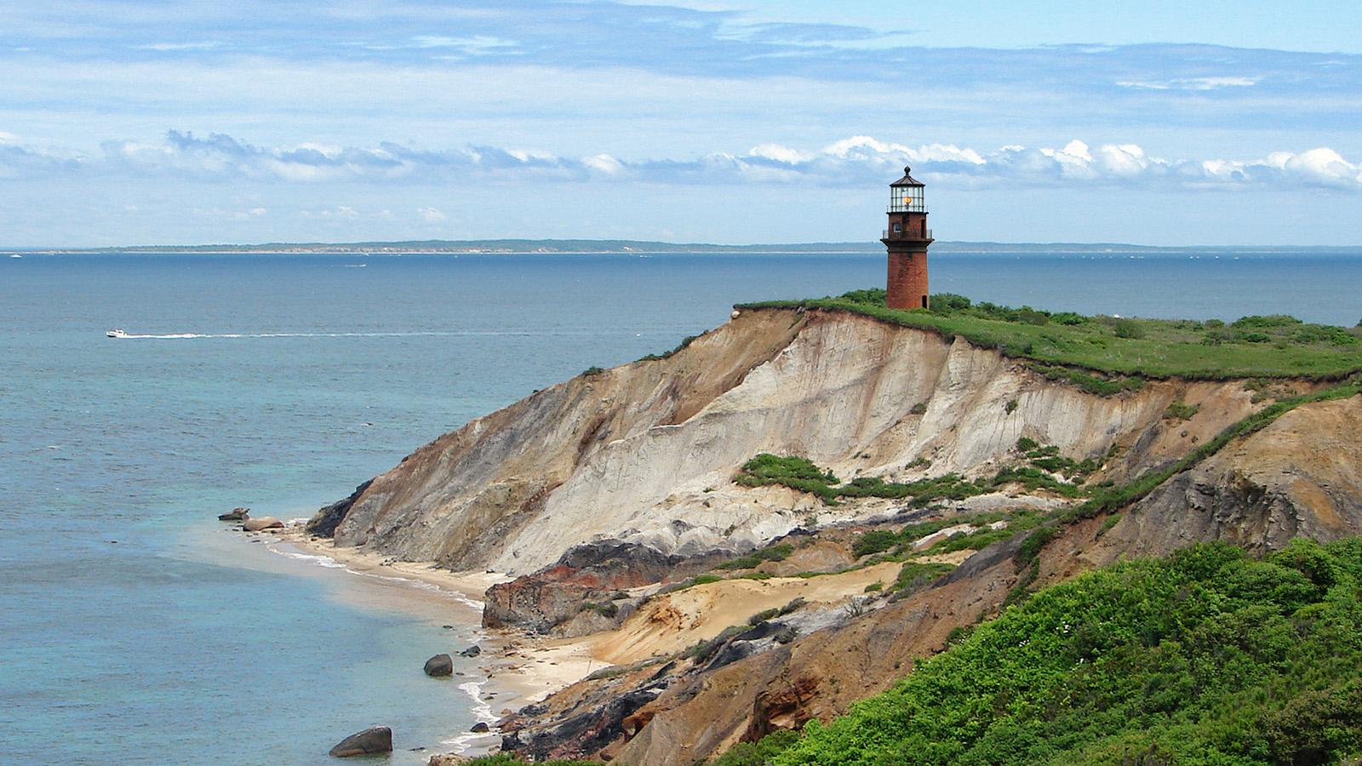
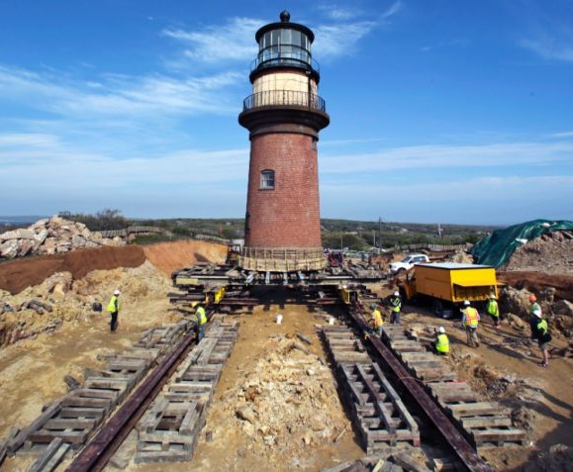

Slide 5
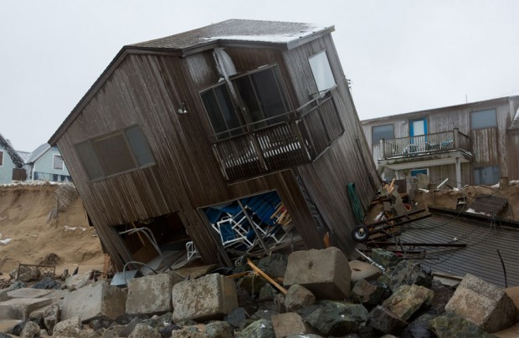

Slide 6
Citations
Slide 2: http://www.muddyrivermmoc.org/ Photos: US Army Corps of Engineers
Slide 3: https://www.americaninno.com/boston/construction-detours-fenway-traffic-project-could-prevent-future-flooding-video/
Slide 4: http://writeonthewater.com/?p=16660; http://www.cnn.com/travel/article/gay-head-lighthouse-move-feat/index.html?gallery
Slide 5: Photo: Jesse Costa, WBUR http://legacy.wbur.org/2013/03/08/plum-island-home-storm

