Slide 1
Erosion Control
Barriers and Plants

Slide 2
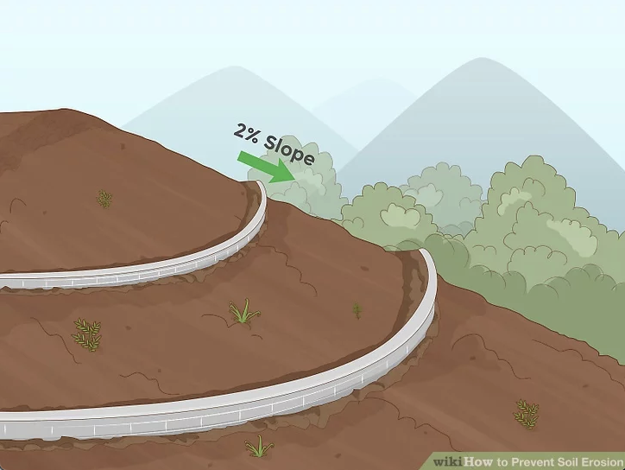
Barriers
Retaining Wall

Slide 3
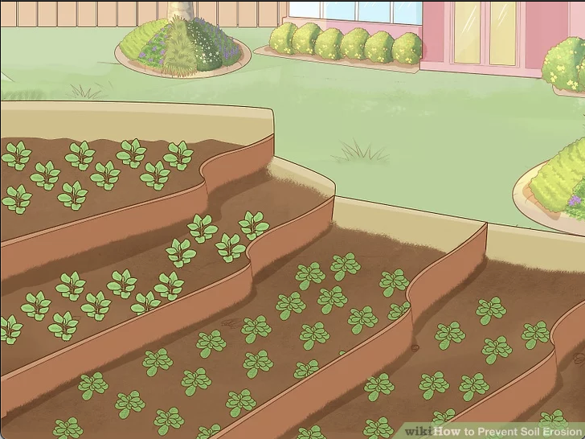
Barriers
Terrace

Slide 4
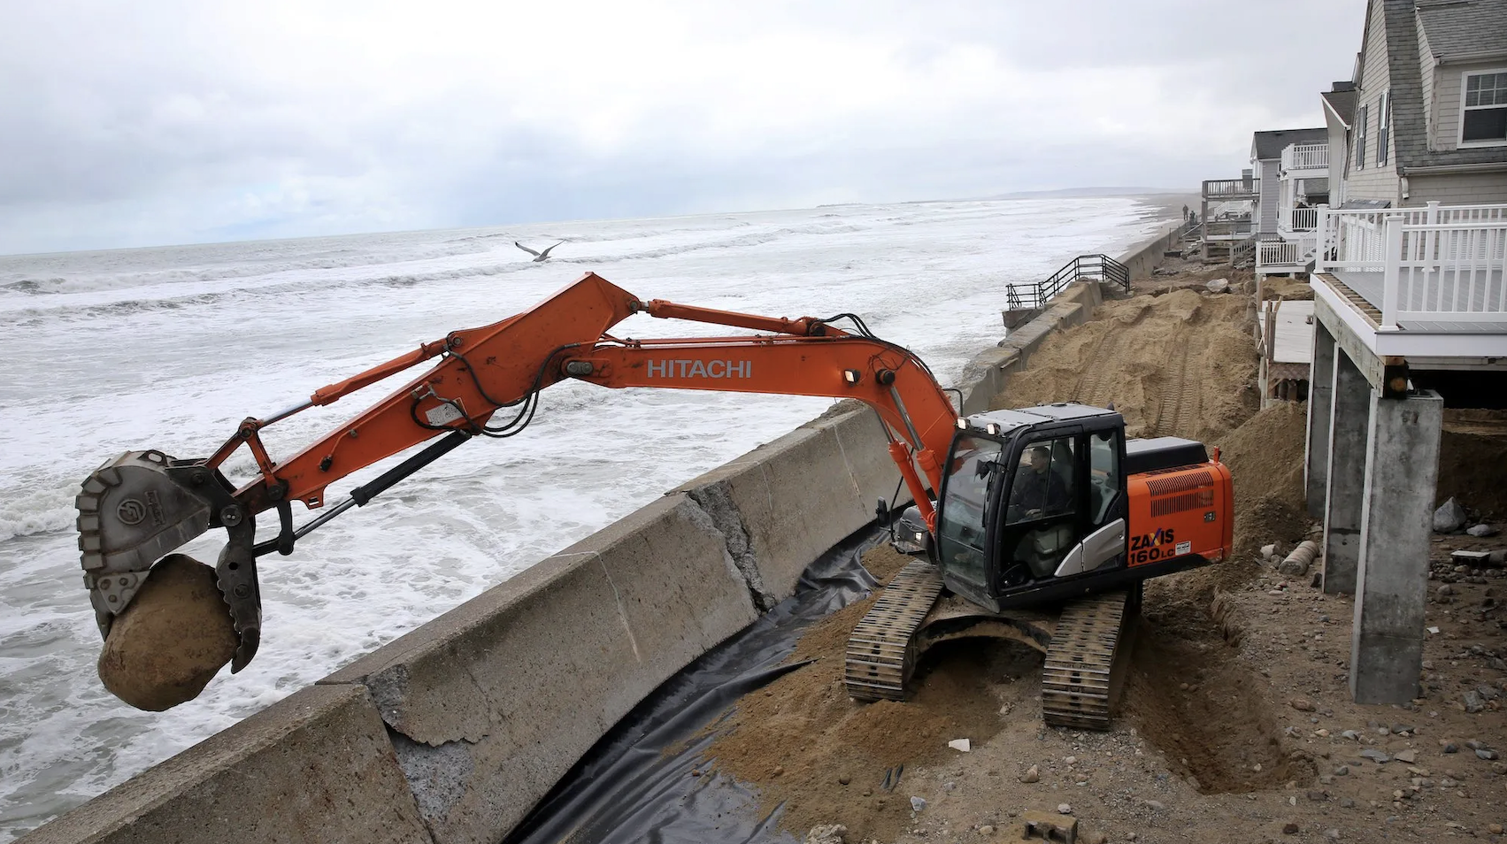
Barriers
Sea Wall

Slide 5
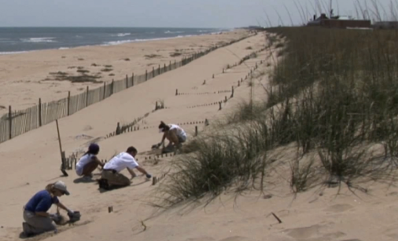
Plants
Dune Grass
Notes:
Plant roots are terrific at stabilizing the soil

Slide 6
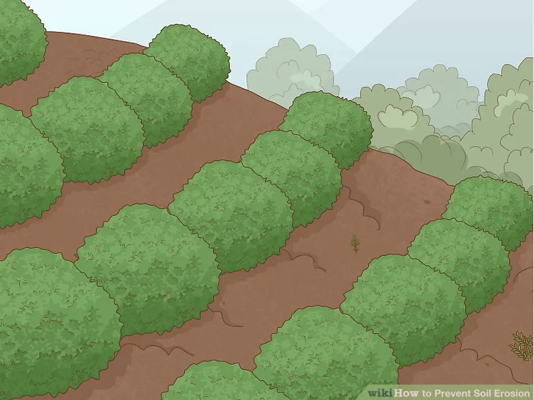
Plants
Terrace Planting

Slide 7
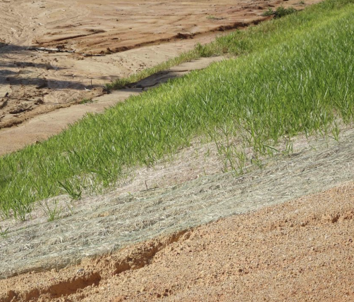
Plants
Grass Mats

Slide 8
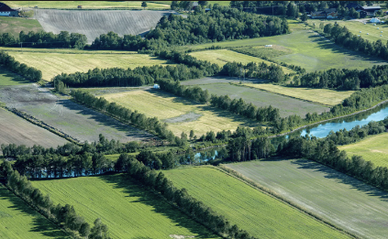
Plants
Windbreak Trees
Notes:
Mostly stop wind erosion (less relevant for water erosion)

