Slide 1
What Can Grass Do?
Text Talk Week 6, Day 4

Slide 2
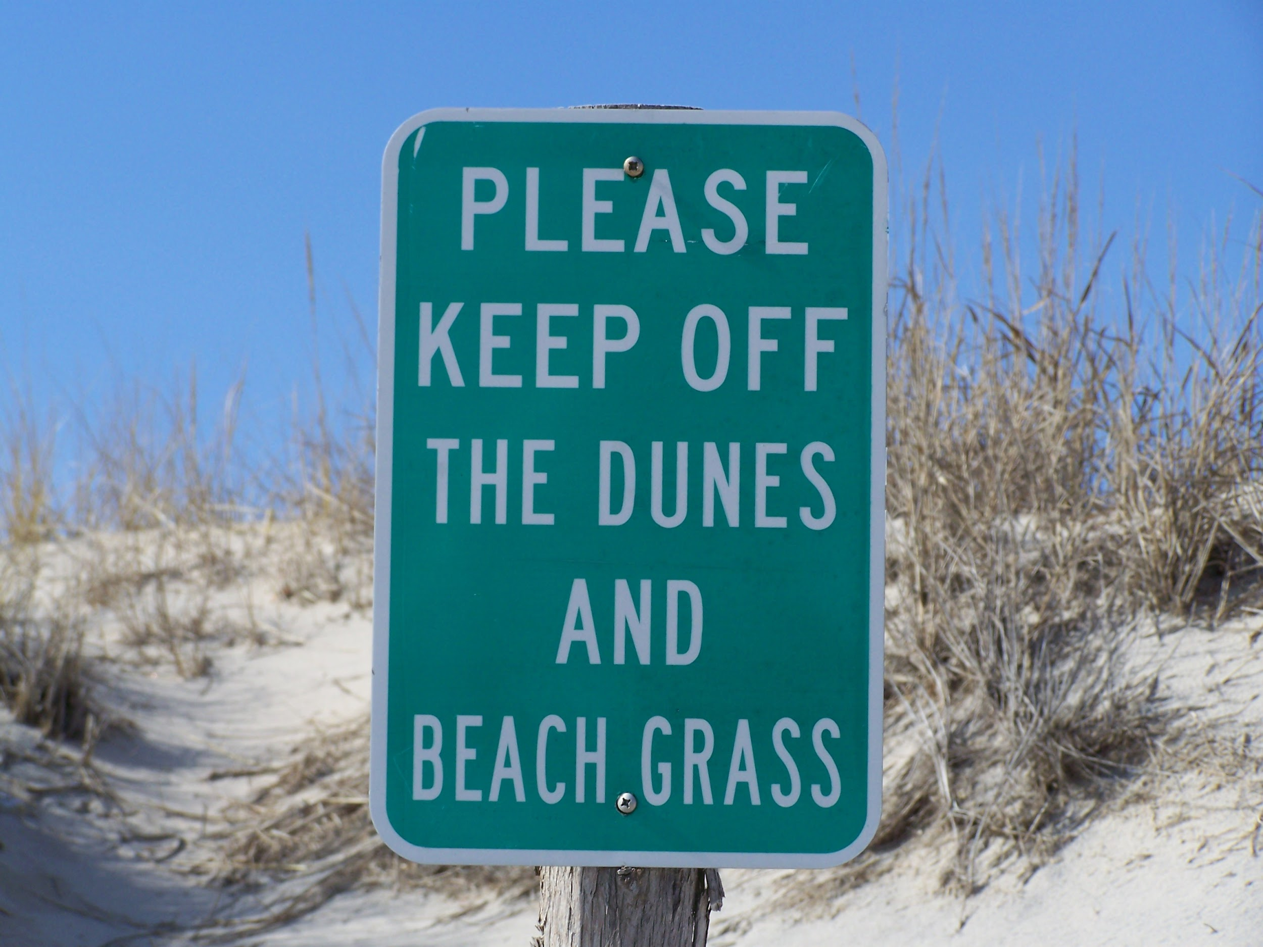

Slide 3
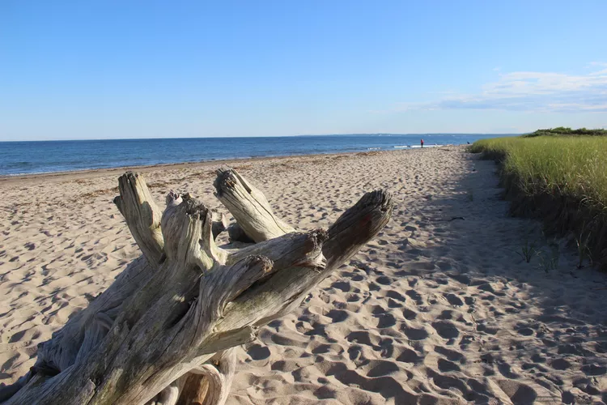
Parsons Beach, Kennebunk

Slide 4
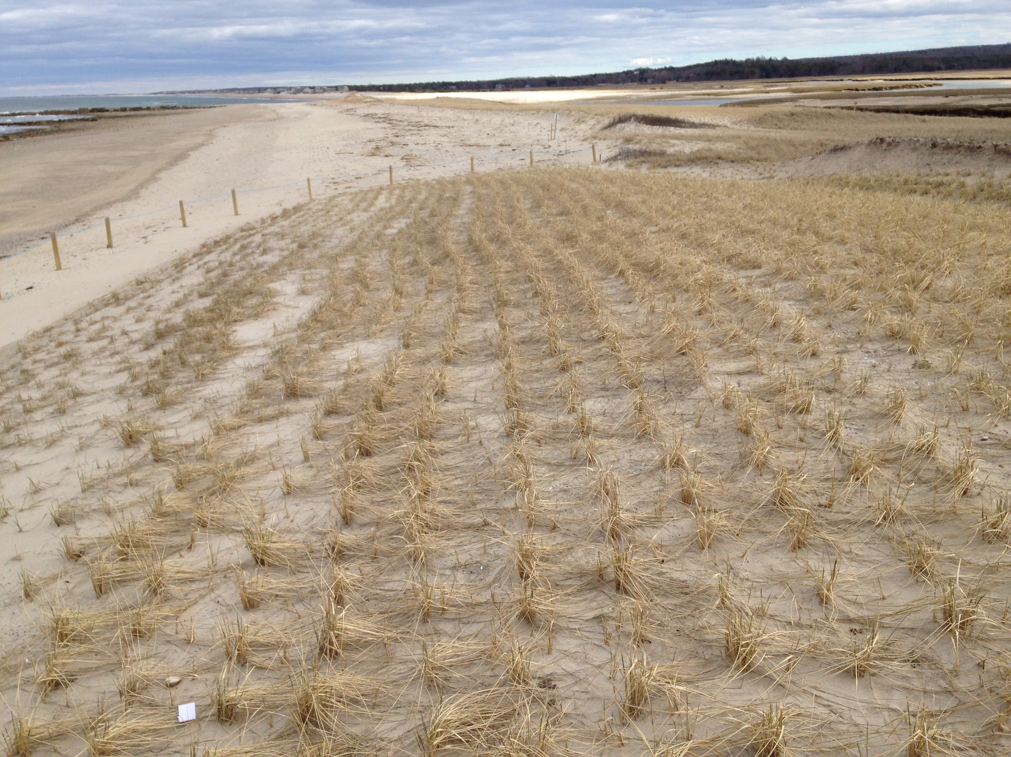
Wellfleet, Cape Cod

Slide 5
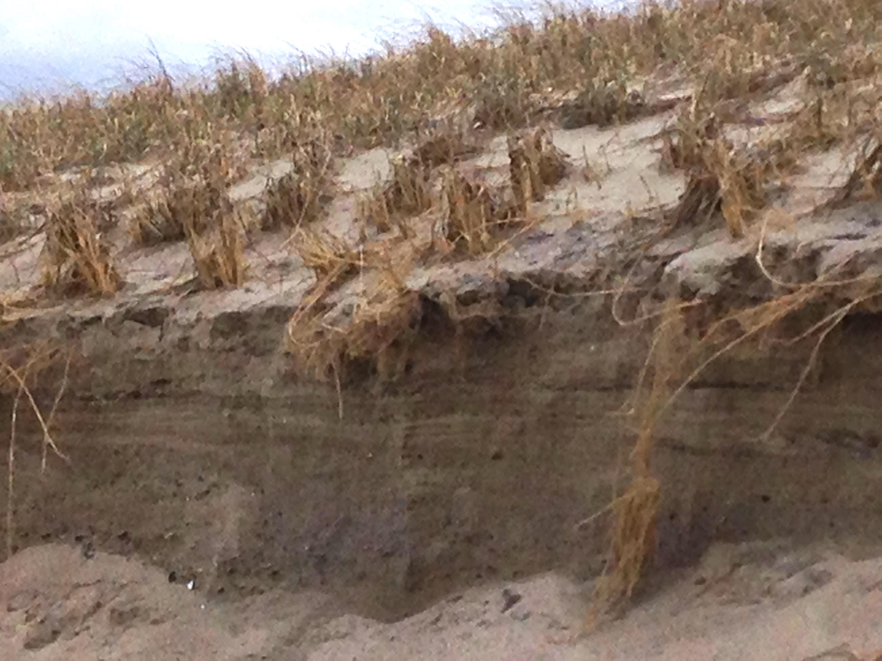
Wellfleet, Cape Cod

Slide 6
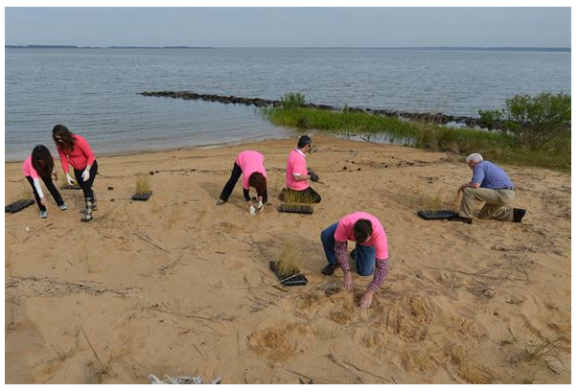
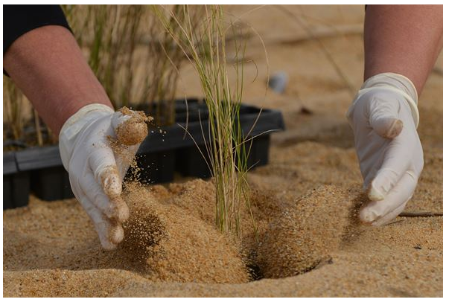
Volunteers plant marsh grass on the shoreline at Fort Eustis, Virginia, April 19, 2016

Slide 7
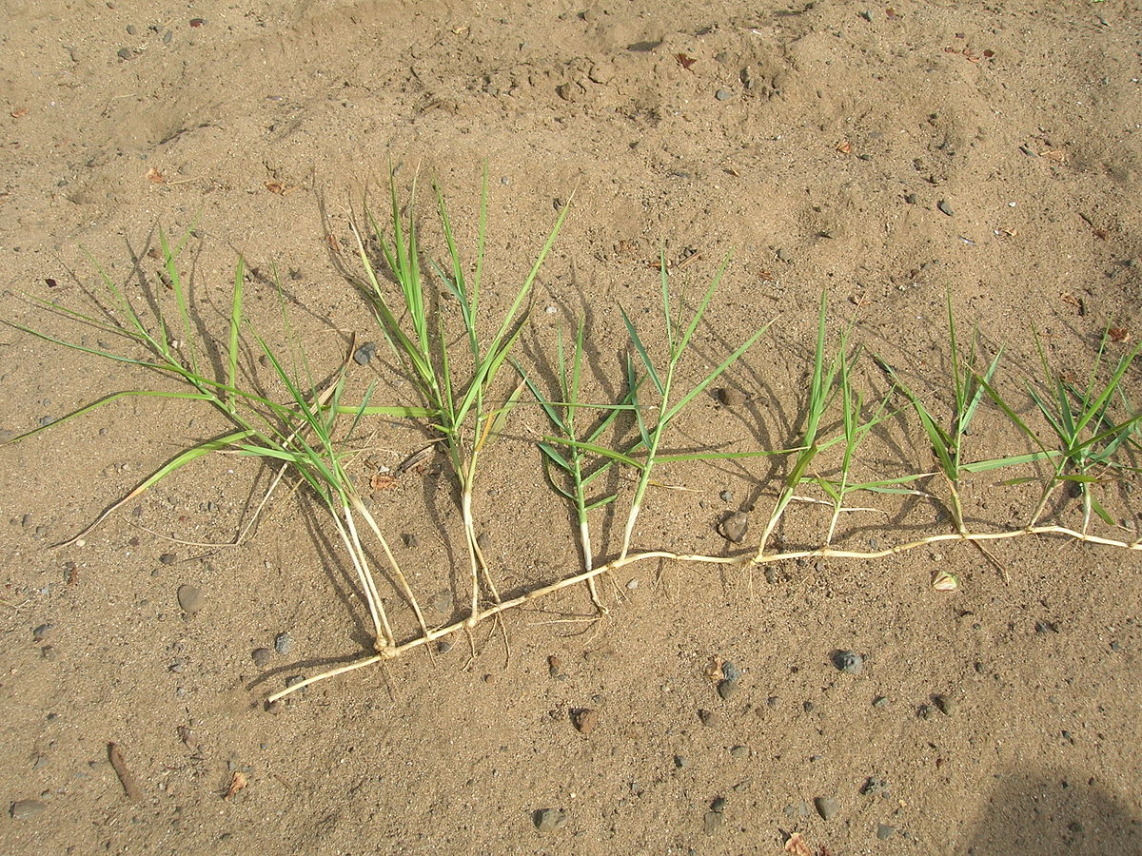

Slide 8
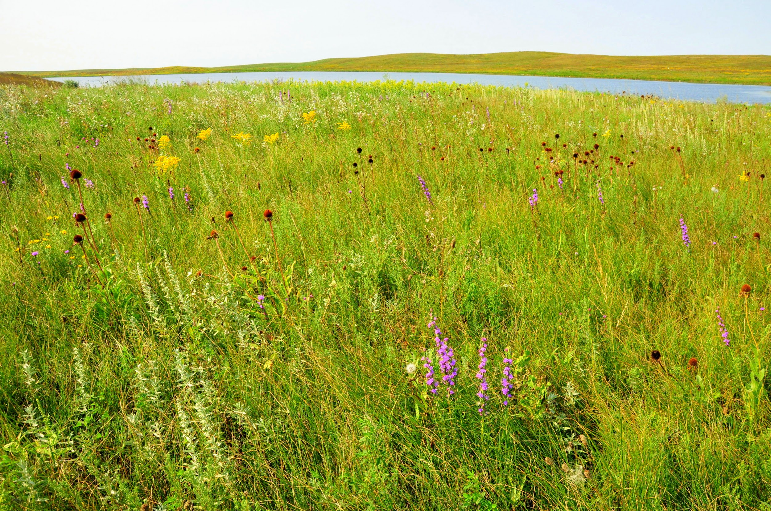
Sand Lake Wetland Management District, South Dakota

Slide 9
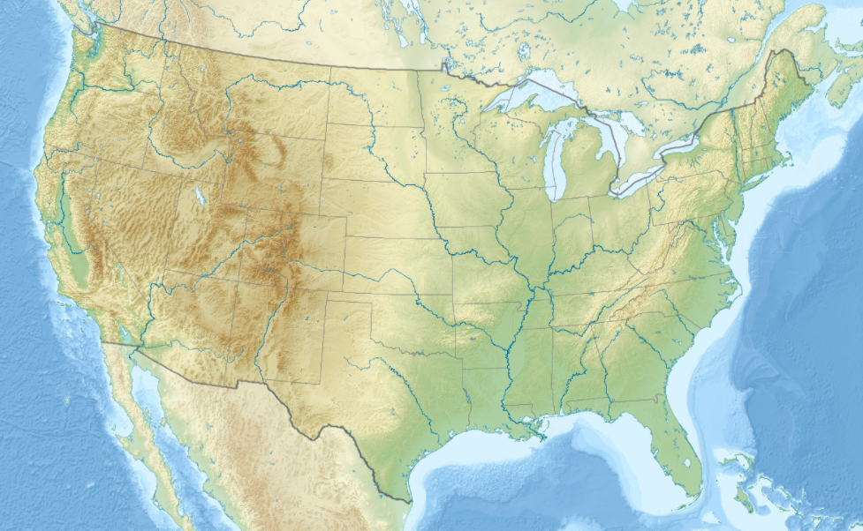

Slide 10
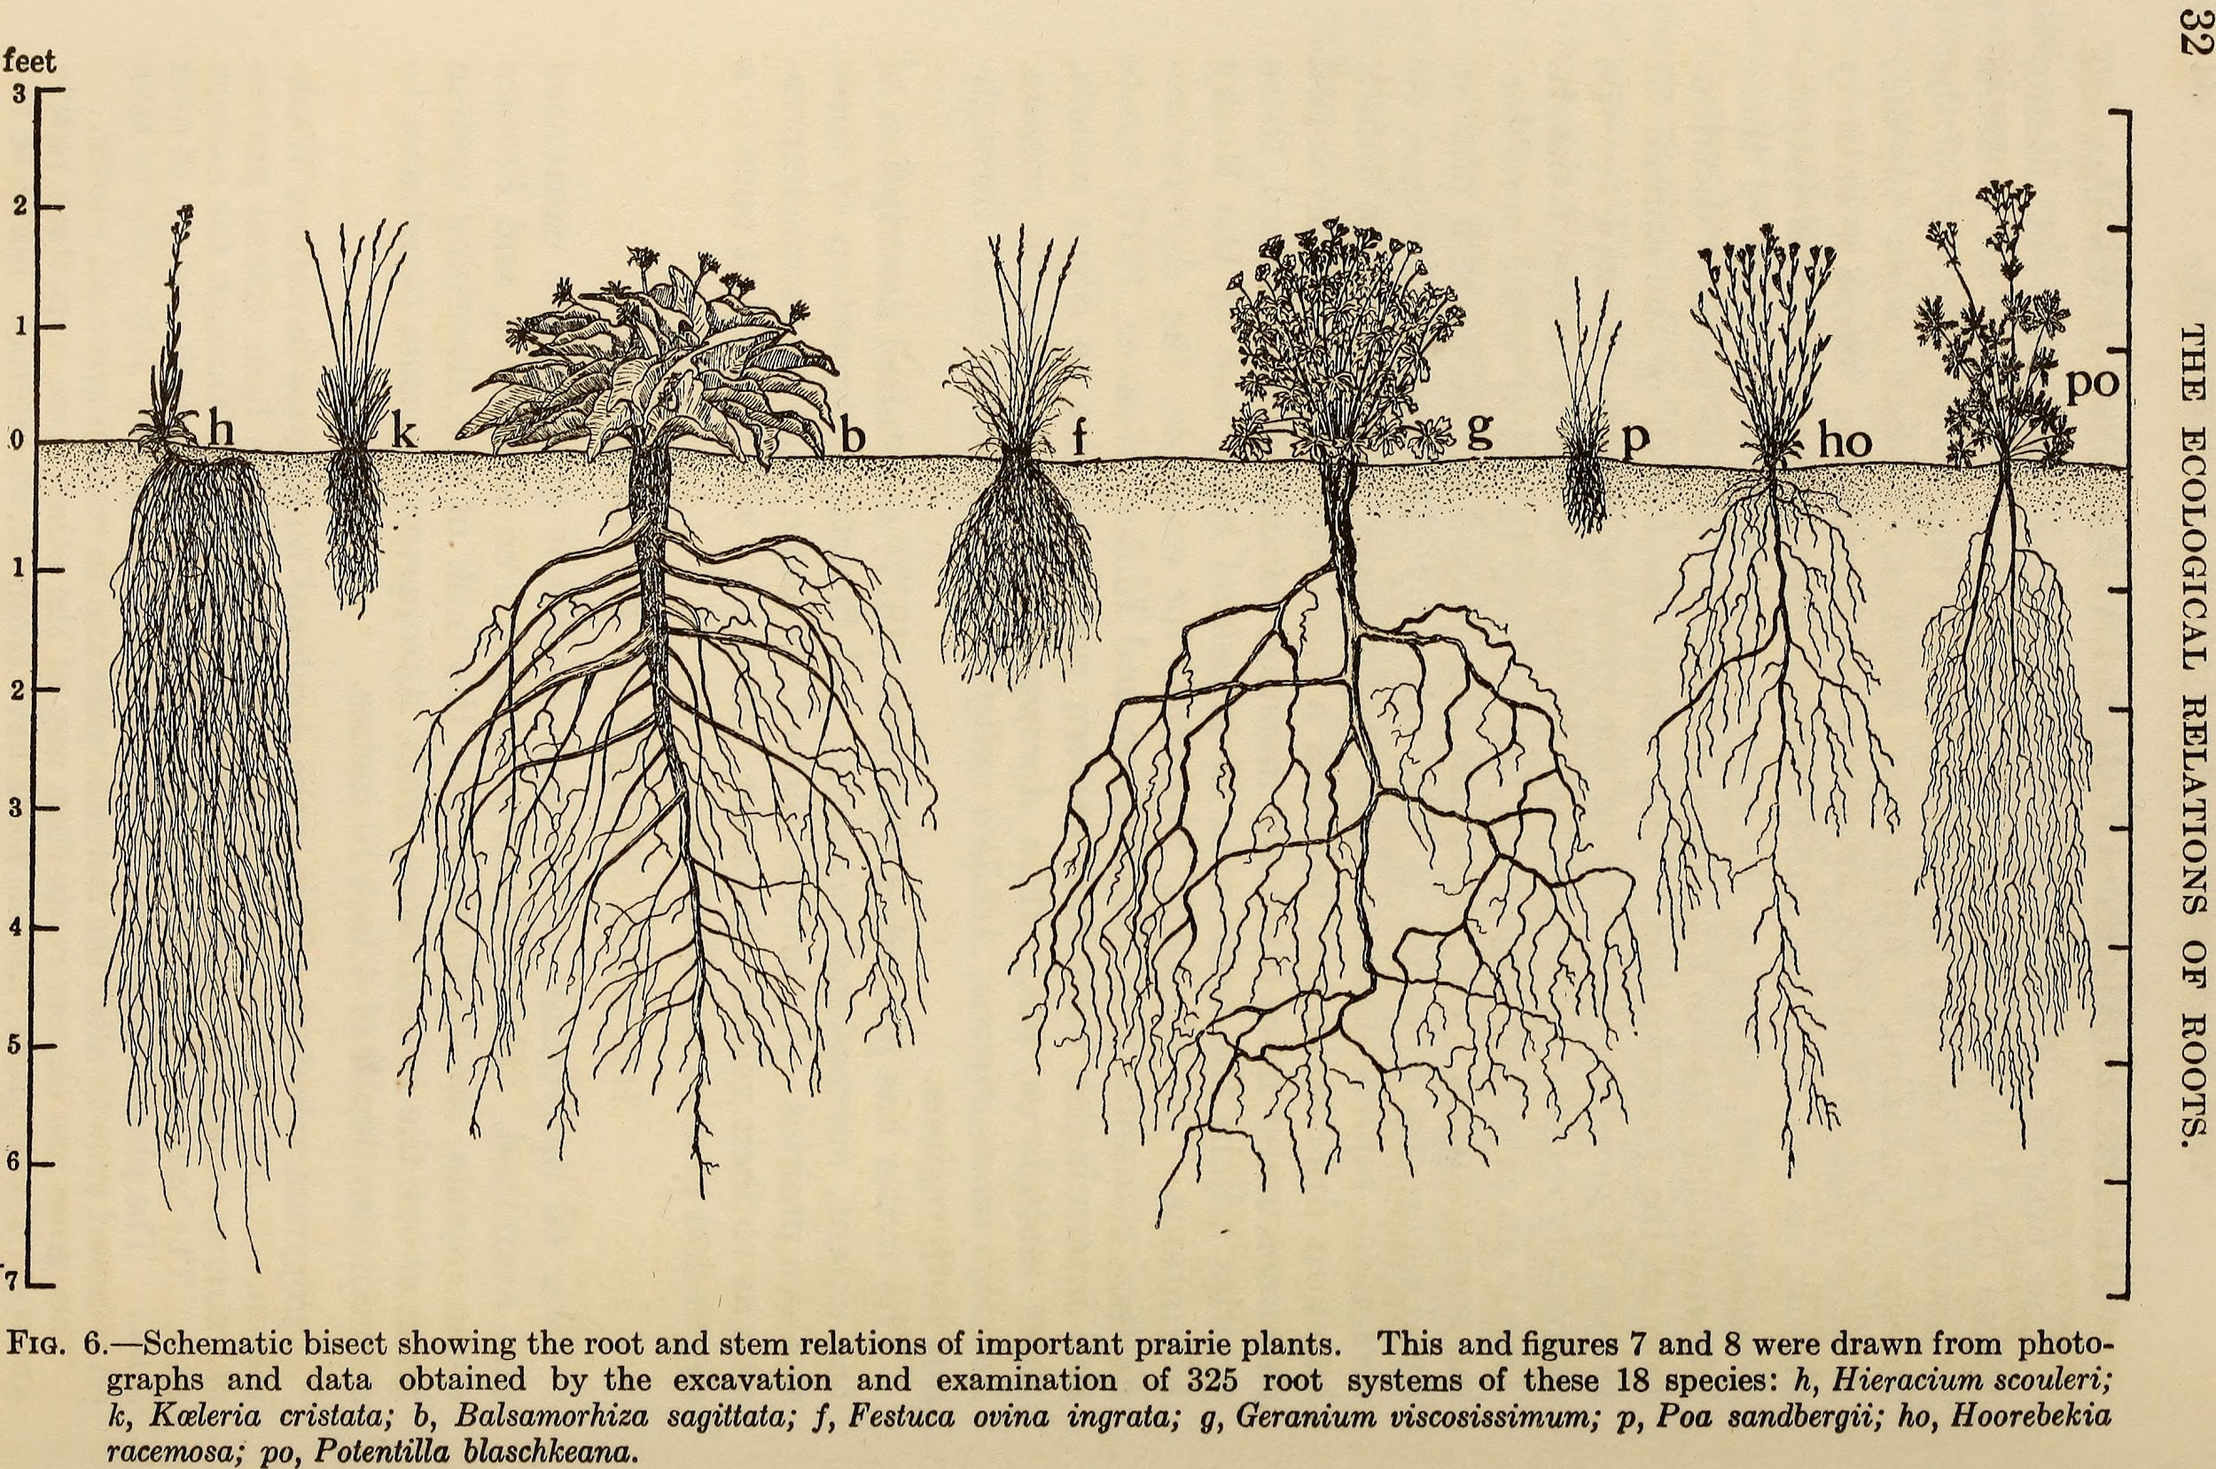

Slide 11
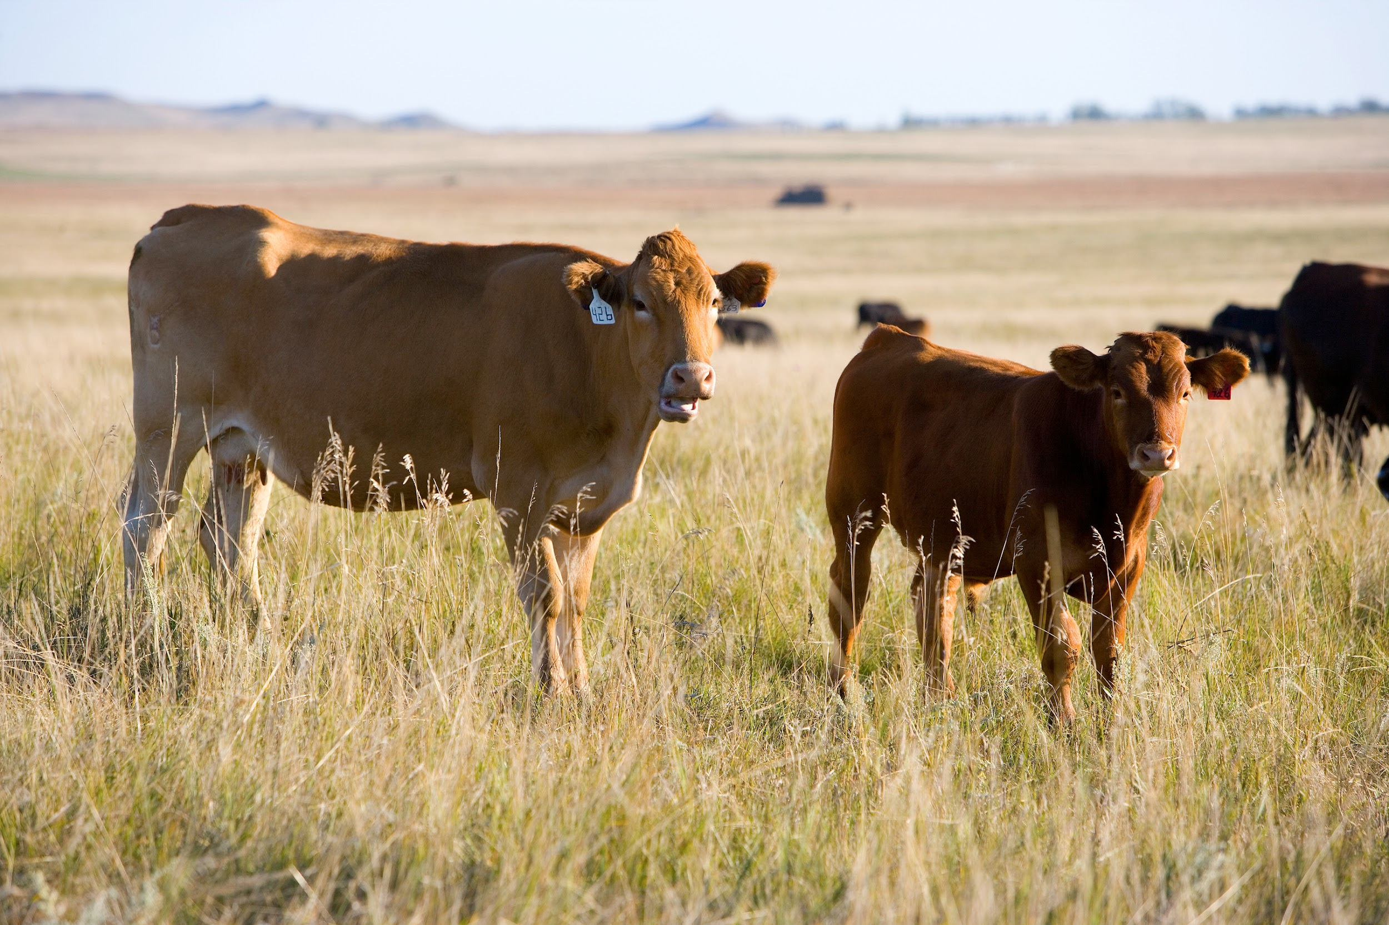

Slide 12
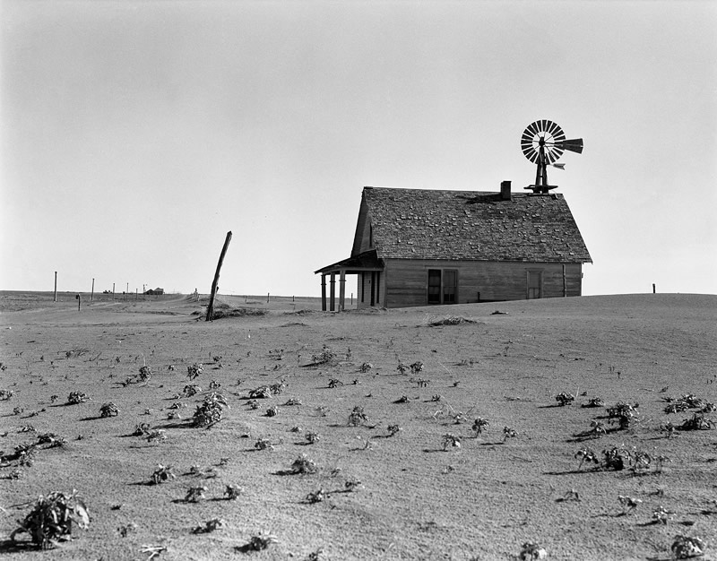
Dorothea Lange Abandoned farm north of Dalhart, Texas. 1938.

Slide 13
Now people are replanting prairie grasses and flowers with very long roots. They are not letting animals graze in the same place for too long.
Sand Lake Wetland Management District, South Dakota

Slide 14
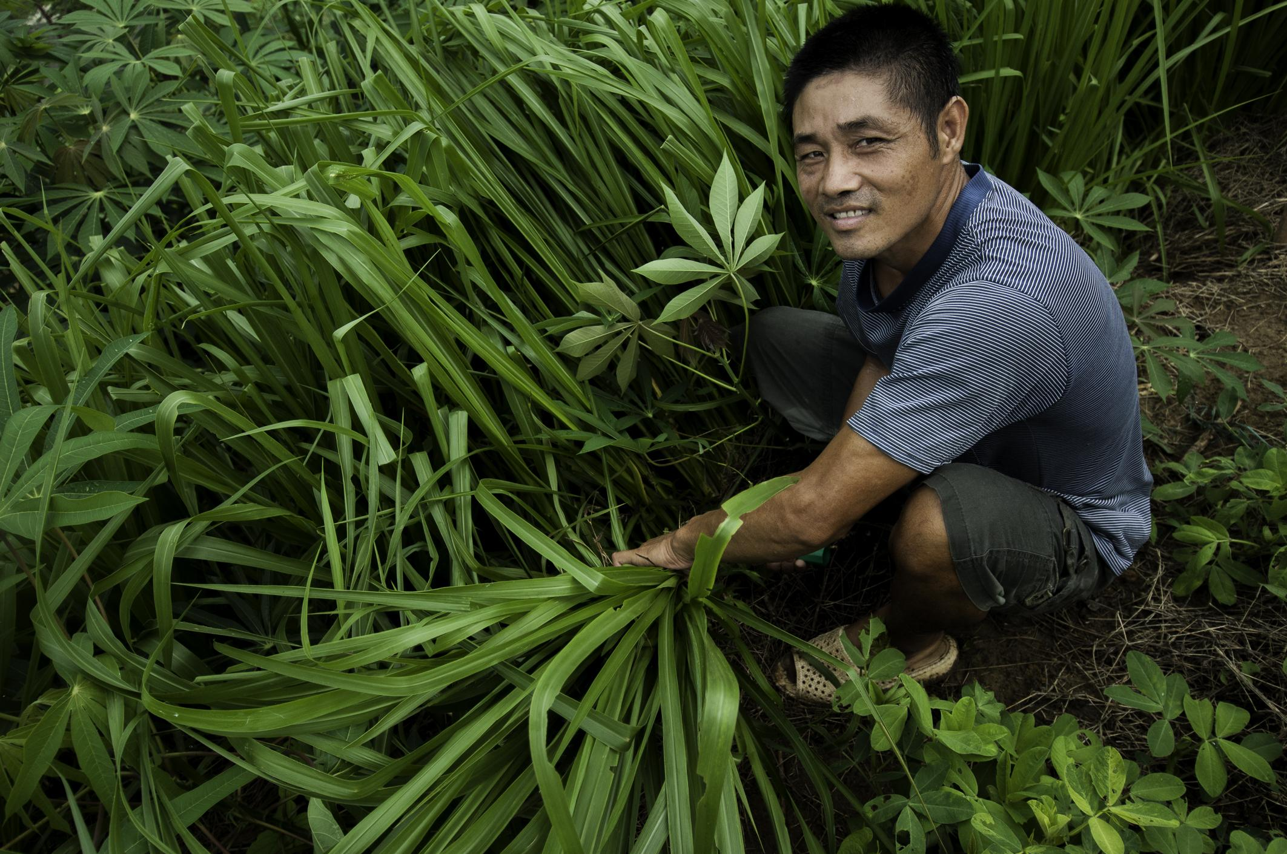
A farmer harvests hedgerow grass planted on sloping land to prevent soil erosion. The grass is then fed to cattle.
Northern Vietnam

Slide 15
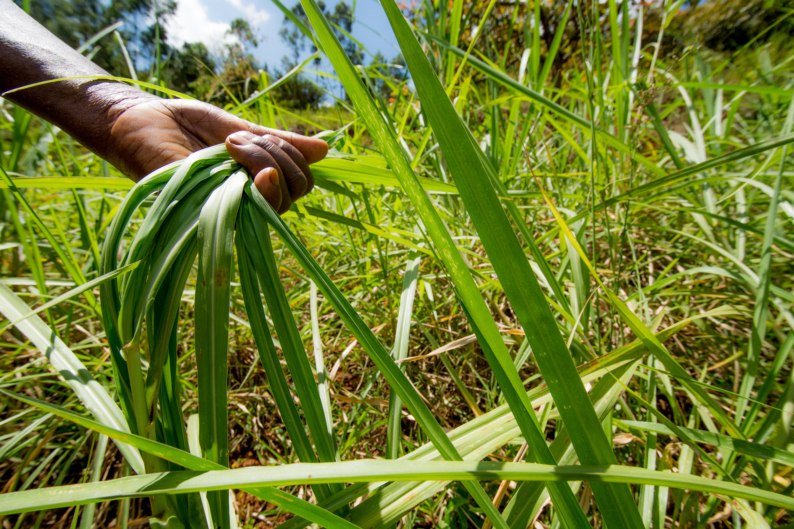
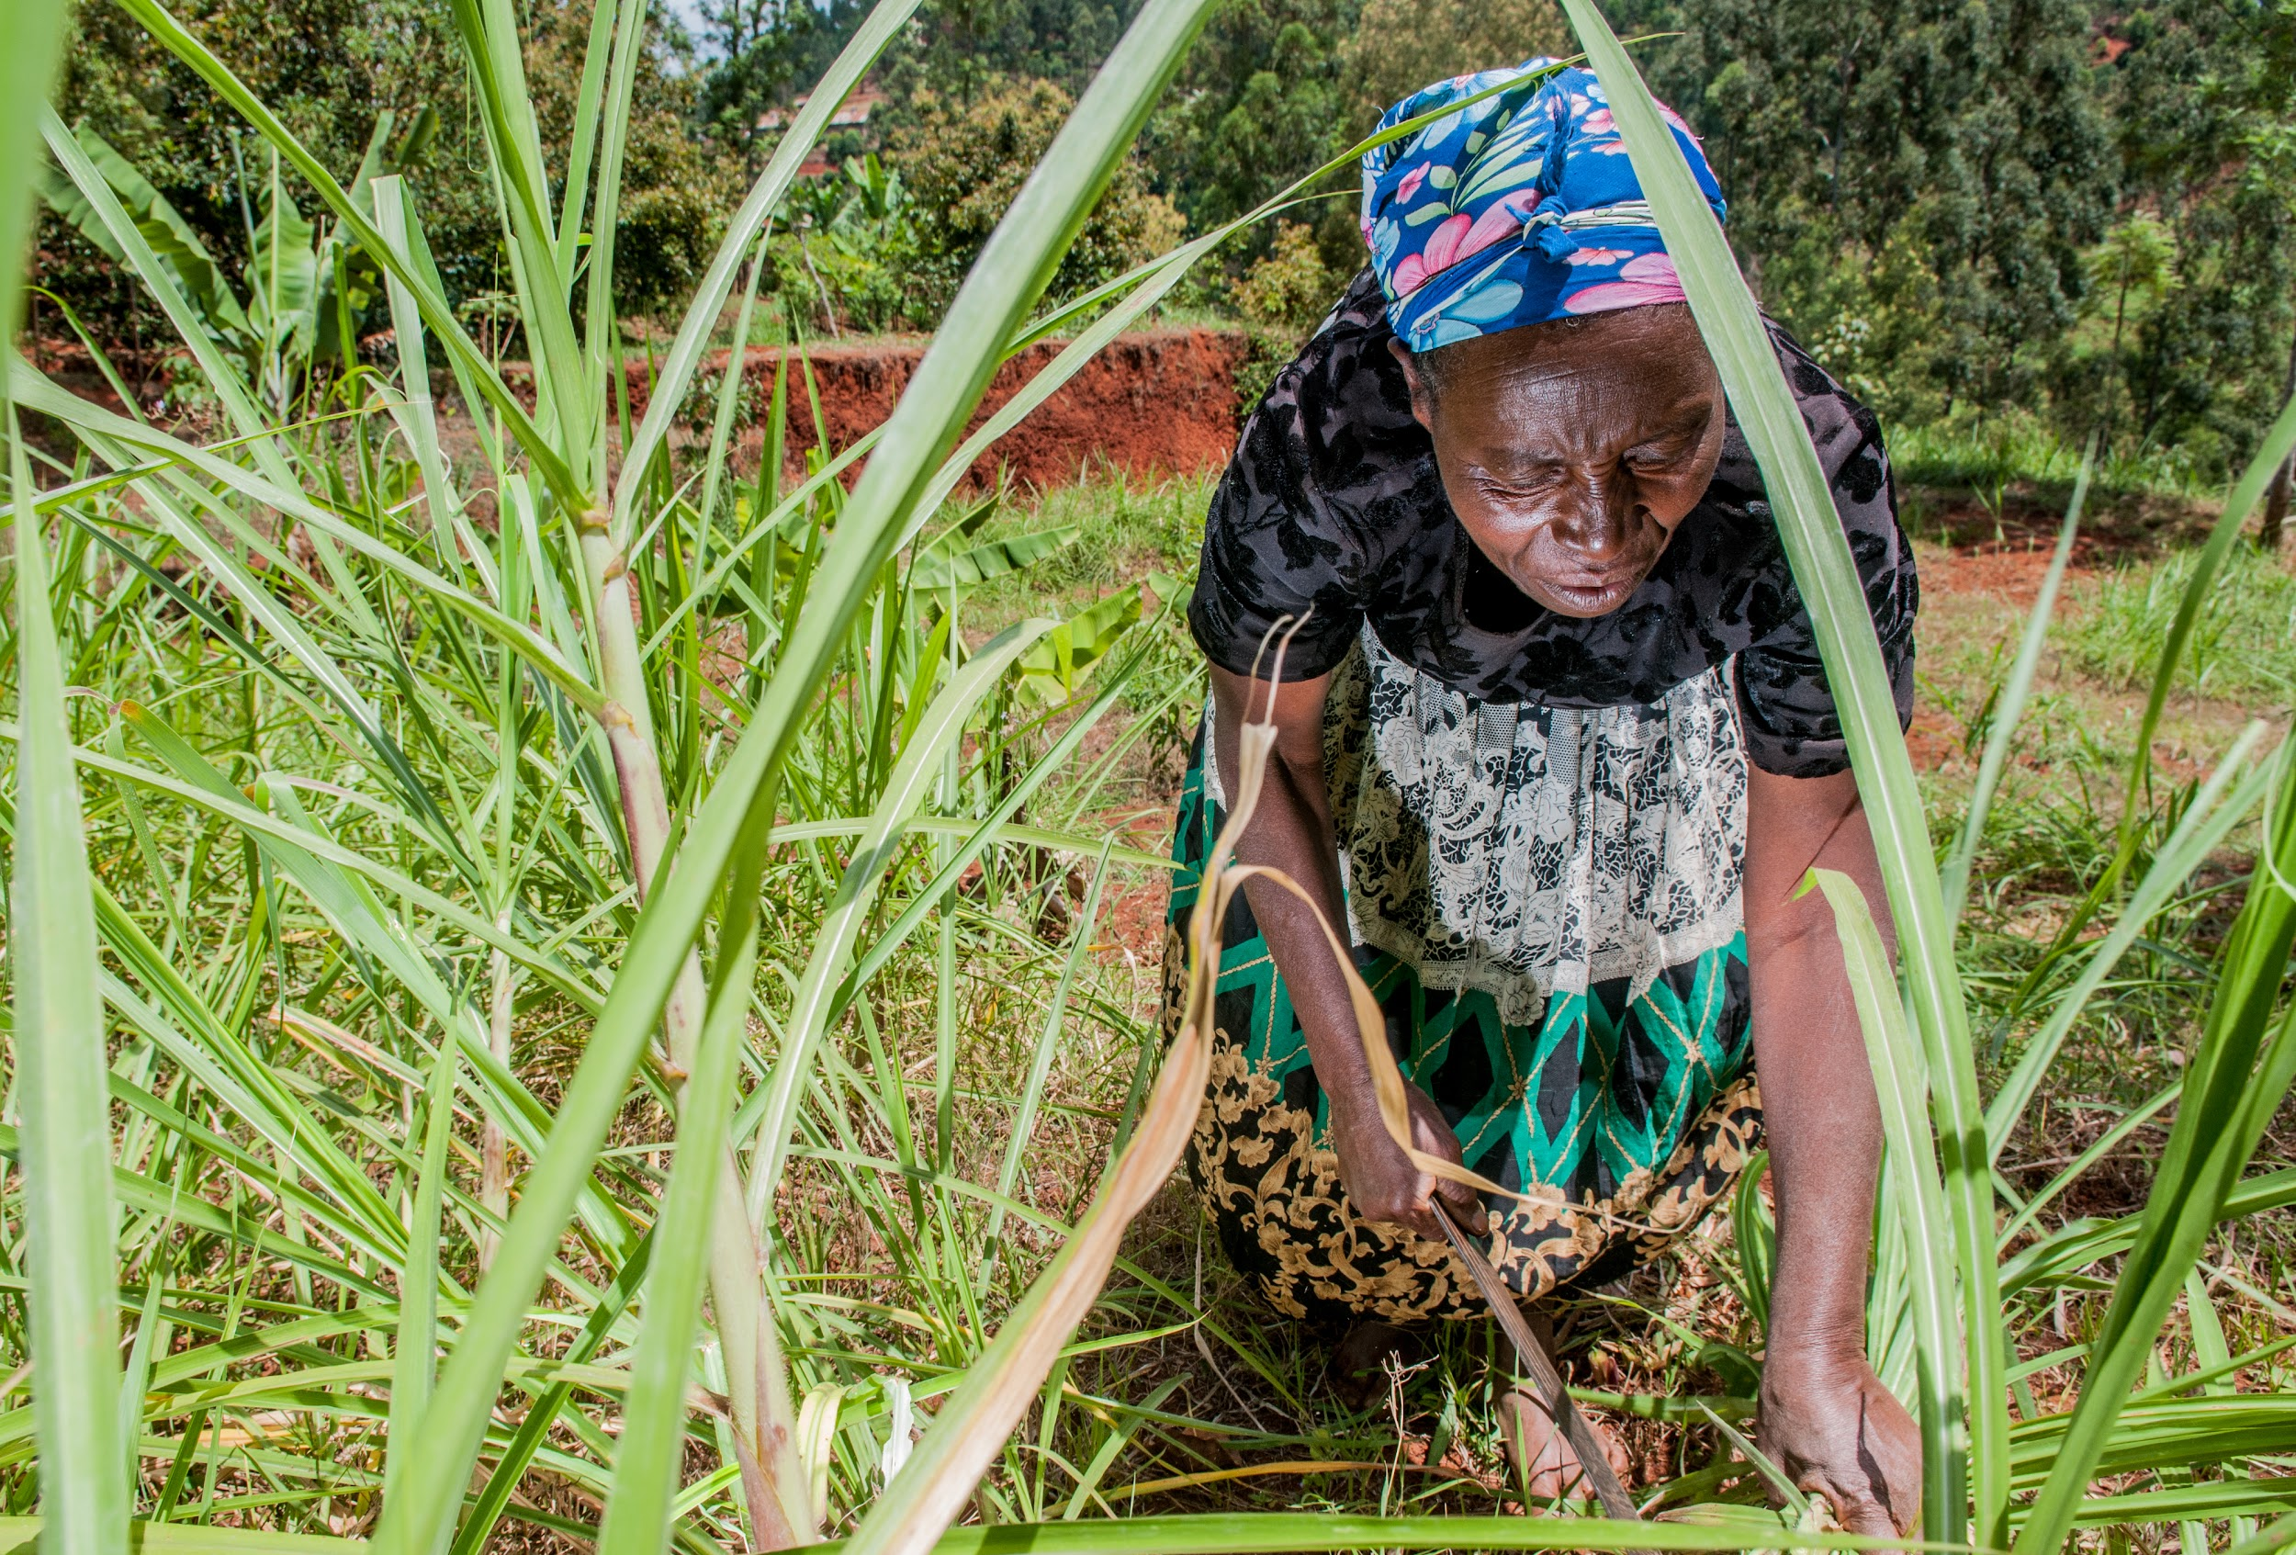
Planting Napier grass in Kenya

Slide 16
Citations
Slide 2: https://www.epa.gov/beaches/act-beach
Slide 3: https://www.tripsavvy.com/best-beaches-in-maine-4586898
Slides 4 & 5: photos: Melissa Tonachel
Slide 6: U.S. Air Force photo: Staff Sgt. Natasha Stannard, http://www.jble.af.mil/News/Article-Display/Article/1154999/
Slide 7: https://en.wikipedia.org/wiki/Panicum_repens
Slides 8: photo: Tom Koerner/USFWS, https://www.flickr.com/photos/usfwsmtnprairie/14617234562
Slide 9: Wikimedia Commons
Slide 10: Weaver, John E. (John Ernest), 1884-1966 [No restrictions], via Wikimedia Commons
Slide 11: Scott Bauer / Photo courtesy of USDA Natural Resources Conservation Service., via Wikimedia Commons
Slide 12: photo: Dorothea Lange; The Library of Congress, Prints & Photographs Division
Slide 13: photo: Tom Koerner/USFWS, https://www.flickr.com/photos/usfwsmtnprairie/14617234562
Slide 14: photo: Georgina Smith / CIAT
Slide 15: CIAT, Napier grass, Kenya, https://www.flickr.com/photos/ciat/15428461988

