Slide 1
Weekly Words
Unit 2, Week 6
Notes:
determine: to come to a conclusion
expose: to uncover
interact: to have an effect on or change one another
preserve: to keep safe from harm or loss
remove: to take away
shape (v): to give a certain form or shape to, to mold
soak: to make completely wet
uninhabited: not lived in

Slide 2
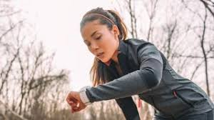
determine
verb
to come to a conclusion
Notes:
determine (verb)
Elaboration:
This woman is looking at her watch. She might be trying to determine how much time she has been exercising. Or she might be reading her watch to determine, or find out, how far she has run. She is using information from the watch to collect information she needs.
Think, Pair, Share prompt:
How do you determine when lunch time will be? What information do you use to find this out?
https://www.techradar.com/best/running-watches

Slide 3
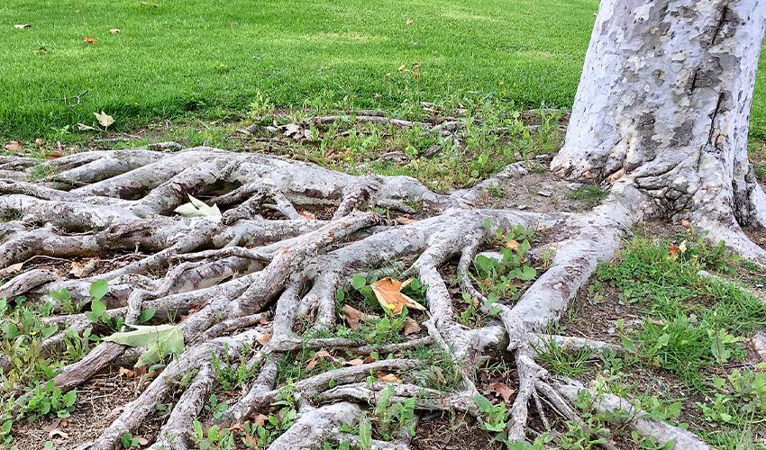
expose
verb
to uncover
Notes:
expose (verb)
Elaboration:
Erosion can expose the roots of a tree.
Think, Pair, Share prompt:
What parts of our faces do we expose when we take off our masks?
https://www.groundsguys.com/blog/2019/october/how-to-fix-exposed-tree-roots/

Slide 4

interact
verb
to have an effect on or change one another
Notes:
interact (verb)
Elaboration:
During the pandemic, we have learned to interact with each other in new ways. Instead of talking together in person, we sometimes talk online. We learned to interact online. When we interact, you do something, and that affects what I do next. For example, one of us asks a question, and that affects what the next person says.
Think, Pair, Share prompt:
How do you interact with people in the place where you live? How do you interact with people on a bus or in a store?
https://www.oise.utoronto.ca/oise/News/2020/Connecting_during_COVID-19_Jackman_Lab_School_keeps_their_students_on_the_learning_curve.html

Slide 5
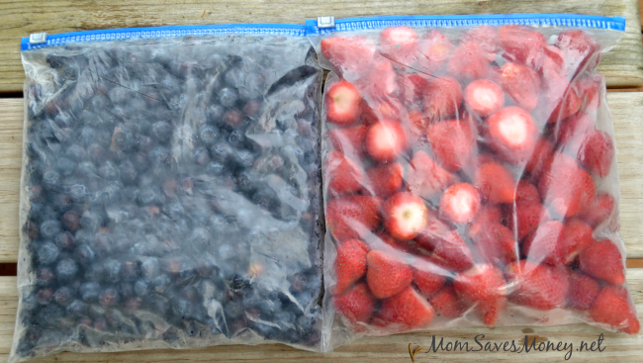
preserve
verb
to keep safe from harm or loss
Notes:
preserve (verb)
Elaboration:
One way to have fresh berries in the winter is to freeze them. Freezing food preserves it, or keeps it safe to eat. Food is also preserved in cans and jars.
Think, Pair, Share prompt:
Why might it be important to preserve food?
What is something else that is important to preserve? Why?
https://momsavesmoney.net/2016/07/how-to-freeze-berries.html

Slide 6
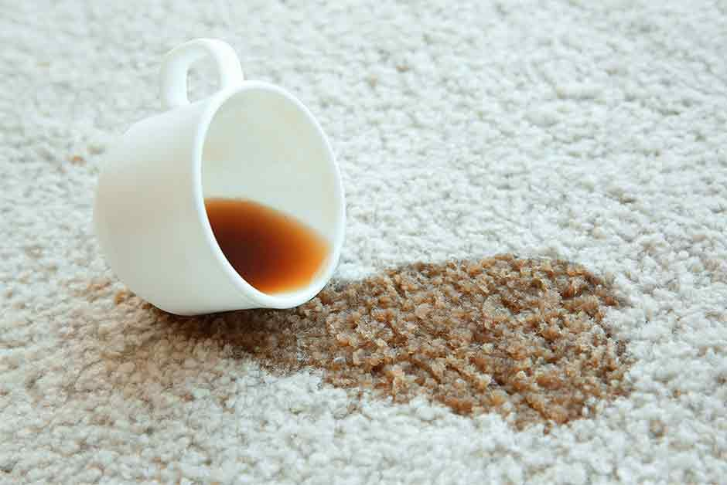
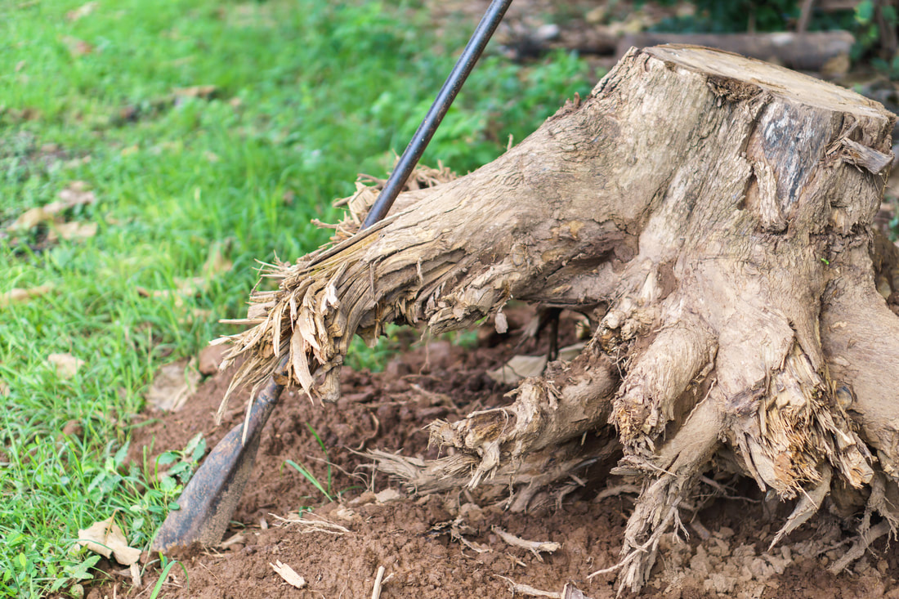
remove
verb
to take away
Notes:
remove (verb)
Some things are easy to remove—for example, it is easy to remove a dish from the table—to take it away and put it in the sink.
Some things are difficult to remove—like this coffee stain on the rug.
Think, Pair, Share prompt:
Why might people remove a tree stump from an area of land?
https://www.coit.com/top-five-carpet-stains, https://www.rochesterstumpremoval.com/blog/how-to-remove-a-tree-stump-by-hand

Slide 7
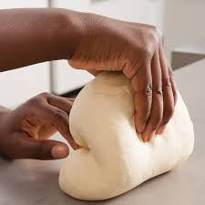
shape
verb
to give a certain form or shape to, to mold
Notes:
shape (verb)
Elaboration:
Here someone shapes bread dough with their hands. They push and pull it so that it looks the way they want it to—maybe a long, thin loaf of bread or maybe a round one. Hands are the force that shapes the bread.
Think, Pair, Share prompt:
What are some forces that shape the land, and how does that happen?
https://www.americastestkitchen.com/kids/recipes/how-to-knead-and-shape-bread-dough

Slide 8
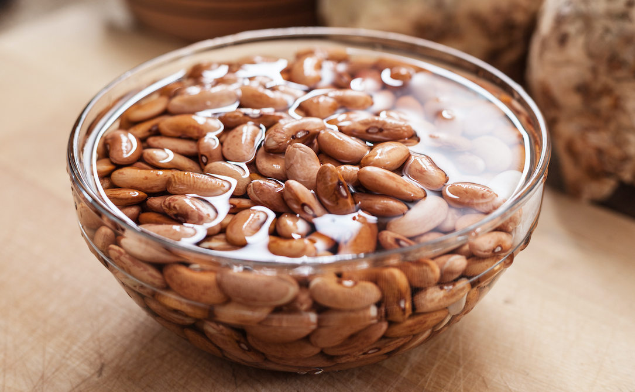
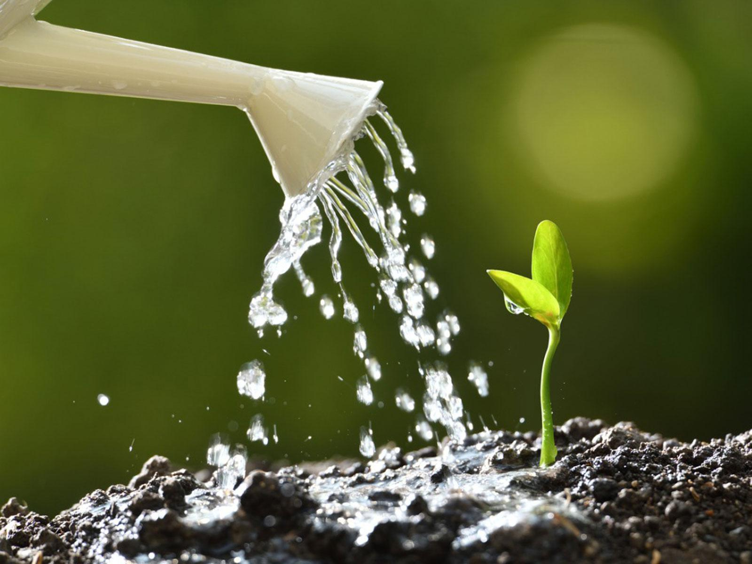
soak
verb
to make completely wet
Notes:
soak (verb)
Elaboration:
People soak dry beans to get them ready to cook. These beans are in a bowl full of water, so each bean is all the way wet.
In the second picture someone is pouring water on the seedling so that the soil around it is soaked to make sure the seedling’s roots have as much water as the plant needs. When we add the suffix -ed to the verb “soak” we get an adjective that describes something: soaked.
Think, Pair, Share prompt:
What is a material that is easy to soak? Why do you think that is so?
Or:
When you take a bath or shower, what gets soaked?
https://www.humnutrition.com/blog/how-to-soak-beans/, https://www.gardeningknowhow.com/special/children/how-does-water-affect-plant-growth.htm

Slide 9
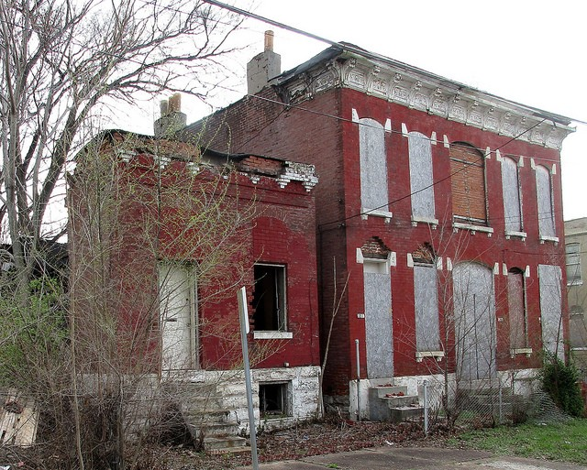
uninhabited
adjective
not lived in
Notes:
uninhabited (adjective)
Elaboration:
Think about the word habitat—a place where animals and plants live. Do you hear part of that word in this one, uninhabited? The suffix un- means “not.” Uninhabited is a place where no one lives. An uninhabited place might be a house or apartment building, or a piece of land, like an island, where no one lives.
Think, Pair, Share prompt:
If you discovered an uninhabited place, what would you be curious to investigate there?
https://www.riverfronttimes.com/newsblog/2018/03/01/board-bill-would-remove-mckee-exemption-for-code-violations

