Slide 1
General Nouns
Vocabulary & Language Week 6, Days 3-4

Slide 2
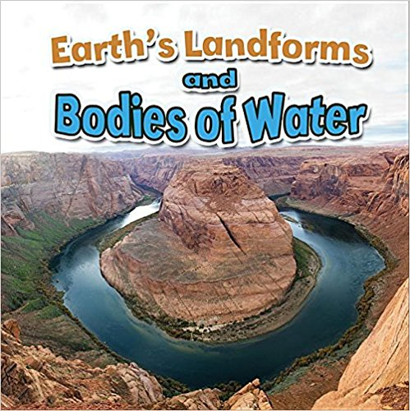
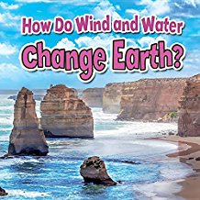
General Nouns

Slide 3

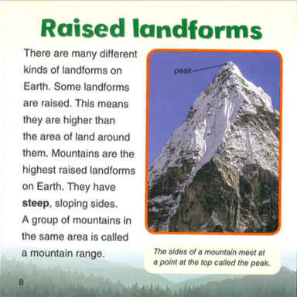

Slide 4
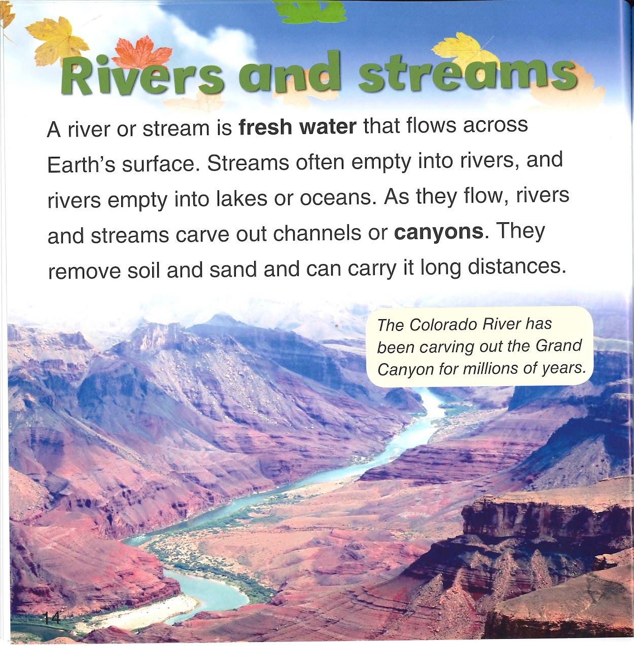

Slide 5
general nouns:
rivers
streams
lakes
oceans
channels
canyons
distances
soil
sand

Slide 6
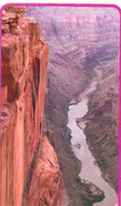
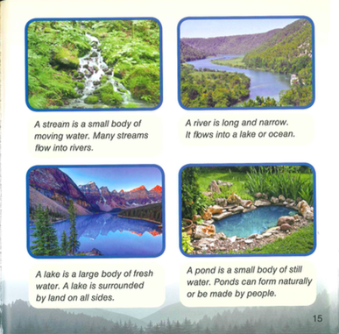
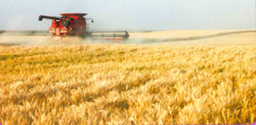
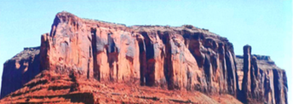
Choose a type of landform or body of water to talk and write about.
Think of three pieces of information you know about that type of landform or body of water.
Say your sentences out loud to a partner.

Slide 7
Write three sentences about the type of landform or body of water.
Underline the general nouns. If you did not include general nouns, go back and revise your sentences.

