Slide 1
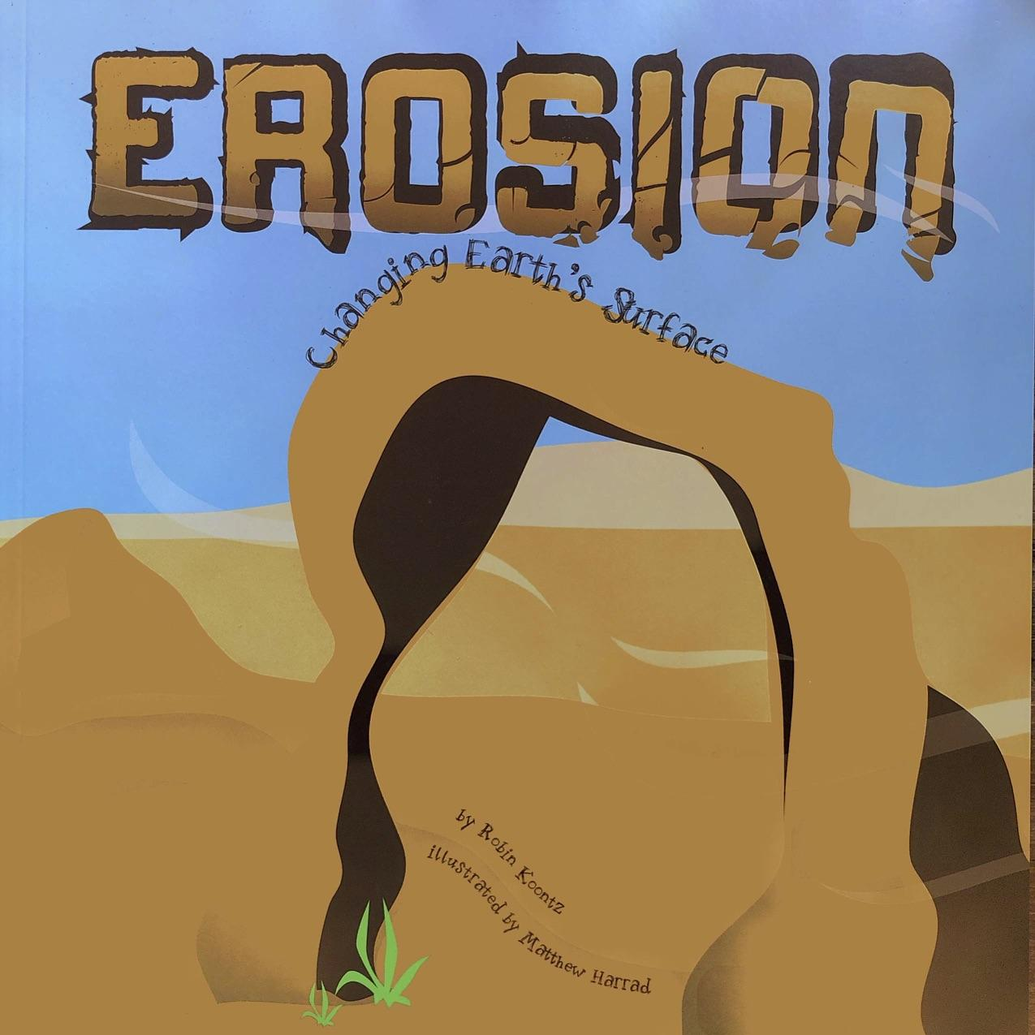
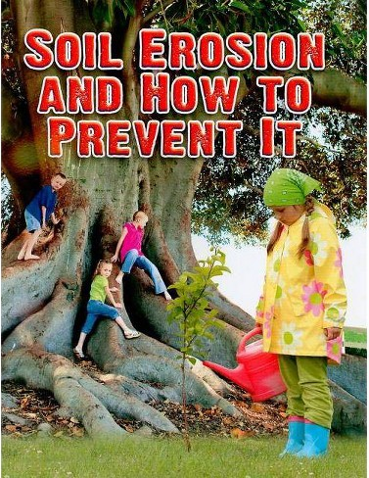
Comparing Erosion
Erosion: Changing Earth’s Surface
excerpt, pages 18-19
Soil Erosion and How to Prevent It
excerpt, page 16
Text Talk Week 6, Day 3

Slide 2
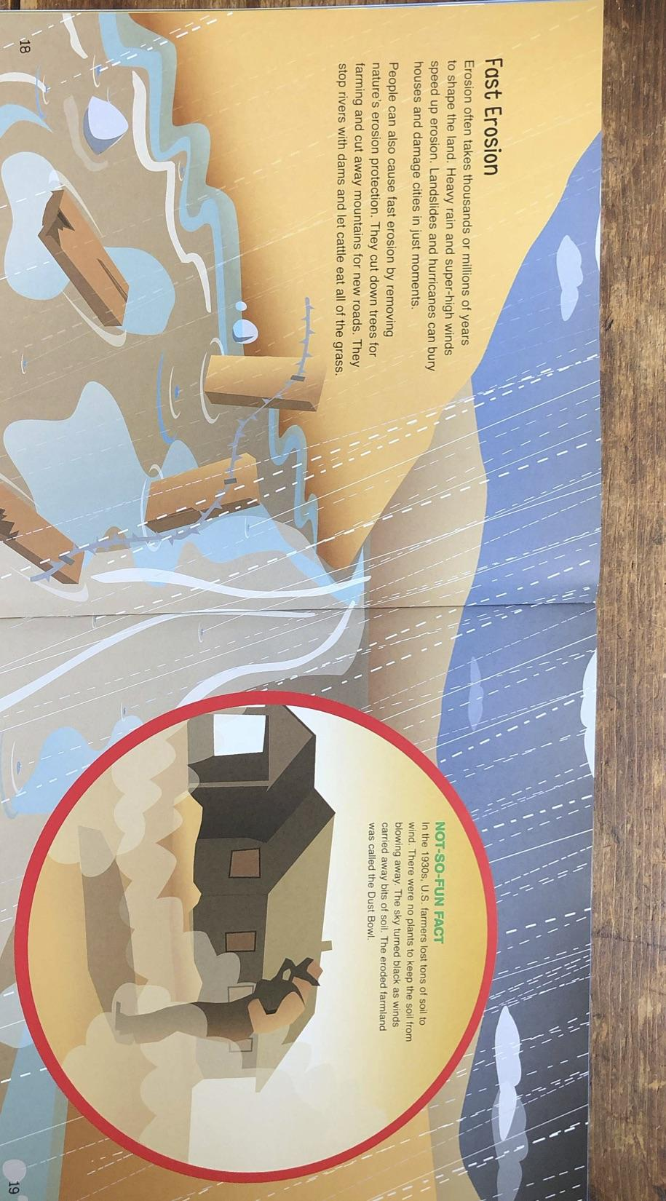

Slide 5
