Slide 1
A Problem on
Popham Beach
Text Talk Week 6, Days 1-2

Slide 2
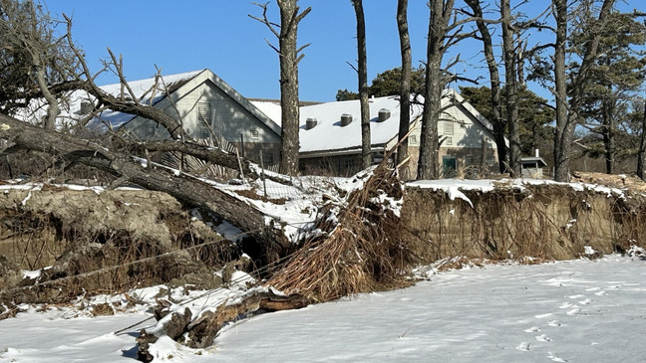
Popham Beach, Phippsburg, Maine

Slide 3
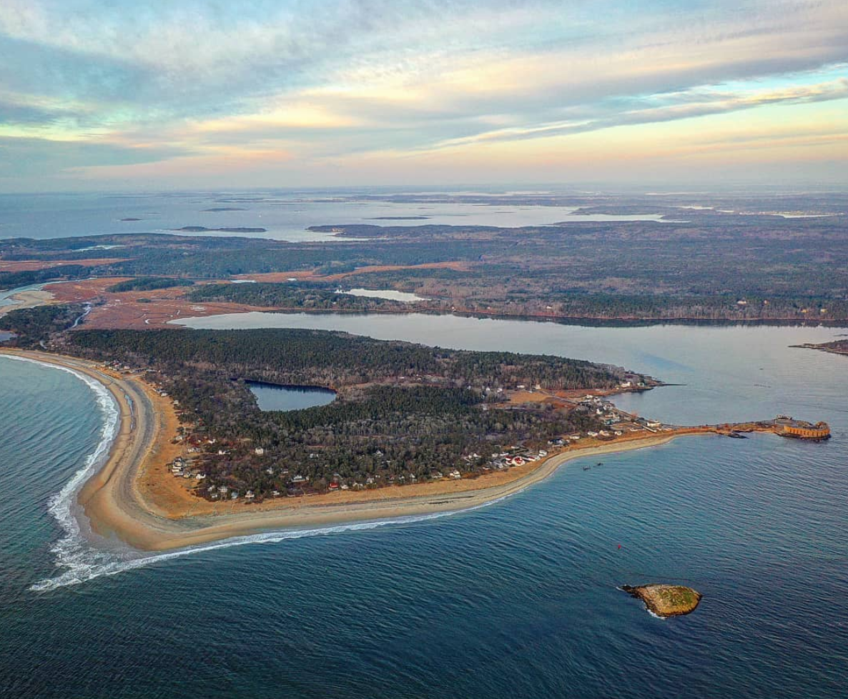

Slide 4
Popham Beach, Phippsburg, Maine

Slide 5
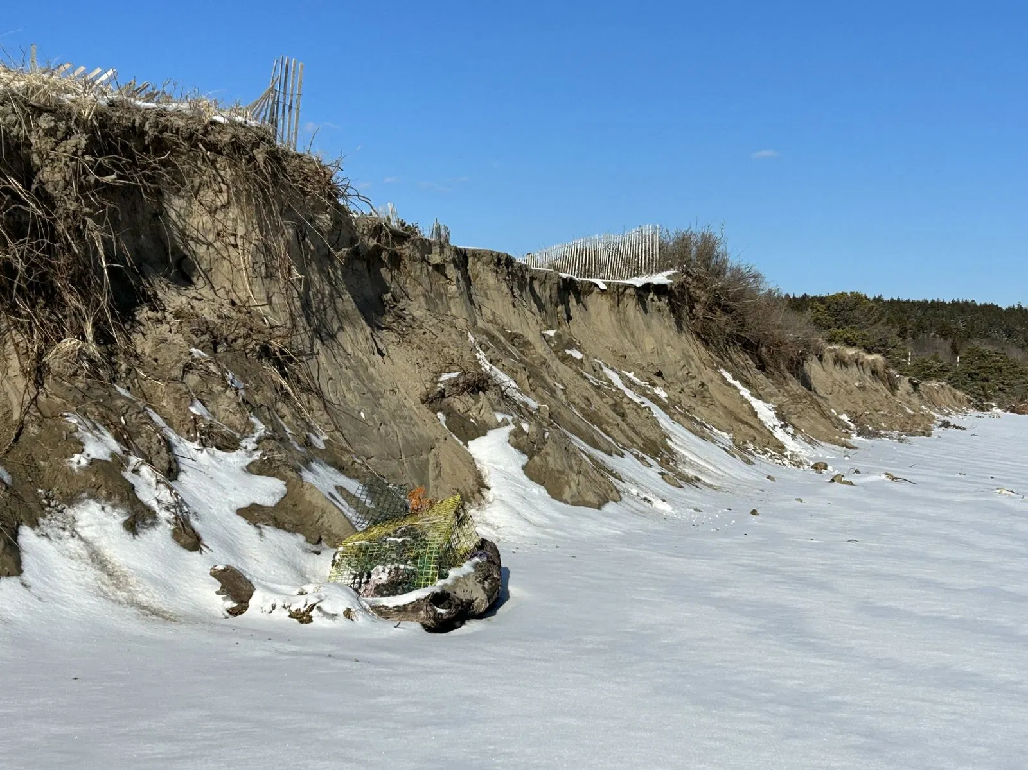

Slide 6
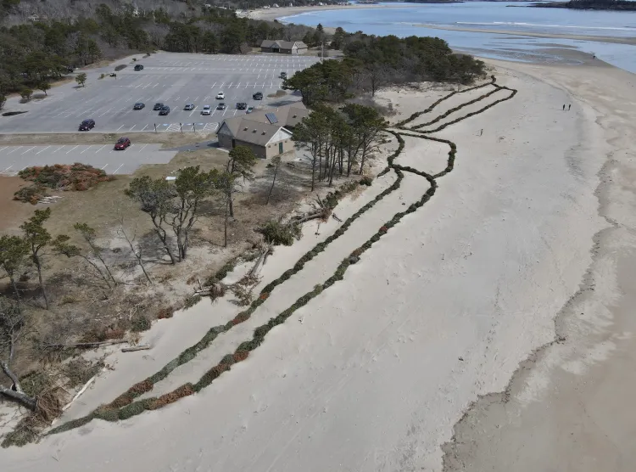

Slide 7
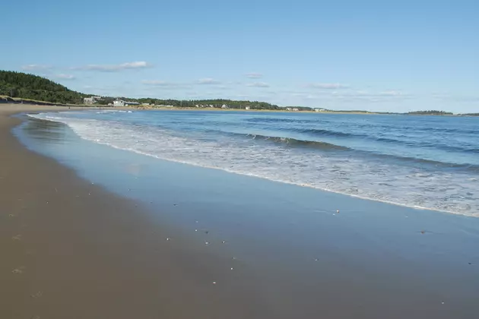
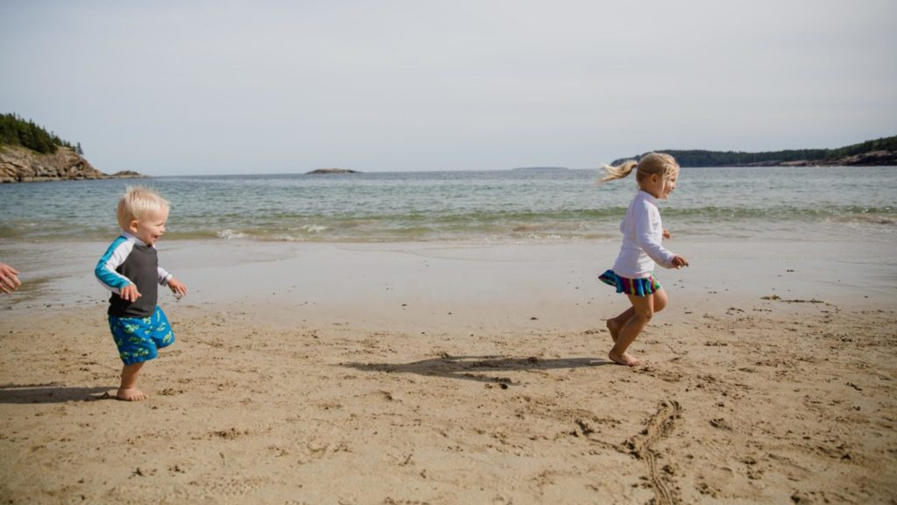

Slide 8
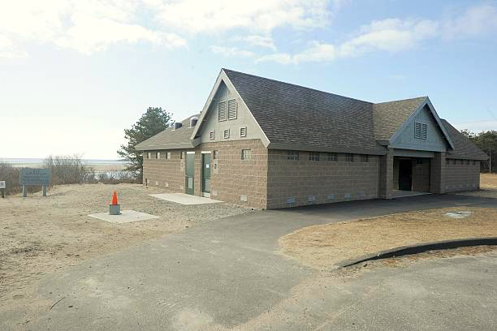

Slide 9
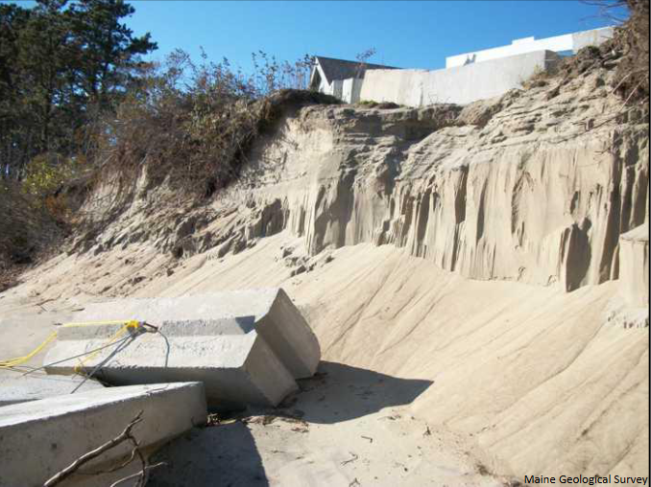
bathhouse in danger!

Slide 10
Citations
Slides 2 & 4: https://wgme.com/news/local/dunes-damaged-at-popham-beach-threatening-coastal-communities-and-wildlife
Slide 3: https://www.mainetourism.com/listing/popham-beach-state-park/3021/
Slide 4: https://wgme.com/news/local/popham-beach-uses-christmas-trees-to-combat-erosion-seeing-promising-results
Slide 5: https://wgme.com/news/local/gallery/dunes-damaged-at-popham-beach-threatening-coastal-communities-and-wildlife?photo=1
Slide 6: https://www.pressherald.com/2024/07/03/has-pophams-effort-to-save-dunes-with-christmas-trees-pay-off/
Slide 7: https://wcyy.com/popham-beach-erosion-maine-visit/ and https://familyvacationist.com/best-family-beaches-in-new-england-and-where-to-stay/

