Slide 1
Weekly Words
Unit 2, Week 5
Notes:
batter: 1. to beat hard again and again; 2. to damage by beating
destroy: to ruin completely
grind: to crush or make by crushing into very small pieces or a powder
particle: a tiny amount or piece
transform: to change the form, look, or shape of something
warn: to tell of a possible danger, to alert
weather (v): to change from being exposed to weather such as wind, rain, or sleet
weathering: what happens when a part of a rock is loosened by nature; the breakdown of landforms into smaller pieces

Slide 2
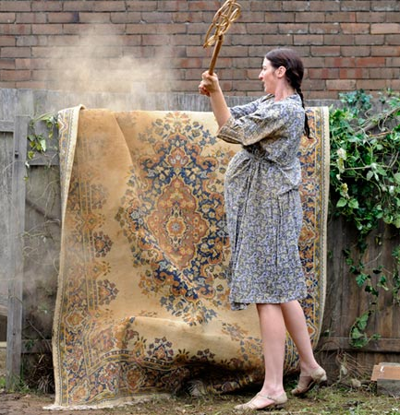
batter
verb
1. to beat hard again and again;
2. to damage by beating
Notes:
batter (verb)
Elaboration:
People sometimes beat or batter a rug—this is a way to clean it! You hit it over and over again so the dust and dirt that are stuck in it loosens and comes out. See all the dirt coming out of this rug?
But if you batter a rug too hard or too often, you can damage or destroy the rug you are trying to clean. You can imagine making a spot where the rug is worn away from all the battering.
Think, Pair, Share prompt:
Picture ocean waves on a rocky coast. Do the waves beat or batter the rocks? What is the difference?
https://greenrugcare.com/2018/04/13/how-to-care-oriental-rugs/

Slide 3
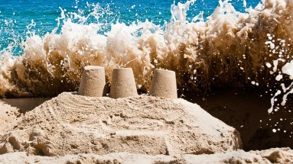
destroy
verb
to ruin completely
Notes:
destroy (verb)
Elaboration:
Some person or people built this sand castle on the beach, and now the waves are about to destroy it! It will be completely ruined, unable to be put back together.
Think, Pair, Share prompt:
Have you ever had something you made or cared about be destroyed? was it? What destroyed it? How did that feel?
https://hbr.org/2015/06/how-merck-is-trying-to-keep-disrupters-at-bay

Slide 4
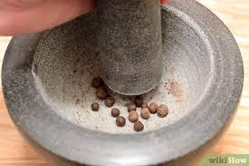
grind
verb
to crush or make by crushing into very small pieces or a powder
Notes:
grind (verb)
Elaboration:
A mortar and pestle is a tool used for grinding—in this case, grinding spices to use in cooking.
Show a gesture of grinding by rotating a fist back and forth in the palm of the other hand.
Think, Pair, Share prompt:
Water can help grind rocks. Describe the action of how this can happen.
https://www.wikihow.com/Use-a-Mortar-and-Pestle

Slide 5
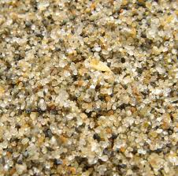
particle
noun
a tiny amount or piece
Notes:
particle (noun)
Elaboration:
Sand is really just tiny particles, or bits, of rock or stone.
Think, Pair, Share prompt:
Can you describe how stones become particles of sand?
https://www.britannica.com/science/sand

Slide 6
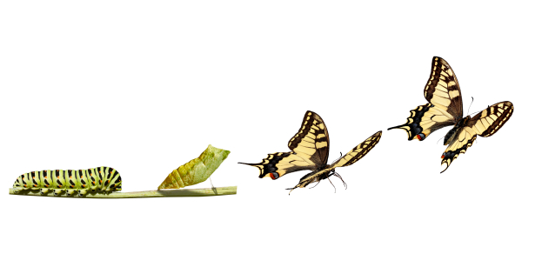
transform
verb
to change the form, look, or shape of something
Notes:
transform (verb)
Elaboration:
When something transforms, it doesn’t change a little bit, it changes a lot, sometimes into something completely different. Some things transform pretty quickly—like a ball of clay that you transform with your hands into a new shape—and some things transform over a long period of time.
Think, Pair, Share prompt:
What’s something else that might transform quickly? What’s something that takes a long time to transform?
https://greattransitionstories.org/patterns-of-change/the-metaphor-of-metamorphosis/

Slide 7
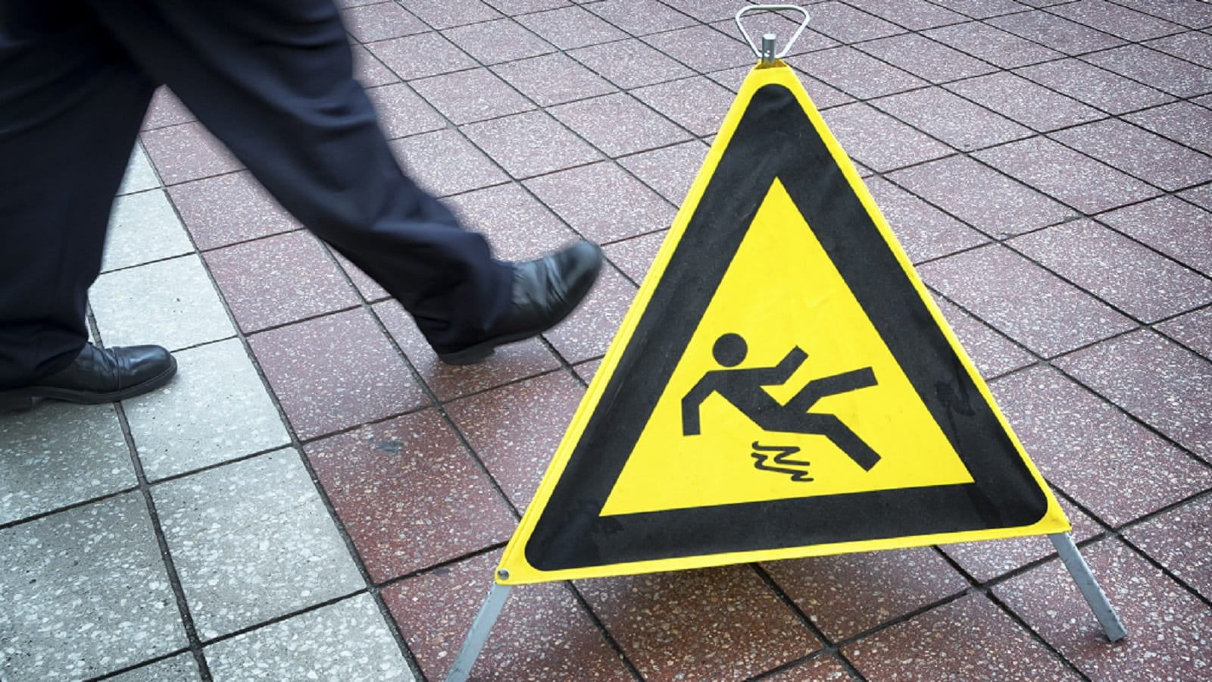
warn
verb
to tell of a possible danger, to alert
Notes:
warn (verb)
Elaboration:
We warn someone about something before it happens, to keep that person out of danger. We see danger coming, and we do or say something to let them know to be careful or get out of the way. People often use signs to warn people about possible danger.
Think, Pair, Share prompt:
What are some words people use to warn each other about possible danger? What is a gesture, or body movement, you might use to warn someone?
https://lowrylaw.com/slip-and-fall-lawyer/

Slide 8
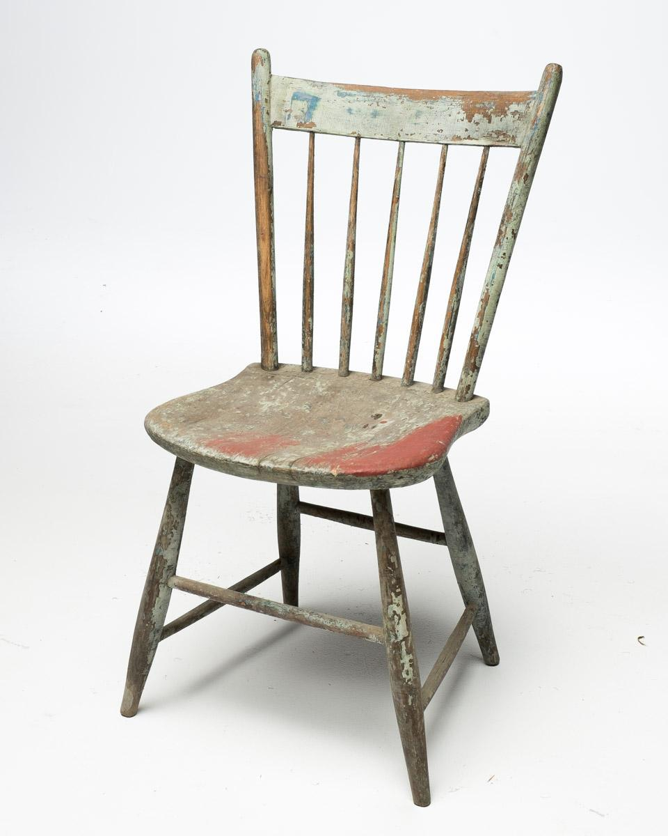
weather
verb
to change, from being exposed to weather such as wind, rain, or sleet
Notes:
weather (verb)
Elaboration:
You know this word as a noun: weather is wind, sun, rain, snow…
To weather, the action verb, is to be worn down or worn away from that wind and rain.
Think, Pair, Share prompt:
What do you think has caused this wooden, painted chair to weather?
https://www.acmebrooklyn.com/prop/ch061-weathered-multicolor-wood-chair/

Slide 9
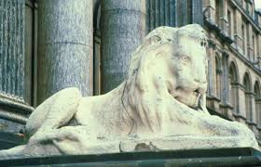
weathering
noun
changes produced by exposure to weather
Notes:
weathering (noun)
Elaboration:
We have seen weathering on landforms. This photo shows weathering on a stone statue in England. When this statue was first carved, the details were clearer. They have been worn down by the weather over many, many years.
Look how the suffix -ing changes this word! To “weather” is a verb that describes the action of being worn down by rain, ice, or wind. The -ing suffix, in this case, makes the word mean the thing that happens from the action.
Think, Pair, Share prompt:
Try to explain in your own words how you think weathering happens.
https://rhs.rocklinusd.org/subsites/Geology/documents/CHAPTER%2014%20WEATHERING%20AND%20EROSION.pdf

